Slide 1
FindHere

Slide 2
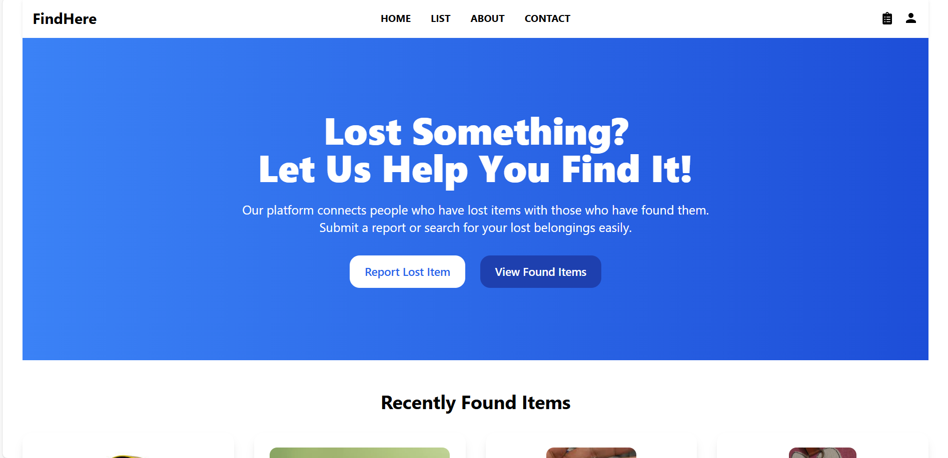
Landing Page

Slide 3
🧾 About Our Lost and Found Management System: Welcome to our Lost and Found Management System, a platform designed to seamlessly connect people who have lost items with those who have found them. Our goal is to make the process of recovering lost belongings quick, easy, and efficient.

Slide 4
🔍 What We Do
We provide a user-friendly platform where you can:
Report Lost Items: Submit a detailed report if you've lost something valuable.
List Found Items: Help others by reporting items you’ve found.
Search Lost & Found: Easily browse and track lost or found items using our advanced search filters.

Slide 5
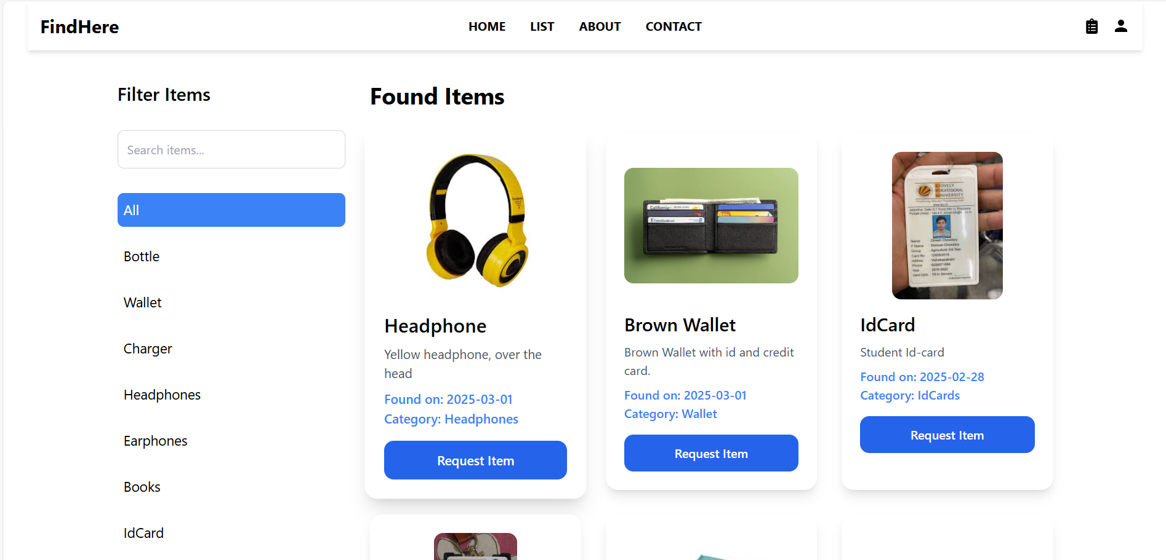
Found Items list
You can filter and search the items also.

Slide 6
📌 Key Features
Item Request System: Users can claim found items by submitting a request.
User Authentication: Secure login and registration for better privacy and tracking.
Real-Time Updates: Stay informed with real-time item status and notifications.

Slide 7
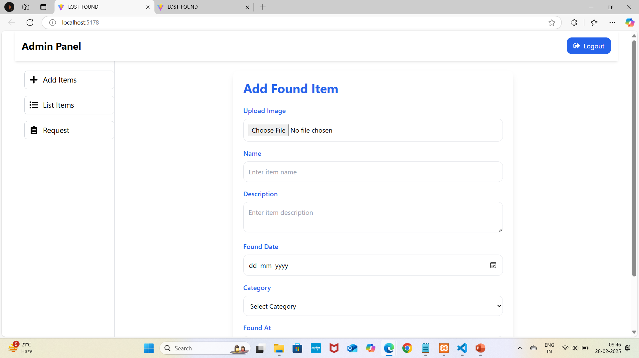
Admin panel to add found items.

Slide 8
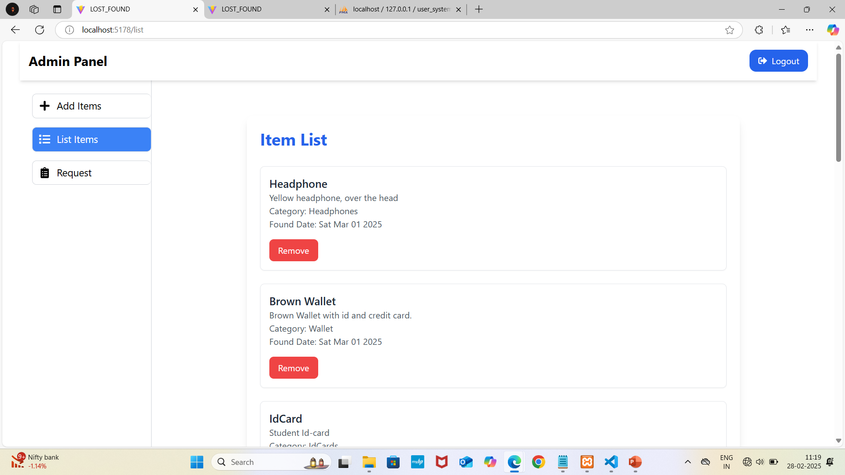
Admin can remove item from list after deliver to belonging.

Slide 9
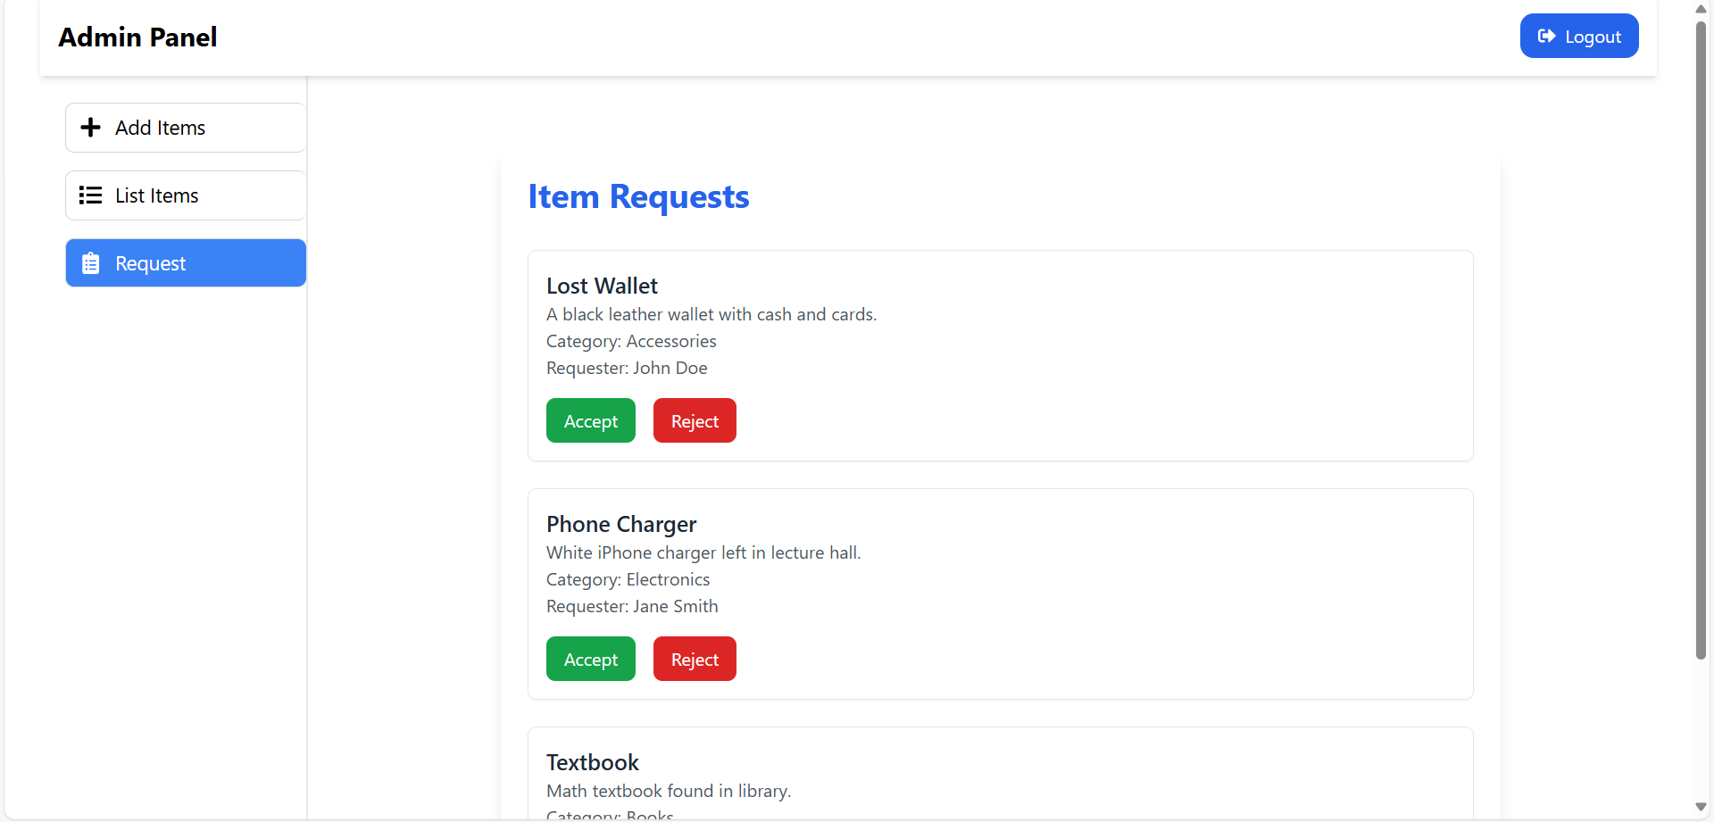
Request list make by user.

Slide 10
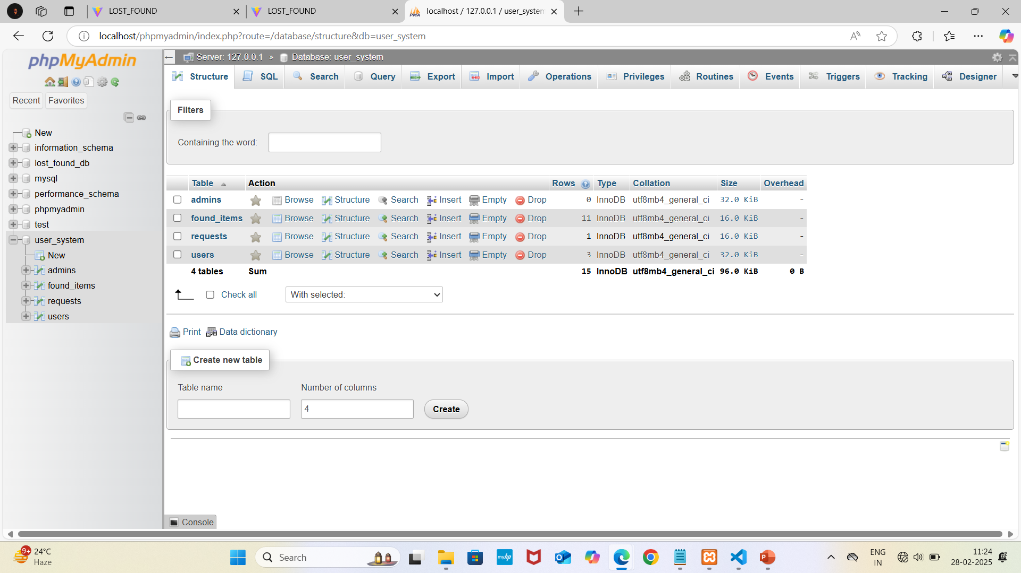
Database

Slide 11
💙 Our Mission
We aim to build a community where honesty and kindness thrive. By making it easier to return lost belongings, we foster trust and help people reconnect with what matters most.

