Slide 1

Cloud-Native Employee Attendance and Leave Management System
24CND3101 – Cloud-Native Application Development and Container Orchestration (CNAD)
23-09-2026
 | Under the Guidance of Dr. Srilatha Professor, Department of Computer Science and Engineering, KLH CSE Bowrampet Campus
Team Members – CNAD12 Pasupuleti Moukshitha – 2420030164 Kamalesh Battula – 2420030156 Nitish Chowdary Potla – 2420030642

Slide 2
Outline of Review-2 Presentation
Problem & Requirements
System Architecture & Design
Module-wise Description
Implementation
Module Integration
Presentation & Demonstration
Individual Contribution
Viva Voce

Slide 3
Problem Definition & Requirements
Core requirement: a resilient, independently scalable HR platform — built on microservices, containers, an API Gateway, and automated CI/CD delivery.
01
02
03
Functional Requirements
Non-Functional Requirements
Technical & DevOps Requirements
Employee/Auth, QR & web check-in, leave apply/approve, and real-time notifications, each as an independent service.
Independent scalability, self-healing, zero-downtime rolling updates, and sub-second API response under peak load.
Docker containers, Kubernetes orchestration, database-per-service, and an automated CI/CD pipeline with IaC.

Slide 4
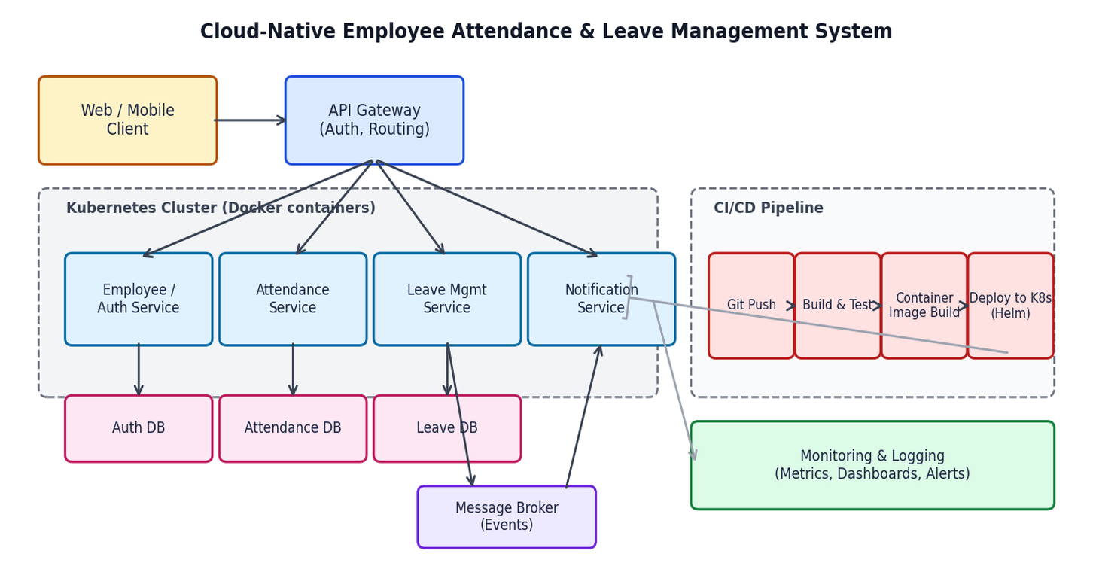
System Architecture & Design
Four microservices, each with its own database, sit behind an API Gateway on Kubernetes; REST handles sync calls and a message broker handles async events.

Slide 5
Module Design & Implementation
Each module is an independently deployable microservice, containerized with Docker and implemented with its own database and API.
1
Employee/Auth Service — employee profiles, login, and JWT-based authentication; owns the Auth DB.
2
Attendance Service — web & QR-code check-in/check-out with real-time logging; owns the Attendance DB.
3
Leave Management Service — leave apply, balance tracking, and configurable manager-approval workflow; owns the Leave DB.
4
Notification Service — consumes events from the message broker and sends email/in-app alerts on approvals.
5
Implementation stack — Docker, Kubernetes, Helm, REST + event broker, Git-based CI/CD with centralized monitoring.

Slide 6
Module Integration
All four microservices are integrated through a common gateway, synchronous APIs, an event bus, and a shared delivery pipeline.
API Gateway
Synchronous REST APIs
1
Single entry point for all clients; handles routing, auth-token validation, and rate limiting to every service.
2
Direct service-to-service calls for request/response flows, such as validating an employee during check-in.
Event-Driven Messaging
CI/CD Pipeline
3
A message broker carries async events — e.g., a leave-approval decision triggers a Notification Service alert.
4
Every code change is built, tested, containerized, and deployed to Kubernetes via Helm charts automatically.

Slide 7
Presentation & Demonstration
Live walkthrough of the deployed system on Kubernetes, from employee login through to the monitoring dashboard.
Step 1
Step 2
Step 3
Step 4
Step 5
1
2
3
4
5
Login & Setup
Attendance & Leave
Notification
CI/CD in Action
Monitoring
Employee login via the Auth service, routed through the API Gateway.
QR/web check-in, then a leave application routed for manager approval.
Approval event triggers a real-time email/in-app alert.
A live code push triggers the pipeline and a zero-downtime rollout.
Dashboard view of autoscaling, service health, and logs under load.

Slide 8
Individual Contribution & Viva
Team Member | Module Owned | Individual Contribution | Skills Demonstrated | Viva Focus Area
Pasupuleti Moukshitha – 2420030164 | Employee/Auth Service | Built the Auth DB schema, login/JWT flow, and API Gateway skeleton. | Spring Boot / Node.js, JWT auth, REST API design. | Authentication flow, API Gateway routing and security.
Kamalesh Battula – 2420030156 | Attendance & Leave Services | Implemented QR/web check-in logging and the leave apply/approval workflow. | Database-per-service design, workflow state machines. | Attendance logging logic, leave-approval workflow.
Nitish Chowdary Potla – 2420030642 | Notification Service & Infra | Set up the message broker, Notification service, Docker/K8s manifests, and CI/CD pipeline. | Kubernetes, Helm, CI/CD tooling, event-driven design. | Deployment pipeline, monitoring & observability setup.

