Slide 1

Smart Retail Customer Analysis & Prediction
DATA SCIENCE (24AD3107) Project Review-1
17 September 2026, 10:00 AM
 | Under the Guidance of Ms. Prathusha Assistant Professor, Department of Computer Science and Engineering, KLH CSE Bowrampet Campus
Team Members S. Niteesh – 2420030178 Gagan – 2420030093 P. Nitish – 2420030642

Slide 2
Outline of Project Work
Focus
Introduction
Literature Survey
Challenges
Research Objectives
Conclusion & Future Work
References
Publications Details

Slide 3
Problem Statement
Retailers collect large amounts of customer and transaction data, but this data is often not converted into useful insights. Manual analysis becomes difficult when dealing with thousands of customers because purchase frequency, spending, and product preferences are complex to understand. Without proper customer segmentation, retailers may send the same promotions to everyone, resulting in less targeted marketing. Another major challenge is the lack of visibility into future customer purchases, making it difficult for retailers to identify who is likely to buy again. Therefore, our project aims to use data analysis and machine learning to understand customer behaviour, segment customers, and predict future purchasing pattern

Slide 4
Objectives
1
Analyse customer behaviour
Study transactional data - purchase history, frequency, spending and product preferences - to uncover behavioural patterns.
2
Segment customers meaningfully
Group customers using clustering techniques into segments such as high-value, frequent, and price-sensitive buyers.
3
Predict future purchases
Build a machine learning model that estimates the likelihood and timing of a customer's next purchase.
4
Deliver actionable insights
Provide a simple dashboard so retailers can view segments, trends and predictions without technical expertise.
5
Enable data-driven decisions
Support personalized marketing, better sales planning and improved customer engagement strategies.

Slide 5
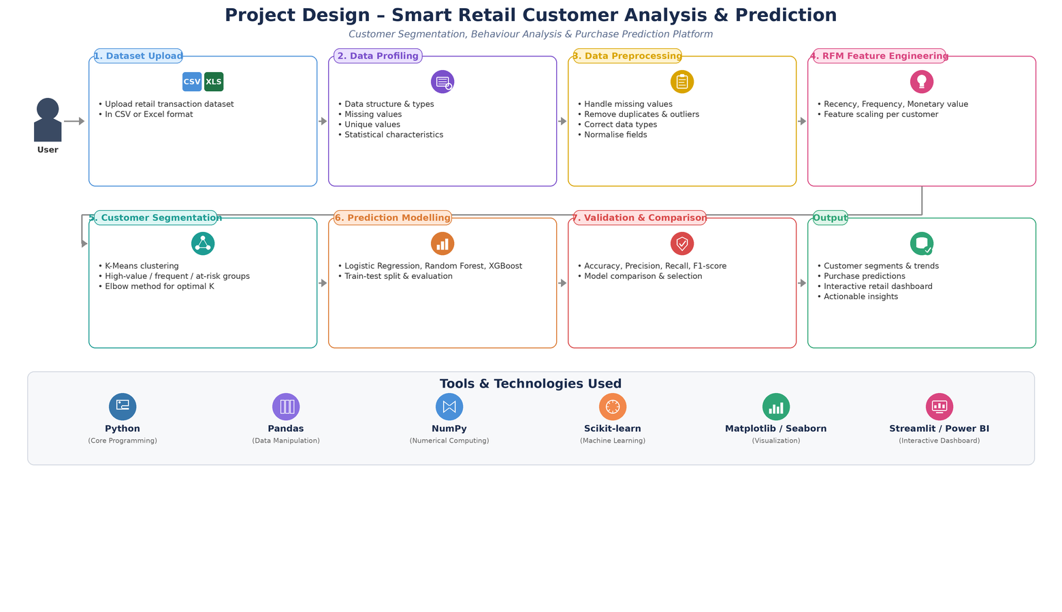

Slide 6
Literature Survey
Authors | Title of the Paper | Methodology | Inferences | Limitation/Future work
Mahfuza et al. [1] | LRFMV: An Efficient Customer Segmentation Model for Superstores, PLOS ONE, 2024 | Extends RFM with Length and Volume (LRFMV); K-Means, K-Medoids and Mini-Batch K-Means clustering on superstore transaction data | LRFMV segments show a clearer profit-to-quantity relationship than classic RFM/LRFM; K-Means gave the most precise clusters | Volume feature is specific to superstore data; does not address predicting a customer's future purchases
Ullah et al. [2] | Customer Analysis Using ML-Based Classification for Segmentation Using RFMT, Sensors, 2025 | RFMT (Recency, Frequency, Monetary, Time) model with cluster validation and majority voting across multiple algorithms on e-commerce data | Adding the Time dimension improved cluster validity and segmentation accuracy over the standard RFM model | Focused on segmentation only; no forward-looking prediction of purchase likelihood is proposed
Chavhan et al. [3] | RFM Analysis for Customer Segmentation Using Machine Learning: A Survey of a Decade of Research, 2026 | Comparative survey of RFM-based clustering approaches (K-Means, hierarchical, fuzzy C-means) applied to online retail datasets | Fuzzy C-Means gave the best silhouette scores but at higher computational cost than K-Means | Survey-level work; does not implement an end-to-end segmentation-plus-prediction system for retailers

Slide 7
Problem Gap Identification
1
Narrow feature set
Most existing RFM-based methods use only Recency, Frequency and Monetary value, ignoring product-category diversity and preference trends.
2
Segmentation without prediction
Many studies stop at descriptive clustering and do not connect segments to a forward-looking model of future purchases.
3
Not built for everyday retail use
Advanced analytics tools are often costly, complex, and not tailored to small and medium retail businesses.
4
No unified, interpretable output
Few solutions combine segmentation and prediction into one simple dashboard that non-technical retail staff can act on.

Slide 8
Innovation, Creativity, and Novelty
1
Unified segmentation + prediction pipeline
Combines customer segmentation and purchase-prediction in a single workflow instead of treating them as separate, disconnected tasks.
2
Extended behavioral features
Goes beyond standard RFM by adding product-category diversity and purchase-frequency trend to better capture customer behavior.
3
Retailer-friendly dashboard
Presents insights and predictions through a simple visual interface designed for users without a data-science background.
4
Action-oriented outputs
Generates directly usable outputs - targeted promotion lists, at-risk customer alerts and high-value customer flags - rather than raw statistics.

Slide 9
Feasibility and Project Plan
Project Timeline
Phase | Activity | Duration
Phase 1 | Literature survey & problem identification | Weeks 1-2
Phase 2 | Data collection, cleaning & exploratory analysis | Weeks 3-4
Phase 3 | Customer segmentation (clustering) | Weeks 5-6
Phase 4 | Predictive model development & tuning | Weeks 7-9
Phase 5 | Dashboard / interface development | Weeks 10-11
Phase 6 | Testing, evaluation & final report | Weeks 12-13

