Slide 1

TEMPERATURE MONITORING
SYSTEM

Slide 2

PROBLEM STATEMENT
The project aims to design and implement a temperature monitoring system which keeps the temperature of the given system into a given range.

Slide 3
DESCRIPTION
This project presents a versatile and cost-effective temperature monitoring system implemented using the Intel 8086 microprocessor. Utilizing hardware components such as the LM35 temperature sensor, ADC0804, and 7-segment display, the system accurately reads and displays temperature data. The software functionalities include high/low-temperature alarms.
The 8086 microprocessor orchestrates these features through efficient algorithms, providing a simple yet effective solution for diverse industrial and scientific applications. The project ensures optimal performance and safety by continuously monitoring temperature and reacting to predefined thresholds, demonstrating its adaptability and affordability in real-world scenarios.

Slide 4
HARDWARE REQUIREMENTS
1. 8086 MICROPROCESSOR
2. 8255A
3. 74HC373 LATCH
4. SEVEN SEGMENT DISPLAY
5. RED LED LIGHT
6. ADC0804
7. LM35 TEMPERATURE CONTROLLER
8. REGISTER
9. CAPACITOR
10. D CLOCK
11. POWER SUPPLY

Slide 5
SOFTWARE REQUIREMENTS
PROTEUS
EMU8086

Slide 6
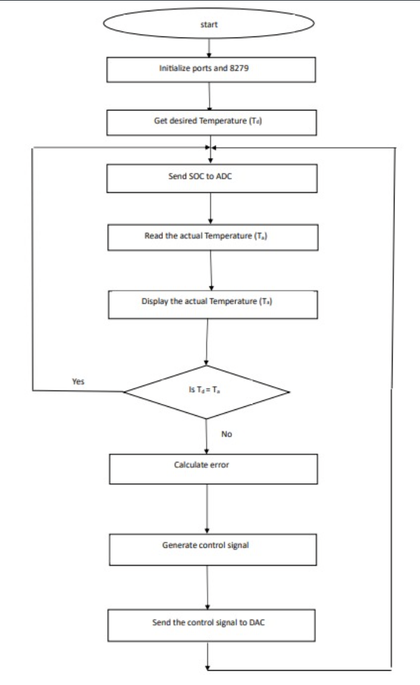
FLOWCHART
This flowchart displays the flow of events.

Slide 7
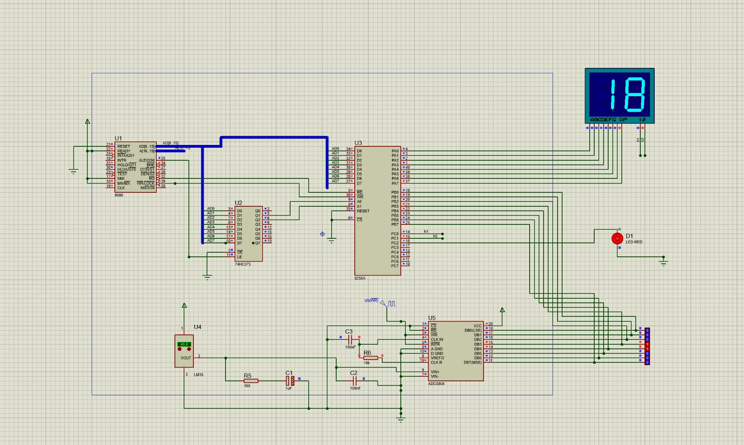
INTERFACING

Slide 8
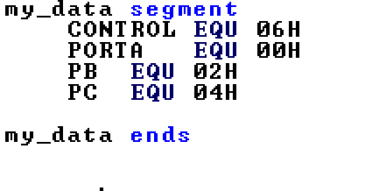
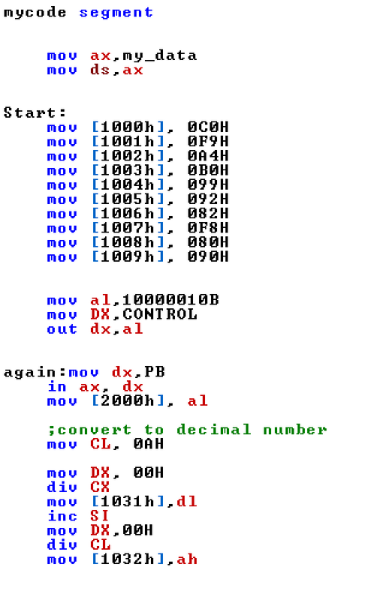
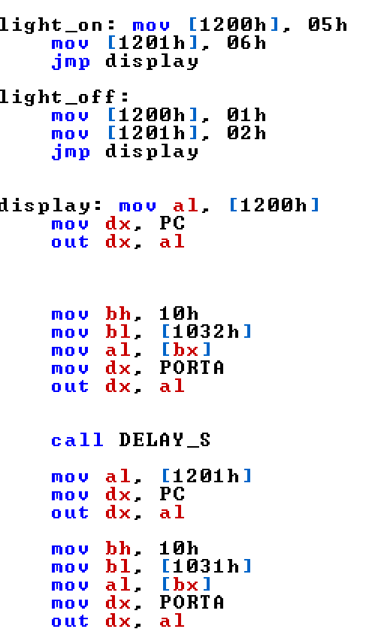
8086- CODE IMPLEMENTATION
DATA SEGMENT
CODE SEGMENT
FUNCTIONALITY

Slide 9
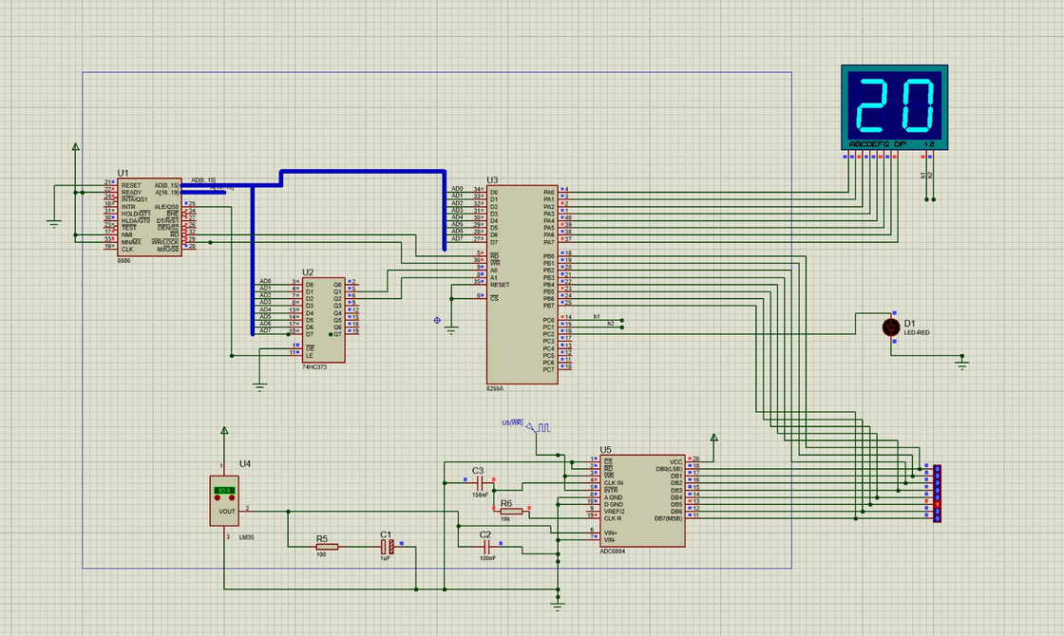

EXPECTED OUTPUT:
HEATER OFF
HEATER ON

Slide 10
THANK YOU

