Slide 1
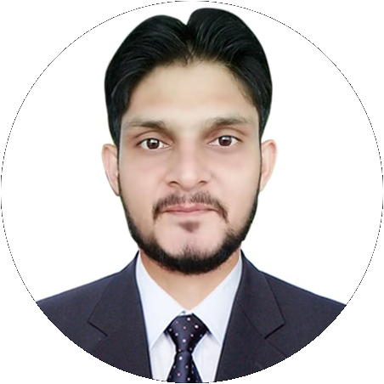

Quality Engineer |Core skills (Functional, Database, API, Automation Testing, Java, Selenium)
Nitish Kumar Chile
Roles and Responsibilities
Key Skills and Industry Expertise
Functional Testing ( Web, Desktop, Mobile )
Database Testing ( My SQL , AWS Dynamo , SQL, MongoDB )
API Testing ( Postman , Apolo router)
Automation Testing ( Web App - Selenium )
Project Management ( Jira, Devops, Asana )
Automation Testing, Java, Selenium
Emulators ( Blue Stacks , Browser Stacks )
Android logs checking ( Android debug bridge )
CI/CD Tools: Jenkins
Version Control: Git
Current training paths:
Python
AI tools (Testrigor, KushoqAI)
Worked as an Individual QA i.e. right from Requirement gathering to Smoke testing to Regression testing to Prod Verification
Engaged in client interactions to comprehend project requirements and facilitated feature discussions
Involved in Functional, API, Database, Automation testing
Assist in the development and maintenance of test automation frameworks.
Ensure automation scripts are up-to-date with application changes.
Making New Test Cases Addons in Automation Scripts after Sanity test for any change request.
Followed Hybrid framework approach for UI automation
Had exposure of Cucumber framework for RestAssured
Utilized SQL and My SQL, AWS Dynamo for backend data validations
Using Postman , Apolo router for verifying APIs and GraphQL
Reviewing the Reports , Test Cases generated and executed by QA Engineers
Doing Smoke, Regression, Sanity testing as per QA lead
Involved in Sprint planning, Daily Standups, Retrospective meetings and managing Testing Tasks as per Testing Life Cycle
Following Agile Process and Using Jira as Bug tracker and Project management tool.
Background
Academic Credentials/Certifications
Nitish is experienced Quality Engineer with approximately 8.5 years of expertise in testing web, mobile, and desktop applications. Possesses a strong understanding of Software Testing Life Cycle (STLC) and bug lifecycle. Specialized in the domains of ed-tech, e-commerce, and event management. Proficient in Functional, API, Database, Automation testing with tools and language like Selenium, Postman, MySql, Java, Devops, Jira, AWS Dynamo
ISTQB Certified Professional QA
Bachelor of Engineering, Chhattisgarh Swami Vivekanand Technical University

Slide 2
Engagements and Accomplishments.
Project name : HALO LMS Scholarships (GCU) Duration : January 2022 to Present Description : To build and operate the LMS and DPA platforms, which help to conduct online offline classes and tracks students Performance, Attendance, Assignments, Scholarships approvals on certain criteria Designation: Senior Software Quality Engineer. Responsibility
Worked as an Individual QA i.e. right from Requirement gathering to Smoke testing to Regression testing to Prod Verification
Engaged in client interactions to comprehend project requirements and facilitated feature discussions
Involved in Functional, API, Database, Automation testing
Assist in the development and maintenance of test automation frameworks.
Ensure automation scripts are up-to-date with application changes.
Making New Test Cases Addons in Automation Scripts after Sanity test for any change request.
Utilized SQL and My SQL, AWS Dynamo for backend data validations
Using Postman , Apolo router for verifying APIs and GraphQL
Reviewing the Reports , Test Cases generated and executed by QA Engineers
Project name : Benchmark Education
Duration : February 2021 – Jan 2022
Description : It’s a digital solution for that suite reporting feature. Accessible to Faculty, Students of School admins ,District of particular city. It counts total login, Unique logins, % of Student teachers logged in to particular District, School.
Designation : Software Quality Engineer
Responsibility :
Doing Smoke, Regression, Sanity , Prod Verification
Utilized SQL and My SQL, AWS Dynamo for backend data validations
Involved in Sprint planning, Daily Standups, Retrospective meetings and managing Testing Tasks as per Testing Life Cycle
Following Agile Process and Using Jira as Bug tracker and Project management tool.
Project name : Brighttutee (E-Learning Platform)
Duration : February 2021 – Jan 2022
Description : It’s a digital solution for that suite reporting feature. Accessible to Faculty, Students of School admins ,District of particular city. It counts total login, Unique logins, % of Student teachers logged in to particular District, School.
Designation : Quality Analyst
Responsibility :
Involved in Functional, API, Database testing
Creating and Executing Testcases as per modules
Provide Training to Junior QAs
Doing Smoke, Regression, System testing
Conducted testing across web application mobile applications
Implemented and optimized quality processes to enhance testing efficiency
Designing , Executing Testcase as per the Tickets assigned
Project name : Kanban Explorer – Salesforce Duration : August 2016 – Sep 2018 Description - Salesforce App which makes the look and feel from classic to lightning, It allows to manage Opportunity, Lead, Case, other custom objects in an user friendly way of Drag and Drop.
Designation : Quality Analyst
Responsibility :
Conducted testing across web application mobile applications
Doing Smoke regression Sanity testing
Doing Database, API Testing
Designing , Executing Testcase as per the Tickets assigned
Project name : Things Todo Duration : August 2016 – Sep 2018 Description - It tells us about various events organized by any person/institute/college etc. A Person can post his business add, Event. Any normal person from this site can see if any event or Business adds is there on that day of any category like sports, Music etc.
Designation : Quality Analyst
Responsibility :
Conducted testing across web application mobile applications
Doing Smoke regression Sanity testing
Doing Database, API Testing
Designing , Executing Testcase as per the Tickets assigned

