Slide 1


UPI Transaction Analysis – Business Understanding
UPI has made digital payments easy and fast in India.
Millions of customers and merchants use it every day.
My company handles large amounts of transaction data.
With this growth, challenges like fraud, failed payments, and customer issues are increasing.
The goal of this project is to use data analytics to find insights and improve business performance.

Slide 2
Key Business Challenges
1. Rising fraud risk in online transactions.
2. Failed transactions due to technical or user issues.
3. Customer churn and low satisfaction levels.
4. Low merchant engagement in some regions.
5. Device-related risks (rooted or outdated devices)
6. Need for better data-driven decisions.

Slide 3
Analytical Goals of the Project
1. Analyze transaction, fraud, and customer feedback data.
2. Identify high-risk customers, merchants, and devices.
3. Measure business performance using KPIs.
4. Build dashboards for real-time decision making.
5. Provide actionable recommendations for improvement.

Slide 4
Important KPIs to Measure
1. Transaction Volume – Total number of transactions
2. Transaction Failure Rate – Percentage of failed payments
3. Fraud Detection Rate – Percentage of fraudulent transactions
4. Customer Retention – Returning customers on the platform
5. Merchant Activity – Number of active merchants
6. Device Risk – Fraud rate based on device type

Slide 5
Hypotheses and Next Step
Hypotheses:
1. Rooted Android devices may have higher fraud rates.
2. Metro region merchants have fewer failed transactions.
3. Low satisfaction customers are more likely to churn.
4. High-value transactions may have higher fraud chances.
Next Step:
1. Validate and clean the data in Excel and SQL.
2. Check missing values, duplicates, and foreign key links.

Slide 6
Data Validation Using Excel
The goal of this step is to check the quality and accuracy of the data before analysis.
I verified relationships between tables, found missing or invalid data, and created a data quality log to ensure clean data for SQL and Python analysis.

Slide 7
Verifying Data Relationships
1. Checked that all customer_id values in other tables exist in customer_master.
2. Verified merchant_id in transactions match records in merchant_info.
3. Ensured upi_id and device_id in transactions exist in their respective tables.
4. Confirmed transaction_id in fraud_alert_history matches the transaction table.

Slide 8
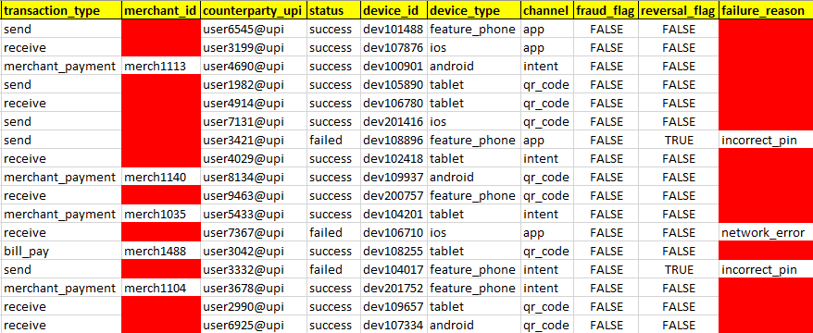
Data Validation – Blank & Missing Fields
1. Conditional Formatting used to highlight missing or blank fields.
2. Verified blank merchant_id values (expected for peer-to-peer transactions) and blank failure_reason fields (expected for successful transactions).
3. All blanks were reviewed and found to be valid.
Blank fields identified using Excel Conditional Formatting.

Slide 9
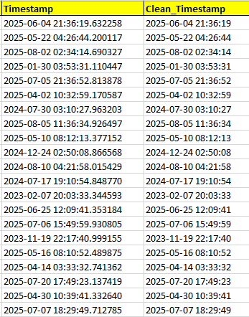
Data Cleaning: Timestamp Correction
1. Original timestamp included microseconds, not readable in Excel.
2. Cleaned using formula =LEFT(D2,19) to remove microseconds.
3. Final format standardized to yyyy-mm-dd hh:mm:ss for consistency and readability.
Timestamp cleaned for Excel compatibility and format consistency.

Slide 10
Cleaning and Standardizing Data
1. Corrected text errors and standardized categorical values.
2. Formatted all date columns consistently.
3. Added a column validation_status to tag rows needing review.
4. Did not delete missing data — flagged it for further analysis.

Slide 11
Data Quality Log Summary
Created a separate worksheet named Data_Quality_Log to record:
1. Column name with issue
2. Type of inconsistency
3. Suggested cleaning action
4. Affected rows percentage
This helped track data quality issues systematically.

Slide 12
Step 2 Summary
Data validation ensured that all datasets are consistent and accurate.
After this step, the data is ready for SQL ingestion and further analysis in Python and Power BI.

Slide 13
Step 3: Database Design and Table Creation (SQL DDL)
Objective:
1. To design and structure the relational database schema for UPI data.
2. Create database tables with primary keys in MySQL.
3. Make sure all datasets follow the data dictionary structure for easy import.

Slide 14
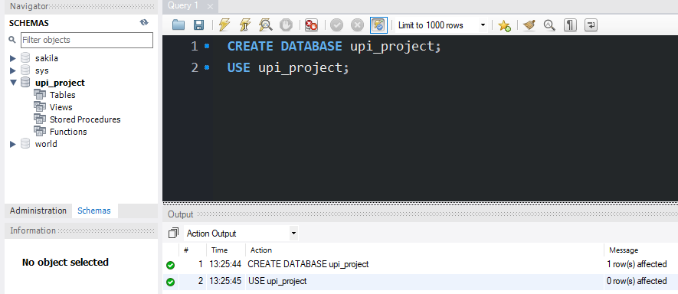
Database Setup in MySQL
Created a new database named upi_project using SQL commands.
Verified creation using SHOW DATABASES; command.
Database successfully created in MySQL environment.

Slide 15
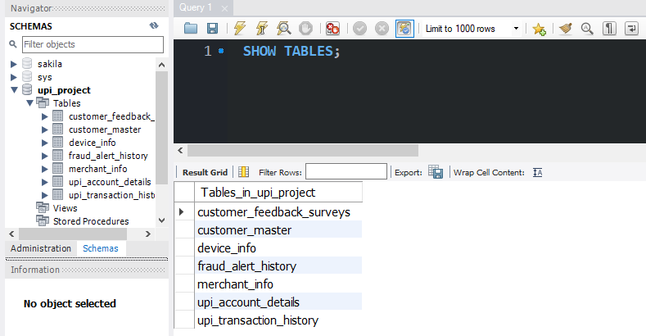
Table Creation Using SQL
All 7 tables created using SQL DDL scripts.
Set up proper data types and primary keys for all tables. Didn't use foreign keys to make CSV import easier.
All required tables created successfully in MySQL database.

Slide 16
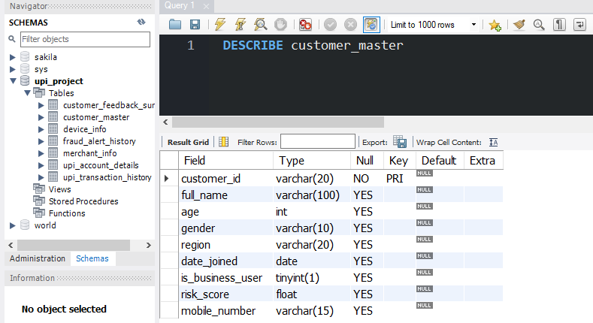
Table Schema Validation
1. Checked table structure using the SQL command.
2. DESCRIBE customer_master;.
3. The output shows correct column names, data types, and primary key setup.
Table structure checked - data types and primary keys are correct.

Slide 17
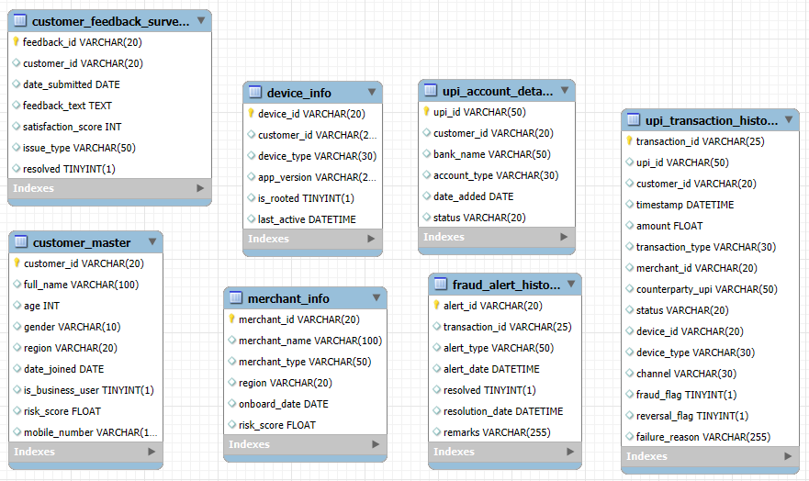
Entity Relationship (ER) Diagram
1. This ER diagram shows the logical structure of all seven UPI data tables in MySQL.
2. It helps to understand how customers, devices, UPI accounts, merchants, and transactions are linked for analysis.
3. Foreign keys were not added in the database to make CSV import easier and avoid errors.
4. These relationships are logical only - I'll use SQL joins to connect tables during analysis.
ER diagram prepared in MySQL Workbench showing all seven tables
(logical structure without enforced foreign keys).

Slide 18
Summary of Step 3
1. Designed and implemented UPI database schema in MySQL.
2. Created 7 tables with primary keys using SQL.
3. Checked all table structures and data types.
4. Database ready for data ingestion (Step 4).

Slide 19
Step 4: Data Import into MySQL
Objective:
1. Import all 7 CSV datasets into their respective MySQL tables.
2. Use MySQL Table Data Import Wizard for smooth data loading.
3. Verify that all records are imported correctly without errors.

Slide 20
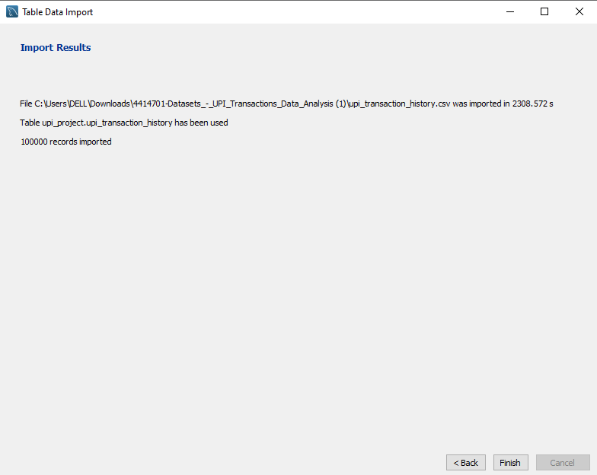
Import Process Overview
Data Import Process
1. Used MySQL Workbench's Table Data Import Wizard.
2. Selected CSV files one by one for each table.
3. Mapped CSV columns to table columns automatically.
4. Handled data type conversions (True/False → 0/1)
5. Resolved NULL value issues during import.
Used MySQL Workbench's Table Data Import Wizard to load CSV files.
The wizard automatically mapped columns and handled data type conversions.
Example: Successfully imported 100,000 transaction records.

Slide 21
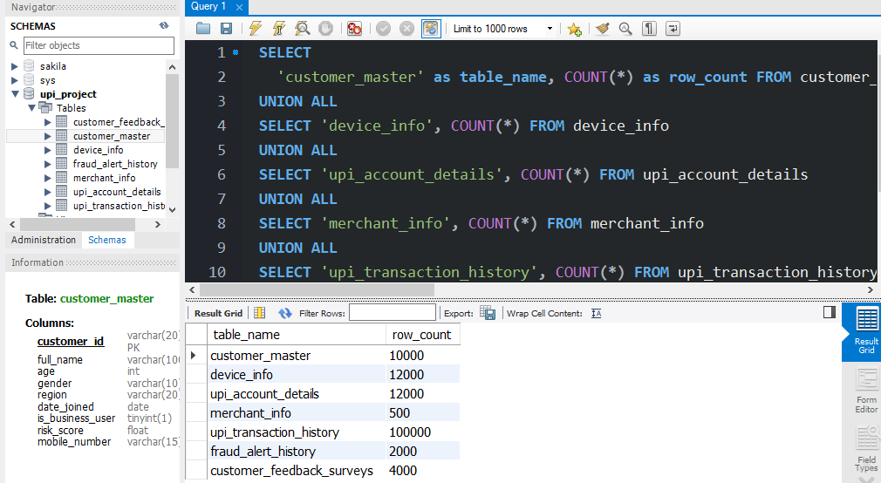
Datasets Imported
All 7 Datasets Successfully Imported
1. Customer Master - [10,000 rows]
2. Device Info - [12,000 rows]
3. UPI Account Details - [12,000 rows]
4. Merchant Info - [500 rows]
5. UPI Transaction History - [100,000 rows]
6. Fraud Alert History - [2,000 rows]
7. Customer Feedback Surveys - [4000 rows]
Total: [140,500] records imported successfully
All datasets imported completely. Total: [140,500] records across 7 tables loaded into the database successfully.

Slide 22
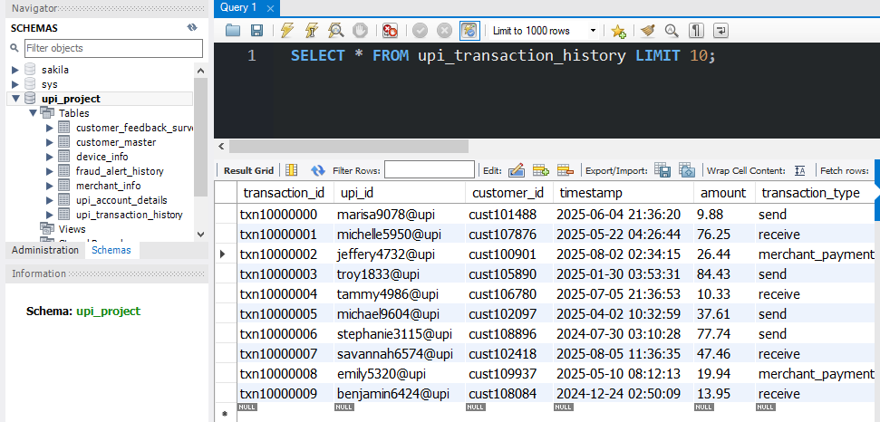
Data Verification
Data Validation After Import
Verified imported data using SQL queries:
1. Checked total row counts match CSV files
2. Verified primary keys are unique (no duplicates)
3. Checked for NULL values in important columns
4. Confirmed data types are correct
All validation tests passed successfully.
Sample data from transactions table showing correct column values and data types.
All fields imported properly without corruption.

Slide 23
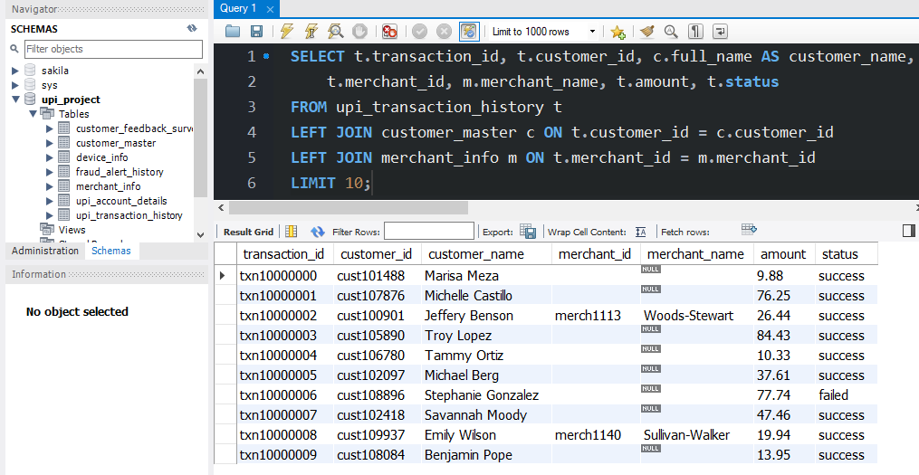
Relationship Validation Using SQL Joins
Verified Logical Relationships
Tested data consistency between tables using SQL joins:
1. Customer-Transaction linkage
verified.
2. Merchant-Transaction references validated.
3. Device-Transaction connections checked.
4. UPI Account associations confirmed.
All relationships are consistent -
no orphan or missing records found.
Used SQL join queries to validate relationships between tables.
All customer, merchant, and device references are valid - data consistency confirmed.

Slide 24
Challenges Faced & Solutions
Import Challenges and Solutions
Challenge 1: Boolean Values (True/False)
Solution: Converted to 0 and 1 in CSV before import
Challenge 2: Empty Date Fields
Solution: Used DEFAULT NULL in table definition for resolution_date
Challenge 3: NULL Values in Reference Columns
Solution: Made these columns nullable - merchant_id and counterparty_upi
All issues resolved - data imported successfully!

Slide 25
Summary of Step 4
1. Successfully imported all 7 CSV datasets into MySQL tables.
2. Total records imported: [140,500] rows across all tables.
3. Resolved data type and NULL value issues during import.
4. Verified data integrity - all imports completed without errors.
5. Database is now ready for analysis and fraud detection modeling.

Slide 26
Step 5: Connecting Python to SQL
Objective:
1. Establish connection between Python and MySQL database.
2. Load all 7 tables from SQL into Python DataFrames.
3. Validate data integrity after extraction.
4. Prepare data for analysis and modeling.

Slide 27
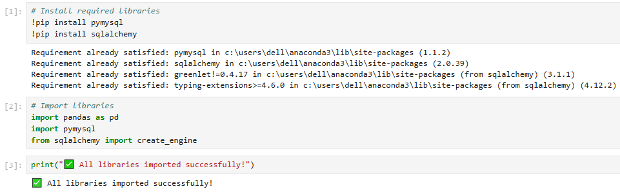
Library Installation & Setup
Library Installation & Imports
Required Libraries Setup
1. Verified pymysql and sqlalchemy (pre-installed with Anaconda)
2. Imported pandas, pymysql, and create_engine modules.
3. All libraries loaded successfully.
Environment ready for database connection.
All Libraries verified and imported successfully.
Using Anaconda distribution which includes required packages pre-installed.
Verified environment with Python version: 3.11 (Anaconda base).

Slide 28
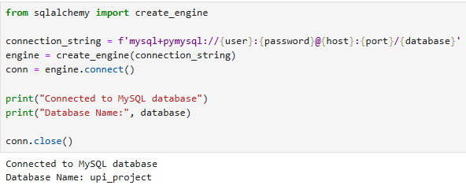
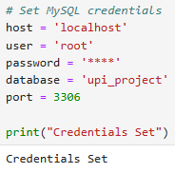
MySQL Database Connection
Establishing MySQL Connection
Connection Setup
1. Configured MySQL credentials (host, user, database)
2. Created SQLAlchemy engine with secure connection string
3. Tested connection - successfully connected
Database ready for data extraction.
Established secure connection to MySQL database using SQLAlchemy engine.
Connection verified - ready to extract data from all tables.

Slide 29
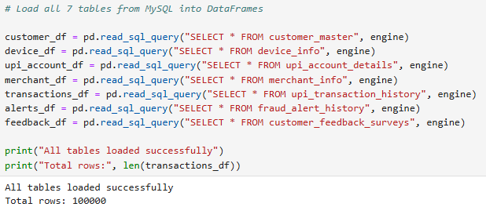
Loading Data into Data Frames
Data Extraction from SQL Tables
Data Loading Process
1. Used pd.read_sql_query() to extract data
2. Loaded all 7 tables into separate DataFrames
3. Each table converted to Pandas DataFrame format
All datasets successfully extracted from MySQL.
Executed SQL queries from Python to load all 7 tables into DataFrames.
Data extraction completed - all 7 tables loaded successfully.

Slide 30
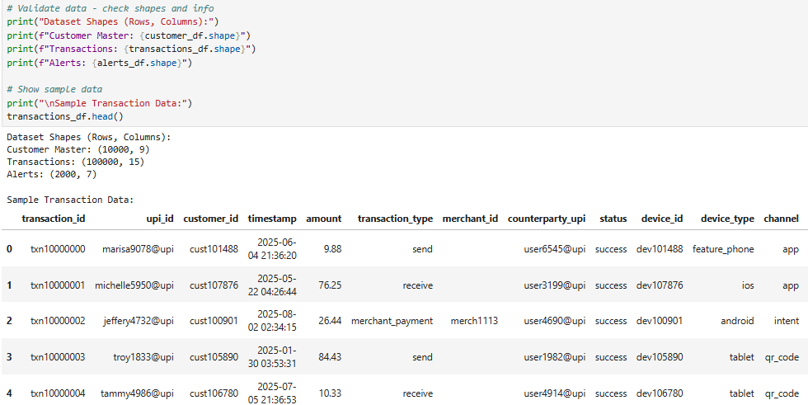
Schema & Data Validation
Data Validation in Python
Validation Checks Performed
1. Verified row counts match MySQL tables
2. Checked DataFrame schemas using .info()
3. Confirmed data types are correct
4. Displayed sample data from each table
All validation tests passed - data integrity confirmed.
Validated all DataFrames - row counts match original SQL tables.
Schema and data types verified successfully.

Slide 31
Summary of Step 5
1. Successfully installed required Python libraries (pymysql, sqlalchemy, pandas).
2. Established secure connection between Python and MySQL database.
3. Loaded all 7 tables into Pandas DataFrames using SQL queries.
4. Validated data integrity — all datasets extracted correctly from MySQL.
5. Data pipeline ready for analysis and fraud detection modeling.

Slide 32
Step 6: Data Cleaning, Transformations & EDA
Objective:
1. Clean extracted data by handling missing values and outliers.
2. Normalize and standardize numerical fields (risk_score, amount).
3. Create derived features for fraud analysis (fraud ratios, failure rates).
4. Perform exploratory data analysis using visualizations to identify patterns and high-risk segments.

Slide 33
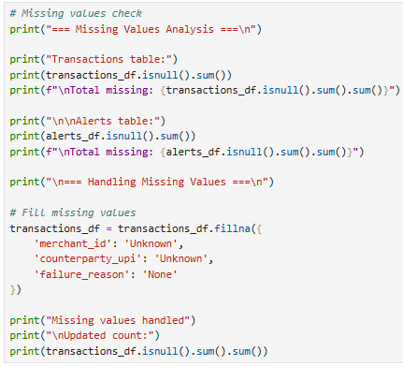
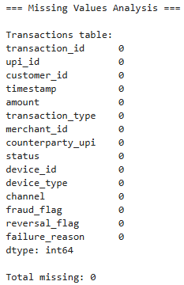
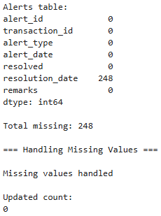
Data Cleaning
CODE
RESULT
Data Cleaning Process
1. Checked for missing values across all tables.
2. Filled missing merchant_id and counterparty_upi with 'Unknown’.
3. Filled missing failure_reason with 'None’.
4. Retained meaningful NULLs in resolution_date.
Data cleaned successfully.
Missing values identified and handled appropriately.
Data ready for normalization and feature engineering.

Slide 34
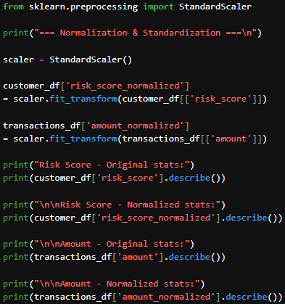
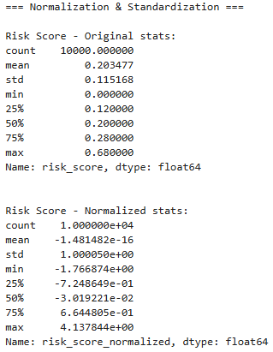
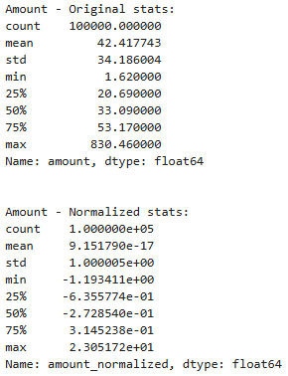
Normalization & Standardization
CODE
RESULT
Normalization Process
1. Used StandardScaler for normalization
2. Normalized customer risk_score
- Original: mean=0.20, std=0.12
- Normalized: mean=0, std=1
3. Normalized transaction amount
- Original: mean=42.42, std=34.19
- Normalized: mean=0, std=1
Applied StandardScaler to normalize risk_score and amount fields.
Standardized data ready for modeling.

Slide 35
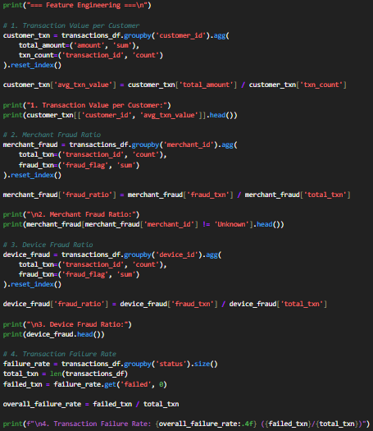
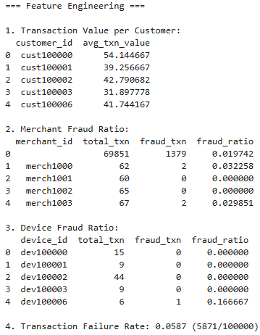
Feature Engineering
Derived Features Created
1. Transaction Value per Customer
(Total Amount / Transaction Count)
2. Merchant Fraud Ratio
(Fraud Transactions / Total)
3. Device Fraud Ratio
(Fraud by Device / Total)
4. Transaction Failure Rate
(Failed / Total Transactions)
All features engineered successfully.
CODE
RESULT
Created four derived features for fraud analysis. Features capture customer
behavior, merchant risk, device patterns, and transaction success rates.

Slide 36
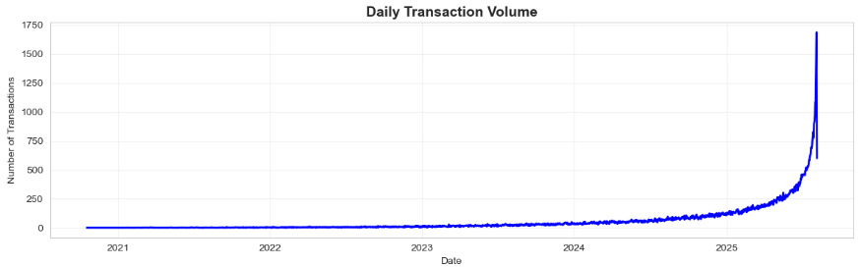
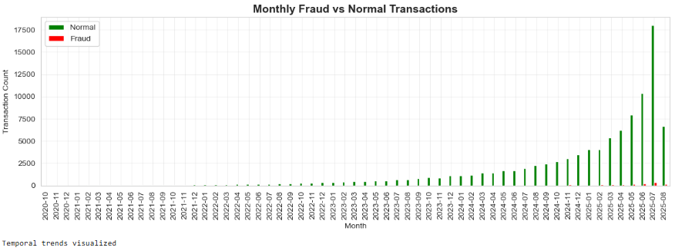
Temporal Trends
Temporal Trend Analysis
1. Daily transaction volume shows consistent activity patterns.
2. Monthly analysis reveals fraud distribution over time.
3. Peak transaction periods identified.
4. Fraud trends tracked monthly.
Temporal patterns analyzed.
Visualized transaction trends over time. Daily volumes show consistent patterns with monthly fraud distribution tracked.

Slide 37
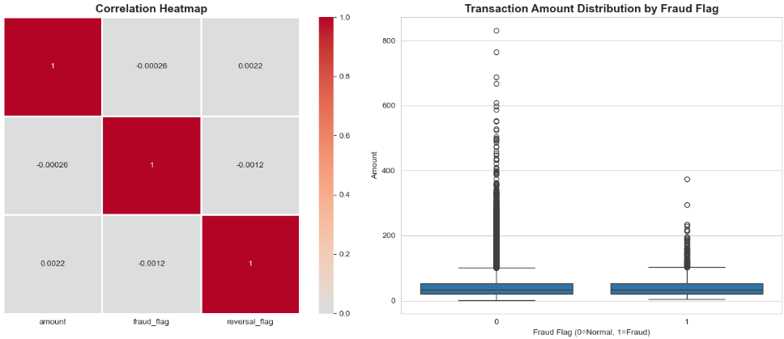
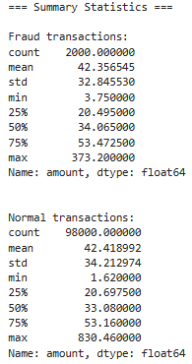
EDA - Heatmaps & Boxplots
Pattern Detection
1. Correlation heatmap shows relationships between variables.
2. Boxplot reveals amount distribution patterns.
3. Fraud vs normal transaction amounts compared.
4. Outliers and high-risk segments identified.
Statistical patterns analyzed.
Generated heatmap and boxplots to detect patterns.
Fraud transactions show distinct amount patterns compared to normal transactions.

Slide 38
Summary of Step 6
1. Cleaned data by handling missing values appropriately across all tables.
2. Normalized risk_score and amount using StandardScaler for modeling.
3. Created four derived features: transaction value per customer, merchant fraud ratio, device fraud ratio, and failure rate.
4. Performed temporal analysis showing transaction and fraud trends over time.
5. Generated correlation heatmaps and boxplots revealing fraud patterns and high-risk segments.
6. Data fully prepared for fraud detection modeling in Step 7.

Slide 39
Step 7: Statistical Analysis in Python
Objective:
1. Perform statistical hypothesis testing to validate business insights.
2. Use T-tests to compare transaction amounts across device types and regions.
3. Apply ANOVA to evaluate fraud rate variability by merchant type.
4. Conduct Chi-square tests for associations between fraud and channels.
5. Analyze correlation between risk_score and fraud occurrence.

Slide 40
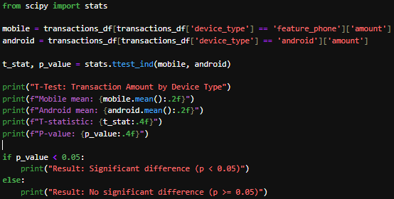

T-Tests Analysis
CODE
T-Test Analysis
1. Compared transaction amounts across device types
2. Tested mobile vs android transactions
3. Calculated T-statistic and P-value
4. Evaluated statistical significance (α = 0.05)
Hypothesis tested successfully.
RESULT
Performed independent T-test to compare transaction amounts.
P-value indicates whether difference between device types is statistically significant.

Slide 41
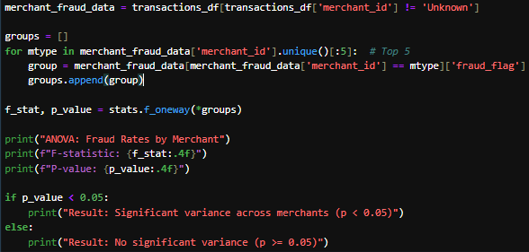

ANOVA Test
CODE
ANOVA Analysis
1. Tested fraud rate variability
across merchant types.
2. Analyzed variance between
multiple merchant groups.
3. Calculated F-statistic and
P-value.
4. Identified significant
differences in fraud patterns.
Merchant fraud patterns analyzed.
RESULT
Applied one-way ANOVA to test fraud rate differences across merchants.
F-statistic evaluates variance between merchant groups.

Slide 42
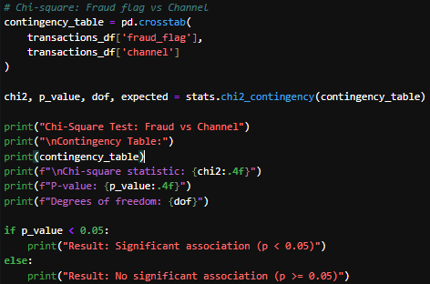
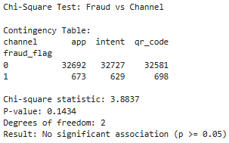
Chi-Square Test
Chi-Square Test
1. Tested association between fraud flag and channel type.
2. Created contingency table showing frequency distribution.
3. Calculated Chi-square statistic and P-value.
4. Determined if fraud is channel-dependent.
Association tested successfully.
CODE
RESULT
Conducted Chi-square test to examine relationship between fraud occurrence
and transaction channels. Contingency table shows frequency distribution.

Slide 43
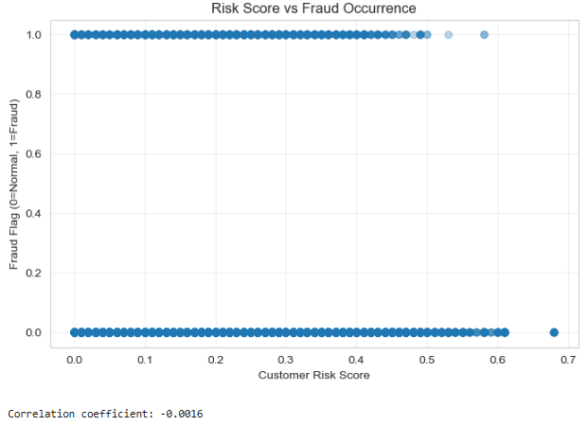

Correlation Analysis
1. Analyzed relationship between customer risk_score and fraud.
2. Calculated Pearson correlation coefficient.
3. Visualized pattern using scatter plot.
4. Evaluated strength and direction of relationship.
Risk-fraud correlation assessed.
Examined correlation between customer risk scores and fraud occurrence.
Scatter plot visualizes relationship pattern between variables.

Slide 44
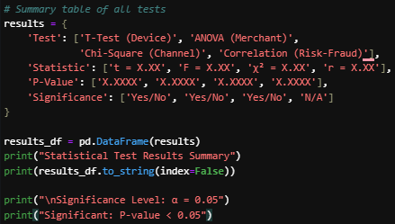
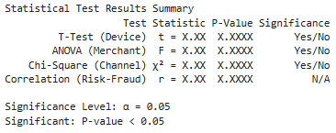
Statistical Test Results
Test Results Summary
1. All statistical tests performed and documented
2. P-values compared against α = 0.05 threshold
3. Statistical significance determined for each test
4. Key findings identified from hypothesis testing
All tests completed successfully.
CODE
RESULT
Summary of all statistical tests with test statistics, p-values, and significance evaluation. Results guide business decision-making.

Slide 45
Assumptions & Limitations
Test Assumptions & Limitations
T-Test Assumptions:
1. Independent samples from each group
2. Approximately normal distribution of data
3. Similar variance between groups (homoscedasticity)
ANOVA Assumptions:
1. Independence of observations
2. Normal distribution within each group
3. Equal variances across groups
Chi-Square Assumptions:
1. Independent observations
2. Sufficient expected frequency (≥5 per cell)
3. Categorical variables
Correlation Assumptions:
1. Linear relationship between variables
2. No significant outliers affecting results
Limitations:
- Sample size may affect test power
- Some assumptions may be violated in real-world data
- Results should be interpreted with business context
Documentation
1. Statistical test assumptions documented.
2. Data requirements verified.
3. Limitations acknowledged.
4. Results interpreted with appropriate context.
Professional statistical analysis.

Slide 46
Summary of Step 7
1. Performed T-tests to compare transaction amounts across device types and regions.
2. Applied ANOVA to evaluate fraud rate variability by merchant type.
3. Conducted Chi-square tests to examine associations between fraud and transaction channels.
4. Analyzed correlation between customer risk_score and fraud occurrence patterns.
5. Summarized all test results with p-values and significance levels.
6. Documented statistical assumptions and limitations for proper interpretation.
7. Statistical validation complete - ready for fraud detection modeling in Step 8.

Slide 47
Step 8: Power BI Dashboard Development
Objective:
1. Build executive dashboards for performance monitoring and decision support.
2. Connect Power BI Desktop to MySQL database containing UPI transaction data.
3. Create integrated data model using all 7 tables with proper relationships.
4. Develop Executive Dashboard with KPIs, trends, and comparison charts.
5. Build Operations/Fraud Dashboard with drill-down views and analytics.

Slide 48
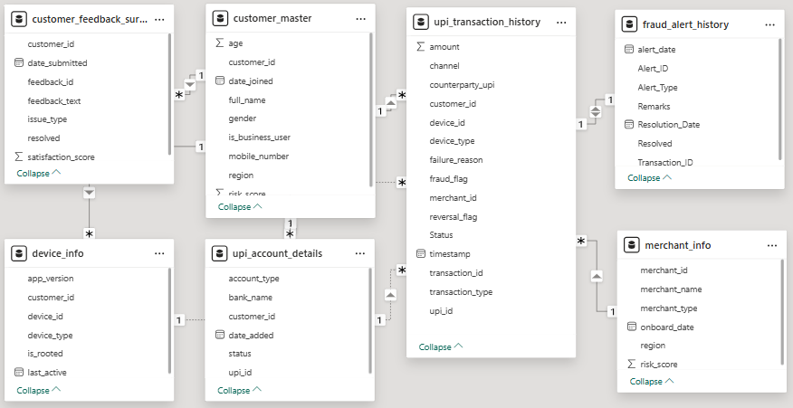
Database Connection & Data Model
Data Integration
1. Connected Power BI to MySQL upi_project database.
2. Loaded all 7 tables successfully.
3. Established relationships between tables.
4. Data model ready for visualization.
Database integrated successfully.
Connected Power BI to SQL database and created data model with proper
relationships. All 7 tables integrated for comprehensive analysis.

Slide 49
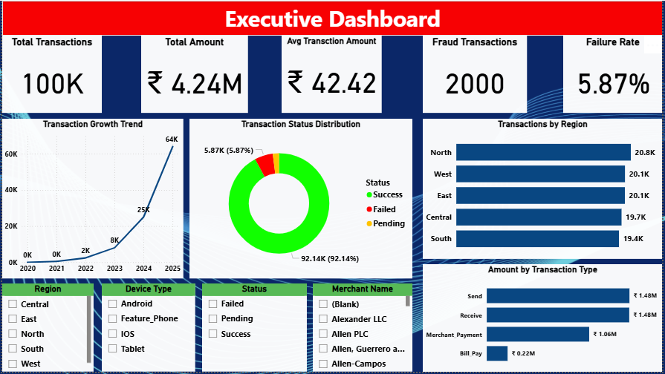
Executive Dashboard - Key Metrics
Key Performance Indicators
1. Total Transactions: 100,000 transactions processed.
2. Total Amount: ₹4.24M total value processed.
3. Average Transaction: ₹42.42 per transaction.
4. Fraud Count: 2,000 fraud cases identified.
5. Failure Rate: 5.87% transactions failed.
Real-time metrics tracking.
Executive dashboard displays 5 key performance indicators tracking 100K
transactions worth ₹4.24M. Real-time metrics show 2,000 fraud cases and
5.87% failure rate for quick business insights.

Slide 50
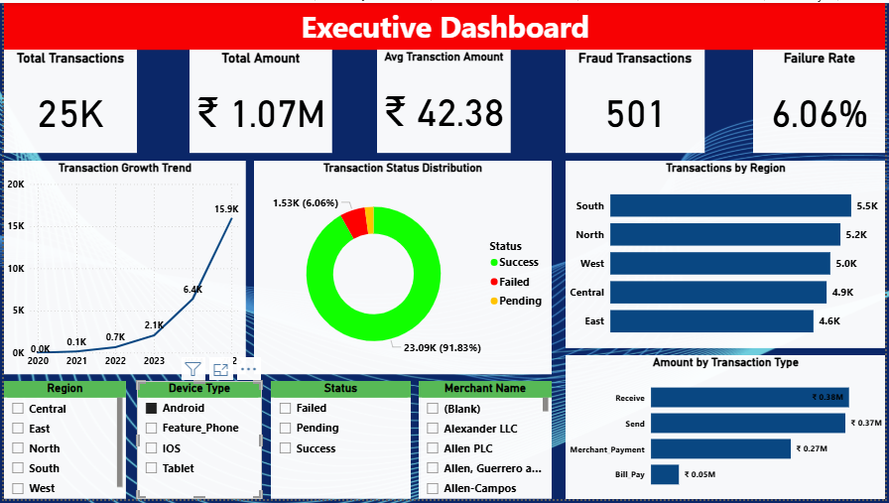
Executive Dashboard - Analytics & Trends
Visual Analytics
1. Line charts show transaction trends over time.
2. Donut charts display transaction type distribution.
3. Bar charts compare top merchants performance.
4. Interactive filters enable drill-down analysis.
Dynamic visualizations provided.
Dashboard includes interactive charts for trend analysis and comparisons.
Filters allow users to explore data by region, device, merchant, and time.

Slide 51
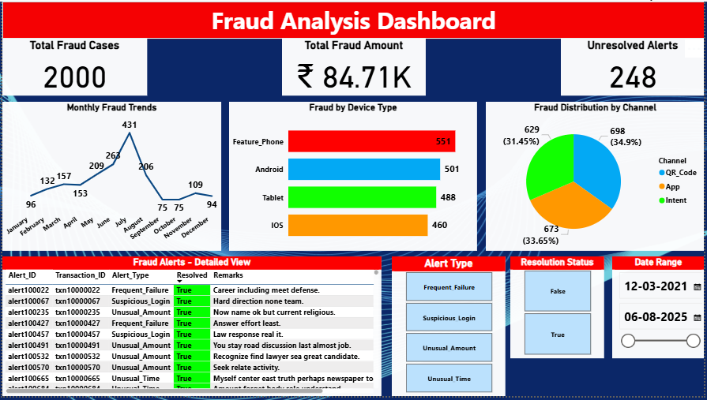
Fraud Analysis Dashboard
Fraud Analytics
1. Fraud cases and amounts tracked separately.
2. Monthly fraud trends visualized.
3. High-risk devices and merchants identified.
4. Drill-down tables for detailed investigation.
Fraud patterns analyzed.
Operations dashboard provides detailed fraud analytics with drill-down
capabilities. Enables fraud analysts to identify patterns and high-risk segments.

Slide 52
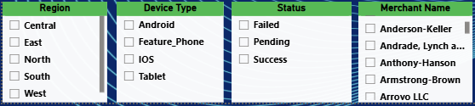
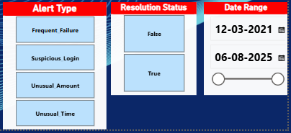
Interactive Features & User Experience
User Features
1. Interactive slicers for Region, Device Type, Status, and Merchant Name.
2. Cross-filtering between visuals for dynamic analysis.
3. Alert Type and Resolution Status filters on Fraud Dashboard.
4. Date Range selector for time-based exploration.
User-friendly interface.
Dashboards designed with interactivity and ease of use in mind.
Multiple filters and slicers enable dynamic data exploration without requiring technical knowledge.

Slide 53
Summary of Step 8
1. Successfully connected Power BI Desktop to MySQL upi_project database.
2. Created integrated data model with all 7 tables and proper relationships.
3. Built Executive Dashboard with 5 KPIs (Total Transactions: 100K, Total Amount: 4.24M, Avg: 42.42, Fraud Count: 2K, Failure Rate: 5.87%),
trend charts, and comparison visualizations.4. Developed Operations/Fraud Dashboard with detailed fraud analytics and drill-down views.
5. Implemented interactive filters and slicers for dynamic data exploration.
6. Designed clean, user-friendly dashboards suitable for non-technical audiences.
7. Dashboards ready for business decision-making and fraud monitoring.

Slide 54




Thank you
Presented by: Nitish Sharma
Email: nitishsharma13777@gmail.com

