Slide 1


REAL-TIME AI SALES INTELLIGENCE AND
SENTIMENT-DRIVEN
DEAL NEGOTIATION ASSISTANT

Slide 2
TEAM DETAILS
Mule Jasmitha Reddy
21204031@rmd.ac.in
Joshitha Chennamsetty
joshithachennamsetty@gmail.com
Nitisha Choudhary
choudharynitisha00@gmail.com
‹#›
Notes:
‹#›

Slide 3
PROJECT OVERVIEW
The project is focused on developing a cutting-edge AI tool that helps sales teams improve their performance during sales calls by providing insights and suggestions based on sentiment analysis. By integrating advanced language models, CRM data, and Google Sheets, the tool will help optimize negotiations, enhance customer engagement, and ultimately drive better sales outcomes.
‹#›
Notes:
‹#›

Slide 4
PROBLEM STATEMENT
Sales teams often face challenges such as:
Lack of structured insights from customer interactions.
Inability to gauge customer intent and sentiment during calls.
Missed opportunities due to inadequate deal prioritization and suboptimal negotiation strategies.
Customers face difficulty in finding the right choice due to the overwhelming number of options and lack of personalized recommendations.
‹#›
Notes:
‹#›

Slide 5
SOLUTION HIGHLIGHTS
Sentiment and Intent Analysis: Real-time analysis of customer sentiment and intent during sales calls using audio and text data.
Deal Recommendations & Insights Hub: AI-driven suggestions for next steps and detailed customer insights to improve decision-making.
AI-Powered Negotiation Coach: A virtual assistant offering real-time advice for negotiations, including language and tone adjustments.
End-to-End System: Automated workflows from speech-to-text processing to final insights delivery.
‹#›
Notes:
‹#›

Slide 6
SYSTEM ARCHITECTURE
TECHNOLOGY STACK
Backend and Processing:
Pandas, re
Time
Wave and pyaudio
Speech_recognition
oauth2client.service_account
gspread
Large Language Models (LLMs):
Transformers( Used for Sentiment analysis: “cardiffnlp/twitter-roberta-base-sentiment”)
Cohere LLM( Used to Answer the input and Suggesting negotiation tips from Cohere’s NLP API: “ command-light-nightly”)
Groq LLM( Used for summarization of conversations from Groq’s NLP API: “ llama-3.3-70b-versatile”)
Data Sources and Integrations:
Google Sheets
CSV Files: Laptop_sales_updated.csv, Previous_chat_interaction.csv
Frontend: Streamlit
‹#›

Slide 7
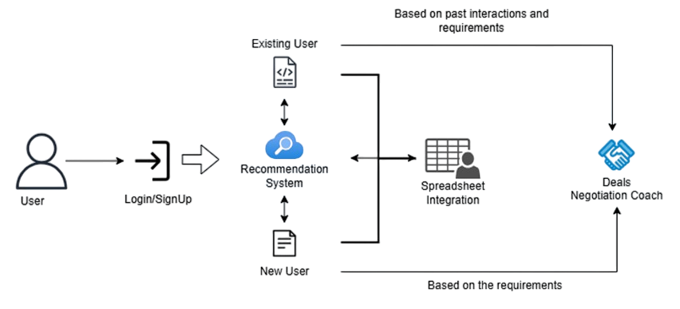
WORK FLOW DIAGRAM
‹#›

Slide 8
SENTIMENT AND INTENT ANALYSIS
The models used will analyze the conversation between the salesperson and the buyer in real-time and interpret language, detect sentiment, and identify key points such as buyer concerns, tone, and intent.
Uses Natural Language Processing (NLP) to extract customer emotions and determine intent.
Sentiment scores and intent classification are derived from conversation data in real-time.
Model: cardiffnlp/twitter-roberta-base-sentiment
‹#›
Notes:
‹#›

Slide 9
DEAL RECOMMENDATIONS
AND
INSIGHTS HUB
Centralized platform offering:
  Prioritized deal opportunities based on analysis.
  Insights on customer pain points and preferences.
Integrates data from structured datasets and live call transcripts for comprehensive recommendations.
Dataset: laptop_dataset_updated.csv
Model: command-light-nightly from Cohere’s API
‹#›

Slide 10
AI-POWERED NEGOTIATION COACH
AI-powered negotiation coach offers personalized tips for sales calls and deals recommendations.
Provides real-time feedback on language, tone, and suggested responses.
Helps sales representatives adapt their negotiation strategies on the fly.
Employs AI models for sentiment-driven coaching during calls.
Model: command-light-nightly from Cohere’s API
‹#›

Slide 11
GOOGLE SHEETS INTEGRATION
Integration with Google Sheets allows seamless data storage and management of customer interactions.
Chat summaries, sentiment analysis, and deal statuses are updated in real time in the spreadsheet.
This system provides actionable insights by organizing customer preferences, negotiation outcomes, and past deals in an easily accessible format.
Sellers can leverage this data during future interactions to make informed decisions and improve negotiation strategies.
Google Sheets serves as a centralized hub, ensuring collaborative access and simplifying the tracking of customer relationship histories.

Slide 12
EXPECTED OUTCOMES
Enhanced Sales Efficiency: Faster decision-making and better resource allocation.
Improved Customer Relationships: Tailored interactions based on intent and sentiment insights.
Higher Deal Closure Rates: AI-backed recommendations optimizing sales strategies.
Streamlined Sales Process: End-to-end automation from customer interaction to insights delivery.
‹#›

Slide 13
THANK YOU!
‹#›

