Slide 1

Autonomous Vehicle Group
SoECE
Image Segmentation
Using Machine Learning
Students Details:
Under the Guidance of:
Prof. Heera Wali
Sl.No | Name | USN
1. | Nitish D Kulkarni | 01FE20BEC111
2. | Sanjana Bagewadi | 01FE20BEC215
3. | Vijayshankar Warad | 01FE20BEC227
4. | Shweta B Kamatad | 01FE20BEC250

Slide 2
Autonomous Vehicle Group
SoECE
Contents:
Introduction
Need statement
Problem Statement
Why Image segmentation?
Types of Image segmentation
Block diagram
7)Literature survey
8)References

Slide 3
Autonomous Vehicle Group
SoECE
Introduction
Precision and accuracy go hand in hand with Machine Learning.
A popular sub-field of Artificial Intelligence.
Presently ML is being used in each and every sector for its analyzing and predicting power.
It can be applied in E-commerce, Social media, the Automotive industry, Image and speech recognition, the stock market, the medical field, agriculture, weather, sports, and many more.
A vast concept with great potential.
By considering “Image processing/ recognition” which is one of the concepts in the sea of machine learning, we are going to implement the same in the field of image segmentation as a part that is required for self-driving cars.

Slide 4
Autonomous Vehicle Group
SoECE
Need Statement:
The concept of partitioning, dividing, fetching, and then labeling and later using that information to train various ML models have indeed addressed numerous business problems. Satellite images are processed to identify various patterns, objects, geographical contours, soil information, etc., which can be later used for agriculture, mining, geo-sensing, etc. Image segmentation has a massive application area in robotics, like RPA, self-driving cars, etc. Security images can be processed to detect harmful objects, threats, people, and incidents.

Slide 5
Autonomous Vehicle Group
SoECE
Problem Statement:
To identify road patterns ,objects and other vehicles, thereby enabling a hassle-free and smooth ride for autonomous vehicles.

Slide 6
Autonomous Vehicle Group
SoECE
What is Image Segmentation?
It is a method in which digital image is broken down into various subgroups called image segments.
This method helps in reducing the complexity of the image.
Segmentation in easy words is assigning labels to pixels.
All picture elements or pixels belonging to the same category have a common label assigned to them.
Approaches to image segmentation:
Similarity approach: It is based on detecting similarities between image pixels to form a segment.
Dicontinuity approach: This approach relies on the discontinuity of pixel intensity values of the image.

Slide 7
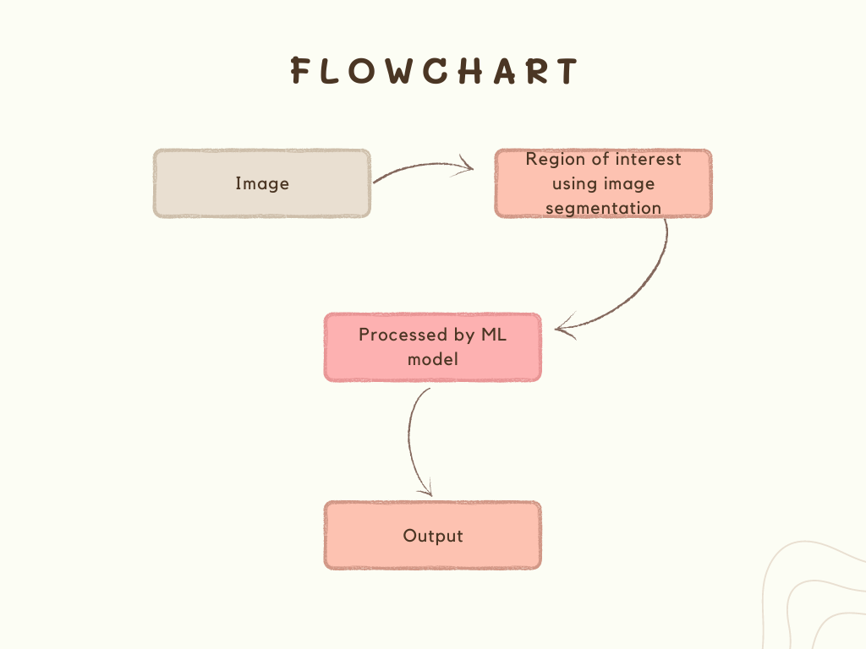
Autonomous Vehicle Group
SoECE
Block diagram:

Slide 8
Autonomous Vehicle Group
SoECE
Importance of Image segmentation:
In these growing years in the field of technology there has been a constant effort in adopting self driving cars.
In order to bring self driving cars which are capable of taking decision on its own according to the situation. This decision making ability matters and plays a very important role.
Image segmentation in autonomous vehicles is an automobile platform capable of sensing and reacting to its immediate environment in an attempt to navigate roadways without human intervention.
It is a feature used in autonomous vehicles which are a hopeful solution for increasing road safety, traffic problems and it also enhances the passengers comfortness.

Slide 9
Autonomous Vehicle Group
SoECE
Types of Image segmentation:
Semantic Segmentation: It refers to the classification of pixels in an image into semantic classes. Pixels belonging to a particular class are simply classified to that class with no other information or context taken into consideration.
Instance Segmentation: Instance segmentation models classify pixels into categories on the basis of “instances” rather than classes.
Papnotic Segmentation: It is the most recently developed segmentation task, can be expressed as the combination of semantic segmentation and instance segmentation where each instance of an object in the image is segregated and the object’s identity is predicted.

Slide 10
Autonomous Vehicle Group
SoECE
As mentioned earlier, there are many techniques/methods for instance image segmentation such as:
Region-Based Segmentation.
Edge detection Segmentation.
Clustering.
Convolutional Neural Network.(CNN)
R-CNN
Fast R-CNN
Faster R-CNN
Mask R-CNN
Mesh R-CNN

Slide 11
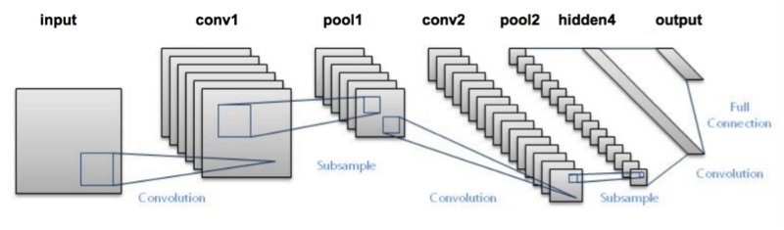
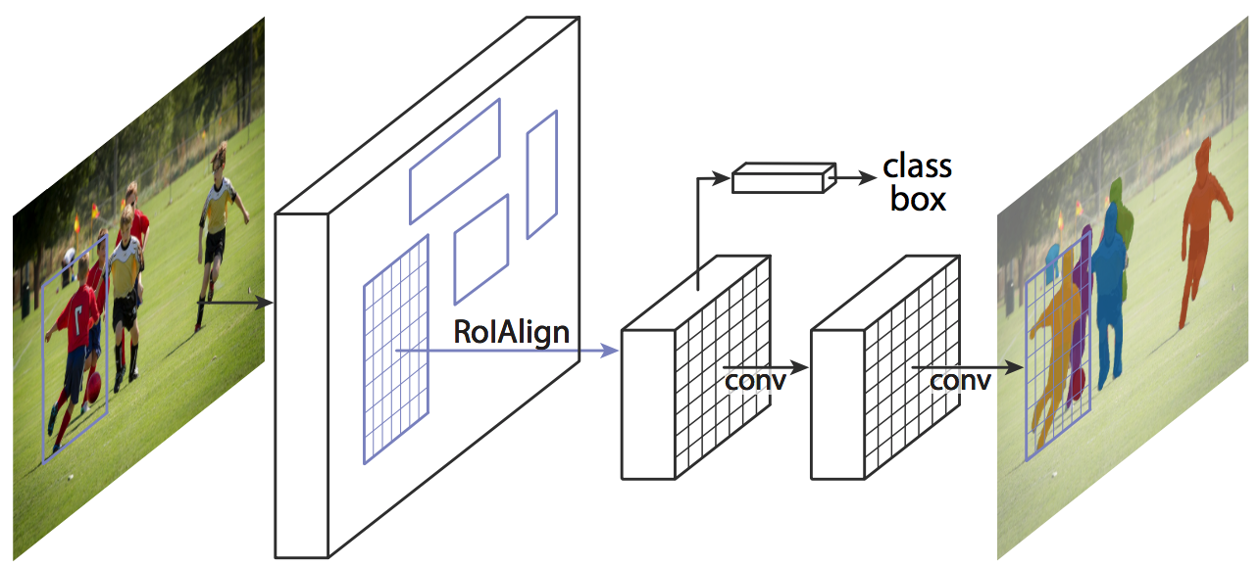
Autonomous Vehicle Group
SoECE
This is a normal and basic R-CNN approach where there is more number of region of interest. In this, there is no guarantee that the selected region has the object or not
Here in this mask R-CNN the RoI is selected in such a way that it has the object in it. Thus reducing the computational time.

Slide 12
Autonomous Vehicle Group
SoECE
Identification of multiple solution and selecting best suited solution:
There are 3 categories of segmentation to overcome the challenge:
Semantic ,panoptic and instance segmentation.
In semantic segmentation, there is no specific classification for objects, it categorises group of objects belonging to same class.
But instance segmentation deals with tasks related to countable things .It can detect each object or instance of a class present in an image and assigns it a different mask or bounding box with a unique identifier.
Instance image segmentation allows overlapping of segments whereas in panoptic it is not possible.

Slide 13
Autonomous Vehicle Group
SoECE
Literature Survey: Based on the research papers referred
Sl.No | Title: | Authors: | Summary:
1. | Instance Segmentation Technique: A Taxonomy | Abdul Mueed Hafiz & Ghulam Mohiuddin Bhat | •RCNN model involves computing class agnostic region proposals obtained using selective search and then model fine-tuning is done which consists of using the region proposals for fine-tuning a pre-trained CNN model like AlexNet.A set of class-specific Support Vector Machine (SVM) classifiers is trained on features extracted from the CNN which replace the softmax classifier learned by fine-tuning. •MultiPath Network technique has been done to the standard Fast R-CNN model. •Non-local neural networks are a filtering technique that computes a weighted mean of all pixels in an image

Slide 14
Autonomous Vehicle Group
SoECE
Sl.No | Title: | Authors: | Summary:
2. | Artificial Neural Network (ANN) based image segmentation | Wencang Zhao,Lijun Zhang,Shohel Ali Ahmed | •Image segmentation calculation based on textural features and Neural Network to isolate the focused Images from the foundation. •Neural network-based image segmentation system for color images. Wavelet decomposition is performed to remove noise. Image is taken and pre-preparing is performed and then highlight extraction is performed through ANN classifier which is utilized for surface grouping.

Slide 15
Autonomous Vehicle Group
SoECE
Sl.No | Title: | Authors: | Summary:
3. | Threshold based image segmentation. | Shiping Zhu,Anping XU,Wu Kaihua & Ban Tau,Frank Jiang | •Threshold based edge detection and image segmentation algorithm. They calculate the threshold of each pixel in the image on the basis of its neighboring pixels and also the edges of image with the help of proposed algorithm. •Threshold-based level set approach comprising both threshold-based segmentation and Fast Marching Method (FMM) for medical image segmentation. The result of the denoising filter is passed to FMM for segmentation purposes with the help of the threshold-based level set technique. •Optimal threshold segmentation method based on entropy criteria and Genetic algorithm in order to improve the image acquisition process in computer vision.

Slide 16
Autonomous Vehicle Group
SoECE
Sl.No | Title: | Authors: | Summary:
4. | Region based image segmentation | D. Barbosa ,Group Chen ,Zhen Hua, Yewei Li and Tiancan Mei. | It is a system that joins the edge and locale-based data with an unearthly strategy utilizing Morphological Watershed calculations. Enhanced visual consideration and district developing methodology in which the dim portions and edges of the image are removed utilizing the Gabor channel and Guass-Laplace channels and an artificial neural network is used to extract the interesting region of the image. Supervised image segmentation method, i.e., Region-based Multi-scale segmentation method in which natural scene images are used as a dataset. Image segmentation based on the LEAST SQUARE strategy is a weight grid for an area-based strategy that additionally considers the local data and furthermore the utilization of the Least Square technique gives ideal and quick segmentation.

Slide 17
Autonomous Vehicle Group
SoECE
References:
Sl.No: | Links:
1. | https://www.v7labs.com/blog/instance-segmentation-guide.
2. | https://www.academia.edu/67178485/Image_Segmentation_Techniques_with_Machine_Learning?show_app_store_popup=true
3. | https://nanonets.com/blog/machine-learning-image-processing/
4. | https://analyticsindiamag.com/semantic-vs-instance-vs-panoptic-which-image-segmentation-technique-to-choose/
5. | https://towardsdatascience.com/image-segmentation-part-1-9f3db1ac1c50#161f
6. | https://youtu.be/qej73NGDQfohttps://www.analyticsvidhya.com/blog/2019/07/computer-vision-implementing-mask-r-cnn-image-segmentation/

