Slide 1

Banking Analytics Project
Team 12
Undersupervised :
Eng . Ahmed Ali
Eng . Ahmed Hafez

Slide 2
Team Member
Ahmed Walid
Sohila Walid
Mohamed Radi
Youssef Abdelnasser
Mennatallah Eid
Omar Fawzy
Marwa Shabaan
Reham Fathy
Aya Mahmoud
Ahmed Aly

Slide 3
Introduction!

Slide 4
With the rapid evolution of the banking sector, data analytics has become key to improving customer experience and service quality.
In this project, we analyzed 10 years of banking data to:
Identify key issues and inefficiencies.
Understand customer and transaction trends.
Provide data-driven solutions to enhance services.
Our goal is to turn insights into action, helping banks deliver smarter and more personalized services.

Slide 5
Agenda
01
insights
02
problems
03
steps
04
reports
05
Action plan

Slide 6
Insights!

Slide 7
Customers
. 36.5% of customers do not have accounts.
. 63% are at high churn risk.
. Sharp decline in new customers from Dec 2024 to Nov 2025.
. Only 36.6% of customers have been active in the past 6 months.
Bank Accounts
. 2,710 dormant accounts.
. Business accounts hold the highest total balance. .
. Highest balances are in accounts aged 2 to 10 years.

Slide 8
Customer Support:
. Only 49.3% of issues are resolved.
. Average of 4 calls per customer — high support load.
. Top issues: Transaction disputes, account access, card issues, loan inquiries.
Loans
. 2,500 loans totaling 82.4M.
. Balanced distribution across loan types.
. Highest interest rate is for personal loans.

Slide 9
Transactions
. 20K transactions totaling 100.11M.
. Even distribution between payments, transfers, deposits, and withdrawals.
. Gradual monthly decline in transaction volume from Oct to Apr
Cards
. 4,000 cards issued, only 2,745 actively used.
. Major drop in card issuance from 2022 to 2025.
. Equal distribution between credit, debit, and prepaid cards.

Slide 10
Challenges
are obstacles or difficulties that arise during a project or analysis, which can hinder progress, accuracy, or the ability to reach desired outcomes.

Slide 11
challengs
Increase Customer Retention
Activate Dormant Accounts
* High churn risk (63% of customers).
* Decline in customer acquisition over time.
* Low recent activity (only \~36% active).
* Over 2,700 dormant accounts.
* Many customers have no recent transactions.

Slide 12
challengs
Improve Customer Support
Grow Card and Transaction Usage
* Over 50% of support issues are unresolved.
* High support load (4 calls/customer avg).
* Drop in card issuance year-over-year.
* Significant portion of cards unused (\~32%).
* Decline in monthly transaction volume.

Slide 13
challengs
Optimize Lending
* Loan interest rates are similar — no incentive differences.
* Slight downward trend in loans issued over time.

Slide 14
Technical
Steps

Slide 15
Technical Steps
Set Up the Environment
Connect SQL Server to Power BI
Data Cleaning & EDA
SQL Development

Slide 16
Technical Steps
Data Modeling in Power BI
AI-Enhanced Insights
Data Visualization

Slide 17
1 . Set Up the Environment
- Create an Azure account.
- Set up a SQL Server database on Azure.
- Upload the banking dataset to the Azure SQL database.

Slide 18
2. Data Cleaning & EDA (Exploratory Data Analysis)
Use Python (Pandas, Matplotlib, Seaborn) to clean the dataset.
Perform EDA to understand patterns, detect anomalies, and prepare for modeling.

Slide 19

3. SQL Development – Business Logic Layer
Create SQL Views to answer specific business questions and extract insights.
Use aggregations, filters, and conditional logic to prepare clean query layers.

Slide 20
4. Connect SQL Server to Power BI
Use DirectQuery to connect Power BI directly to the SQL Views.
Ensure real-time data updates and avoid importing large datasets.

Slide 21
5. Data Modeling in Power BI
Build relationships between tables/views.
Create a well-structured star or snowflake schema for efficient querying.

Slide 22
6. AI-Enhanced Insights with Power BI
Integrate insights from Pandas Profiling and Safari into your Power BI story.
Add AI visuals and smart narratives (Power BI’s Smart Insights).
Use AI-generated tags for churn risk, segmentation, or behavioral clustering as slicers or dimensions.

Slide 23
7. Data Visualization & Insight Discovery
Design dashboards using cards, bar charts, funnel charts, pie charts, and line charts.
Highlight key findings like customer behavior, risk levels, and financial performance.
Add slicers and filters for interactivity.

Slide 24
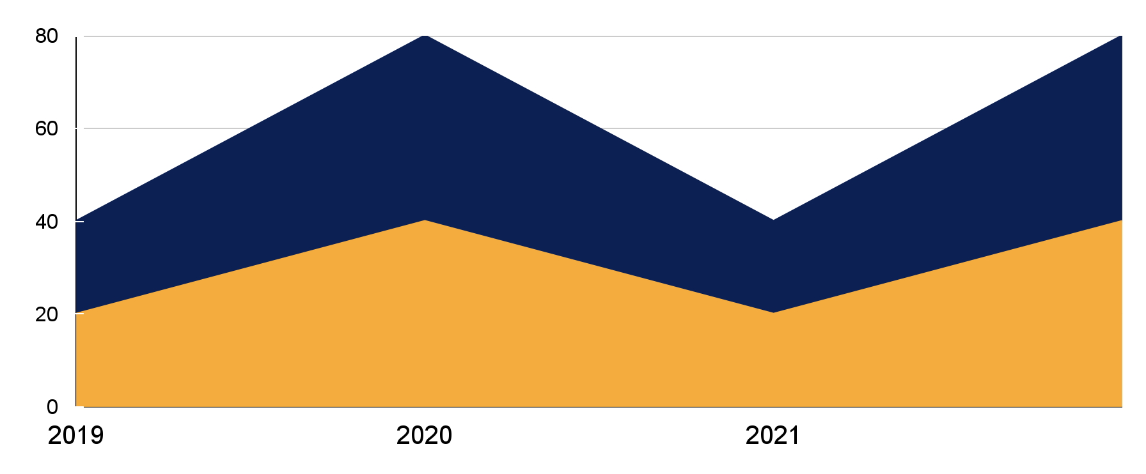
Reports

Slide 25
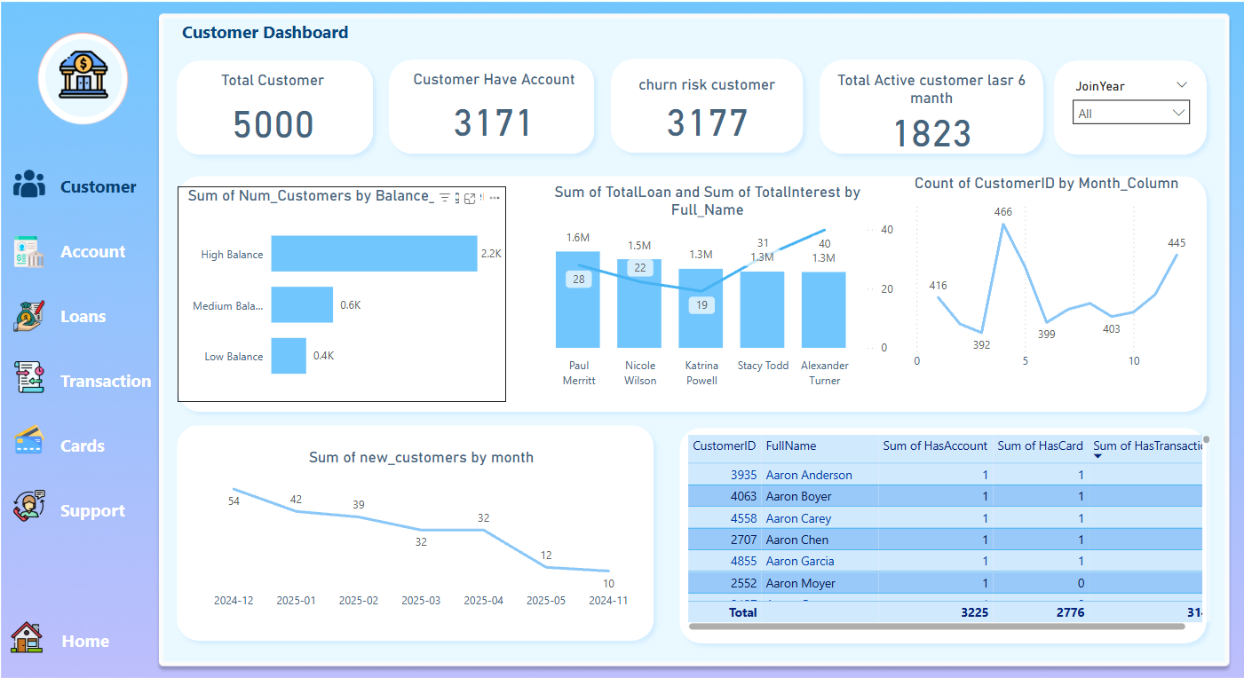

Slide 26
Customer Overview
Total Customers: 5,000
Customers with Accounts: 3,171
Churn Risk Customers: 3,168
Active Customers in the Last 6 Months: 1,832
Balance Segmentation
Total High Balance: 2,248
Medium Balance: 648
Low Balance: 564
Insight :
High churn risk indicates a need for retention strategies

Slide 27
Customer Trends
New Customers per Month: Decline from 132 to 9
Customer Activity Trend: Peak activity in April; low mid-year, recovery in final months
Top Customers by Loan & Interest: Hala, Youssef, Ahmed lead in loan value and interest earned
Insight :
Acquisition is slowing. Focus on marketing and engagement

Slide 28
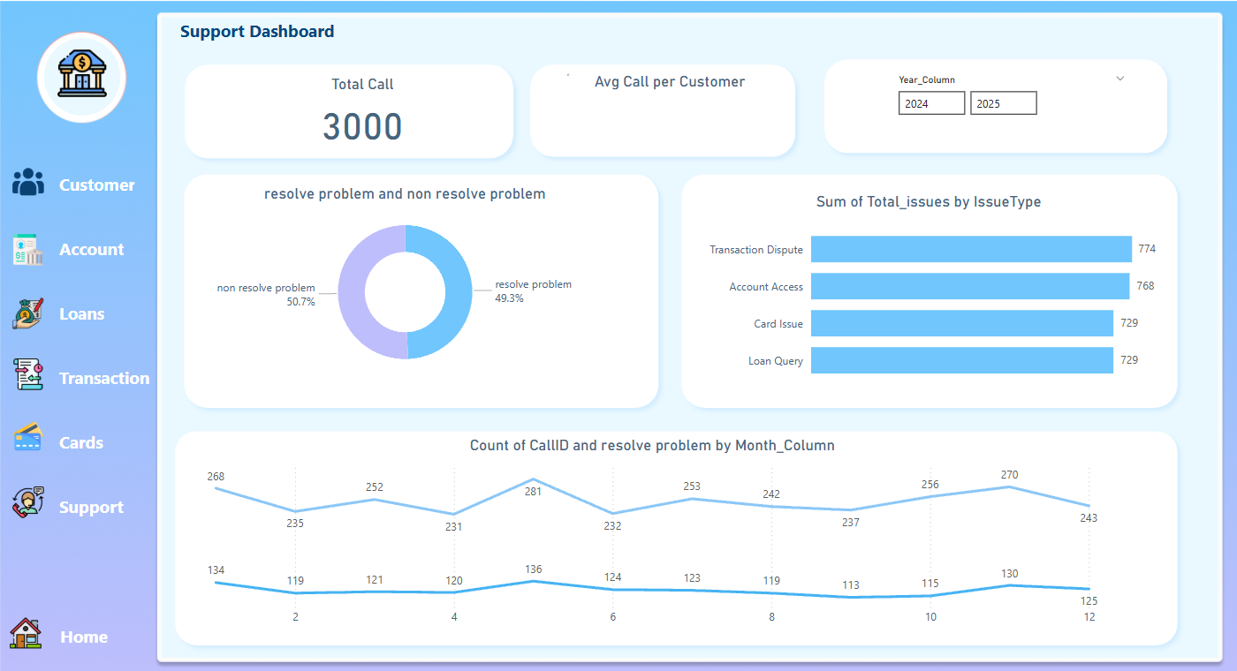

Slide 29
Support Performance
Total Support Calls: 3,000
Average Calls per Customer: 4
Issue Types
Transaction Dispute, Account Access, Card Issues, User Delay (Each with \~720 cases)
Resolution Rate
Resolved: 48.83%
Unresolved: 51.17%
Insight :
Over half of support issues are not resolved—improvements needed in service.

Slide 30
Support Trends
Resolved Issues by Month: Peaks mid-year
Call Volume Trends: Fluctuating activity, high around months 4–6
Issue Resolution by Month: Shows variation, requiring consistent service quality
Insight :
Optimize support staff allocation and training.

Slide 31
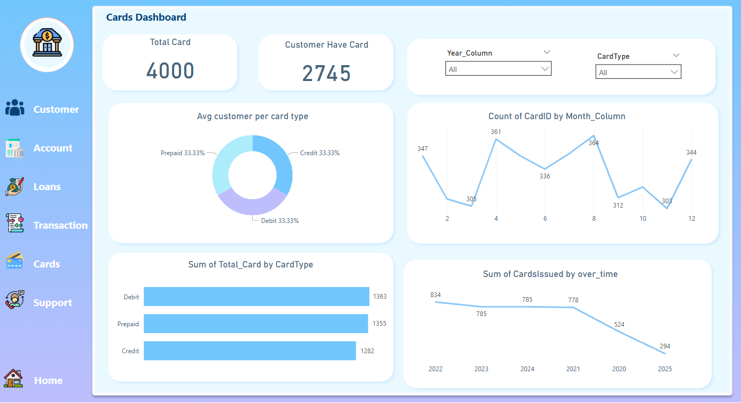

Slide 32
Cards
Total Cards Issued: 4,000
Customers with Cards: 2,745
Card Types
Prepaid: 33.33%
Credit: 33.33%
Others: 33.33%
Trends
High card issuance in months 2, 6, 12
Overall decline in cards issued since 2021
Insight :
Consider revitalizing card offers or marketing strategies

Slide 33
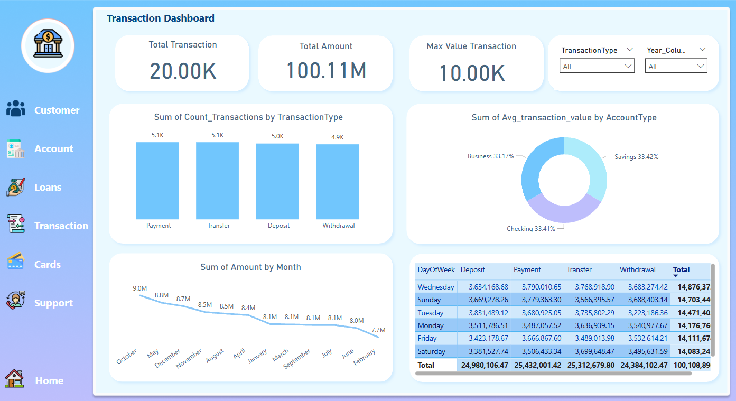

Slide 34
Transactions Overview
Total Transactions: 20,000
Total Amount: 100.11M
Max Transaction: 10K
Transaction Types
Payment, Transfer, Deposit, Withdrawal (each \~5K)
Account Type Usage
Checking: 71.43% of total average value
Savings: 15.45%
Business: 13.11%
Insight :
Checking accounts dominate usage—explore cross-selling savings/business products.

Slide 35
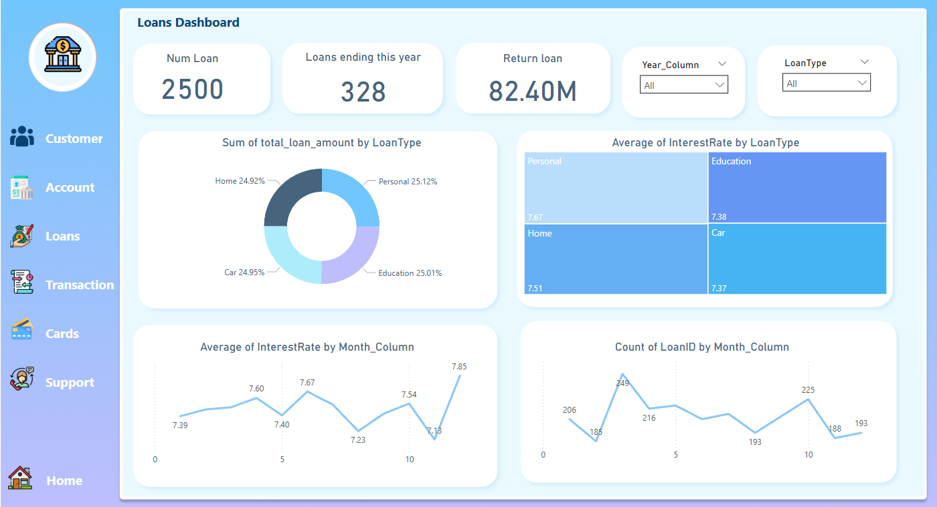

Slide 36
Loans
Total Loans: 2,500
Loans Ending This Year: 328
Loan Returns: 82.4M
Loan Types by Amount:
Home, Car, Education, Personal
Interest Rates:
Education: Highest (7.26%)
Car: Lowest (2.87%)
Insight :
Optimize offers and rates based on loan type performance.

Slide 37
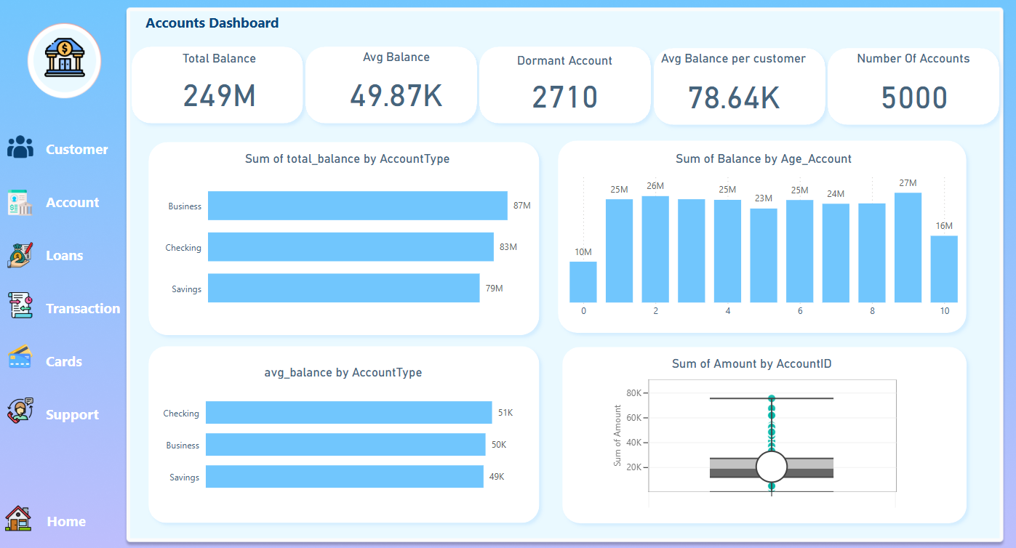

Slide 38
Accounts Overview
Total Balance: 249M
Average Balance: 49.87K
Dormant Accounts: 2,710
Avg Balance per Customer: 78.64K
Balances by Account Type:
Business: 87M
Checking: 82M
Savings: 76M
Insight :
High number of dormant accounts indicates low engagement—consider reactivation campaigns.

Slide 39
Action Plan

Slide 40
Action plan
Customer Retention
Improve Loan Performance
Enhance Support Quality
Activate Dormant Accounts
Boost Card & Transaction Engagement

Slide 41
Enhance Support Quality:*
Hire or train more support agents
* Implement chatbots for common queries.
* Track resolution time and satisfaction metrics.

Slide 42
Customer Retention
Launch loyalty programs targeting high-value customers
Use surveys or support data to identify and address churn causes
Target inactive customers with personalized email/SMS campaigns

Slide 43
Activate Dormant Accounts
Send automated reminders to dormant users
Offer small incentives or fee waivers for reactivation

Slide 44
*Boost Card & Transaction Engagement
Introduce card usage rewards (cashback, points)
* Run educational campaigns for digital transaction ease and benefits.
Review and simplify transaction processes

Slide 45
*Improve Loan Performance
Offer interest discounts for on-time repayments or new borrowers.
Introduce loan calculators and simulators to aid decisions
Market personal/education loans based on customer profiles

Slide 46
Any Question?
Thank You

