Slide 1

Redux
A predictable state container for JavaScript apps

Slide 2
What is Redux ?
State Container
Single source of truth
Read-Only states
Pure functions

Slide 3
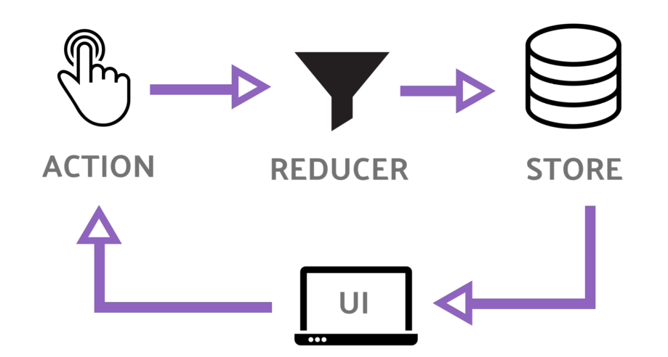
What is Redux ?
State Container
Single source of truth
Read-Only states
Pure functions

Slide 4
Why Redux ?
Separation Logic/UI
Scalability
Pure functional
Time traveling debugging
Only 2kb

Slide 5
Let’s see some code !

