Slide 1
SOCIAL MEDIA WEBSITE
Presented By:
Shubh Purwar(191500795)
Sneha Banga (191500813)
Rishabh Garg (191500649)

Slide 2
OUTLINE
About the Project
Objective
Requirements
Snapshots from the website

Slide 3
ABOUT THE PROJECT
Our Full stack project “FOOPERS” is an online website which helps to utilizes the waste food and other daily things from the hotels, common people to the “NGO’s” that ultimately enhance their moto of service to furnish and grow the poor peoples.
We are filling the gap between people who are in need and who want to contribute toward the society.
Users create service-specific profiles for the website or app that are designed and maintained by the social-media organization.

Slide 4
OBJECTIVE
Communication: To develop an instant solution to enable users to seamlessly communicate with each other by sharing images, videos, and exchange their thoughts.
User friendliness: The project should be very easy to use enabling even a novice person to use it

Slide 5
REQUIREMENTS
Software Specification Used:-
Technology Implemented: Front-End Technologies
Languages/Technologies Used: HTML, CSS, JavaScript, Bootstrap
IDE Used: Visual Studio Code
Web Browser: Google Chrome

Slide 6
Hardware Used:
Processor Used: Intel i5/Ryzen 5
Operating System: Windows 10
RAM: 4 GB (minimum)
Hardware Devices: Computer System
Hard Disk: 256 GB

Slide 7
THIS IS HOW OUR WEBSITE LOOKS
Hope you will like it :)

Slide 8
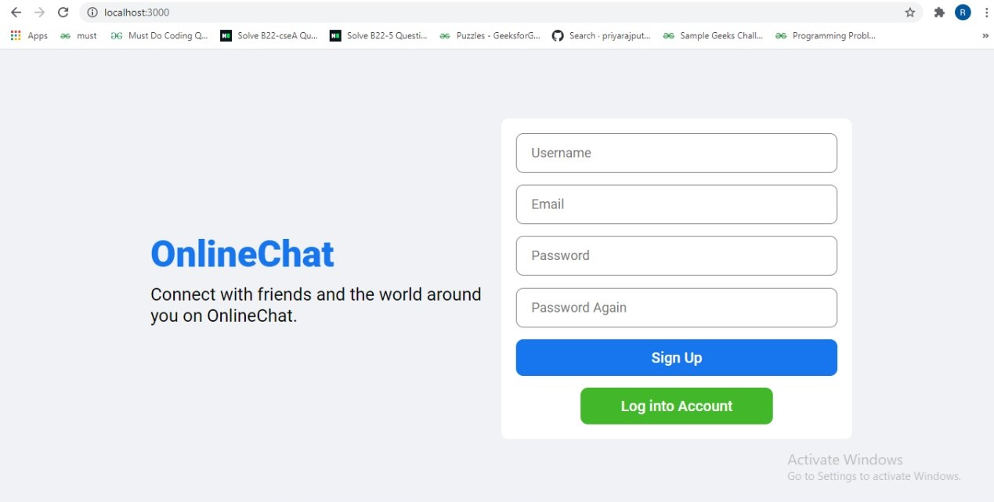
SIGNUP PAGE

Slide 9
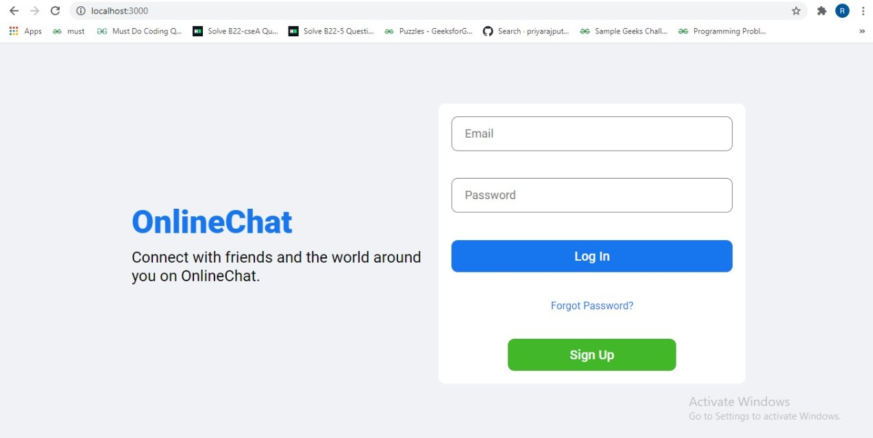
2. LOGIN PAGE

Slide 10
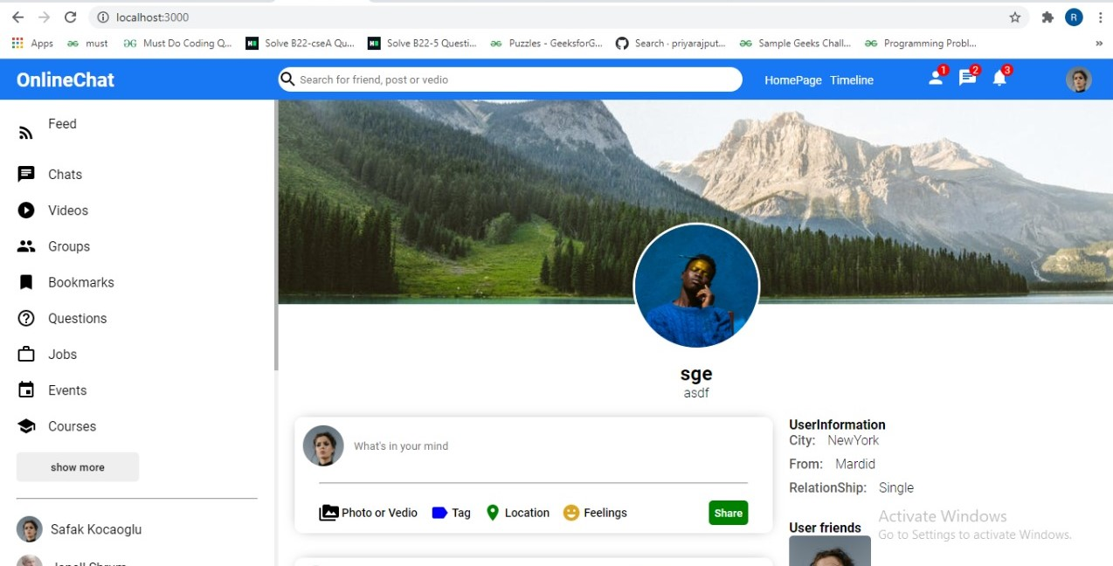
3. HOME SECTION

Slide 11
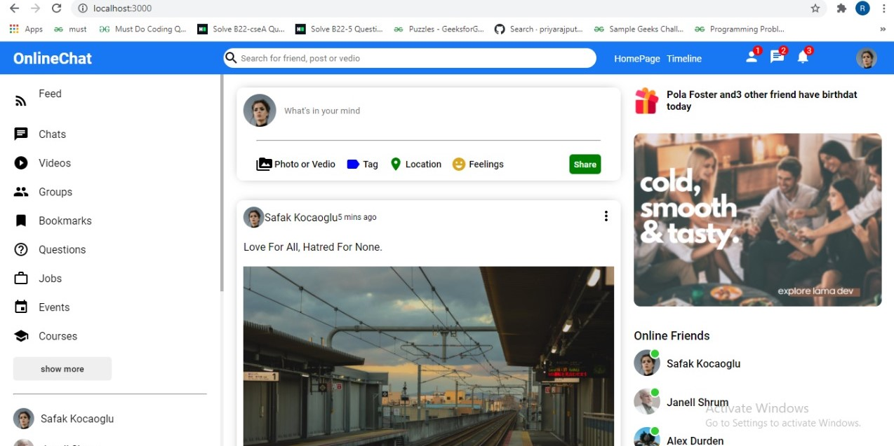
4. CLIENT SECTION

Slide 12
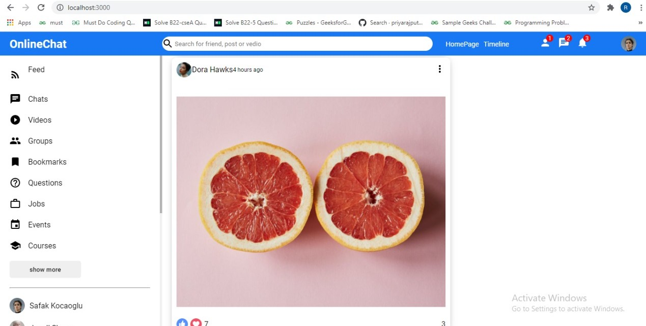
5. SERVICE SECTION

Slide 13
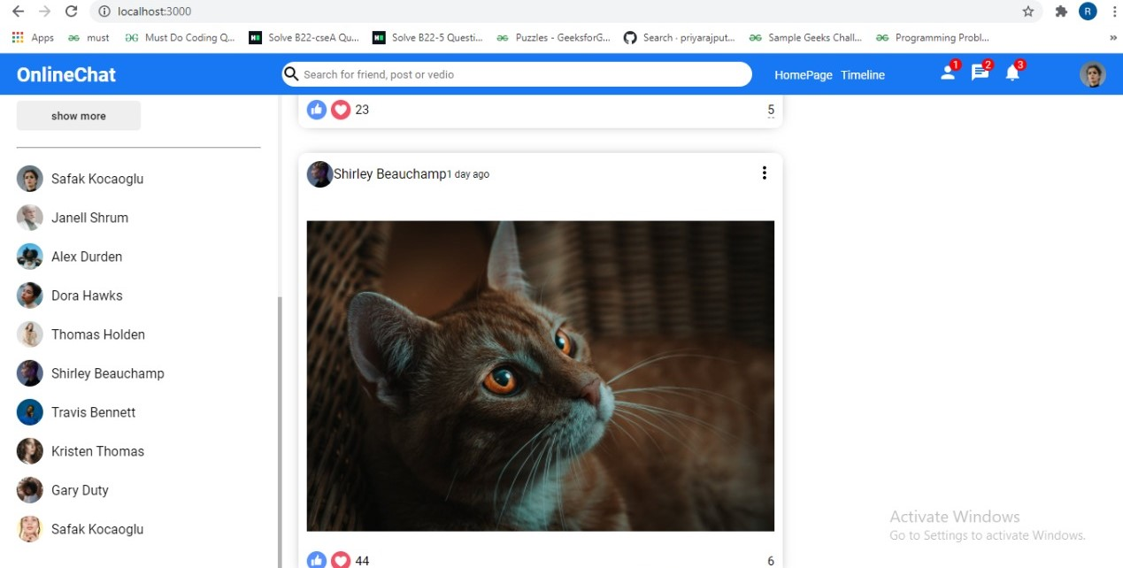
6. SERVICE SECTION

Slide 14
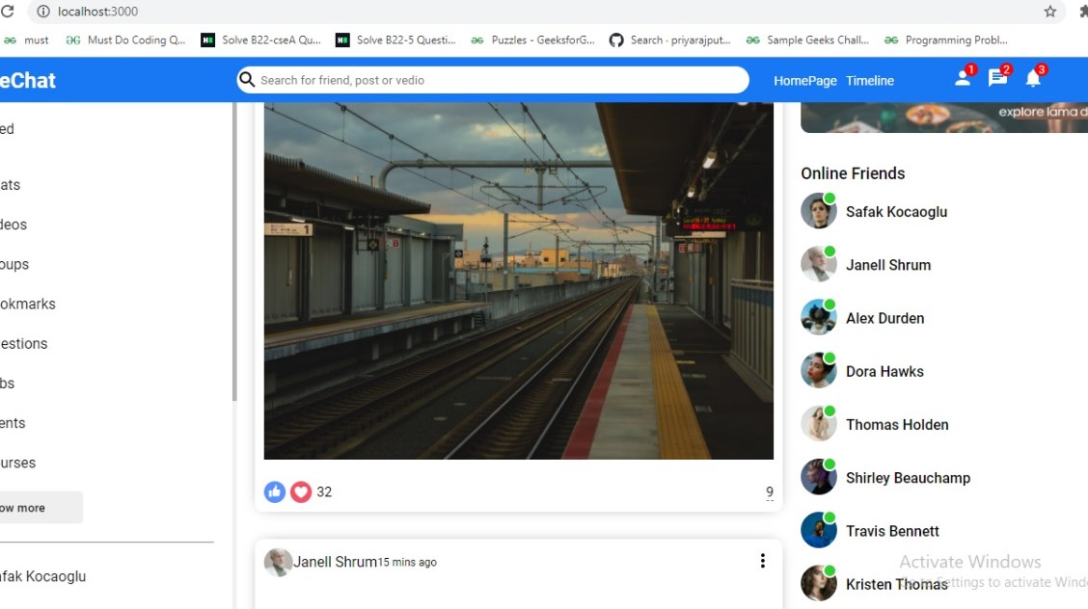
7. PROFILE SECTION OF AN NGO

Slide 15
Thank You!!!

