Slide 1


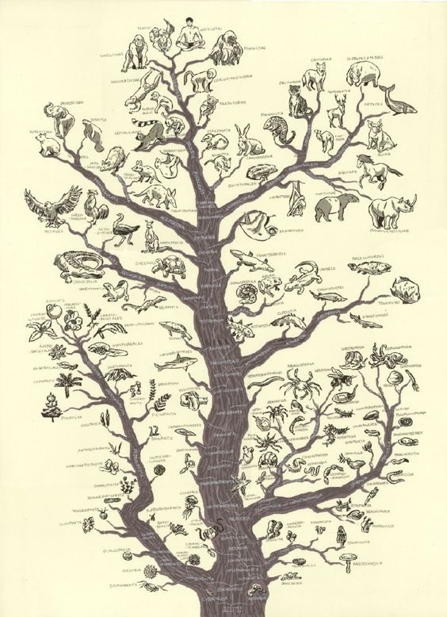
The Reconstruction of Phylogenetic Trees
CSPE43 : ADVANCED DATA STRUCTURES AND ALGORITHMS
106121085 : Nishith Eedula
106121077 : Mercia Melvin Perinchery
CSE A
National Institute of Technology, Tiruchirappalli

Slide 2
Agenda
Introduction
KMACS
Suffix Tree
Distance Matrix
Suffix Array
UPGMA
LCP
Implementation
Induced Sorting
ACS

Slide 3
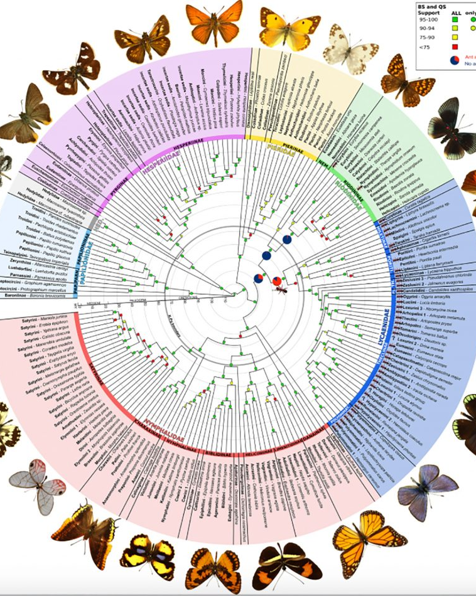
Introduction
A phylogenetic tree (cladogram) is a diagram used to represent the evolutionary relationship among organisms. The trees give hypotheses, not facts.
Two species are said to be more related if they have a more recent common ancestor and less related if they have a less recent common ancestor.
All life on Earth is part of a single phylogenetic tree, showing common ancestry.

Slide 4
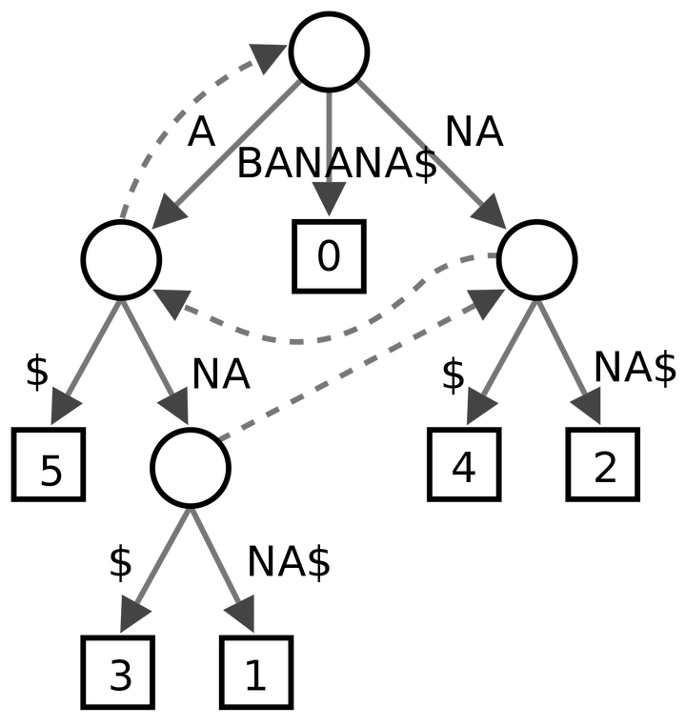
Suffix Tree
A suffix tree is a compressed version of a trie, but unlike a trie, each unique suffix in the list is compressed together and represented by a single node or branch. It is typically used to store a list of strings.
A suffix tree can be constructed from a string in O(N) time.

Slide 5
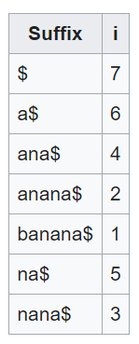
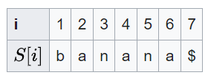
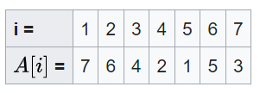
Suffix Array
A suffix array is a sorted array of all the suffixes of a string. It is used in full-text indices, data compression algorithms and bibliometrics.
It is similar to, but the improved version of a suffix tree and is constructed from the suffix tree by DFS traversal.
A suffix tree can be constructed from a string in O(N) time.

Slide 6
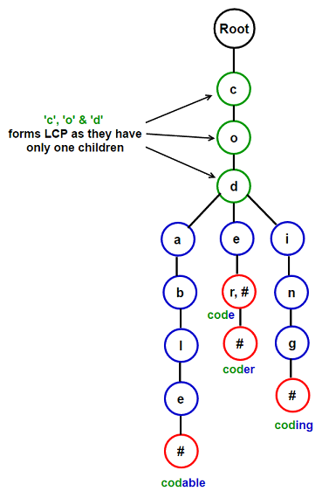
LCP
The Longest Common Prefix or LCP is the longest string S which is the prefix for two dissimilar strings S1 and S2.
Input : {“manoeuvre”, “mandate”, “mango”, “manicure”}
Output : “man”
Input : {“spirit”, “sprout”, “spy”}
Output : “sp”

Slide 7
Induced Sorting
Induced Sorting is an algorithm to construct Suffix Arrays and LCP Arrays in O(N) time.
Induced Sorting defines three types of suffixes :
S , S and S*. Where sets of order S* are first sorted. Then S* is used to induce S while S is used to induce S .
The main logic behind it is to use information about the order of T to induce the order of suffix T = T[i-1]T
-
+
-
-
+
i
i-1
i

Slide 8
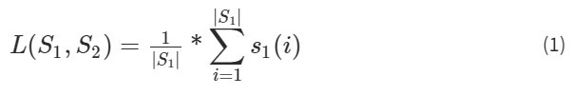


ACS
The Average Common Substring (ACS) approach is one of the most well-known alignment-free approaches.
It calculates for each position i in one sequence the length of the longest substring starting at i and matching some substring of a second sequence.
These lengths are then averaged and normalized to define a similarity measure - (1).
This is turned into a (non-symmetric) distance measure by defining - (2).
To obtain a symmetric distance, the distance between S1 and S2 is then defined by Ulitsky et al. (2006) as - (3).

Slide 9
K-Mismatch ACS (KMACS)
The distance generated using the ACS approach is generalised by using a greedy heuristic of substring matches with k-mismatches instead of exact matches.
Calculate for each position i in S1, the length s1(i) of the longest common substring starting at i matching a substring of S2 , as is done in ACS.
Let j be the start of this matching substring in S2 ; the character S1[i+s(i)] must therefore differ from S2[j+s(i)]
We then extend this match without gaps in S1 from position i+s(i)+1 and in S2 from j+s(i)+1 , until the next mismatch occurs.
This is repeated until the k + 1-th mismatch or the end of one of the two sequences is reached.
For a position i in S1 , the corresponding position j in S2 of the longest exact match to a substring starting at i may not be unique.
Time Complexity - O(N logkN)

Slide 10
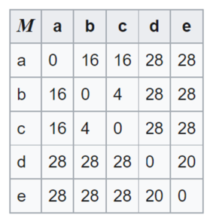
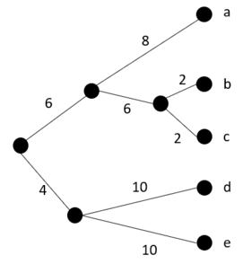
Distance Matrix
A distance matrix is a symmetric matrix generated from phylogenetic data using methods such as KMACS and consists of pairwise distances for all the sets of species in the given data.
The distance matrix can further be converted into a tree using algorithms like UPGMA, Neighbour-Joining etc.

Slide 11
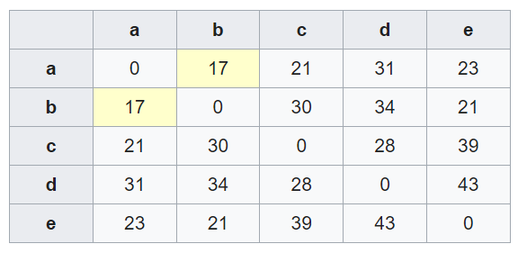
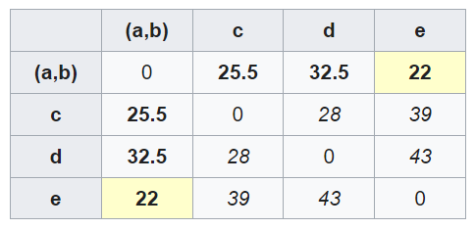
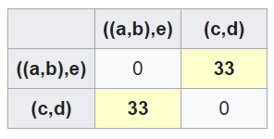
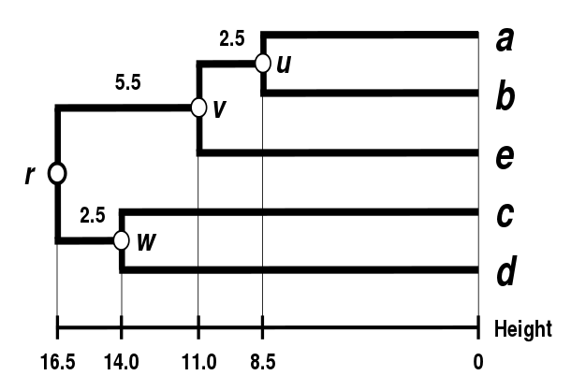
UPGMA
UPGMA stands for Unweighted Pair Group Method with Arithmetic Mean.
It is a ultrametric distance matrix is which models the constant molecular clock. It is used to build a unique, rooted phylogenetic tree
Algorithm
The pair with the smallest distance in the matrix is merged to form a cluster
The cluster forms an interior node positioned halfway between the entries
A new distance matrix is created using the average of the pairs and the procedure is repeated until no pairs remain
Time Complexity - O(N^2 logN)

Slide 12
Implementation
Phase 3
Phase 2
The UPGMA method is implemented in Python to generate a rooted phylogenetic tree from the distance matrix. The BioPython library is used to visualise the graph.
Phase 1
The KMACS method is implemented in C++ to generate a ultrametric distance matrix from the phylogenetic data which also involves the usage of suffix arrays and LCP arrays.
Phylogenetic data is parsed from the FASTA file format to a program-readable format.

Slide 13
Thank you!

