Slide 1
Game Concept
Presentation #1
CSCE-552-001
Due: 15th September 2017
Team “BOTS”
Abbi Reisig
M. Brady O’Leary
A. Danielle Talley

Slide 2
Team “BOTS”
Abbi Reisig
M. Brady O’Leary
A. Danielle Talley

Slide 3
Mission Statement
The goal of this game is to create a networked multiplayer 3D game in Unity that is a blend of PvP and PvE, whose level is procedurally generated, and that empowers the players based on strategic, cooperative gameplay.

Slide 4
High Concept
Rivaling teams are thrown into unknown territory to collect resources in order to build components and parts to create massive siege machines, robots, and powerful equipment in order to claim the enemy’s home land.

Slide 5
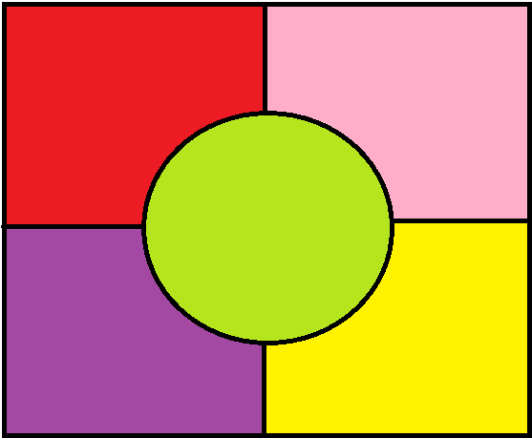
Level Design
Four regions (one for each corner) randomly selected:
Mountains
Forest
Desert
Swamp
Coast
The center is open grassland
“No man’s land”
The configuration of the map and each region will be generated each match
Resources and enemies will be region specific
Excluding generic (common) resources that might appear in multiple regions at varying percentages (wood, rocks, etc.)

Slide 6
Decision Tree
Pre-Game
Team Composition
Character Selection
Early Game
Abilities
Components
Personal Goal
Regions
Resources
Enemy Composition
Late Game
Team Objective

Slide 7
Networking
One player will host the game (act as a server), other players will act as clients
Computer-Controlled Players (AI), Field Layout, and Items on the field will be controlled by the server
Clients will only control their player and view the Game around them
If in a single-player mode, Client and server will run on the same computer, and all other players will be controlled by AI

Slide 8
Audio Design
During the Battle Sequences, the focus will be on gameplay
Sound Effects will be louder, music will be in the background
Battlefields are usually noisy with the sound effects
Music will be more minimal and syncopated, but can swell when the player is close to an enemy or the match is about over or during other tense moments

Slide 9
Timeline
Phase | Due | Interval | Objective
Phase 1 | 15th September 2017 | 1 week | Preliminary Design
Phase 2 | 22nd September 2017 | 1 week | In-Depth Design
Phase 3 | 20th October 2017 | 4 weeks | Core Functionality
Phase 4 | 10th November 2017 | 2 weeks | Required Modeling
Phase 5 | 24th November 2017 | 2 weeks | User Interfaces
Phase 6 | 8th December 2017 | 2 weeks | Refine

