Slide 1

AGRI KHETI

Slide 2
OBJECTIVE
Our Aim is to establish an e-bidding interactive sms system , that is easily available and accessible by the least literate farmers.

Slide 3
Features
Intermediate between the farmer and wholesaler.
Bidding platform for the wholesaler on the website.
Sms platform for the farmer for receiving all the information.

Slide 4




Whom we are focusing on:
Illiterate farmers who don’t have the smart phones.
Farmers who can not access the websites.
Farmers who have the featured phone.
No necessary for using website for illitetrate .

Slide 5
Problems a farmer face
Middle man commisions.
Lack of knowledge.

Slide 6
Security features
My SQL is not used so hacking attacks are not possible easily.

Slide 7
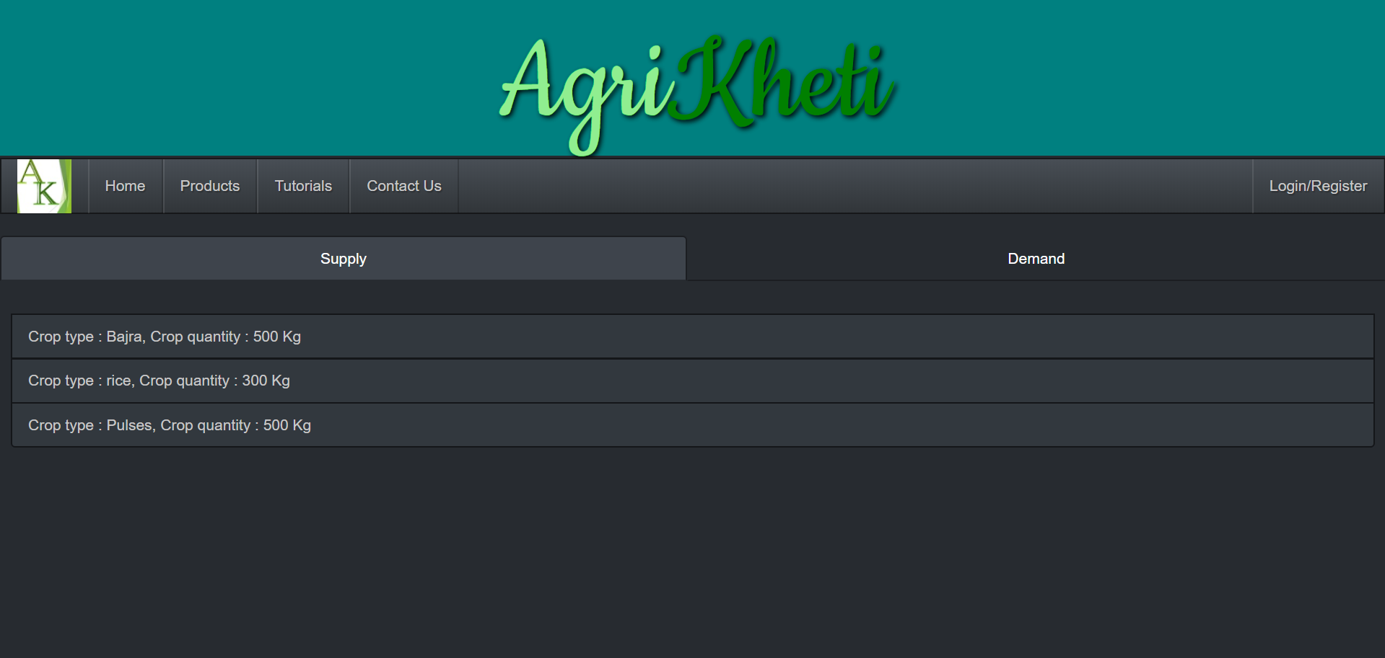
HOME PAGE

Slide 8
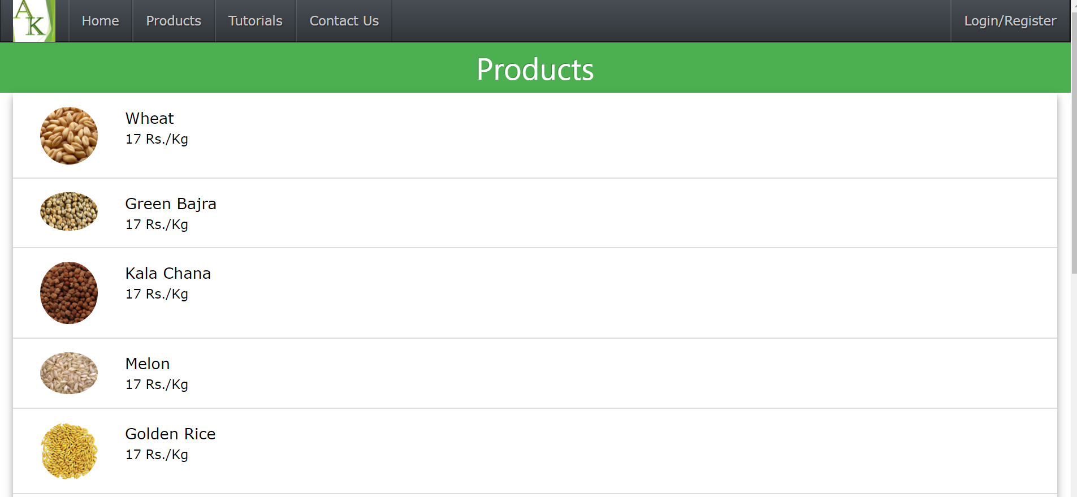
PRODUCTS

Slide 9
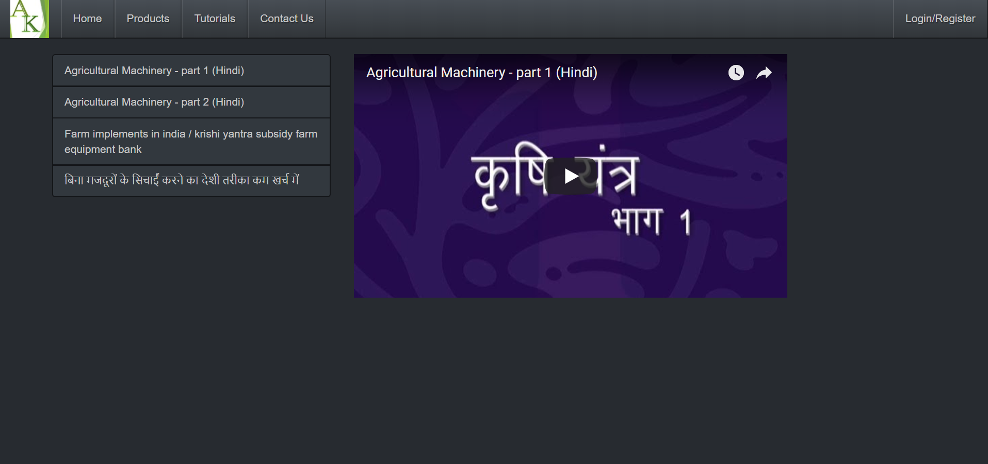
VIDEO TUTORIALS

Slide 10
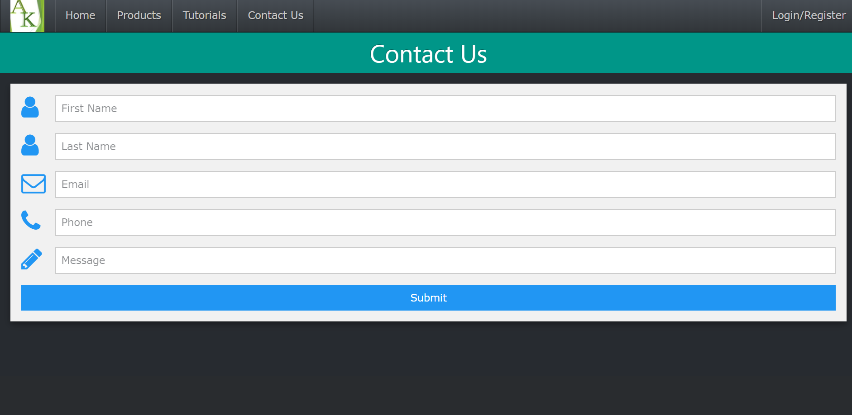
CONTACT US

Slide 11
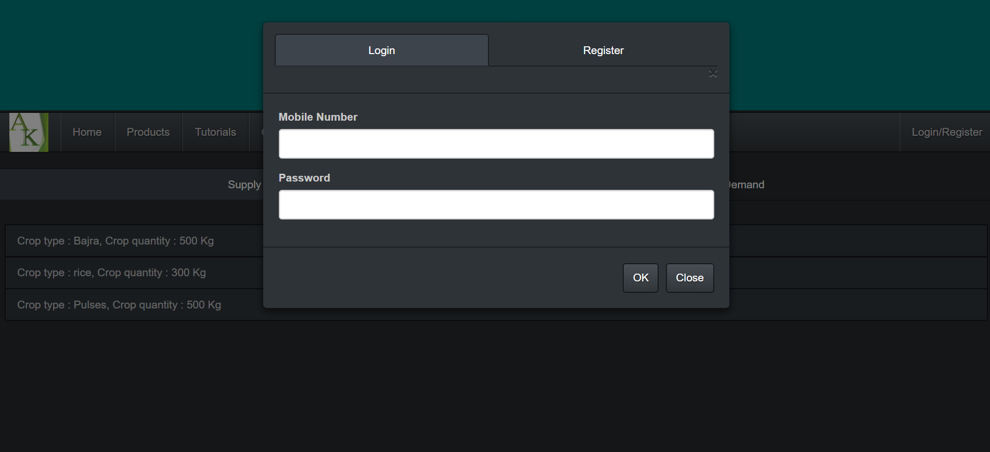
LOGIN :

Slide 12
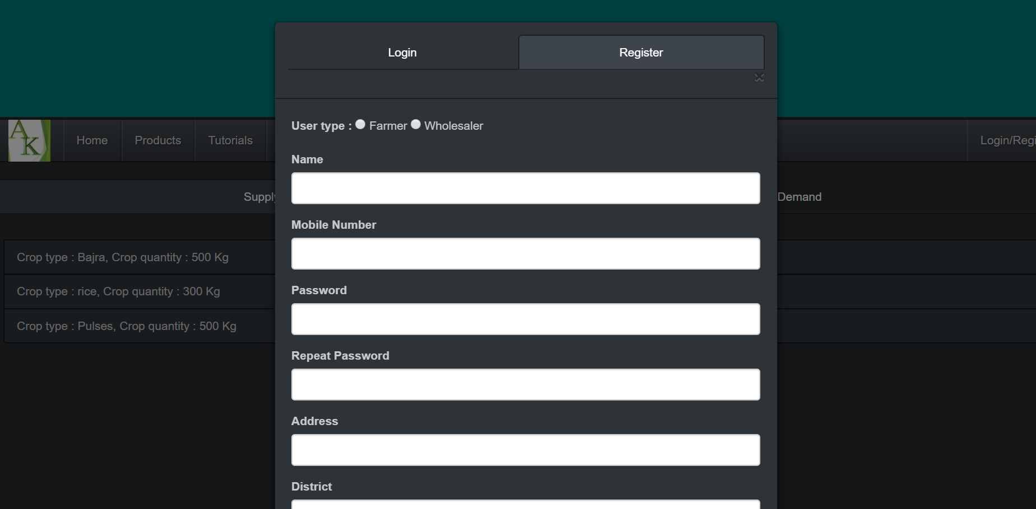
REGISTRATION FORM

Slide 13
REQUIREMENTS
Node JS
Mongo DB

