Slide 1
Data Visualization & Time Series Analysis
Submitted by
Sharma Nikki

Slide 2

What measures can be taken to control gun violence in Miami Dade county based on time and location ?

Slide 3
Table of Content
Introduction
Data Analysis
Data Forecast
Prescriptive analysis
Q&A

Slide 4
Data Source
Gun Violence Archive
Kaggle
Dataset Usage
The data used is 5 years data from 2013 -2018
The dataset consists of 1379 records of incidents reported for Miami Dade county
Data is exported in csv format and is unstructured data
The data has various categorial values
Variables used
Independent Variable - date, month , year
Dependent Variable – incident id ,no of killed, no of injured, location , incident characteristics

Slide 5
Analysis of Incidents - based on time

Slide 6
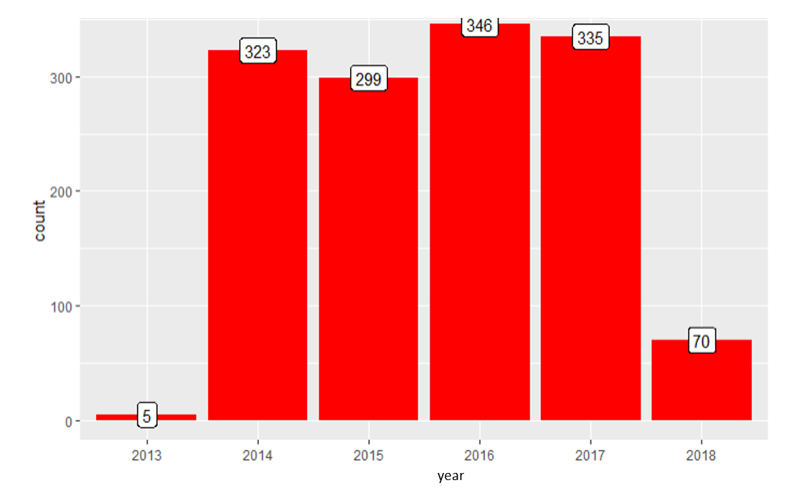
INCIDENT COUNT BY YEAR

Slide 7
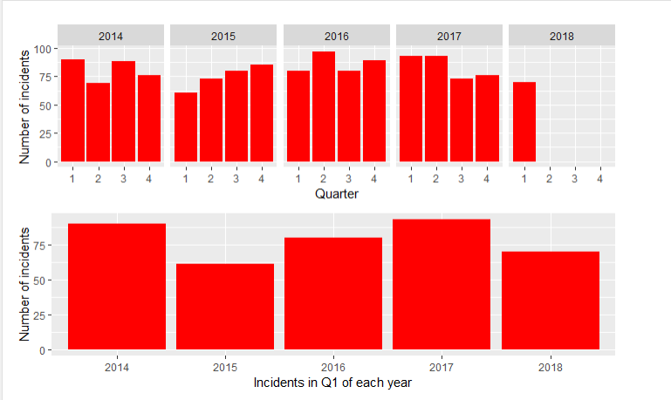
INCIDENT COUNT BY QUARTER

Slide 8
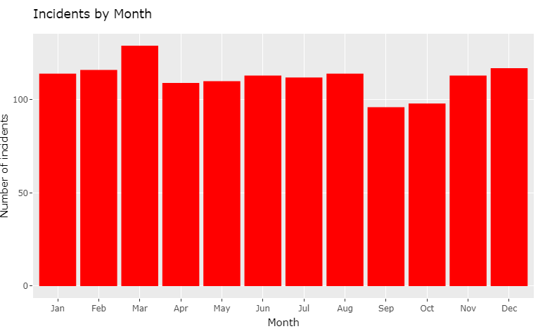
INCIDENT COUNT BY MONTH

Slide 9
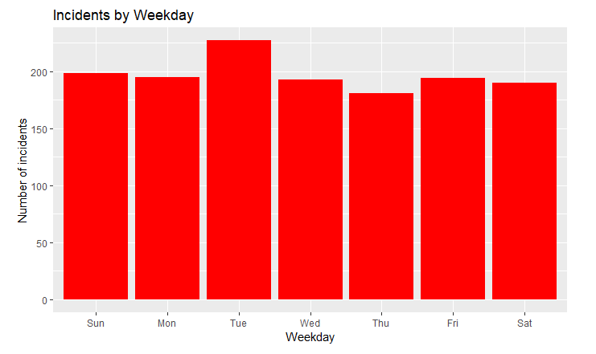
INCIDENT COUNT BY WEEKDAY

Slide 10
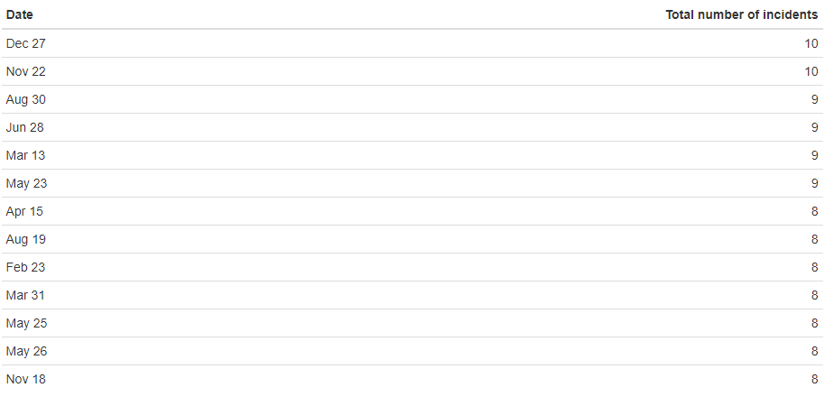
DATES WITH HIGHEST NUMBER OF INCIDENTS BEING REPORTED

Slide 11
Analysis of Incidents reported based on cities

Slide 12
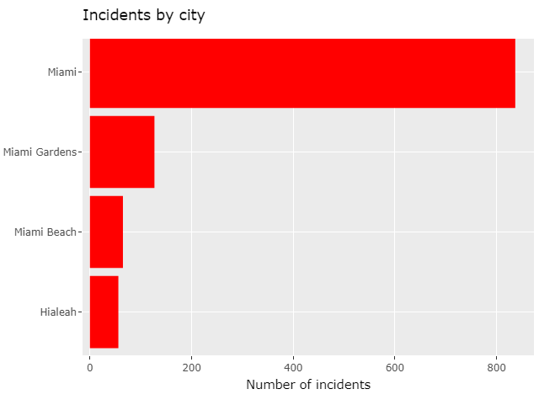
TOP 3 CITIES BY HIGHEST NUMBER OF INCIDENTS REPORTED

Slide 13
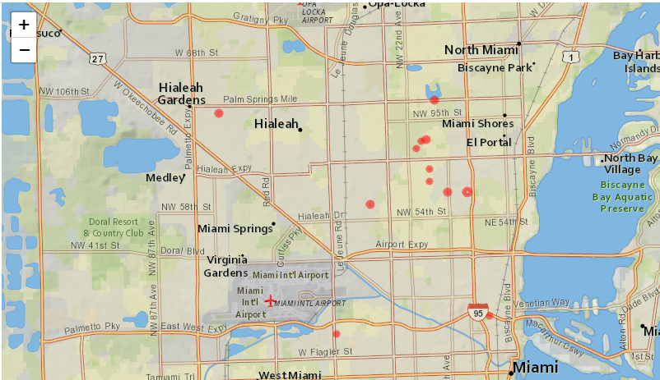
INTERACTIVE MAP – CITIES WITH HIGH INCIDENTS COUNT (TOP 10)

Slide 14
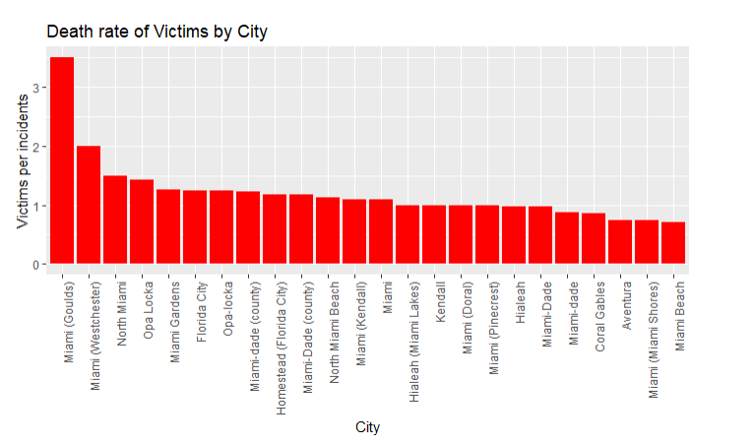
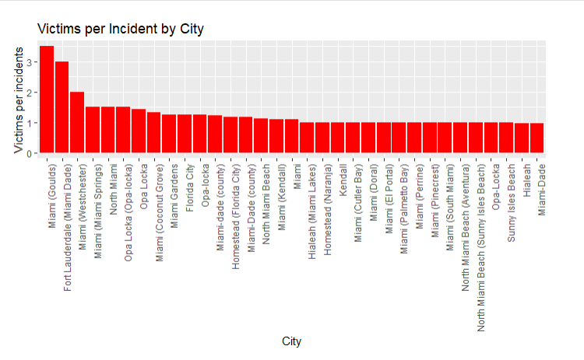
VICTIMS PER INCIDENT
BY CITY
Notes:
vicPerInc=round(sumVic/sumIncidents,2))
PercDeath=round(sumDeath/sumVic,2)

Slide 15
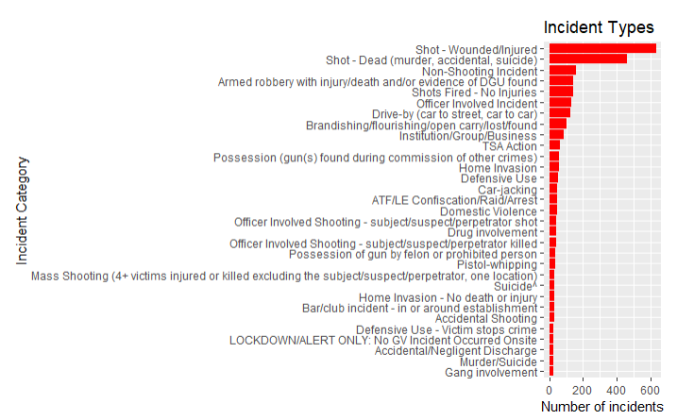
INCIDENT CATEGORY REPORTED

Slide 16
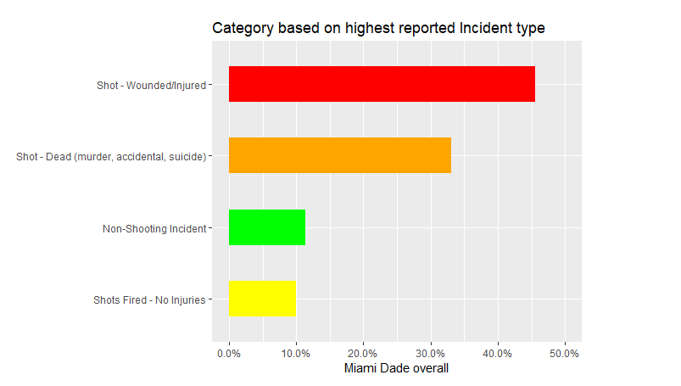
TOP 4 INCIDENT CATEGORY

Slide 17
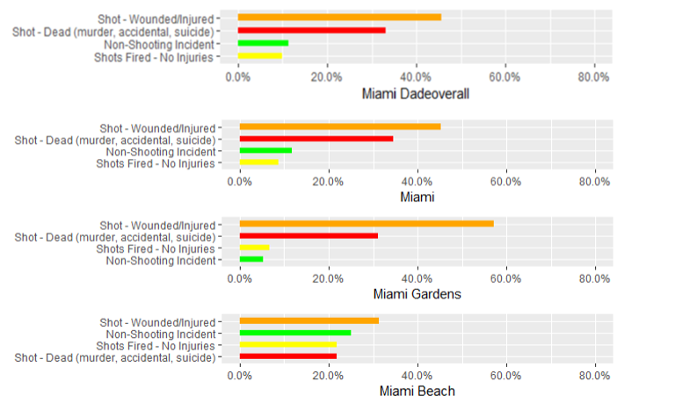
COMPARISON - INCIDENT CATEGORY BY TOP 3 CITIES WITH HIGH INCIDENT REPORT

Slide 18
PREDICTIVE ANALYSIS FORECASTING THE DATA

Slide 19
EXAMINING THE DATA
Decompose the Data
Fitting an ARIMA model

Slide 20
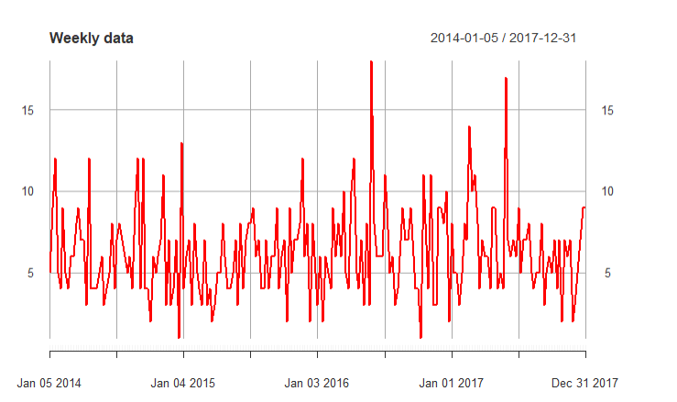
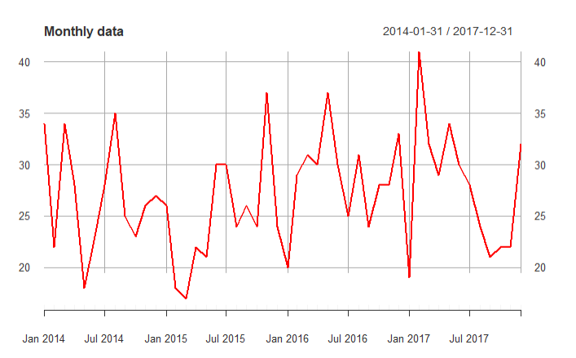
AGGREGATED DATA

Slide 21
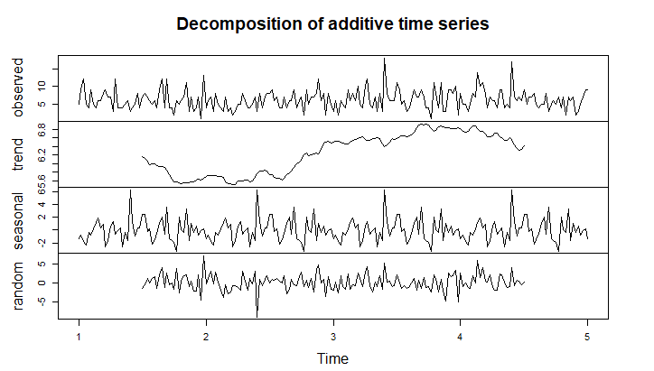
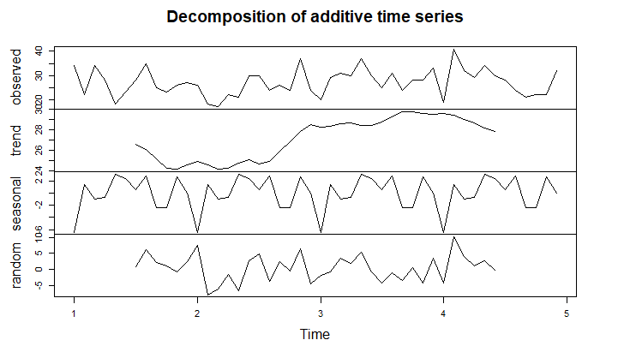
DECOMPOSITON OF DATA
BY WEEK
BY MONTH

Slide 22
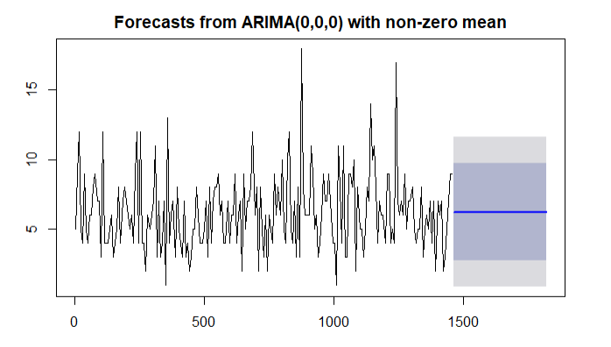
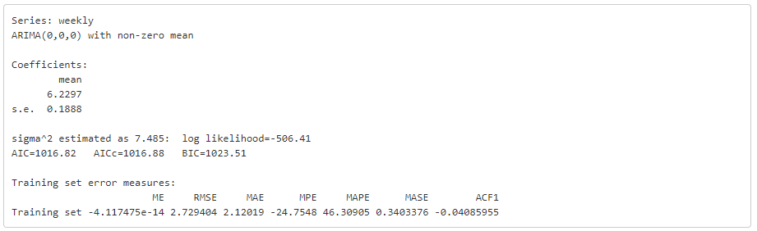
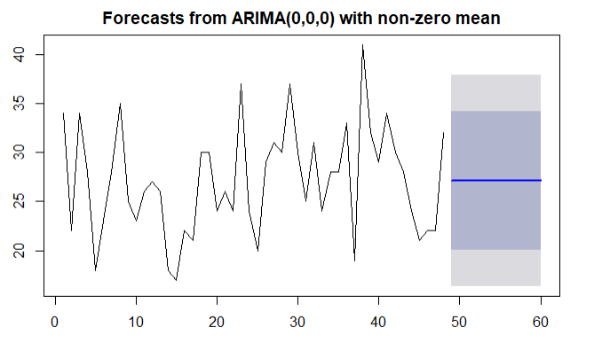
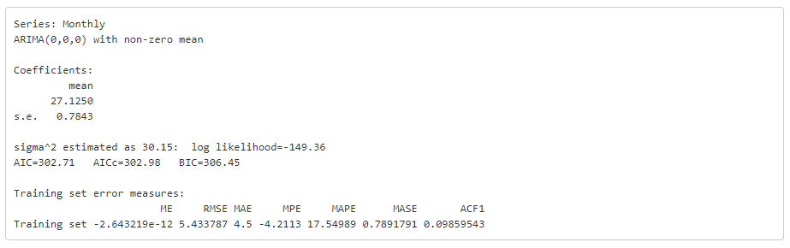
WEEKLY FORECAST
MONTHLY FORECAST

Slide 23
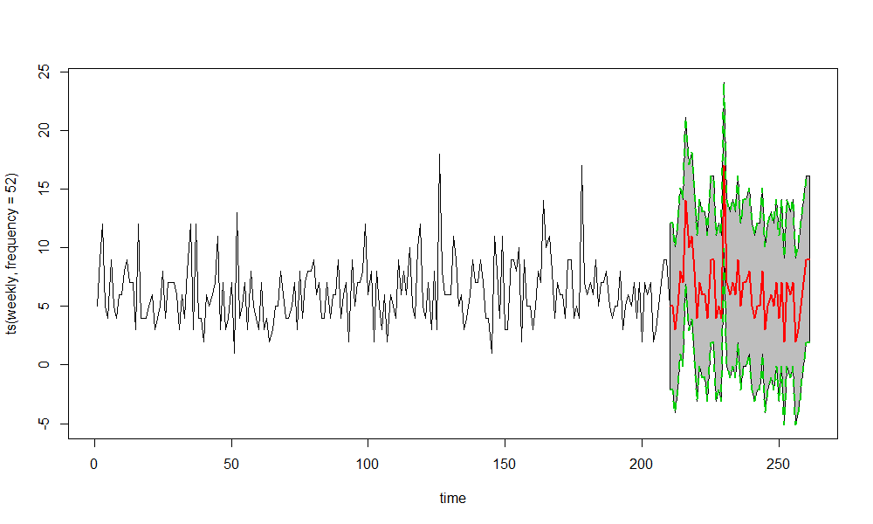
ARIMA WITH SEASONALITY FOR WEEK

Slide 24
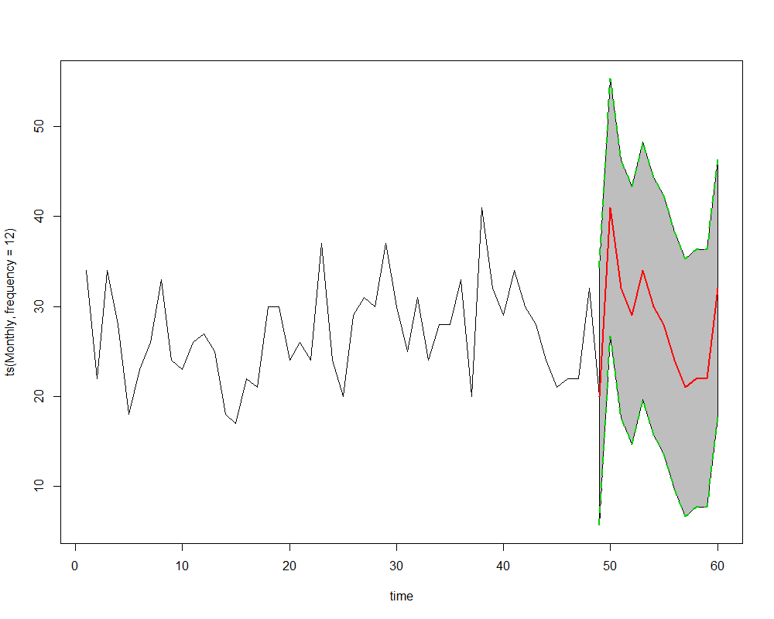
ARIMA WITH SEASONALITY FOR MONTH

Slide 25
PRESCRIPTIVE ANALYSIS

Slide 26
Restrict the gun issuance Law
Invest in smart gun technology
Strengthen the background checks
Reduce firearm access to youth and individuals who are at risk of harming themselves or others
Insist on mandatory training and licensing for owners.
Require safe and secure gun storage
Eliminate funding restrictions on gun violence research
MEASURES TO COTNROL GUN VIOLENCE

Slide 27
Open Requirement :
Identifying the age group and the gender for analyzing which of the group is more involved in crime.
Identifying the type of gun being used for the crime.

Slide 28
THANK YOU

