Slide 1

What measures can be taken to reduce road accidents in the major cities in THE United Kingdom

Slide 2
DATASET & VARIABLES
Dataset
The data source used – UK Department of Transport and the dataset consists of more than 200k records
Data is exported in csv format and is structured data
The data used is from 2005 -2016
Variables
Independent Variable – road types, weather ,speed limit, time of accidents
Dependent Variable – Severity of Accident

Slide 3
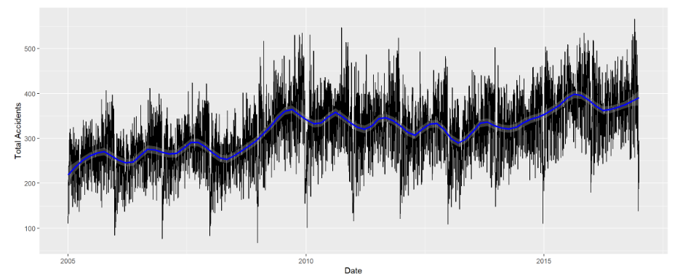
TOTAL NUMBER OF ACCIDENTS BY YEAR in UNITED KINGDOM

Slide 4
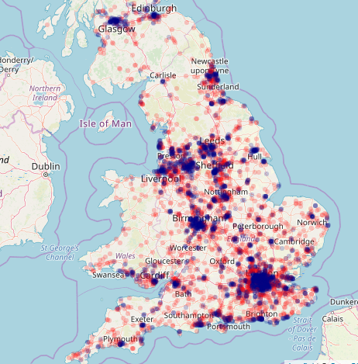
URBAN & RURAL AREA ACCIDENTS
Urban
Rural

Slide 5
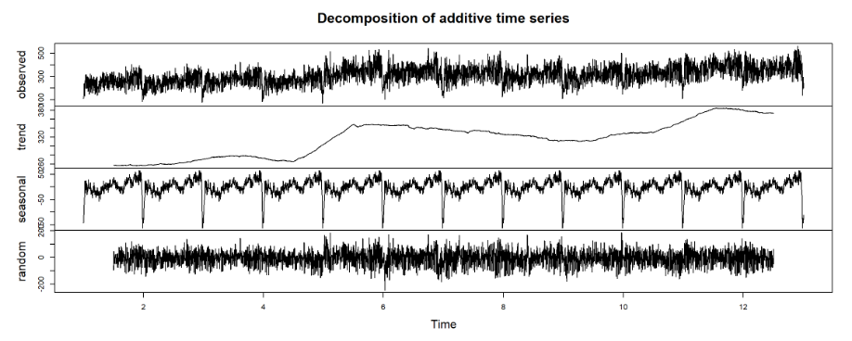
TIME SERIES ANALYSIS

Slide 6
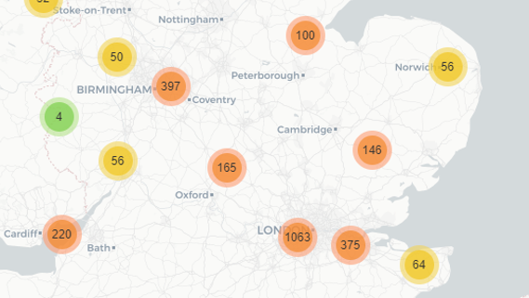
UNITED KINGDOM

Slide 7
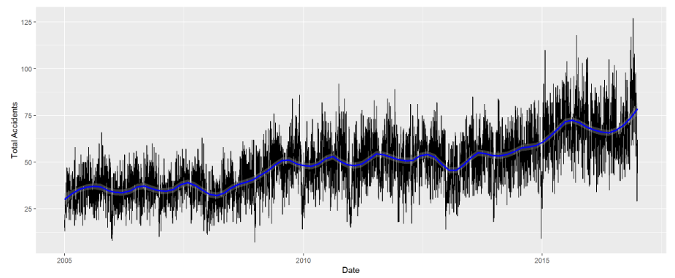
TOTAL NUMBER OF ACCIDENTS BY YEAR in LONDON

Slide 8
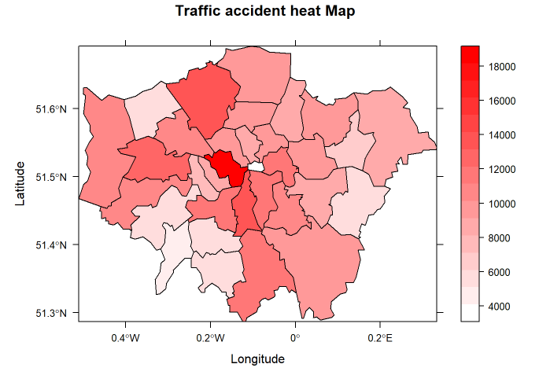

Slide 9
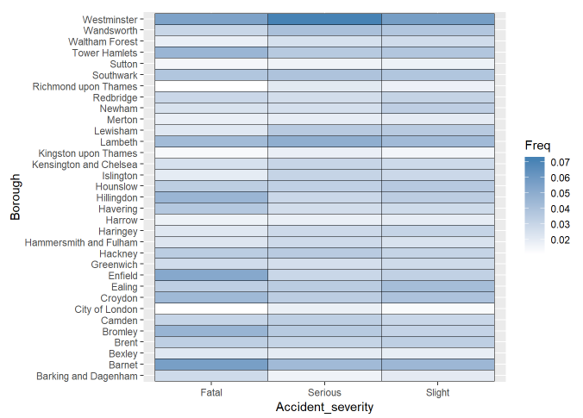
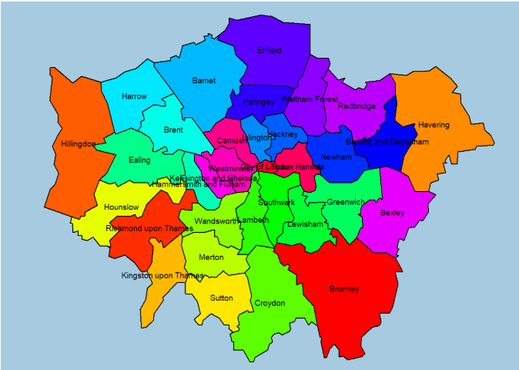
ACCIDENT SEVERITY BY BOROUGH

Slide 10
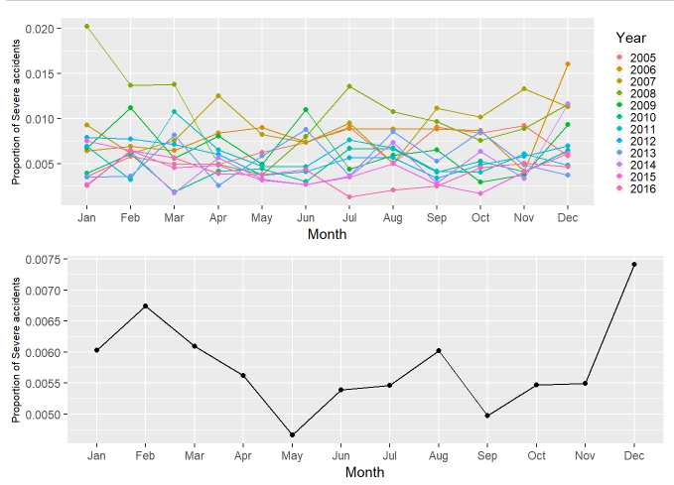
PROPROTION OF ACCIDENTS BY YEAR & MONTH

Slide 11
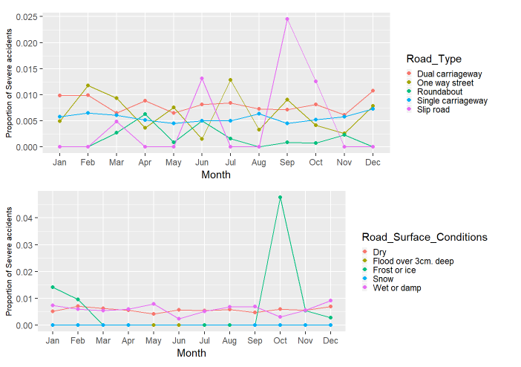
ACCIDENTS BY ROAD TYPE & ROAD SURFACE CONDITIONS

Slide 12
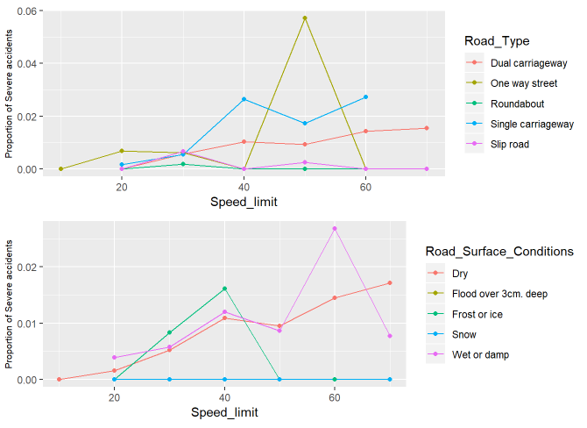
PROPORTION OF ACCIDENTS BY SPEED LIMIT

Slide 13
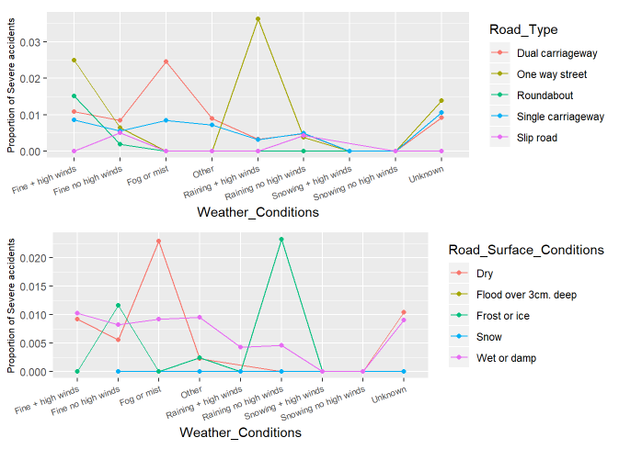
PROPORTION OF ACCIDENTS BY WEATHER CONDITIONS

Slide 14
CHI SQUARE TEST
Evaluating whether there is a significant association between the categories
X- squared | 96.372
P- value | 0.0004998
X- squared | 27.864
P- value | 0.006497

Slide 15

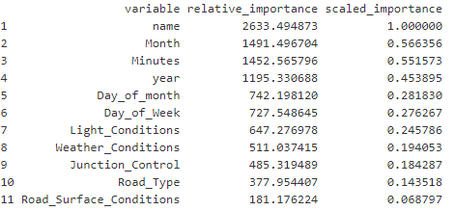
RANDOM FOREST MODEL

Slide 16

MEASURES TO CONTROL THE ACCIDNETS IN LONDON

Slide 17
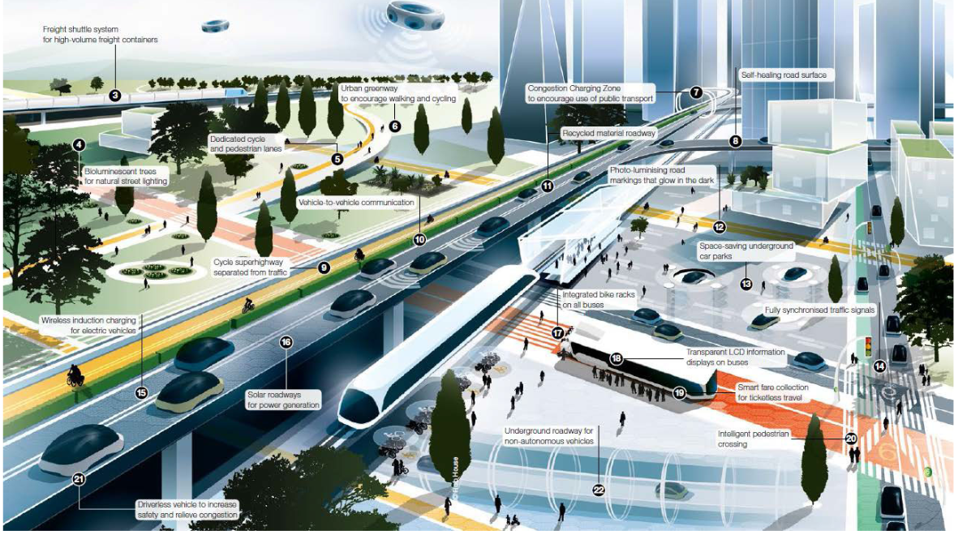

Slide 18
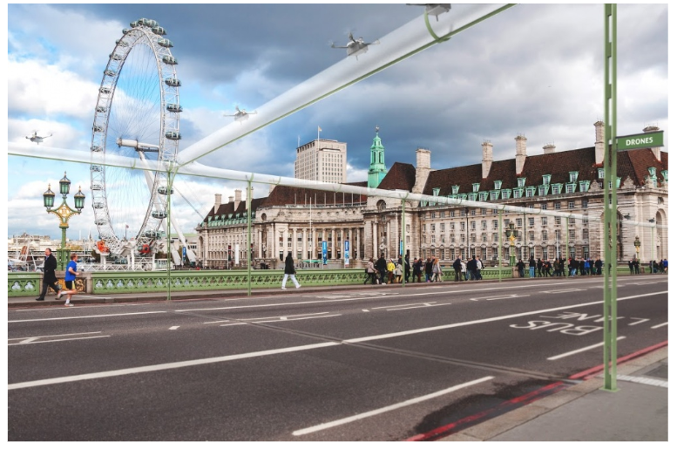

Slide 19
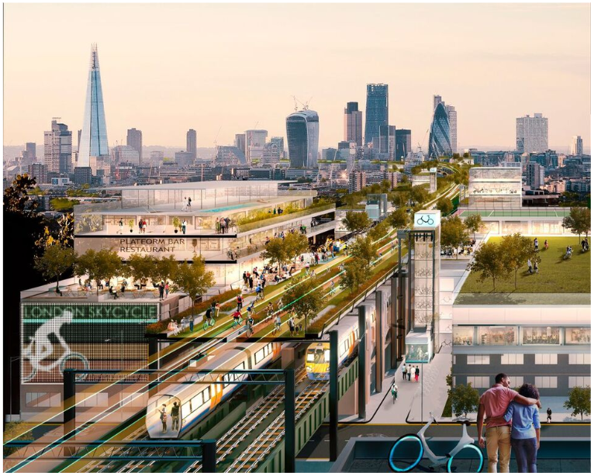
Foster + Partners

Slide 20
Reducing the speed limits
patrolling on the busy roads
Introducing technological development to clear road surface - due to frost/ice & wet lands
widening the Roads and FLYOVERS FOR AVOIDING TRAFFIC
Accident prevention advice
Increase use of public transport or bicycles

Slide 21
THANK YOU

