Slide 1
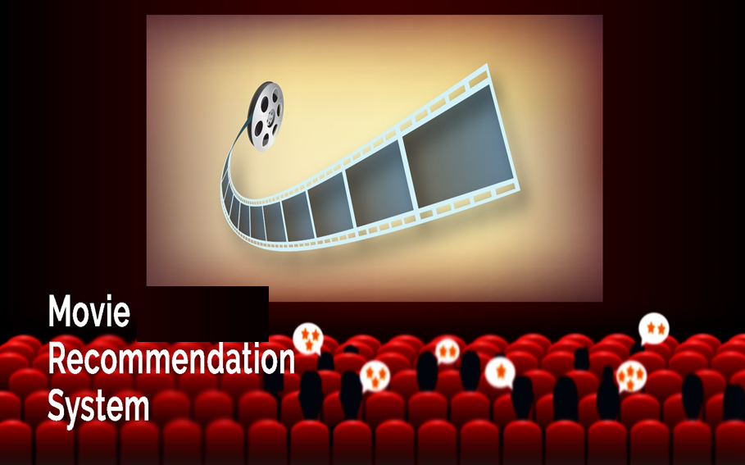
Submitted by :
Huang, Ran
Sharma, Nikki

Slide 2
  Introduction
  Data Usage
  Recommendation system
  Data Analysis
  Testing the data
  Conclusion
  Q&A
  References

Slide 3
Dataset Usage
Data sources
The data source is the MovieLens – https://grouplens.org/datasets/movielens
IMDB datasource https://datasets.imdbws.com/
The data consists of 100,836 ratings (1-5) from 610 users on 9719 movies
Each user has rated at least 20 movies
Data is stored in csv format and is structured data

Slide 4
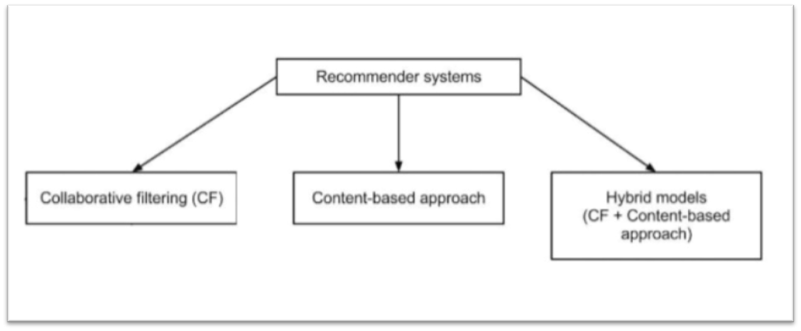
Recommendation System
Recommendation system produces a ranked list of items on which a user might be interested in the context of the current choice of a item(movie).
Subclass of data filtering that aspects to anticipate the rating or preference that user would provide for them

Slide 5





Method: Collaborative filtering
UBCF
Collaborative filtering algorithms are based on measuring the similarity between users or between items.
ITEM-based Collaborative Filtering
USER -based Collaborative Filtering
Notes:
Collaborative filtering approach builds a model from a user’s past behaviors (items previously purchased or selected and/or numerical ratings given to those items) as well as similar decisions made by other users. This model is then used to predict items (or ratings for items) that the user may have an interest in

Slide 6
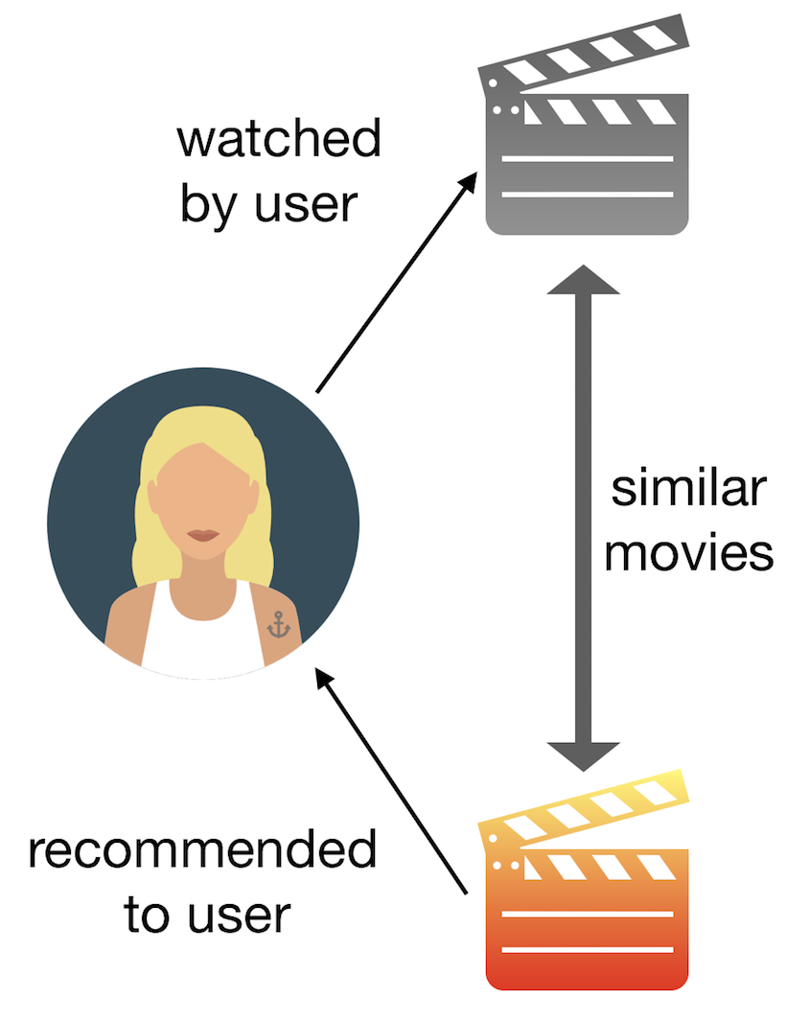
ITEM-BASED COLLABORATIVE FILTERING MODEL
In the algorithm, the similarities between different items in the dataset are calculated by using one of a number of similarity measures, and then these similarity values are used to predict ratings for user-item pairs not present in the dataset.
Notes:
measure the similarity between the items that target users rates/ interacts with and other items

Slide 7
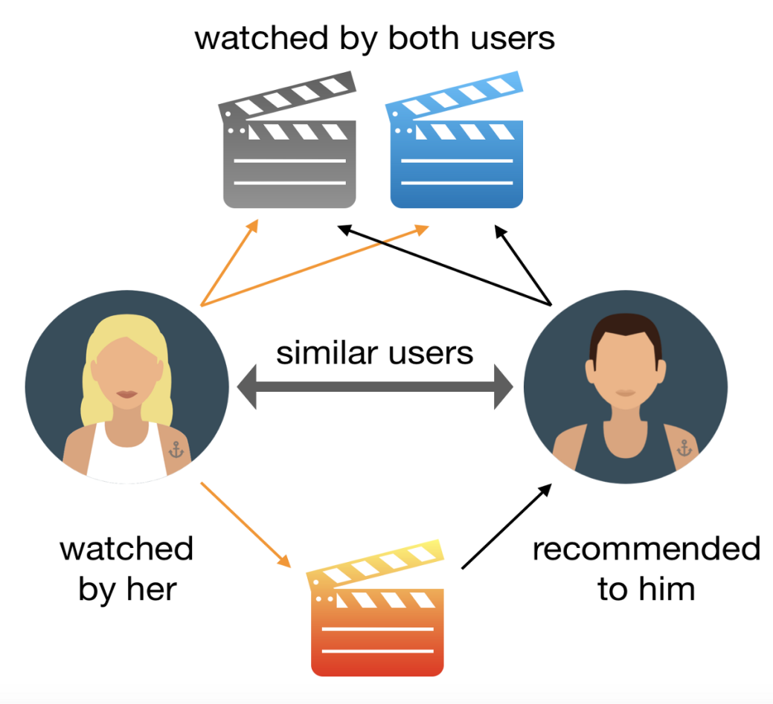
USER-BASED COLLABORATIVE FILTERING MODEL
User based Model: In this algorithm the similarity between pairs of users by using the cosine similarity formula, a technique much like the item-based approach is used.

Slide 8
Data Analysis

Slide 9
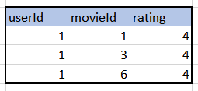

Converting the data frame into real Rating Matrix
Recommender lab package uses realRatingMatrix as input
Original data
Converting to real rating matrix
Prior to using any of the pre-built recommenderlab functions for collaborative filtering we must first convert the data frame to a realRatingMatrix().

Slide 10
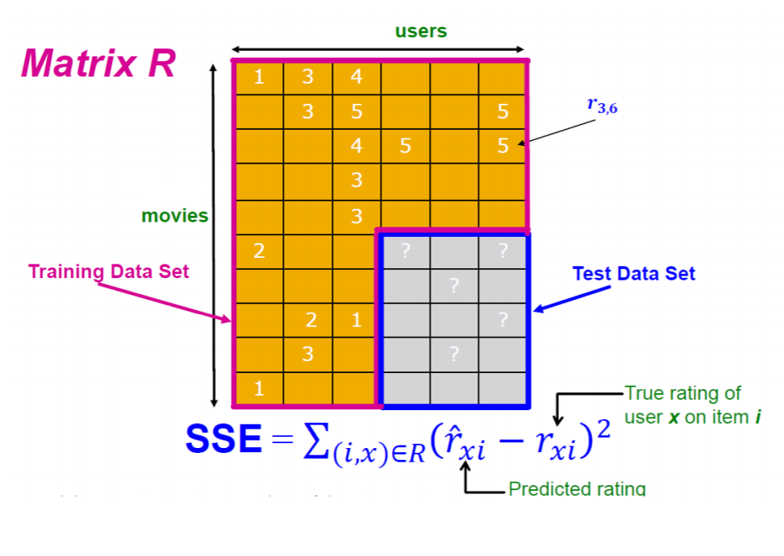
Training and testing sets
The first version consists of 100836 ratings by 610 users across 9742 movies.
The system constitutes 90% training set from the dataset and 10 % testing set .
It selects the data using the evaluate schema function.

Slide 11
TESTING THE DATA

Slide 12
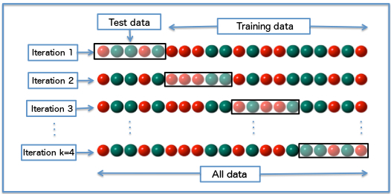
TESTING THE DATA - cross validation
The data set is divided into k subsets, and the holdout method is repeated k times.
Each time, one of the k subsets is used as the test set and the other k-1subsets are put together to form a training set.
Then the average error across all k trials is computed.

Slide 13

PROS
The advantage of this method is that it matters less, how the data gets divided. Every data point gets to be in a test set exactly once, and gets to be in a training set k-1 times.
The variance of the resulting estimate is reduced as k is increased.
The advantage of doing this is that you can independently choose how large each test set is and how many trials you average over.

Slide 14

CONS
The disadvantage of this method is that the training algorithm has to be rerun from scratch k times, which means it takes k times as much computation to make an evaluation.
A variant of this method is to randomly divide the data into a test and training set k different times.

Slide 15
CONCLUSION

Slide 16
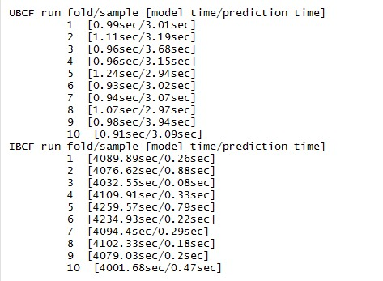

UBCF & IBCF model runtime
UBCF has less time in building the model, but more time in prediction
IBCF took more time in building the model , and less time for prediction
Error Rate Evaluation

Slide 17
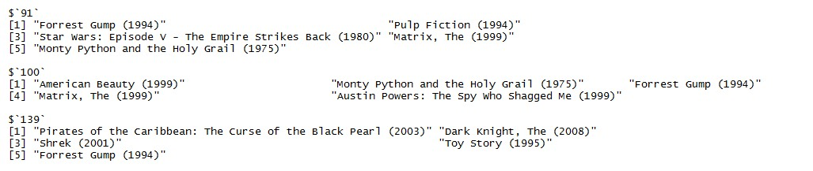
Output: Movie Recommendation to User

Slide 18
Requisite for the current System
The open requirement would be categorizing movie based on the genres, for example: Drama, Comedy, Action, Thriller, and Romance.
The system be able to recommend movie for specific genre area and identify ratings for the same.

Slide 19
Q & A

Slide 20
References
https://www.cs.cmu.edu/~schneide/tut5/node42.html
https://www.dummies.com/programming/big-data/data-science
https://en.wikipedia.org/wiki/Cross-validation_(statistics)
https://stackoverflow.com/questions/49394118/k-fold-cross-validation-in-r

Slide 21
THANK YOU

