Slide 1

What measures can be taken by Meetup to draw in more users for category with less members

Slide 2
Table of Content
Database & R connection
Data Analysis
ANOVA Test
Prescriptive analysis
Q&A

Slide 3
Introduction:
Meetup is a application (service) used to organize online groups that host in-person events for people with similar interests.
Dataset Usage
The data source used - Kaggle and the dataset consists of more than 100k records
Data is exported in csv format and is structured data
The data used is from 2002 -2017
Variables used
Independent Variable - Category
Dependent Variable – date , member enrolment, group, state

Slide 4
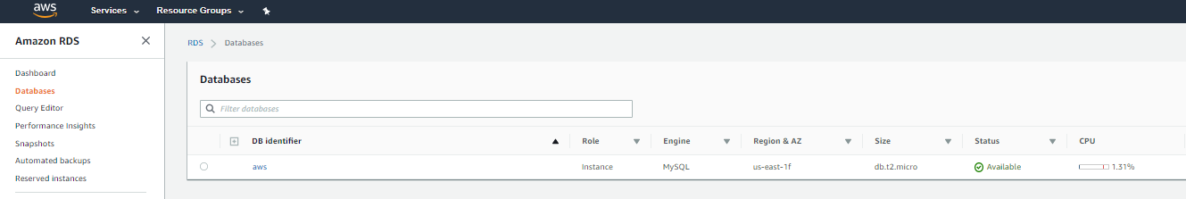
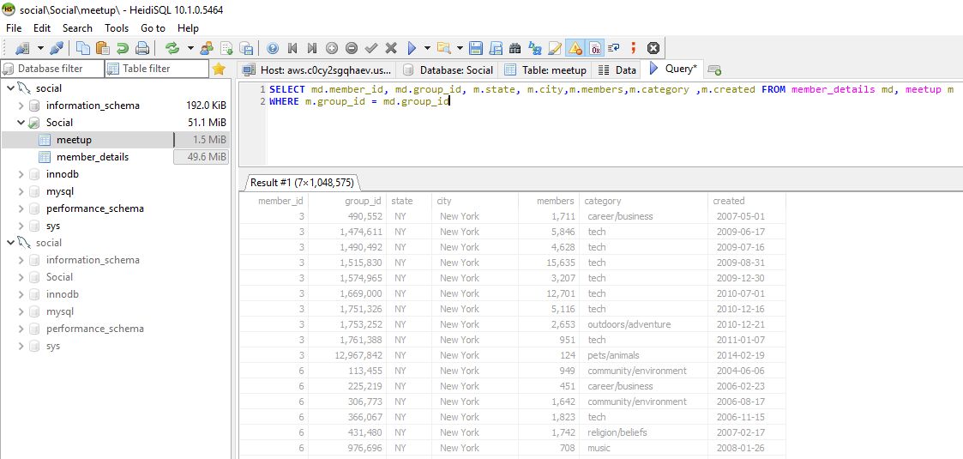
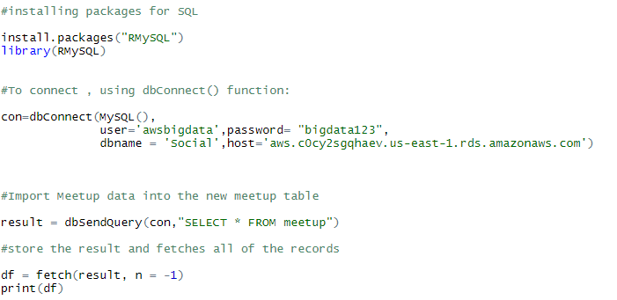
DATABASE CONNECTION & SCHEMA
AWS Database creation
My SQL schema
R connection

Slide 5
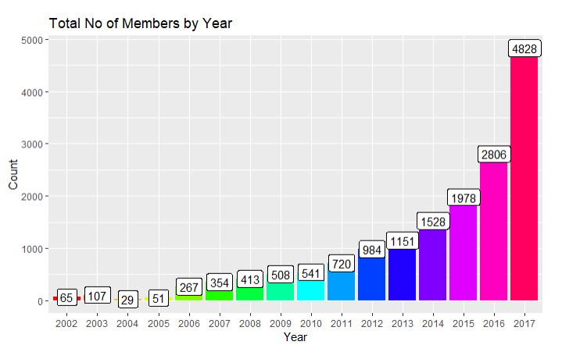
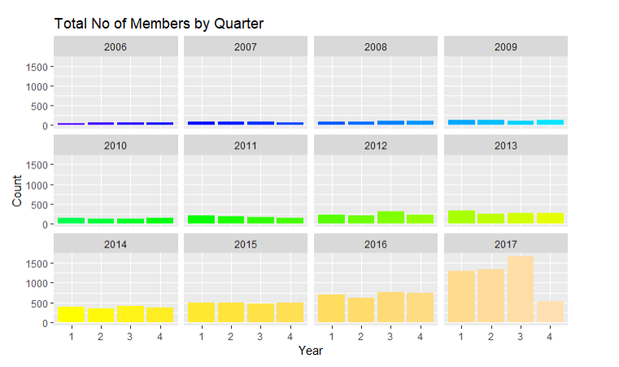
User Enrolment Data- By Year & Quarter

Slide 6
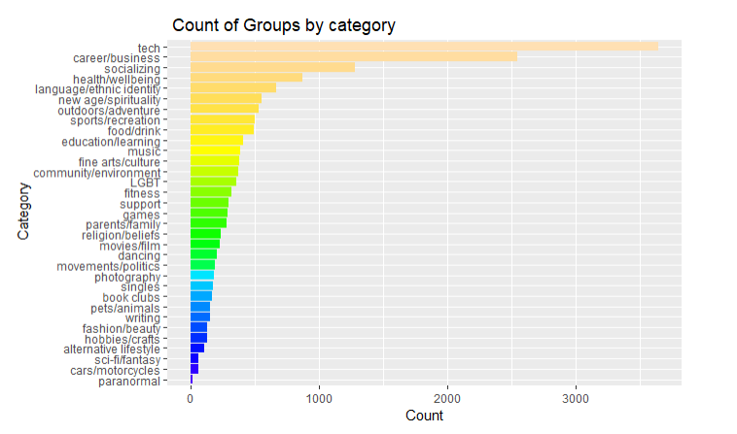
User Enrolment Data for Category - By Group

Slide 7
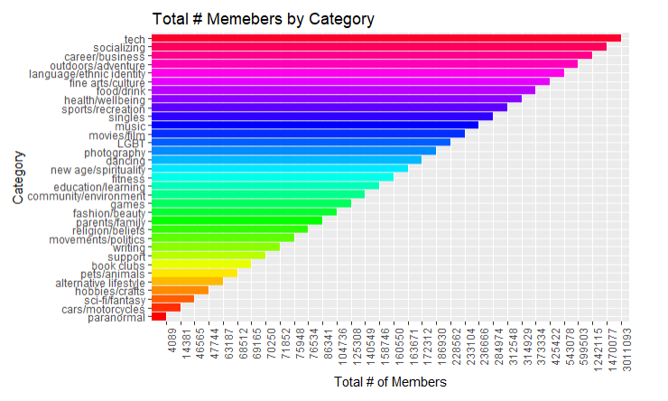
User Enrolment Data for Category by count of members

Slide 8
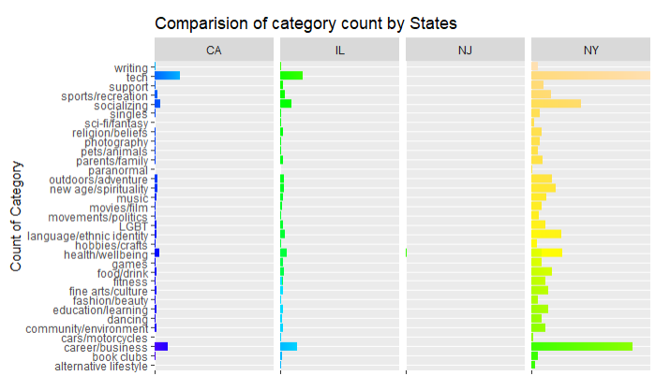
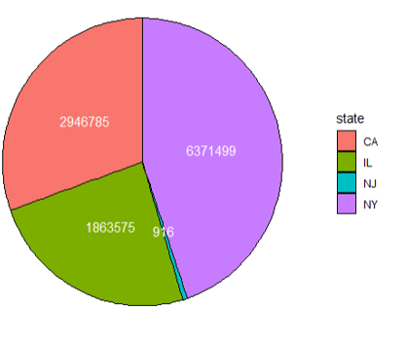
User Enrolment Data for Category by state

Slide 9
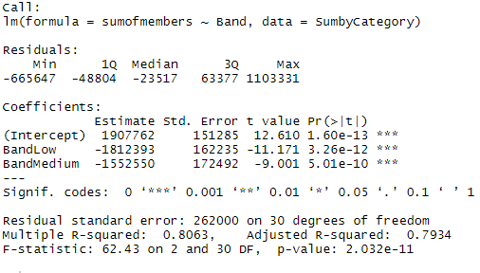
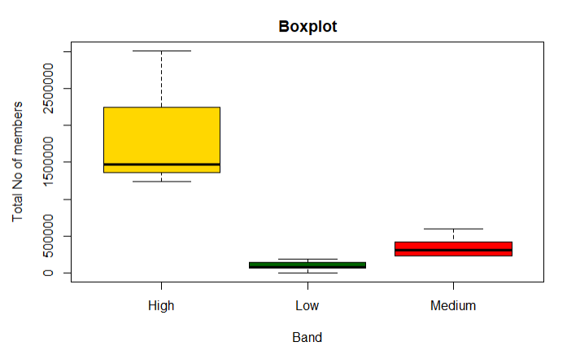
LINEAR MODEL RESULT

Slide 10
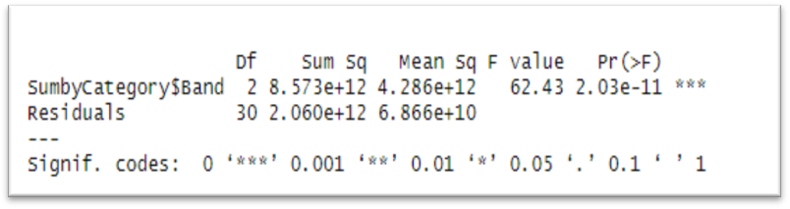
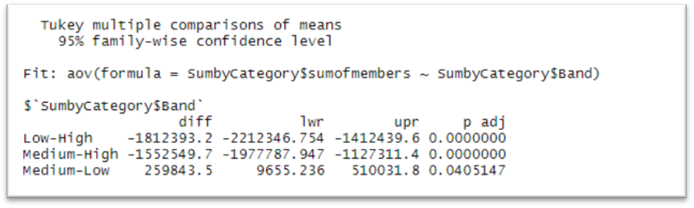
ANOVA TEST AND TUKEY TEST RESULTS

Slide 11
MEASURES TO INCREASE THE MEMBERS ENROLMENT
Marketing Campaign
Creating awareness through existing(popular) groups
Demographic study for promotion of category
Awareness through other social media applications

Slide 12
THANK YOU

