Slide 1

EPAM · STREAM 2
ReguGuard
Autonomous AML & Sanctions-Compliance Analyst
An agentic multi-agent swarm on the Google Gemini Enterprise Agent Platform —
triaging alerts, screening sanctions, and producing audit-ready dispositions with a human in the loop.
ADK
MCP
Agent Engine
Model Armor
Vertex RAG
Contributors
NiteshChand Sharma
Rakesh Kumar
Mihir Mohanty
Raghavendra Banda

Slide 2






THE PROBLEM
Compliance teams are drowning in false alarms
90%+
Hours
$Billions
of AML alerts are false positives
to investigate a single alert
in annual AML penalties
Analysts burn hours clearing noise that was never a real risk.
Manual data-gathering across siloed systems is slow and repetitive.
A missed true hit means fines, remediation, and reputational damage.
Every existing approach fails one of three tests
Rules engines
Manual analysts
Black-box LLMs
Deterministic but brittle. Thresholds generate a flood of false positives and miss novel patterns.
Accurate but unscalable. Skilled investigators spend most of their day gathering data by hand.
Scalable but ungoverned. Hallucinations, no citations, and no audit trail are unacceptable to regulators.
Fails: accuracy
Fails: scale
Fails: trust
Notes:
Problem. >90% false positives, hours per alert, billions in fines. Rules over-flag, manual can't scale, black-box AI is unacceptable in compliance.

Slide 3



THE SOLUTION
Meet ReguGuard — a governed compliance swarm
A team of specialized AI agents that investigates an alert end-to-end: it pulls the data, cross-references policy and sanctions, and returns an audit-ready decision — pausing for a human whenever the stakes are critical.
Multi-agent, not monolithic
Decoupled from any data source
Governed by design
An orchestrator delegates to data, policy, and synthesis specialists — isolating errors and retrying locally.
Agents reach data only through governed MCP tools. A new legacy system means a new server — zero agent changes.
Every tool call passes identity, gateway, and Model Armor screening before it runs. Sanctions hits never auto-clear.
Built entirely on Google’s Agent Development Kit + Model Context Protocol, deployed to Vertex AI Agent Engine.
Notes:
Solution overview. Three pillars: multi-agent, decoupled via MCP, governed by design. All on ADK + MCP + Agent Engine.

Slide 4
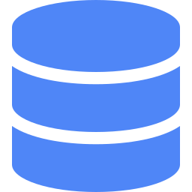



CAPABILITIES
One system, the full agentic toolchain
Agent orchestration
Governed data access
Grounded reasoning
ADK-native swarm with A2A interoperability at the boundary.
Custom MCP servers expose narrow, read-only, parameterized tools.
Vertex RAG cites the exact policy rule — no hallucinated verdicts.
Enterprise security
Human-in-the-loop
Proven reliability
Model Armor + per-tool IAM + mTLS on every call.
Critical cases pause, persist state, and resume on approval.
Trace-level observability and a precision/recall eval harness.
Notes:
Capabilities grid. Six pillars that together cover the entire Stream 2 rubric surface.

Slide 5



HOW IT WORKS
From alert to audit-ready decision in one loop
1
2
3
4
5
Trigger
Extract
Assess
Review
Dispose
An alert or batch arrives; the orchestrator opens a tracked, stateful audit.
The data agent pulls the transaction, vendor history, and related transfers via MCP.
The policy agent screens sanctions and grounds every finding in a cited AML rule.
Critical or sanctions cases pause for a compliance officer’s sign-off.
The synthesis agent emits an escalate / clear / request-info decision with evidence.
Errors are isolated: a failed step retries locally — the whole audit never restarts.
Notes:
How it works. Five steps: trigger, extract, assess, review (HITL), dispose. Emphasize local retry / error isolation.

Slide 6
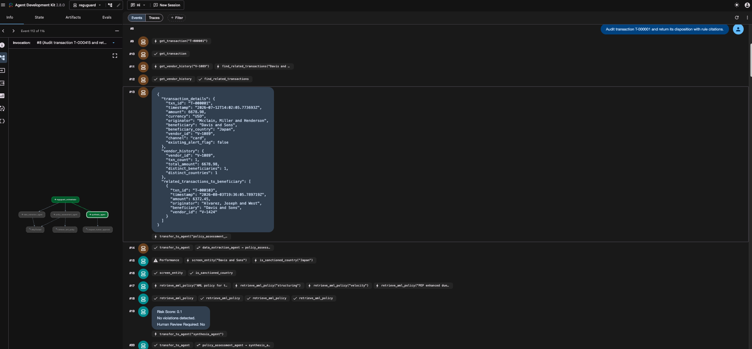
Demo

Slide 7
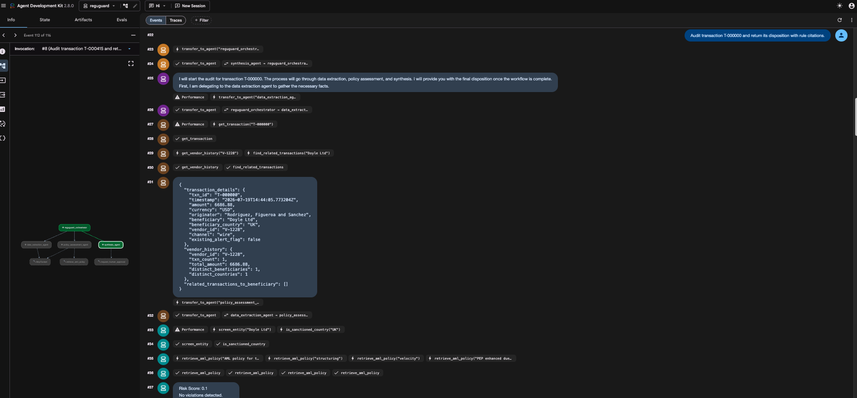

Slide 8
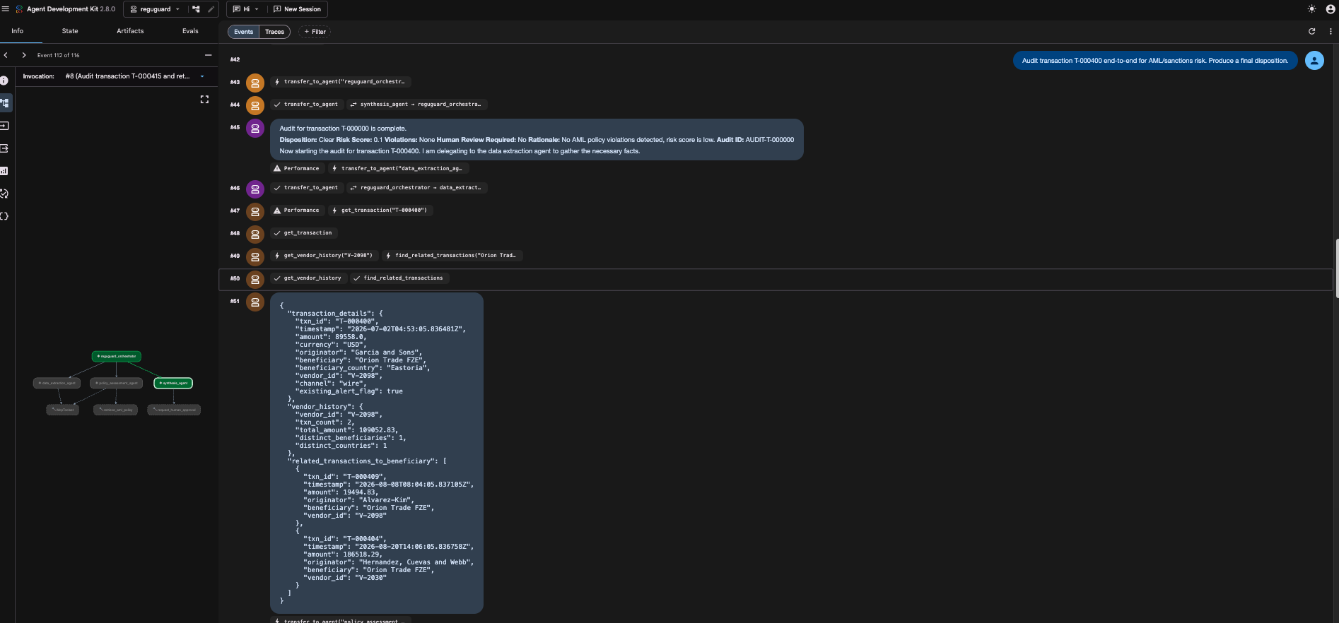

Slide 9
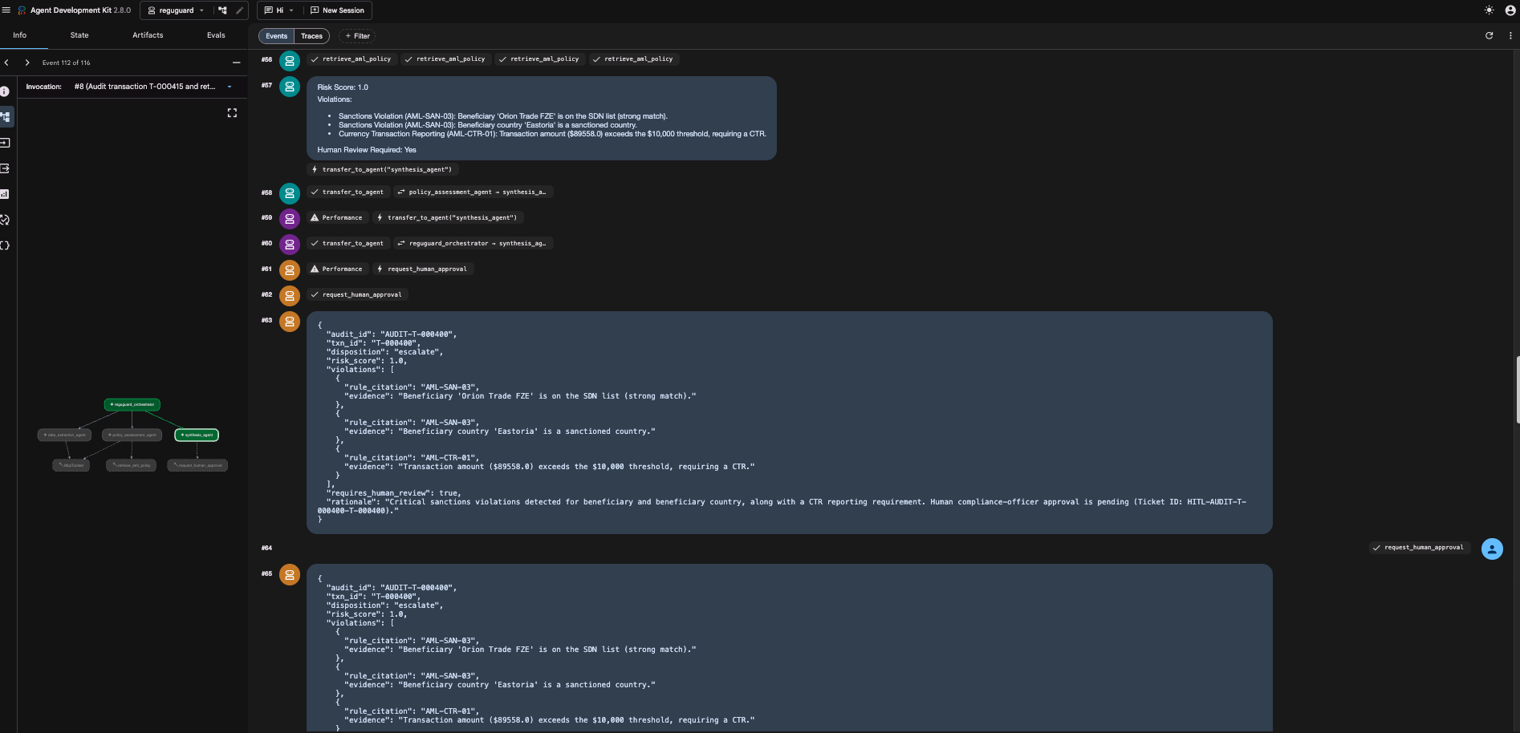

Slide 10
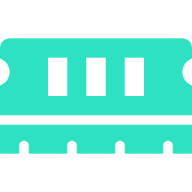

ARCHITECTURE
Seven governed layers, one execution graph
Analyst / Alert Trigger
Root Orchestrator
L1
L5
Knowledge
Vertex RAG grounding + context caching
Data Extraction
Policy Assessment
Synthesis
State & HITL
L4
Governance Gate · Agent Identity + mTLS · Agent Gateway (per-tool IAM) · Model Armor
L3
Sessions + Memory Bank, pause / resume
Transaction MCP (Cloud Run)
Sanctions MCP (Cloud Run)
L2
L6
Observability & Eval
Cloud Trace + precision / recall harness
BigQuery — Transactions
Sanctions / Watchlist Store
L7 · Roadmap: distill routine checks into a fine-tuned lightweight model (future).
Notes:
Architecture. Walk the main column top-to-bottom (orchestrator to workers to governance gate to MCP to data) then the right column cross-cutting layers. Note L7 is roadmap-only.

Slide 11



THE DIFFERENTIATOR
Defense-in-depth: security is a platform property
Weighted at 30% of the score — and where most teams have nothing to show. Every tool call runs this gauntlet.
Perimeter
Identity
Authorization
Cloud Armor (WAF/DDoS) + Identity-Aware Proxy on ingress.
Per-agent service accounts with end-to-end mutual TLS.
Agent Gateway enforces per-tool IAM — least privilege.
Content
Tool
Audit
Model Armor screens every payload for injection & data-loss.
MCP validates its own schema; read-only parameterized queries.
Every decision and every denial is traced and logged.
Live demo: an unauthorized tool call returns 403; a prompt-injection payload is denied by Model Armor — both visible in the logs.
Notes:
Security. Six concentric controls. This is 30% of the score. Tease the two live denials you will show in the demo.

Slide 12
RELIABILITY BY DESIGN
A human decides when the stakes are critical
Long-running, interruptible audits. When the swarm detects a sanctions hit or a critical risk score, it stops — by policy.
Detect
Pause & persist
Human approves
Resume
Critical violation or sanctions hit identified.
Exact session state snapshotted to Memory Bank.
Compliance officer signs off asynchronously.
Deterministic resume; final disposition recorded.
Policy rule AML-HITL-06: sanctions hits can never auto-clear — the workflow is stateful, auditable, and reversible.
Notes:
Human-in-the-loop. Detect, pause+persist, human approves, resume. Cite AML-HITL-06: sanctions never auto-clear.

Slide 13
PROOF, NOT ADJECTIVES
Reliability we can measure
A labeled eval set of synthetic transactions with deliberately planted violations lets us score the swarm deterministically — the numbers below come straight from the eval harness.
Recall
0.94
Precision
0.91
False-positive rate
0.06
Illustrative targets from the harness — replace with your live run before the pitch.
Notes:
Reliability. Show the eval scorecard. Say clearly these are from the labeled harness; swap in live numbers. Pair with a Cloud Trace screenshot in the live demo.

Slide 14
FOR THE JUDGES
Engineered against the rubric
30%
Certification & Security
25%
Customer Use Case
Gateway + Model Armor + IAM + Cloud Run + token optimization + traces.
A critical, quantified AML problem in EPAM’s largest vertical.
15%
Architecture & Extensibility
15%
Agentic Reliability
ADK swarm + MCP decoupling + A2A boundary on Agent Engine.
RAG grounding, human-in-the-loop, measurable precision/recall.
15%
Team Certification
100% of the team on the Gemini Enterprise certification path.
Notes:
Why it wins. Every rubric criterion has a concrete artifact. Security (30%) is the biggest lever and our strongest showing.

Slide 15


FIT & ROI
Built for EPAM’s biggest market
Organizational fit
The ROI story
Financial Services is EPAM’s largest, fastest-growing vertical.
Analyst hours reclaimed
annual alerts × minutes saved per alert × loaded analyst cost
Mirrors EPAM’s shipped Agentic KYC agent on Gemini Enterprise.
+ avoided regulatory-fine exposure from fewer missed true positives
A marketplace-ready accelerator — not a throwaway demo.
Cut false-positive triage time while never auto-clearing a real hit — lower cost and lower risk at the same time.
Aligns with EPAM’s AI-native GTM (DIAL, AI/RUN, ELITEA).
Notes:
Fit & ROI. Financial services = EPAM's biggest vertical; mirrors shipped Agentic KYC. ROI = analyst hours + avoided fines.

Slide 16

LONG-TERM VALUE
From swarm to a self-optimizing asset
Today’s agents generate a stream of high-quality reasoning traces. That data becomes tomorrow’s cost advantage.
Capture
Distill
Route
Scale
Log successful reasoning paths and input/output pairs from live audits.
Apply PEFT / LoRA to fine-tune a lightweight Flash or Gemma "student" model.
Send routine, high-volume checks to the cheaper, faster student model.
Frontier models reserved for complex cases — cost and latency drop sharply.
Drastic cost reduction · lower inference latency · a proprietary asset insulated from external API pricing.
Notes:
Roadmap (future, not built in-window). Capture -> distill -> route -> scale. Student/teacher paradigm for cost and latency.

Slide 17

Conclusion
ReguGuard turns AML alert triage from a costly bottleneck into an auditable, autonomous workflow — with a human in command of every critical call.
Accurate. Scalable. Governed.
ReguGuard · EPAM Gemini Enterprise Hackathon · Stream 2
Notes:
Close on the three-word promise: accurate, scalable, governed. Restate the outcome and hand to live demo.

