Slide 1
ZS Case Study
RollingEyes
Romit Shah
Dhruv Vora
Pranav Shirke
Parth Shah
Niti Shah

Slide 2
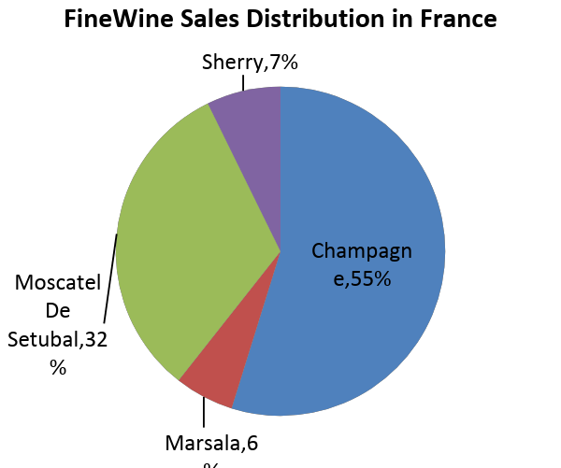
Based on assessment of the market potential, what is the expected demand for FineWine products in Portugal, France, and Italy by 2020?
France
Expected Total demand of FineWine: 80690378.1
Expected demand of Champagne: 44220040.7
Expected demand of Marsala wine :4693520.12
Expected demand of Moscatel De Setubal :25909917.1
Expected demand of Sherry :5866900.15

Slide 3
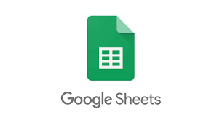
Italy
Expected Total demand of FineWine:73531585.6
Expected demand of Champagne:8680266.1
Expected demand of Marsala wine :40551182.6
Expected demand of Moscatel De Setubal :13846745.3
Expected demand of Sherry :10453391.6
Portugal
Expected Total demand of FineWine:13468741.4
Expected demand of Champagne:1205011.05
Expected demand of Marsala wine :547427.996
Expected demand of Moscatel De Setubal:9913937.71
Expected demand of Sherry :1802364.63

Slide 4
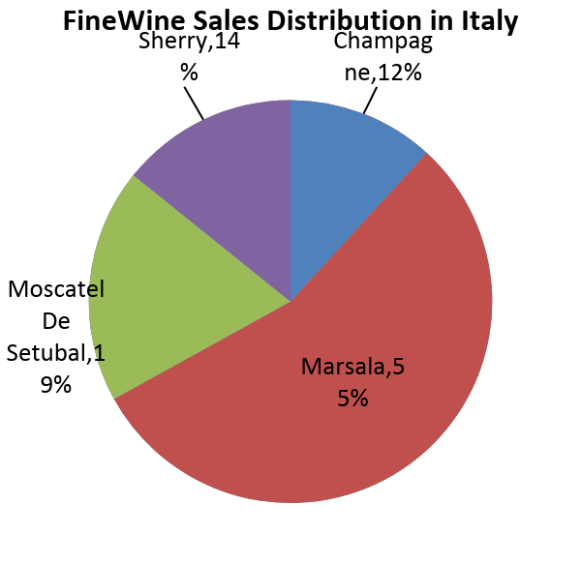
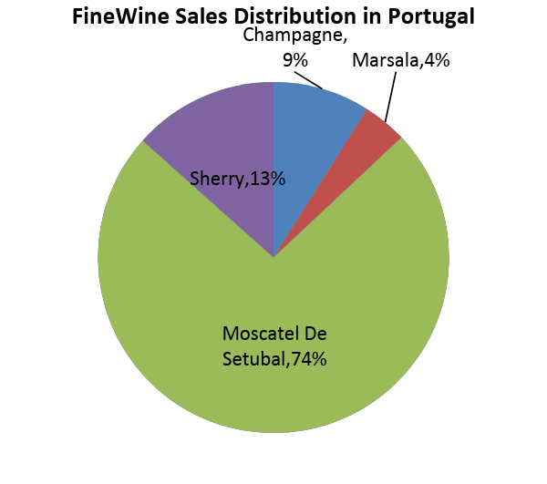
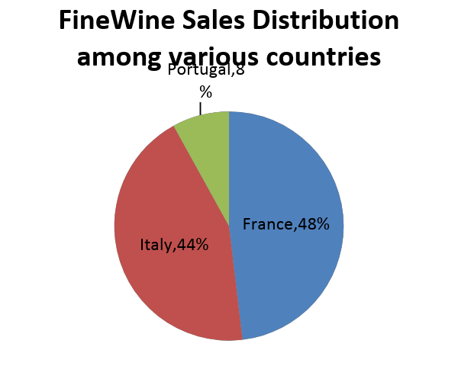
Overall demand in all countries:(open sheet1 for reference)
Expected Total demand of FineWine:167690705
Expected demand of Champagne:54105317.8
Expected demand of Marsala wine :45792130.7
Expected demand of Moscatel De Setubal:49670600.1
Expected demand of Sherry :18122656.4

Slide 5
Q2. a. Estimation for number of sales representatives required for France:
Visits | 40,000 | 60000 | 80000 | 100000 | 120000 | 140000 | 160000 | 180000 | 200000 | 220000
No of Employees | 27.78 | 41.67 | 55.56 | 69.44 | 83.33 | 97.22 | 111.11 | 125.00 | 138.89 | 152.78
Cost | € 2,500,000.00 | € 3,750,000.00 | € 5,000,000.00 | € 6,250,000.00 | € 7,500,000.00 | € 8,750,000.00 | € 10,000,000.00 | € 11,250,000.00 | € 12,500,000.00 | € 13,750,000.00
Annual sales | € 70,000,000.00 | € 130,000,000.00 | € 185,000,000.00 | € 220,000,000.00 | € 245,000,000.00 | € 260,000,000.00 | € 265,000,000.00 | € 270,000,000.00 | € 271,000,000.00 | € 272,000,000.00
Profits | € 67,500,000.00 | € 126,250,000.00 | € 180,000,000.00 | € 213,750,000.00 | € 237,500,000.00 | € 251,250,000.00 | € 255,000,000.00 | € 258,750,000.00 | € 258,500,000.00 | € 258,250,000.00
profits/no of employees | 2,430,000.00 | 3,030,000.00 | 3,240,000.00 | 3,078,000.00 | 2,850,000.00 | 2,584,285.71 | 2,295,000.00 | 2,070,000.00 | 1,861,200.00 | 1,690,363.64
Max ratio= € 3,240,000.00
Hence optimum number of sales reps is = 56

Slide 6
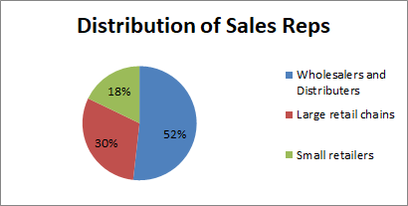
Q2b - How will the activities of the reps differ across the three customer types, and therefore what should FineWine do about it?
1.The activities for Wholesalers and Distributors involves wine dinner, staff educational ,wine tasting monthly visits to ensure smooth trading of the wines, since the wholesaler and distributors are the main customers because they are the biggest buyers and it is important to maintain the goodwill. They are biggest suppliers to almost all the shops in the given geographical region. Thus from the 56 workforce to be employed overall the utmost importance should be given to this category.

Slide 7
2.The activities Large retail chains involves wine dinner with the executive, talking about the wine, how is it different from the other wines, explaining how will it profit the retail chain, tasting, following up monthly or quarterly. The second priority goes to these types of customers.
3.The activities for Small retailers involve wine tasting for all the customers, consistent following up and require the maximum number of visits, staff educational, explaining how will it profit the retailer. The least priority is given to small retail since they require a lot of visits and the profit margin is not as much as the former ones

Slide 8
Q3a. Calculating the commission rate based on the data given(open sheet 3a for reference)
The number of units are first calculated on a quarterly basis, using the formula 17500(quarterly base salary) + 12.5n(as 25EUR per unit and 50% is performance incentive) = sum(Three month earnings)
- where n indicates the number of units sold
Then Commission Rate or CR is calculated as earnings per unit sold
The given excel sheet contains the commission rates and the number of units sold for all the 24 months on a quarterly basis.

Slide 9
3b.What might be some drawbacks of incentivizing the reps based on the number of units they sell?
DRAWBACKS
Fixed focus - Since sales incentives are narrowly focused on just number of units sold, this causes sales representatives to focus only on revenue-generating activities. Consequently, they may rush their paperwork and skip inter-departmental meetings. Some make multiple but hasty calls and focus only on their increasing units.
More cancellations - The use of sales incentives may lead to more cancellations, especially for those clients who feel they were rushed into deals. Clients may also notice the lack of communication from sales representatives spending most of their time selling.
Rewards discourage risk-taking - “People will do precisely what they are asked to do if the reward is significant,” enthused Monroe J. Haegele, a proponent of pay-for-performance programs, in “The New Performance Measures.” And here is the root of the problem. Whenever people are encouraged to think about what they will get for engaging in a task, they become less inclined to take risks or explore possibilities, to play hunches or to consider incidental stimuli. In a word, the number one casualty of rewards is creativity. Excellence pulls in one direction; rewards pull in another. Tell people that their income will depend on their productivity or performance rating, and they will focus on the numbers.

Slide 10
Are there any other payment plan that can be used to incentivize the sales representatives?
Setting targets instead of paying per unit
Looking at profit of the units sold rather than the number because quality over quantity
Wall of Fame. Create a wall of fame for each recognized employee. Be sure to write below their picture what they did that you're recognizing them for.
Points reward system - Develop a points system for a reward program. This provides a perfect platform for ongoing recognition. Employees receive points every time they go above and beyond. After accumulating a certain amount, employees can redeem their points for gifts. You could offer a variety of rewards for the employees to select from.
Cover a major expense - When an employee goes above and beyond in a truly significant fashion, you could pay for a major payment or purchase for that individual. This might be a mortgage payment, automobile payment or major home appliance. There are two key considerations for making this a success. First, the reward should be tied to a significant

Slide 11
3c.Importance of Targets
Sales managers the world over will tell you, universally, that they want team success. No doubt your company is much the same - if the team can make a certain number for the year, they'll be pleased, you'll be pleased and most importantly, your boss will be pleased.
That magic annual number is nothing more than a goal, or target. Hit that and "Bob's your uncle" (a British equivalent to the French expression "et voilà!").
Targets - Near or Far?
The only problem with annual targets is that they are so far distant that they don't seem real. People will procrastinate, make excuses, get distracted and do other things.
So how, as managers, do we get the team to focus on the targets in the distance, today?
We divide up the annual targets into monthly (bite size) pieces and then focus the team on their goals for the current month.
Monthly quotas are important to gauge activity which grows opportunity
For example:
Quarterly sales goal = $500,000
Monthly sales goal = $166,666
Weekly sales goal = $41,666
Now, what are the behaviours you have to execute in order to achieve that monthly number? Based on what you know about your services or products, how many daily sales calls or meetings do you need in order to close enough business to meet that monthly sales number? Now you have a daily roadmap, and as long as you follow it, the goals are a given.

Slide 12
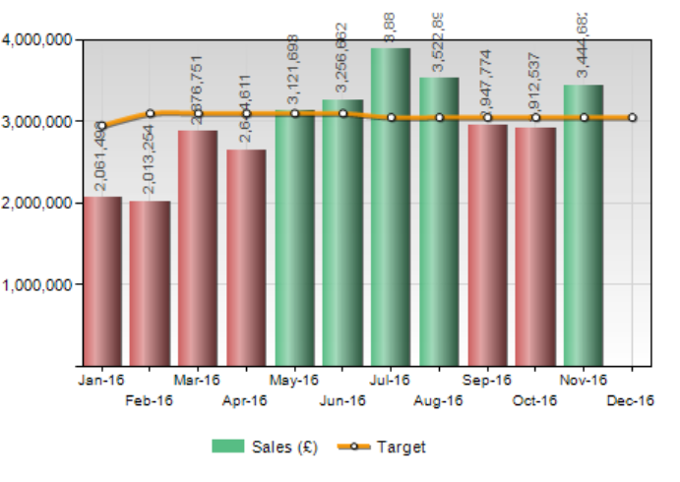
Methods of Calculation
Simple Method
As end of year approaches, management meetings are filled with recaps of the past year, post mortem analysis of why things happened as they did, and new goal posts are set for the year ahead. A departmental sales goal is set and it's one that managers have to live with for the next 12 months.
Turning an annual departmental sales target into individual monthly targets:
Divide the total annual target by the # of sales reps
Divide the annual rep targets by the number of months in a year
Manchester Toys needs to achieve £12.0 million in sales next year to make plan. To do this, the team of 5 sales reps each will each need to generate 1/5th of the £12,000,000 - giving them each an annual target of £2,400,000. Dividing this by 12, each rep is then left with a monthly target of £200,000.

Slide 13
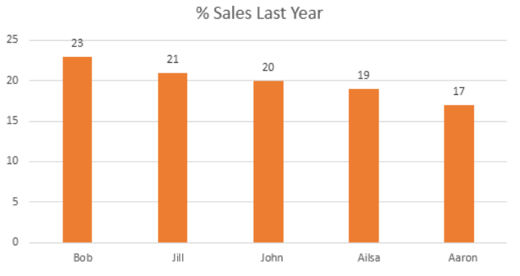
Methods of Calculation
Intermediate method
In order to account for differences in salesperson experience, time in position, skills and pay grade, targets can vary accordingly. One approach to handling these differences is to use performance from last year in making the calculation.
The below example assumes last year total sales of £11,000,000, thanks to the results from each:
£2,530,000 - Bob
£2,310,000 - Jill
£2,200,000 - John
£2,090,000 - Ailsa
£1,870,000 - Aaron
Subtract sales order value for last year from the target for next year and divide by the last year total, to get the percentage increase
£12,000,000 - £11,000,000 = £1,000,000
£ 1,000,000 / £11,000,000 = 9.09090909% increase
Round to 9.1%
SO THE QUARTERLY TARGETS ARE RECOMMENDED
Now, calculate the last year total x salesperson share percentage + 100% (109.1% total) for each person:
£2,757,700 (£2,530,000 x 109.1%) - Bob
£2,517,900 (£2,310,000 x 109.1%) - Jill
£2,400,200 (£2,200,000 x 109.1%) - John
£2,280,190 (£2,090,000 x 109.1%) - Ailsa
£2,040,170 (£1,870,000 x 109.1%) - Aaron
Now, divide this figure by 12 to get the monthly individual target for each person:

Slide 14
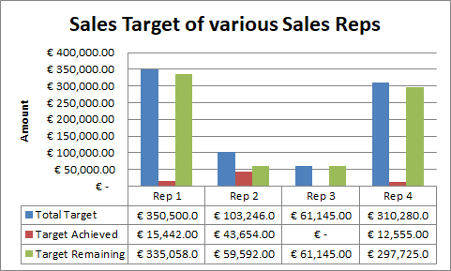
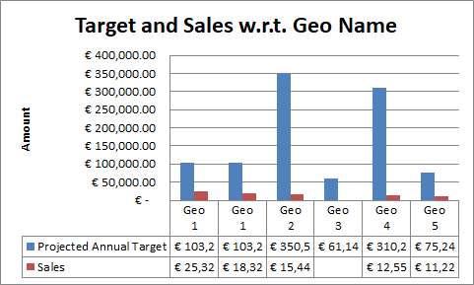

Slide 15
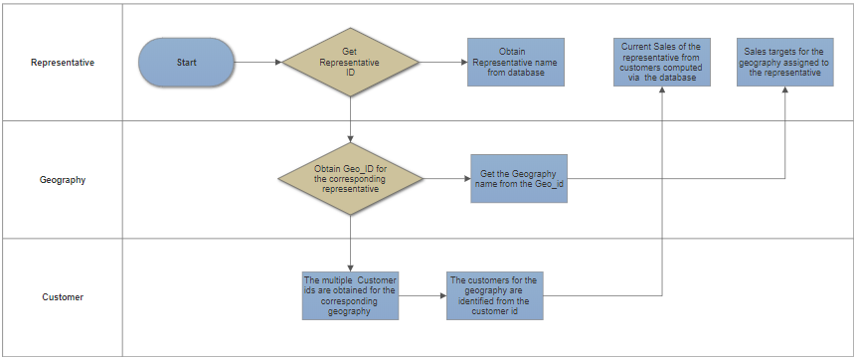
Q3d I. create a process flow and reporting layout that will provide sales representatives the information that sales VP has mentioned.
Process Flow:

Slide 16
Reporting Layout
One way to know that the business is in a stable financial condition is to develop a financial report. This is a statement analysis that reviews and analyzes the progress of financials in a business, and by there we will know when or what changes we need to take to make the financial health of the business consistent.
Not only will they help in realising the targets and the progress of the sales reps, they also serve as a foundation for making decisions that concern the overall strategies and goals of the business report
Additionally the report can also include the a paragraph describing the company’s business, a paragraph outlining the industry in which this company operates, including future prospects (Industry Outlook) and a brief forecast of the company’s future prospects.
The main contents would be data derived from tables 3A, 3B and 3C to help the sales reps analyze and track their performance. Here we have integrated those tables and reproduced the data to be readable in a more lucid format.

Slide 17
Geo ID | Geo Name | Projected Annual Target | Customer ID | Customer name | Sales | Rep_ID | Rep_Name | Rep_EmailID
Geography_1 | Geo 1 | 103,246.00 | 17766 | Customer A | 25,327.00 | 86A235 | Rep 2 | Rep2@finewine.com
 |  |  | 13987 | Customer C | 18,327.00 | 86A235 | Rep 2 | Rep2@finewine.com
Geography_2 | Geo 2 | 350,500.00 | 12888 | Customer B | 15,442.00 | 776543 | Rep 1 | Rep1@finewine.com
Geography_3 | Geo 3 | 61,145.00 |  |  |  | 96387 | Rep 3 | Rep3@finewine.com
Geography_4 | Geo 4 | 310,280.00 | 15890 | Customer E | 12,555.00 | 862109 | Rep 4 | Rep4@finewine.com
Geography_5 | Geo 5 | 75,240.00 | 14778 | Customer D | 11,220.00
Rep_ID | Rep_Name | Total Target | Target Achieved | Target Remaining
776543 | Rep 1 | 350500.00 | 15,442.00 | 335058.00
86A235 | Rep 2 | 103246 | 43,654.00 | 59592.00
96387 | Rep 3 | 61145 | - | 61145.00
862109 | Rep 4 | 310280 | 12,555.00 | 297725.00
REP TABLE:

Slide 18
II. What are some of the quality checks you would put in place to ensure that the reports are accurate?
Separate data entry from all intellectually demanding activities.The data-entry forms should reflect the format in which you originally obtain the data, not the format in which you plan to store the data.
Create a data audit trail: whenever anything is done to the data, starting at the data entry stage, document this and record the procedure in a way that makes it easy to go back and check what went wrong (because things will go wrong).
Automate everything. Assume any step will have to be redone (at the worst possible time, according to Murphy's Law), and plan accordingly. Don't try to save time now by doing a few "simple steps" by hand.
In particular, create support for data entry: make a front end for each table (even a spreadsheet can do nicely) that provides a clear, simple, uniform way to get data in.
If the data are valuable and important, consider independently double-entering the entire dataset. This means that each item will be entered at separate times by two different non-interacting people.
Use a DBMS to store and manage the data. After all data are entered and automatically checked, draw pictures: we should make sorted tables, histograms, scatterplots, etc., and look at them all. These are easily automated with any full-fledged statistical package.

Slide 19
7. Sources of Data Inaccuracies: Businesses should identify the sources (both internal and external) of data inaccuracy to plug the gap.
8. Set Data Entry Accuracy Goals: It is important for businesses to set realistic data accuracy goals to improve accuracy in data entry.
9. Software Tools: Intelligent Character Recognition (ICR) and Optical Character Recognition (OCR) technology and other similar tools can reduce the workload of data entry professionals by automatically reading and extracting certain data.
10. Speed is Fine, But Not At the Cost of Accuracy: Speed is fine as employees should work at a specified pace to achieve desired results in a time bound manner.
11. Avoid Overloading: It is the duty of a manager to ensure that the team is not under pressure to achieve unrealistic targets, as there is limit for data entry work that a person can do in a day.
12. Review: Reviewing goes a long way in reducing data entry errors. Businesses should create an efficient system of review and double-check the data.
13. Automated Error Reports:Always utilize the features of advanced software wisely. One widely used feature is automated error reports.
14. Understanding the Importance of Data: Employees need to be trained to understand the importance of data they are entering.
15. Adopt Robust Data Entry Accuracy Standards: Organizations should adopt robust data entry accuracy standards such as data monitoring, geo-coding, matching, linking and data profiling.
16. Work Environment: A healthy and active mind seldom makes mistakes and often produces accurate results.

Slide 20
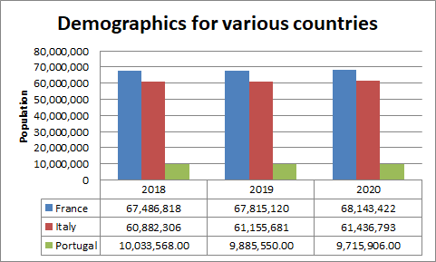
4a. Recommend a method to incorporate the data shared by FineWine along with demographics and consumption data.

Slide 21
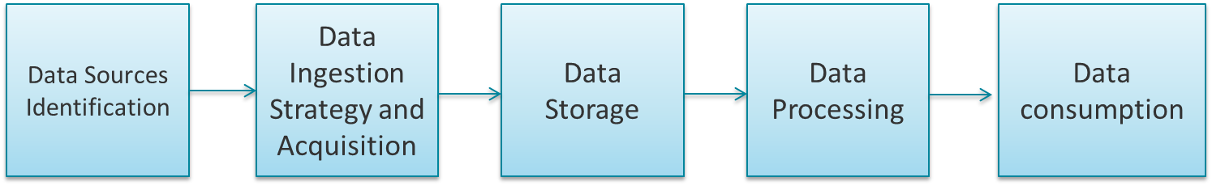
Recommend a strategy to come up with the method of ingesting the data and creating master datasets
Data ingestion is the process of obtaining and importing data for immediate use or storage in a database
The picture below depicts the logical layers involved.
Source profiling is one of the most important steps in deciding the architecture. It involves identifying the different source systems and categorizing them based on their nature and type.
Data ingestion in the Hadoop world means ELT (Extract, Load and Transform) as opposed to ETL (Extract, Transform and Load) in case of traditional warehouses.
One should be able to store large amounts of data of any type and should be able to scale on need basis. There are 2 kinds of analytical requirements that storage can support: synchronous and asynchronous.
The Processing methodology is driven by business requirements. It can be categorized into Batch, real-time or Hybrid based on the SLA.
Consumption - This layer consumes the output provided by processing layer. Different users like administrator, Business users, vendor, partners etc. can consume data in different format. Different forms of data consumption are Export Datasets, reporting and visualization, data exploration, adhoc querying, dynamics of use case, myriad of technology

Slide 22
4b.UI interface for dashboard
The UI should be designed in such a way that the sales executive is able to rack the real time performance of the reps ,the sales of the wines in various country.
Thus, to make the picture clear there should be graphs :
A: Sales of different wines in country

Slide 23
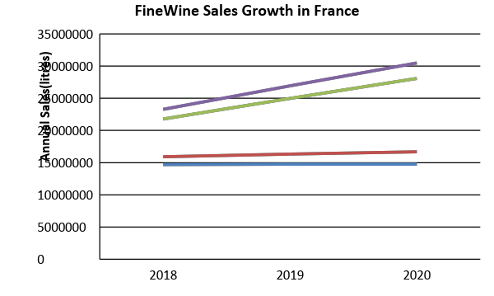
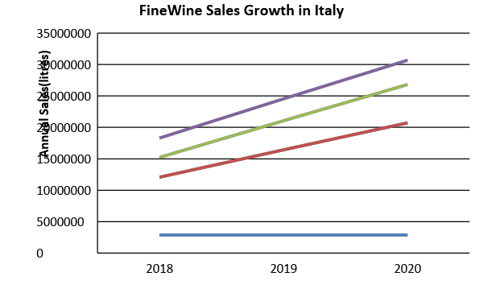
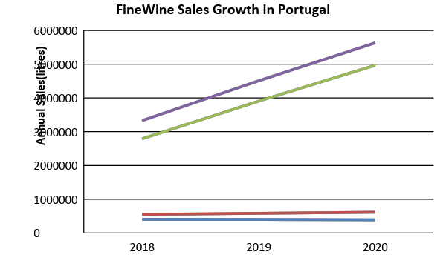
B. Growth of Sales in the countries(all graphs are to scale)

Slide 24
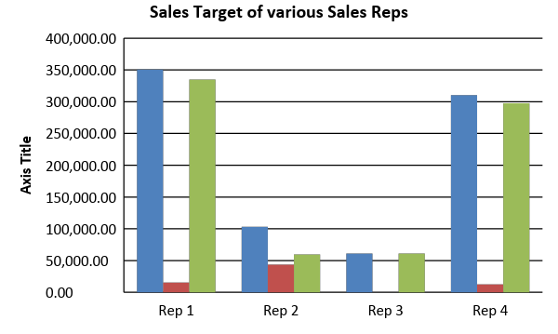
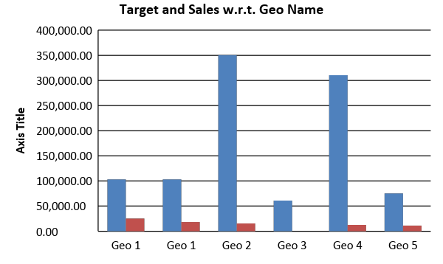
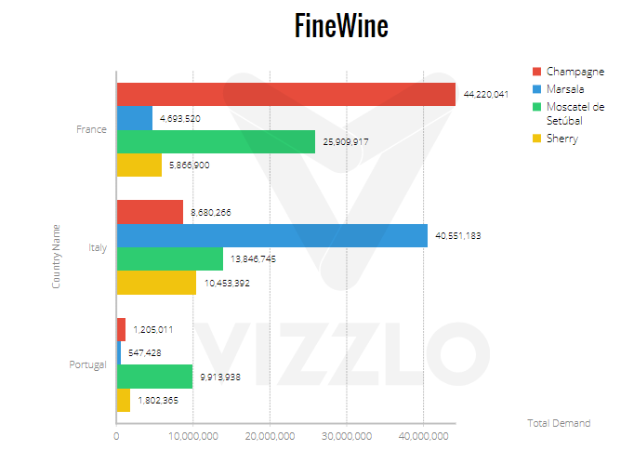
C: Sales and targets of various reps acc. to geographical region
D:Overall comparison of sales in different countries

Slide 25
Q.4c The data coming from different countries, having varied data formats and many multilingual nuances to account for. Suggest a solution that allows users to view the information they need in the format they need, on demand
Data Format may refer to a certain data type or a file format too. When we have data from multiple sources, our first step would be to integrate the data. Data integration involves combining data from several disparate sources, which are stored using various technologies and provide a unified view of the data.
Data Integration Techniques: There are several organizational levels on which the integration can be performed. As we go down the level of automated integration increases. The different levels are Manual Integration or Common User Interface, Application Based Integration, Middleware Data Integration, Uniform Data Access or Virtual Integration and Common Data Storage or Physical Data Integration
Data integration and management can be handled using external software like Talend which is a software integration vendor. The company provides big data, cloud storage, data integration, data management, master data management, data quality, data preparation and enterprise application integration software and services.
If the data format from multiple sources are of different date formats for example, with the help of external software like Sql or SqlServer using functions like CONVERT or TO_DATE(), we can convert all the different formats to a uniform format.
If the data is in a different file format, we can always give the option of downloading any file in different formats for example .docx, .pdf, .csv, .jpg etc depending upon the type of data. For example similar to the image given on the next slide.

