Slide 1
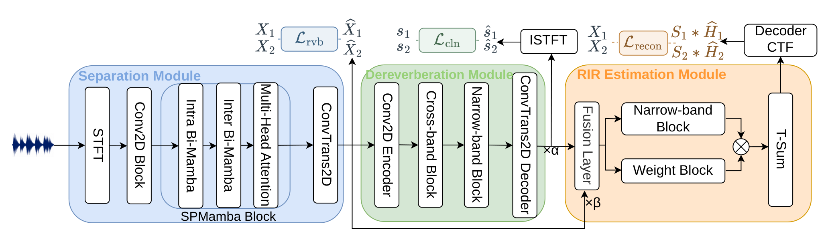
DAMSEP
Distance-Aware Monaural Source Separation
using Multi-RIR Estimation
Wen Wen et al., arXiv:2609.29749v2 (2026)
Jointly estimates clean sources and source-specific RIRs from a monaural mixture.
DRR of each estimated RIR determines the relative near/far order.
Source: Wen et al., arXiv:2609.29749v2, Fig. 1 (cropped from the paper).
1
Notes:
Original Figure 1 from Wen et al., DAMSEP, arXiv:2609.29749v2, PDF page 2. Figure labels and content are unchanged; surrounding paper text is cropped. Joint clean/reverberant source supervision and CTF-based reconstruction are used. Near/far is ordinal, not an absolute distance estimate.

Slide 2
DAMSEP: Results
HETMIXR: 2-source mixtures, 8 kHz, 2,801 test mixtures
Source separation (dB, higher is better)
Model | Params | SI-SDRi ↑ | SDRi ↑ | SIR ↑ | SAR ↑
TDANet | 2.3M | 8.08 | 7.94 | 17.95 | 9.33
SPMamba | 6.1M | 13.06 | 11.68 | 22.28 | 12.48
TF-Locoformer | 15M | 14.25 | 12.67 | 22.50 | 13.51
DAMSEP | 7.2M | 14.90 | 13.24 | 24.29 | 13.91
RIR estimation (lower is better; selected baseline)
Model | RIR-50 | LSD (dB) | DRR MAE (dB) | C50 MAE (dB)
Rec-RIR | 0.051 | 3.58 | 5.85 | 11.07
DAMSEP | 0.032 | 1.84 | 2.58 | 6.38
Near/far accuracy: 99.11% | SI-SDRi: +0.65 dB vs. TF-Locoformer
RIR-50: first-50-ms RMSE. Rec-RIR uses oracle single-source inputs; DAMSEP uses mixtures.
Source: Wen et al., arXiv:2609.29749v2, Tables 1–2.
2
Notes:
Paper-reported results, not local NF-WHAMR/LS experiments. Full source separation Table 1 reproduced as an editable table. RIR Table 2 excerpt shows Rec-RIR and DAMSEP only. Rec-RIR fidelity metrics use ground-truth individual reverberant signals, while DAMSEP always receives the mixture. DAMSEP distance-ordering accuracy 99.11% is from Table 2. RT60 error is not reported in this table.

Slide 3
BLSTM-based CTF Estimator
Time-BiLSTM variant used in the previous CTF estimator comparison
Input: monaural mixture (16 kHz) Output: two source-specific complex CTFs
STFT
+ Conv2D
Time BiLSTM
+ Light-Freq
× 4
Speaker-wise
time pooling
Frequency Attn
+ ConvFFN
× 2
Shared
CTF head
CTF 1
CTF 2
Time BiLSTM (independently at each frequency bin)
LayerNorm
BiLSTM: 64 per direction
Linear: 128 → 64
+ residual
D = 64 | Pooling hidden = 32 | Attention = 4 heads | FFN = 128
STFT: FFT 512 / hop 256 | Output per source: 257 frequency bins × 60 CTF taps
Source: local TimeBiLSTM implementation and comparison configuration (16 kHz).
3
Notes:
Implementation: espnet2/rir/rec_rir/pooled_bimamba.py, TimeBiLSTM and PooledBiMambaCTFPredictor. Configuration: egs2/whamr/rir_2spk/conf/tuning/train_pooled_bimamba_2spk_nf_16k_sweep_v2_bilstm.yaml. STFT complex RI channels -> 3x3 Conv2D (2 -> 64). Four pre-blocks alternate TimeBiLSTM and LightFrequencyBlock. LightFrequencyBlock: depthwise frequency kernel 5 plus low-rank frequency MLP, bottleneck/rank 16. Time pooling uses channel-wise speaker-specific weights normalized across time; speaker-slot embeddings are added. Two post-pooling shared frequency attention/ConvFFN blocks; attention 4 heads, FFN 128. Shared head: LayerNorm -> Linear 64/128 -> SiLU -> Linear 128/120 -> complex reshape [B,2,257,60]. Head does not produce separated speech. Optional subsequent fixed Sweep/PIM conversion to RIR is outside this simplified diagram.

