Slide 1


CODEBASICS · CLAUDE IN 60 MINUTES CHALLENGE
Data Quality Radar
Building a Claude Skill to handle messy data
From learning Claude's capabilities to building a practical, reusable workflow.
August 31, 2026
Data
Identify quality problems
Claude
Solution
Understand capabilities
Build reusable Skill
Nitu Singh
Notes:
1

Slide 2







From Learning Claude to Identifying a Problem
What the session covered
The Problem: Messy Data
Inconsistent datasets make analysis unreliable. Common issues include:
Duplicate records
Projects
Connectors
Inconsistent country names
Mixed date formats
Skills
Workflows
Missing values
Files & Data
Using Claude
Incorrect data types
Suspicious or ambiguous values
Notes:
2

Slide 3

My Solution — Data Quality Radar
A Claude Skill that turns data-quality checking into a reusable, safe workflow.
Inspect
Clean Data
Detect Issues
Core principle: Automate what is certain. Flag what is uncertain. Never invent data.
Notes:
3

Slide 4
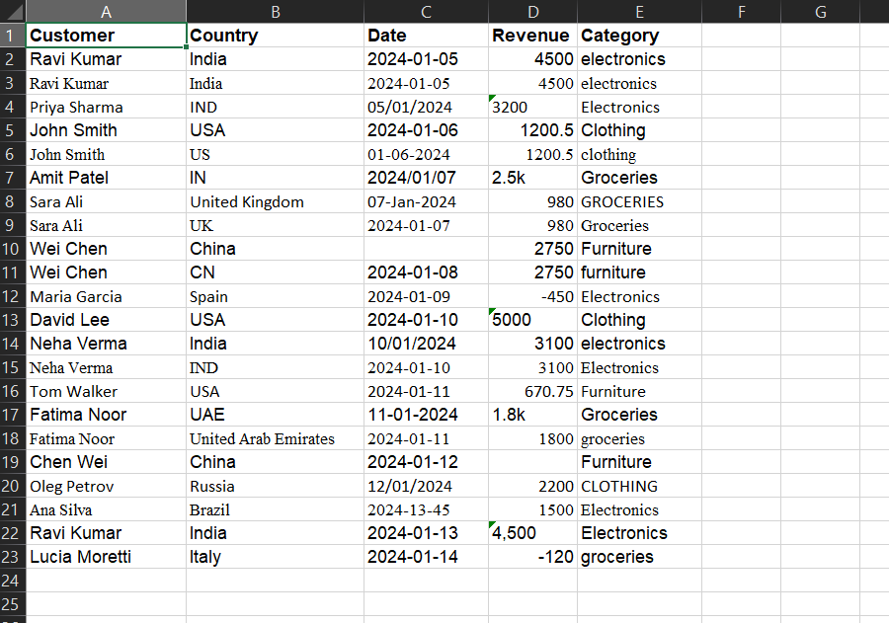
Testing the Skill on Realistic Messy Data
The test dataset included:
Duplicate rows
Country inconsistencies
Mixed & ambiguous dates
Text-based numbers (e.g., "2.5k")
Negative revenue values
Category inconsistencies
Missing values
📁 Original File
🔧 Working Copy
📋 Quality Report
Preserved — never overwritten
Cleaned by the Skill
Generated automatically
Notes:
4

Slide 5


Results & What I Learned
Outputs Delivered
The Iteration That Mattered
During testing, ambiguous dates were sometimes guessed incorrectly. Instead of accepting that, I improved the Skill to flag genuinely ambiguous dates for human review.
✅ Cleaned Excel Dataset
✅ Data-Quality Report
Key takeaway: AI automation is not just about getting an answer — it's about testing, finding failures, and improving the workflow.
✅ Flagged Items for Review
Learning by Building 🚀(created by gamma.ai and canva)
Notes:
5

