Slide 1
SHADOW FOX • DATA ANALYTICS INTERNSHIP
IBM HR ANALYTICS
Executive Overview / Workforce Insight
Prepared by: Nitu Singh
Osmania University | Mentor: Mr. Aakash
Internship period: 1 October – 31 October 2026

Slide 2
Project Overview
What the dashboard is designed to answer
PROJECT PURPOSE
CORE QUESTIONS
Summarize employee attrition and workforce indicators in one interactive Power BI report.
How many employees left? What is the overall attrition rate? How do patterns vary by department, role, age, satisfaction, overtime, tenure, and travel?
Audience: HR teams, managers, and decision-makers exploring workforce patterns.
Output: one-page executive dashboard with KPI cards, charts, and six interactive slicers.
Interpretation: descriptive analysis highlights patterns; it does not prove causation.

Slide 3
Dataset & Tools
A structured employee dataset prepared for workforce analysis
DATASET
MAIN TOOL
DATA CHECKS
IBM HR Analytics
1,470 employee records
39 columns
Microsoft Power BI
Report design, data visualization , Google Colab
Dataset reviewed for missing values and duplicate records; final working data reported as 1,470 rows.
Important fields used
EmployeeNumber — employee identifier used to count employees.
Attrition / AttritionFlag — identifies whether an employee left.
Department, JobRole, AgeGroup, JobSatisfaction, OverTime, YearsAtCompany, BusinessTravel — analysis dimensions.
MonthlyIncome — used for the average monthly income KPI.

Slide 4
Data Preparation & KPI Definitions
The meaning behind the headline numbers
TOTAL EMPLOYEES
EMPLOYEES LEFT
ATTRITION RATE
AVG. MONTHLY INCOME
Count of employees
Dashboard: 1,470
Count where Attrition = Yes
Dashboard: 237
Employees left ÷ total employees
Dashboard: 16.12%
Average of MonthlyIncome
Verify final card value before submission
Counts and rates answer different questions; the rate is used to compare groups of different sizes.
Visual-level filters were used for departure-count charts; rate charts use the Attrition Rate measure without filtering the dataset to Attrition = Yes.
The report uses a consistent purple, lavender, and white theme for readability.

Slide 5
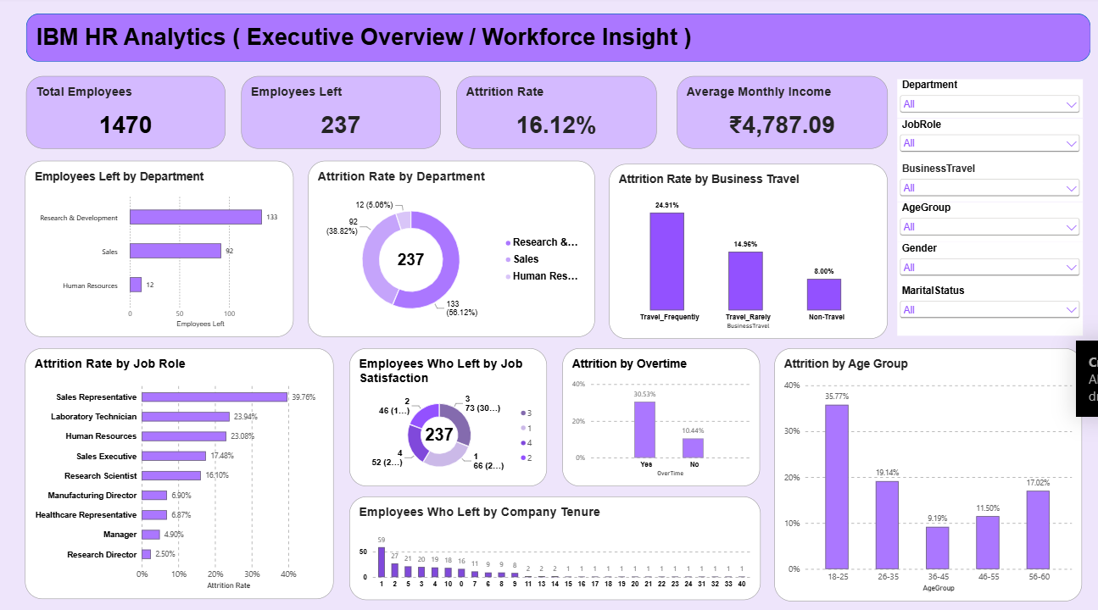
Executive Dashboard

Slide 6
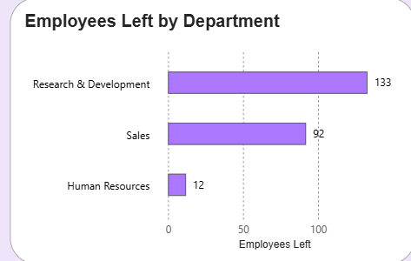
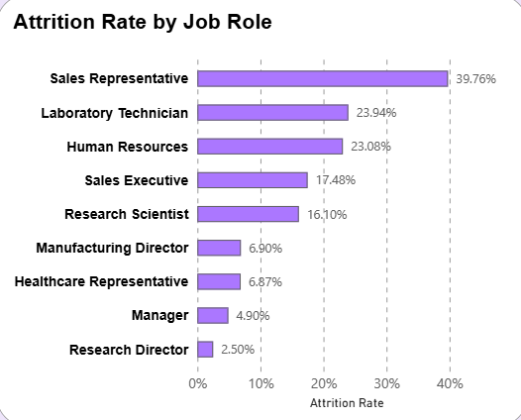
Department & Job Role Analysis
Use the visuals to compare volume and relative attrition
EMPLOYEES WHO LEFT BY DEPARTMENT
ATTRITION RATE BY DEPARTMENT
ATTRITION RATE BY JOB ROLE
Clustered bar chart compares departure counts across departments.
Donut chart compares the rate for Sales, Human Resources, and Research & Development.
Clustered bar chart highlights variation by job role.

Slide 7
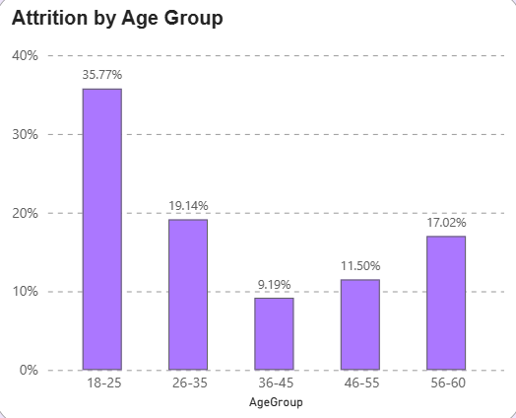
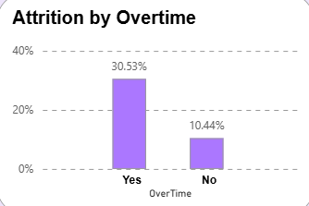
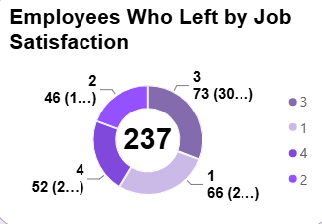
Attrition Patterns
Age, overtime, satisfaction, tenure, and business travel
ATTRITION BY AGE GROUP
ATTRITION BY OVERTIME
JOB SATISFACTION
Column chart compares attrition rates across age bands.
Compares attrition rates for employees who do and do not work overtime.
Donut shows the 237 departures split across satisfaction codes 1–4.

Slide 8
Interactivity, Learning & Conclusion
What the project demonstrates
SIX INTERACTIVE SLICERS
KEY LEARNING
Department • Job Role • Business Travel • Age Group • Gender • Marital Status
Power BI visuals, measures, filters, slicers, visual selection, formatting, and choosing counts versus rates.
Challenge: keeping visual calculations accurate. Solution: check field wells, aggregation, and filter context.
Challenge: fitting multiple visuals on one page. Solution: consistent styling and a grouped slicer panel.
Conclusion: the dashboard makes workforce attrition patterns easier to explore and compare.
Acknowledgement: Shadow Fox, mentor Mr. Aakash.
Prepared by Nitu Singh • Shadow Fox Data Analytics Internship • October 2026

