Slide 1
SHADOW FOX | INTERMEDIATE DATA ANALYST PROJECT
ONLINE RETAIL II
Sales Performance & Customer Insights Dashboard
Prepared by: Nitu Singh
Osmania University • Mentor: Mr. Aakash
Internship period: 1 October – 31 October 2026

Slide 2
Project Overview
From raw retail transactions to business insights
OBJECTIVE
FINAL OUTPUT
Understand revenue trends, top products and countries, customer segments, order values, and customer behaviour.
An interactive Power BI dashboard with KPI cards, time trends, rankings, a map, a matrix, and Year/Country slicers.
Project title: Online Retail II — Sales Performance & Customer Insights Dashboard.
Analysis period spans 2009–2011; 2009 and 2011 are partial years.
The dashboard is descriptive: it highlights patterns and contributors rather than proving causes.

Slide 3
Dataset & Tools
The source file and workflow
SOURCE FILE
PREPARATION
DASHBOARD
Online_Retail_II.csv
1,067,371 rows • 8 columns
Python + Pandas
Google Colab
Power BI Desktop
CSV analytical tables
Fields: Invoice, StockCode, Description, Quantity, InvoiceDate, Price, Customer ID, Country.
Inspected columns, data types, missing values, and duplicates.
Created nine outputs for sales, RFM customers, monthly/yearly revenue, products, countries, segments, yearly product sales, and top orders.

Slide 4
Data Preparation & Metric Definitions
Documenting the choices that affect the results
DUPLICATES
SALES DATA
REVENUE
CUSTOMER DATA
34,335 removed
1,033,036 remained
1,007,913 rows after business-rule filters
Quantity × Price
Missing Customer ID excluded only for customer-level analysis
Excluded cancellation invoices beginning with C, non-positive quantities, and non-positive prices from sales analysis.
Kept rows with missing Customer ID for valid overall sales; excluded them from customer/RFM analysis.
Flagged an unusually large PAPER CRAFT, LITTLE BIRDIE line for validation rather than automatically deleting it.

Slide 5
Dashboard KPIs
Headline metrics and what each one means
TOTAL REVENUE
TOTAL ORDERS
UNIQUE CUSTOMERS
20,476,260.45
Revenue across valid sales rows, including rows with missing Customer ID.
40,077
Distinct invoices in Sales_Data.
5,878
Customers with a known Customer ID.
AVERAGE ORDER VALUE
UNITS SOLD
469.98
Mean customer-known order value; currency not labelled until verified.
~11 million
Sum of quantity across valid sales rows.
Customer-known revenue: 17,374,804.27 • 36,969 customer-known invoices • Median order value: 303.04

Slide 6
Dashboard Visuals
What each visual answers and why it was selected
MONTHLY REVENUE TREND
CUSTOMER SEGMENT SHARE
TOP 10 PRODUCTS / COUNTRIES
Line chart: reveals changes and recurring patterns over time.
Donut chart: shows each segment's share of the selected measure.
Bar charts: make ranked comparisons easier to read.
YEARLY REVENUE / GROWTH
MAP
COUNTRY MATRIX
Column or trend visuals compare annual totals and period changes.
Adds geographic context to country performance.
Shows detailed country-level measures for comparison.
Screenshot space: replace or supplement these cards with screenshots from your final Power BI report. Use one screenshot per visual group and add a short caption describing the question answered.

Slide 7
Key Findings & Limitations
How to interpret the results responsibly
SALES VS CUSTOMER REVENUE
UNUSUAL TRANSACTION
Overall sales revenue is 20,476,260.45; customer-known revenue is 17,374,804.27 because rows without Customer ID are excluded from customer analysis.
PAPER CRAFT, LITTLE BIRDIE: quantity 80,995 and revenue 168,469.60. Flagged for validation, not confirmed as an error.
Customer ID is missing in many transaction rows; sales and customer metrics therefore use different populations.
2009 and 2011 are partial years, so annual comparisons are not full-year comparisons.
Country slicer filters the country matrix, ranking, and map; the pre-aggregated monthly trend remains overall.

Slide 8
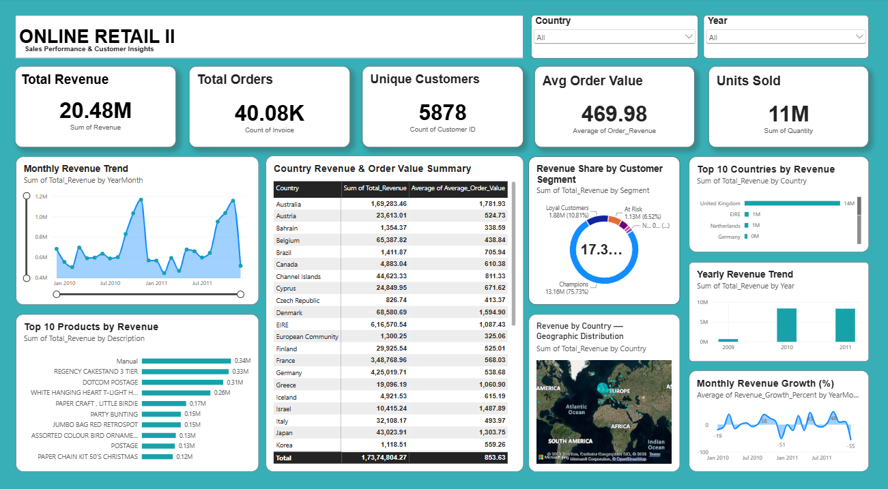
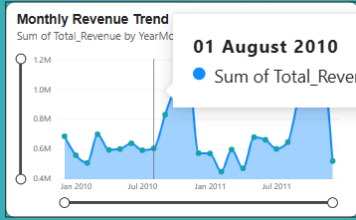
Conclusion & Next Steps
From transaction data to an interactive report
WHAT I LEARNED
NEXT STEPS
Data inspection, cleaning, deduplication, filtering, aggregation, customer analysis, KPI definitions, and dashboard design.
Validate unusual transactions, confirm currency assumptions, improve tooltips, and add country-by-month detail if required.
Thank you • Nitu Singh • Shadow Fox Intermediate Data Analytics • October 2026

