Slide 2
BUSINESS ANALYTICS / NLP PROJECT
FROM REVIEWS
TO RETAIL ACTIONS
NLP analysis of product recommendations in women’s e-commerce
PROJECT TEAM
Nitya Dhulipala • Madhusri • Rashmitha • Raghunandan

Slide 3
Problem Statement
Customer reviews contain useful detail that star ratings alone cannot explain.
Feedback is rich, but unstructured
Ratings are only a summary
Teams need repeatable insight
Customers describe fit, fabric, comfort, sizing, appearance, and expectations in free-text reviews.
A star score signals satisfaction, but often does not reveal the specific experience behind it.
Merchandising, product, and customer-experience teams need recurring themes they can investigate and act on.
RESEARCH QUESTION
Can NLP identify recurring language and sentiment in women’s clothing reviews, examine how sentiment relates to recommendation, and predict the recommendation label from review text?
PROJECT OBJECTIVE • Turn customer language into measurable signals that support clearer product information and more informed retail decisions.

Slide 4
Solution
Combine text analytics and supervised classification to study recommendation behavior.
TRACK A / UNDERSTAND
TRACK B / PREDICT
01 Explore the dataset
01 Define the target
Review ratings, recommendation labels, and text patterns.
Use Recommended IND as the outcome label.
02 Prepare review text
02 Represent text
Clean and normalize text for analysis.
Transform reviews into 5,000 TF-IDF features.
03 Extract language signals
03 Train the classifier
Inspect frequent words and phrase patterns.
Fit Logistic Regression using a stratified 80/20 split.
04 Score sentiment
04 Evaluate performance
Use VADER to classify review polarity.
Measure accuracy, precision, recall, F1, ROC-AUC, and errors.
DELIVERABLES • Language patterns • Sentiment profile • Recommendation predictions • Model evaluation • Retail actions

Slide 5
Tools and Methods
The tools used to prepare, analyze, model, and communicate the review data.
Python
Pandas
NLTK / VADER
Core programming environment for the end-to-end workflow.
Data cleaning, filtering, transformation, and exploratory analysis.
Lexicon-based sentiment scoring of review text.
Scikit-learn
Matplotlib / Seaborn
Jupyter Notebook
TF-IDF vectorization, stratified split, Logistic Regression, and evaluation metrics.
Charts for exploring dataset patterns and communicating results.
Reproducible, step-by-step analysis and experimentation.
MODEL CONFIGURATION
TF-IDF • 5,000 features • unigrams + bigrams | Stratified 80/20 train–test split | Logistic Regression

Slide 6
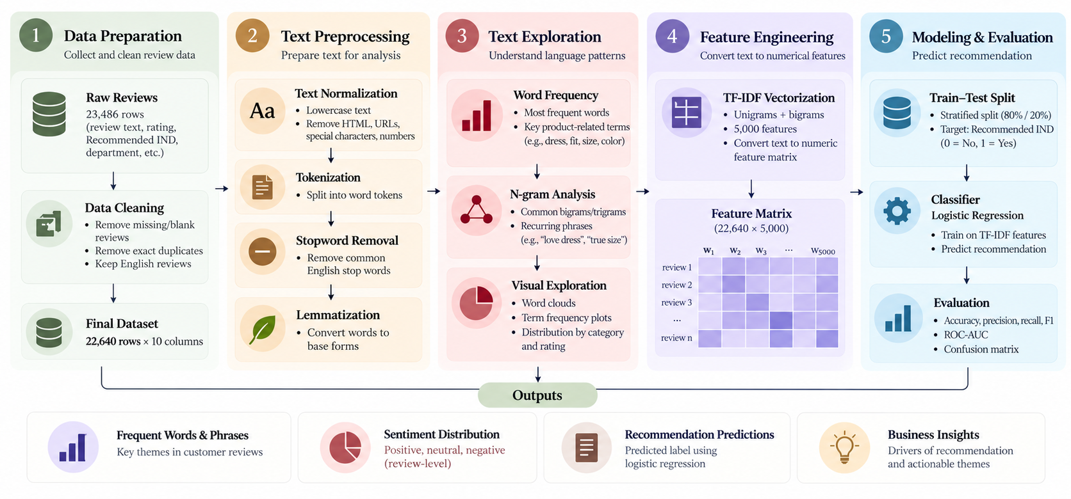
NLP Pipeline

Slide 7
Results Dashboard
A snapshot of review patterns, sentiment, and held-out model performance.
22,640
4.18 / 5
81.89%
0.9286
CLEANED REVIEWS
MEAN RATING
RECOMMENDATION RATE
ROC–AUC
SENTIMENT DISTRIBUTION
LOGISTIC REGRESSION • TEST SET
Positive
20,986 • 92.7%
Accuracy
86.95%
Precision
95.93%
Neutral
277 • 1.2%
Recall
87.78%
Negative
1,377 • 6.1%
F1-score
91.68%
VADER sentiment labels • Review-level sentiment classification
Baseline accuracy: 81.89% • Classes are imbalanced
INTERPRETATION • The model distinguishes recommendation outcomes well overall; precision, recall, and class imbalance should be considered together.

Slide 8
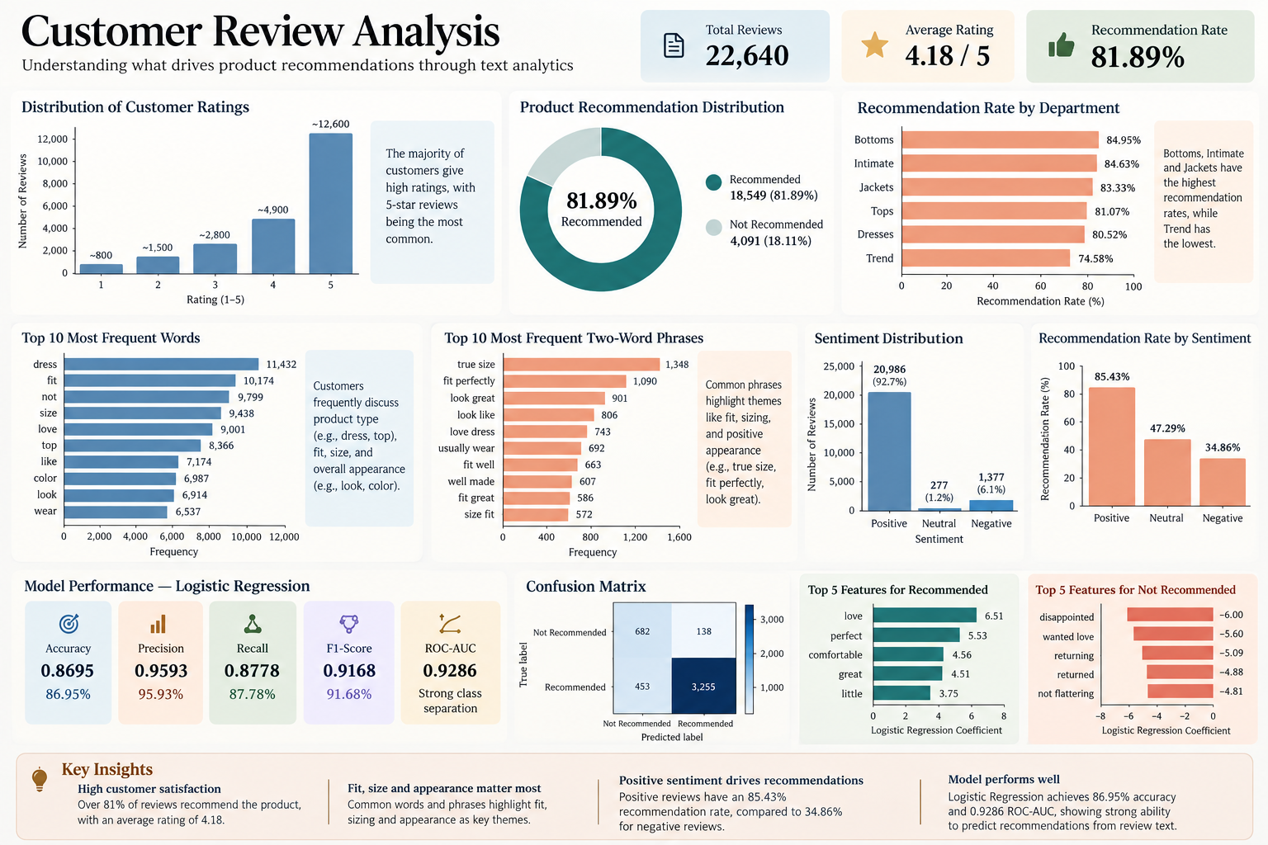

Slide 9
Business Recommendations
Translate recurring review themes into practical retail actions.
01
Make product pages more specific
Clarify fabric, fit, sizing, color, and expected appearance so shoppers can compare the description with the item they receive.
02
Improve fit and size guidance
Review recurring fit and size comments; use them to prioritize clearer size charts, fit notes, and garment-specific guidance.
03
Monitor negative review themes
Track repeated complaints—including returns, poor fit, or disappointing appearance—and route them to the relevant product or CX team.
04
Close the feedback loop
Share summarized review themes with merchandising, product, quality, and customer-experience teams; revisit themes after changes.
DECISION PRINCIPLE • Combine review-language evidence with product knowledge, customer context, and follow-up measurement.

Slide 10
Limitations & Future scope
What the current analysis can tell us—and what to validate next.
LIMITATIONS
FUTURE SCOPE
Class imbalance
Compare alternative models
Recommended reviews dominate the target distribution, which can affect how performance metrics should be interpreted.
Test additional classifiers and tune hyperparameters using consistent validation.
Sentiment nuance
Aspect-based sentiment
VADER may miss context, sarcasm, mixed opinions, and product-specific meaning.
Separate opinions about fit, fabric, quality, comfort, and appearance.
Association ≠ causation
Track themes over time
Text patterns and sentiment can be associated with recommendation without proving what caused it.
Monitor changes in recurring complaints and positive themes across product releases.
Limited generalization
Validate across contexts
The dataset represents one retailer and category context; patterns may differ elsewhere.
Test on other retailers, product categories, and time periods before wider use.
KEY TAKEAWAY • Customer reviews can become structured signals for better product questions, clearer information, and more evidence-informed retail decisions.

