Slide 1









Idea submission

Slide 2


Team details
Team Lead : Name: Nithyashree Nataraj
Contact : 9632114345
Email : nithyahsreenataraj.ai24@bmsce.ac.in
Team Member 2: Name : Nitya R Pawar
Contact : 6360580751
Email : nityar.ai24@bmsce.ac.in
Team Member 3 : Name: Kiran R
Contact : 9611461010
Email : kiranr.ec24@bmsce.ac.in

Slide 3


Our solution
Problem We Are Solving:
Automating patient risk assessment by analyzing symptoms through AI.
Alerting hospitals in severe cases to ensure timely medical attention.
Centralizing patient data management for easy access and tracking.

Slide 4

TECHNICAL APPROACH
AI-Integrated Hospital Management System for patient data handling and risk assessment.
Flask-based backend processes patient records and symptom analysis.
Streamlit is used for Frontend processes
AI chatbot assists users in evaluating symptoms and classifying risk levels.
QR code system enables quick patient identification and information retrieval.
Future improvements include database integration and enhanced AI diagnostics.

Slide 5
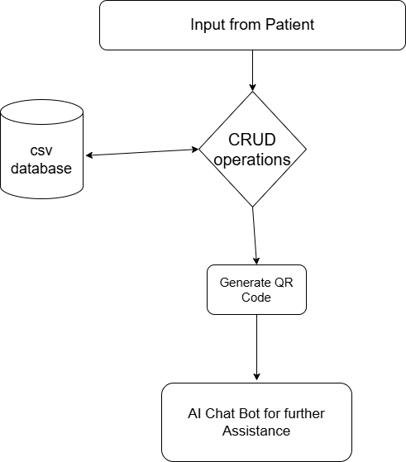
Workflow/pipeline

Slide 6
Feasibility & FUTURE SCOPE
Pros :
AI-driven automated diagnosis for quick risk assessment.
Efficient patient data management with real-time alerts.
Cons:
Accuracy limitations due to dependency on AI predictions.
Data privacy concerns requiring secure handling.
Future Improvements:
Enhancing AI models for better accuracy.
Integration with hospital systems for real-time responses.

