Slide 1
CSE7000 - INTERNSHIP
A Presentation on
Fuel Consumption Estimator for Future UAVs
Student Details
Name | Nitya C Madiwal
Roll No | 20241CSE0853
Section | 5CSE12
Under the Supervision of,
Mr. Chenna Aditya Vardhan
Associate Professor
Presidency School of Computer Science and Engineering
Presidency University
Name of the Program: B.Tech in Computer Science Engineering
Name of the HoD: Dr. Asif Mohamed
Name of the Program Internship Coordinator: Dr. R. Balakrishnan
Name of the School Internship Coordinators: Dr. Bhuvaneshwari Patil

Slide 2
Content
About Company or Organization
Working domain / Technology
Objectives of the work
Methodology Used / Course Description
Results
Conclusion

Slide 3
About Company or Organization
Hindustan Aeronautics Limited (HAL) is India's leading aerospace and defence Public Sector Undertaking (PSU).
Established in 1940 under the Ministry of Defence, Government of India.
Engaged in the design, development, manufacture, and maintenance of aircraft, helicopters, engines, and avionics.
Aircraft Research and Design Centre (ARDC) is HAL's dedicated R&D centre located in Bengaluru.
ARDC focuses on aircraft design, system integration, testing, and development of indigenous aerospace technologies.

Slide 4
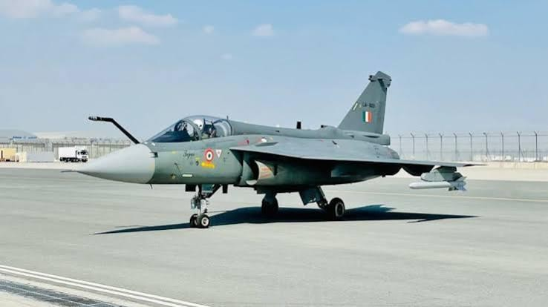
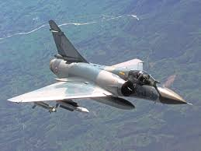
Products & Services
Major Products
LCA Tejas – Light Combat Aircraft
ALH Dhruv – Advanced Light Helicopter
LCH Prachand – Light Combat Helicopter
HTT-40 – Hindustan Turbo Trainer
Hawk Mk132 – Advanced Jet Trainer (manufactured under licence)
Key Services
Aircraft Design & Development
Maintenance, Repair & Overhaul (MRO)
Flight Testing & Certification Support

Slide 5
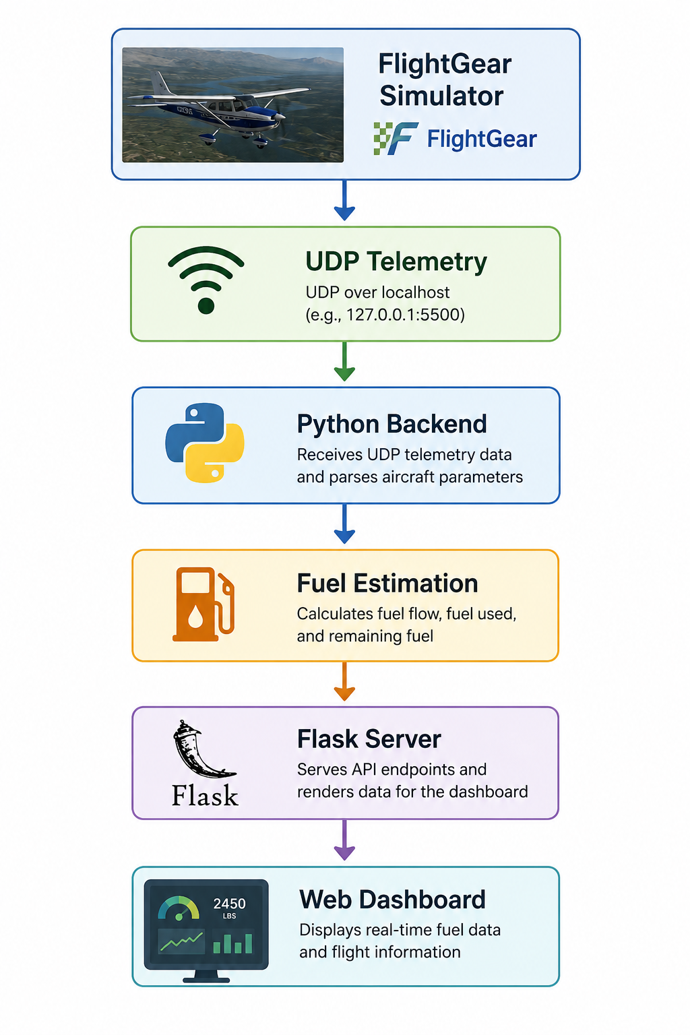
Working domain / Technology
Assigned Domain
Aerospace Software Development
Flight Simulation & Telemetry Processing
UAV Fuel Estimation
Technologies Used
Flight Gear – Real-time flight simulation
Python – Backend processing & fuel estimation
UDP Protocol – Telemetry data communication
Flask – Backend–frontend integration
HTML, CSS & JavaScript – Interactive web dashboard
architecture

Slide 6
Objectives of the work
Purpose
Develop a real-time fuel estimation system for future UAVs.
Convert flight telemetry into meaningful fuel performance information.
Usage
Monitor aircraft fuel status during simulated flight.
Support mission planning through endurance, range, and fuel reserve estimation.
Objectives
Acquire real-time telemetry from Flight Gear using UDP.
Estimate fuel parameters such as fuel flow, endurance, range, reserve fuel, landing fuel, and bingo fuel.
Display the estimated values on an interactive web dashboard.
flight data.

Slide 7
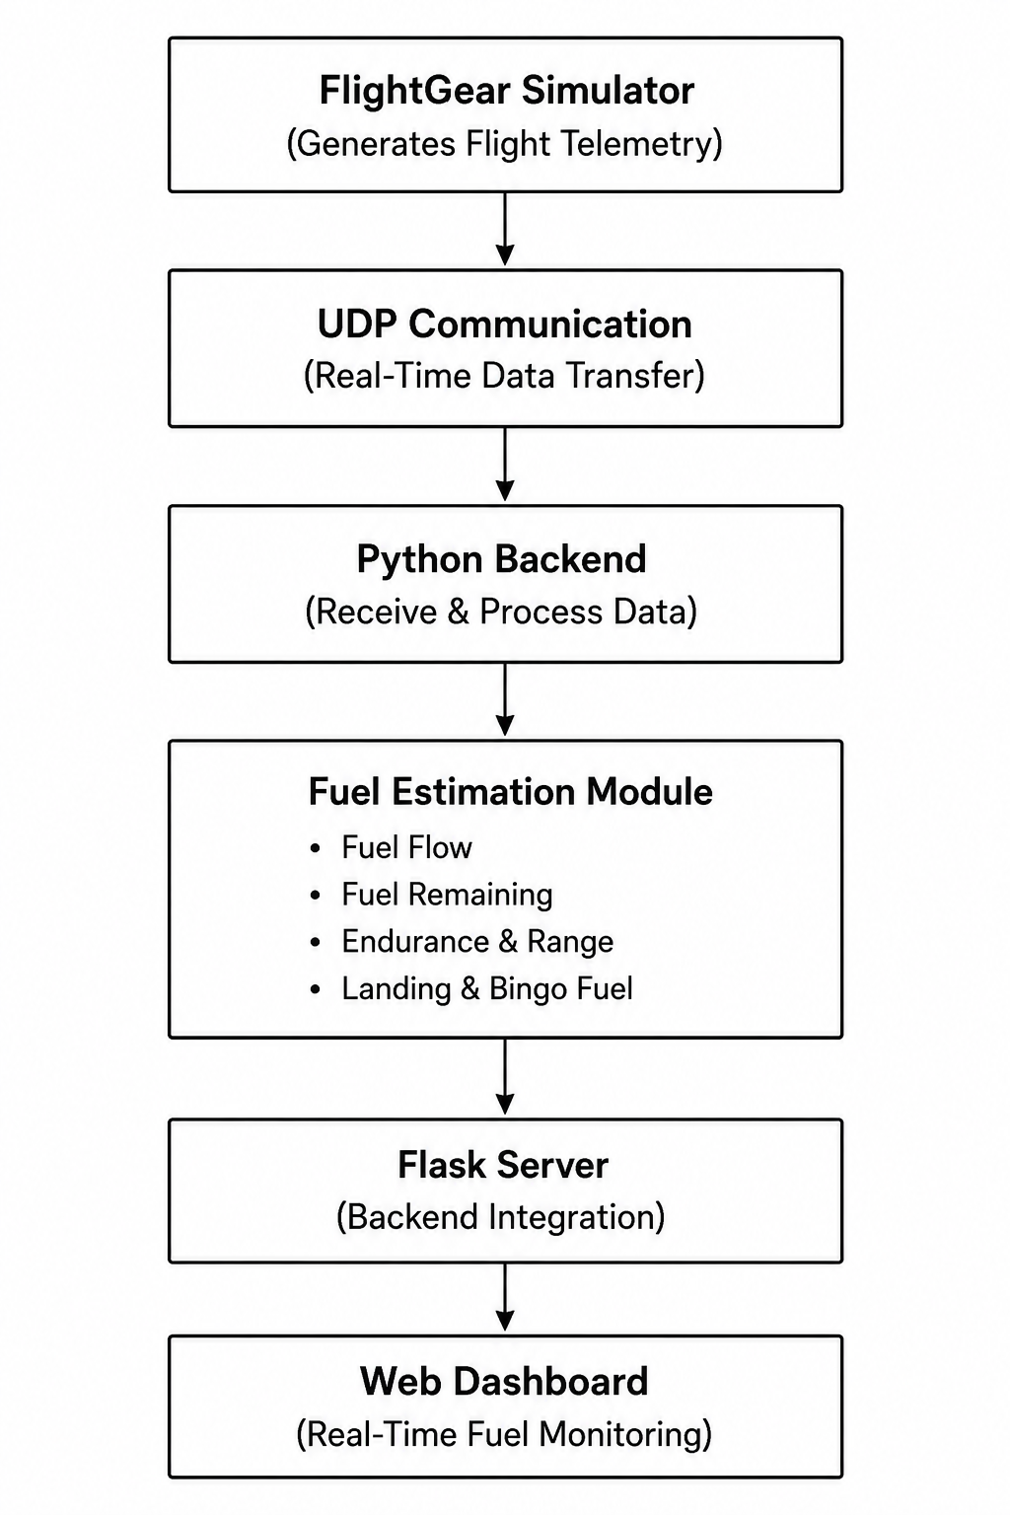
Overall System Workflow
Flight Gear simulator generates real-time flight telemetry.
Python backend receives telemetry through the UDP protocol.
Fuel estimation algorithms compute critical fuel parameters.
A web dashboard displays the estimated values for continuous
monitoring.

Slide 8
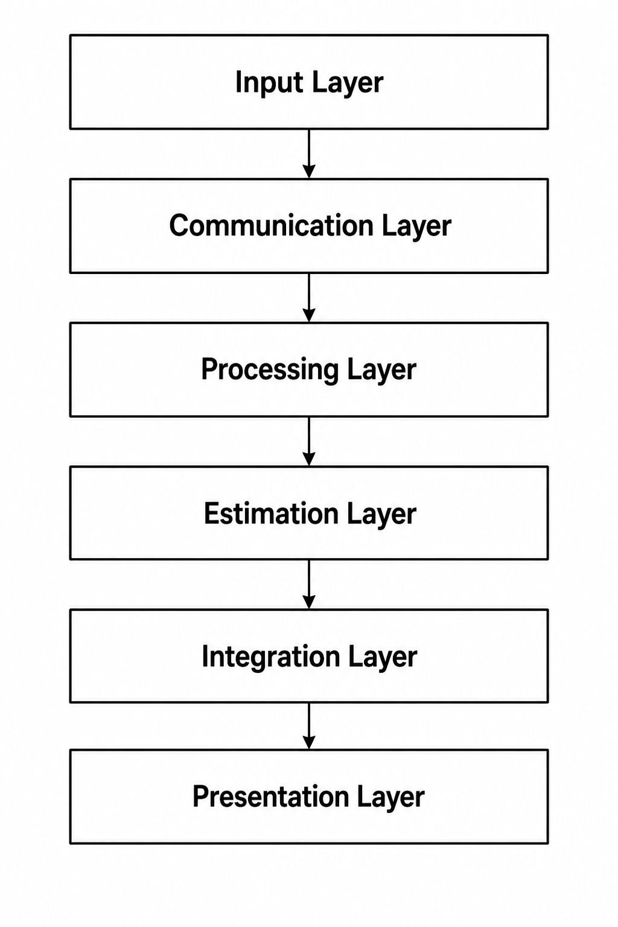
System Architecture
Input Layer
Flight Gear Simulator generates real-time flight telemetry.
Communication Layer
UDP protocol transmits telemetry data to the backend.
Processing Layer
Python backend receives and processes flight parameters.
Estimation Layer
Fuel estimation module calculates fuel parameters
Integration Layer
Flask server connects the backend with the web interface.
Presentation Layer
Web dashboard displays real-time fuel parameters and status alerts.
analysis.

Slide 9
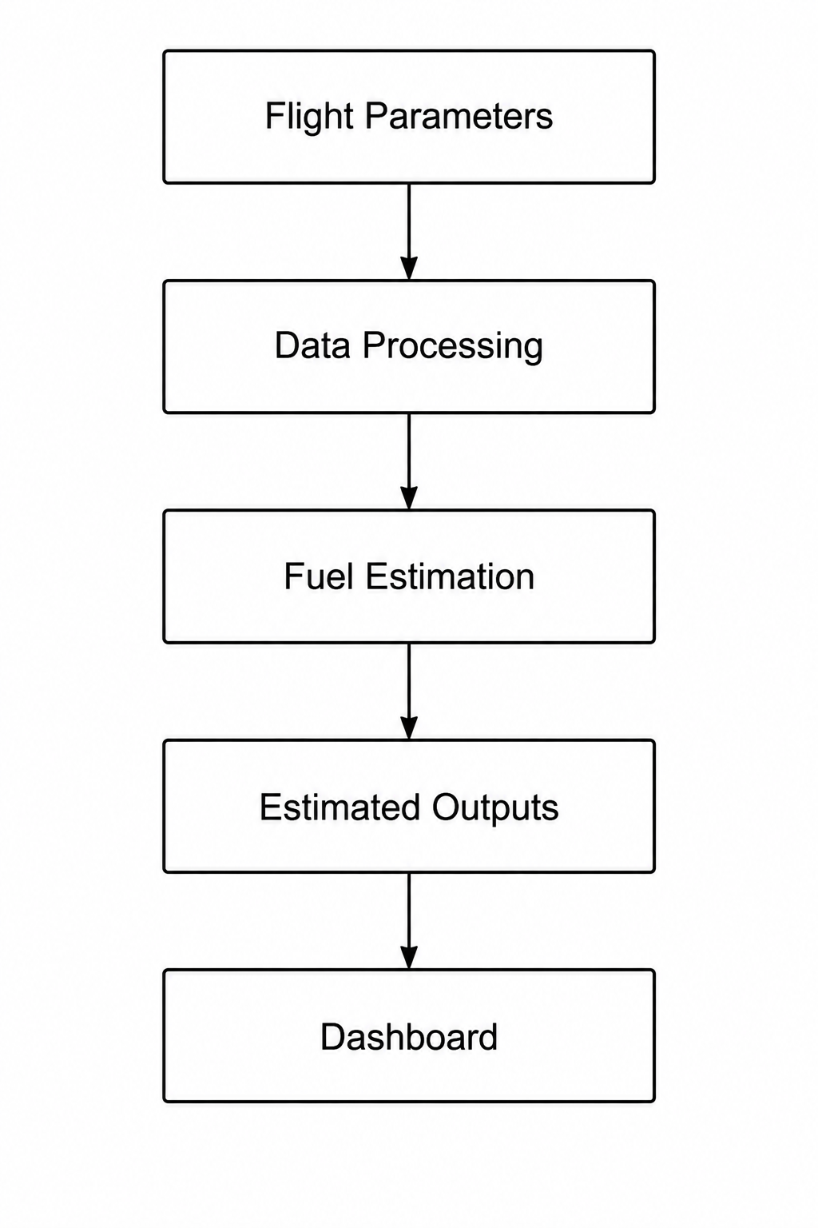
Fuel Estimation Process
Process Overview
Receives real-time flight telemetry from Flight Gear.
Processes key flight parameters in the Python backend.
Estimates fuel-related parameters using the fuel estimation model.
Displays the computed results on the web dashboard.
Estimated Outputs
Fuel Remaining . Fuel at Landing . Range
Fuel Flow . Reserve Fuel
Specific Fuel Consumption (SFC) . Bingo Fuel
Endurance . Fuel Status

Slide 10
Results
Successfully received real-time flight telemetry from the FlightGear simulator using UDP.
Processed flight parameters continuously through the Python backend.
Accurately estimated fuel flow, fuel remaining, endurance, range, landing fuel, and bingo fuel.
Displayed real-time fuel information on the web dashboard.
Generated fuel status alerts when fuel reached predefined thresholds.
Demonstrated stable and reliable real-time system performance throughout the simulation.

Slide 11
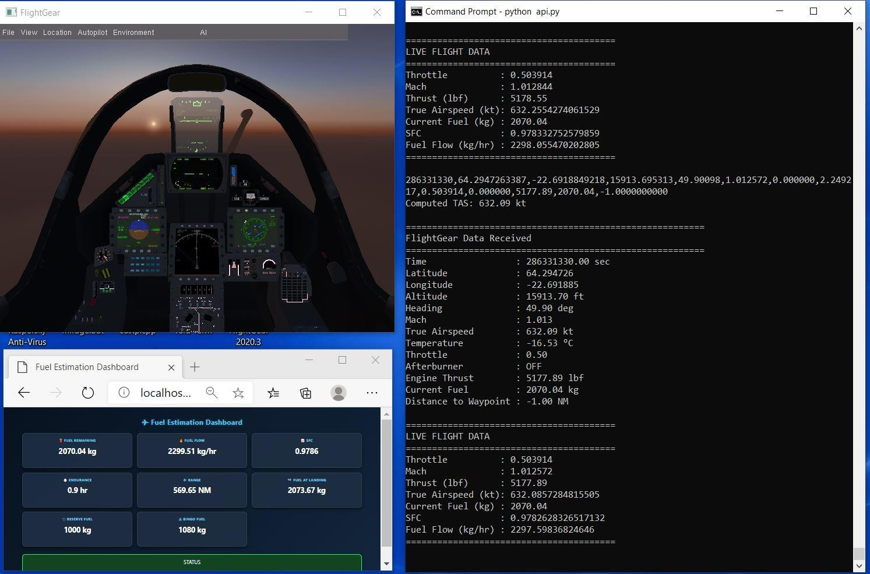
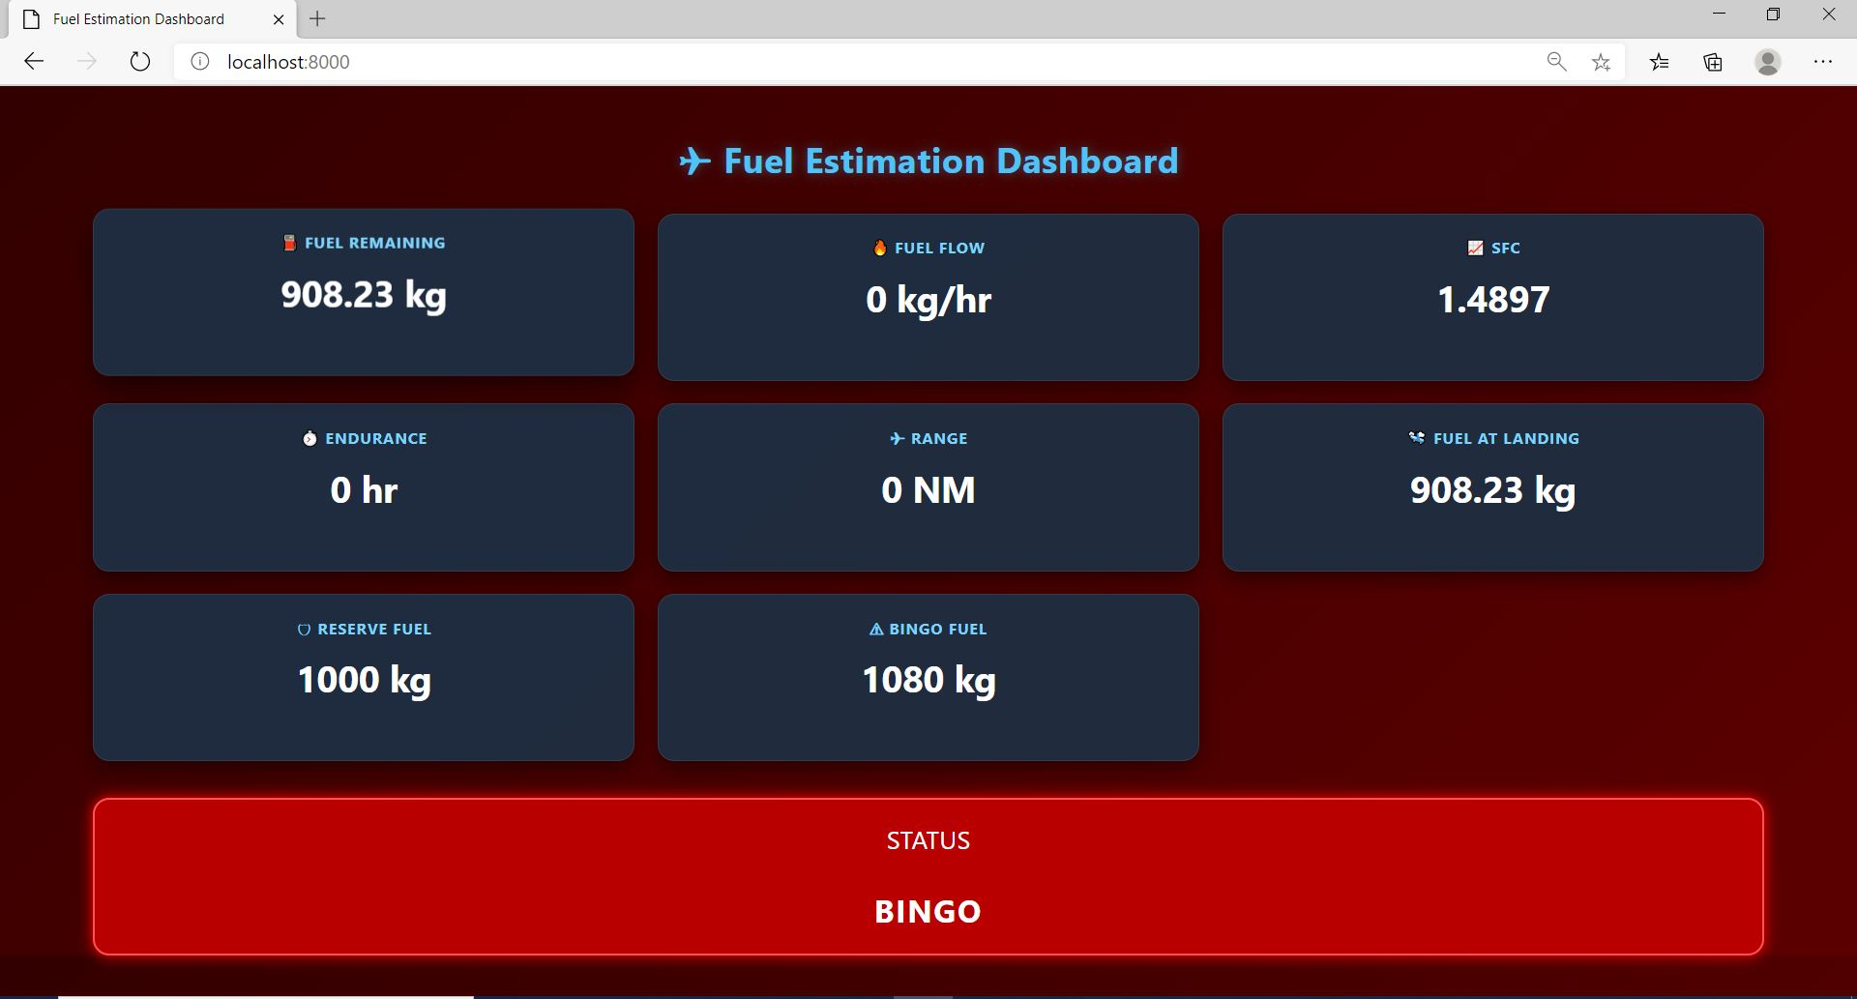
Results – Real Time System Execution

Slide 12
Conclusion
Developed a real-time fuel estimation and monitoring system using the Flight Gear simulator.
Successfully processed flight telemetry through UDP communication and a Python backend.
Estimated key fuel parameters, including fuel flow, fuel remaining, endurance, range, landing fuel, and bingo fuel.
Integrated the system with a Flask-based web dashboard for real-time visualization.
Improved flight monitoring by providing accurate fuel information and timely fuel alerts.
The proposed system demonstrates a reliable and scalable approach for real-time aircraft fuel monitoring and decision support.
.

Slide 13

Q&A

Slide 14
Thank you !!

