Slide 1

Mess Management System
Code and Conquer
Notes:
Line spacing + Page numbers

Slide 2
Agenda
01 Need Analysis
02 Design
03 Pitch
04 Feasibility Analysis
05 Prototype

Slide 3



Need Analysis
01
A Mess Management System is essential to efficiently handle daily operations in institutional or organizational messes such as hostels, offices, or canteens. Traditional manual systems lead to inefficiencies, errors, and poor user experience.

Slide 4
Design
02

Slide 5
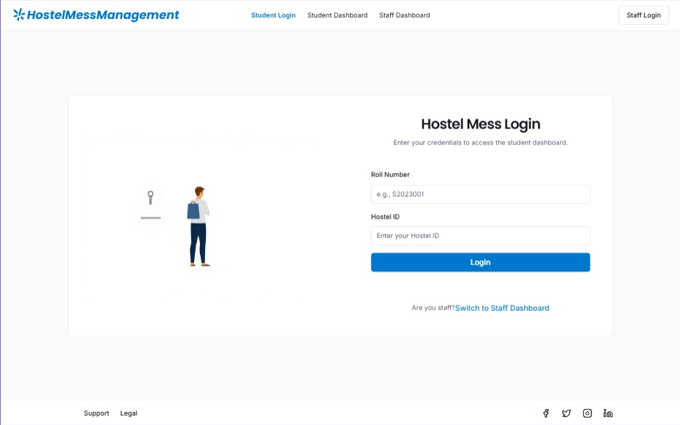
Login Page

Slide 6
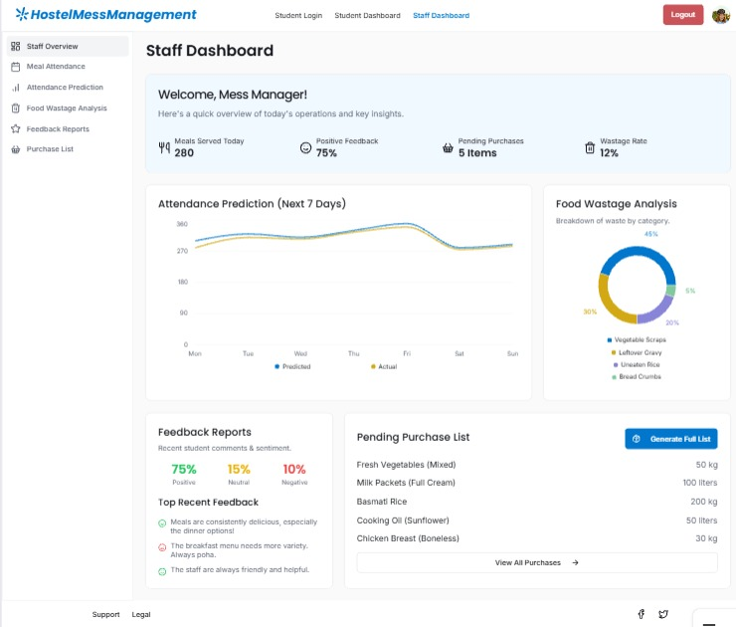
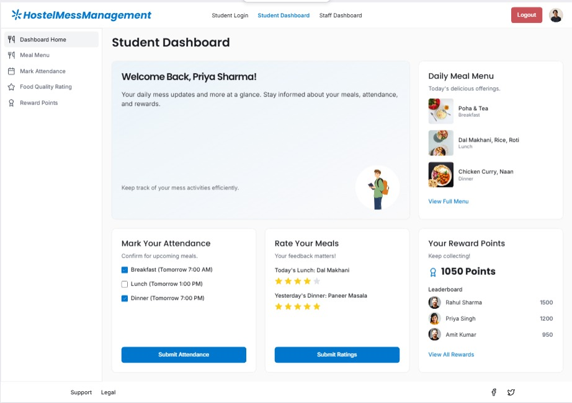
Staff Dashboard
Student Dashboard

Slide 7
Bid and Pitch
03
Our Mess Management System offers a smart, automated solution to simplify daily mess operations.
By integrating meal tracking, billing, and inventory management in a single platform, it eliminates manual errors and improves efficiency.
Key Advantages:
1. Transparency: Real-time meal data and clear cost breakdowns.
2. Reduced Wastage: Predictive analytics optimize food usage.
3. User-Friendly: Web and mobile access for staff and users.
4. Scalable: Suitable for hostels, offices, and corporate cafeterias.

Slide 8
Feasibility Analysis
04

Slide 9

What we asked the mess in charge
What is the current method?
Ask for the number of students present in the hostel
The hostel committee is consulted for the same
Make the food.
How is our solution helpful
The staff will get to know the number of students coming for the meal.
More accurate attendance and estimations.
Food will be made according to the number of students coming for the meal instead of the number of students present in the hostel.

Slide 10

What we asked the students
What are some reasons to not mark the attendance
Forgetfulness
Lack of incentive
Lack of privacy.
Our Solutions
Timely notifications.
Making the reduced food wastage and potentially a point system
Transparency about which data is being collected and why

