Slide 1
BLUESTOCK FINTECH PVT. LTD.
Mutual Fund
Analytics Platform
Nitya Sharma
Data Analytics Intern | June 2026
GitHub: NityaSharma27/bluestock-analytics

Slide 2
Problem Statement & Objectives
PROBLEMS WE SOLVE
OUR SOLUTION
P1
Data Fragmentation
O1 Python ETL pipeline from AMFI data
NAV, AUM, SIP data scattered across sources
O2 5-table SQLite star schema DB
P2
No Unified Platform
Investors can't compare funds easily
O3 EDA — 17+ analytical charts
P3
No Benchmark Tracking
O4 Sharpe, Sortino, Alpha, Beta, VaR
Retail investors lack alpha/tracking data
O5 4-page Power BI dashboard
P4
Investor Blind Spot
Demographics & geography not analyzed
O6 Investor demographic analysis
Slow Reporting
O7 Fund vs Nifty 50/100 benchmark
P5
Static PDFs take days to prepare
O8 Final report + 12-slide deck

Slide 3
Data Sources & Datasets
10
97,268
40
4.5 Yrs
32K+
Datasets
Total Rows
AMFI Schemes
NAV History
Transactions
File | Rows | Description | Source
01_fund_master.csv | 40 | 40 AMFI schemes, expense ratio, risk grade | AMFI India
02_nav_history.csv | 46,000 | Daily NAV Jan 2022–May 2026 | mfapi.in
03_aum_by_fund_house.csv | 90 | Quarterly AUM for top 10 AMCs | AMFI Quarterly
04_monthly_sip_inflows.csv | 48 | Monthly SIP inflows & accounts | AMFI Monthly
05_category_inflows.csv | 144 | Net inflows by category FY25 | AMFI India
07_scheme_performance.csv | 40 | Sharpe, Alpha, Beta, Max Drawdown | Computed
08_investor_transactions.csv | 32,778 | SIP/Lumpsum/Redemption transactions | Simulated
09_portfolio_holdings.csv | 322 | Top stock holdings per equity fund | AMFI India
10_benchmark_indices.csv | 8,050 | Nifty 50, 100, BSE SmallCap daily | NSE/BSE

Slide 4
System Architecture & ETL Pipeline
1
2
3
4
5
EXTRACT
TRANSFORM
LOAD
ANALYSE
VISUALISE
mfapi.in REST API + Local CSVs (AMFI)
Pandas cleaning · Type casting · Forward-fill
SQLite DB via SQLAlchemy · 5-table star schema
Jupyter Notebooks · Sharpe · VaR · Alpha · Beta
Power BI · 4 interactive pages · Slicers

Slide 5
EDA Highlights — Part 1
📈 SIP Inflow Growth
🏦 Fund Distribution
💰 AUM by Fund House (₹ Crore)

Slide 6
EDA Highlights — Part 2
👥 Investors by Age Group
🗺️ T30 vs B30 City Transactions
🔑 Key EDA Findings
✦ SIP inflows grew 2.8× — ₹11,000 Cr → ₹31,002 Cr (Dec 2025 all-time high)
✦ Industry folios doubled — 13.26 Cr → 26.12 Cr in 4 years
✦ 26-35 age group dominates — 43% of all investors
✦ Punjab leads state transactions · T30 cities = 56% · B30 growing 2.5× faster
✦ Large Cap funds highly correlated (>0.85) · Debt + Equity gives good diversification

Slide 7
Fund Performance Analytics
🏆 Top 5 Funds — Composite Scorecard
📐 Metrics Computed
Fund | 3yr CAGR | Sharpe | Alpha
SBI Small Cap Direct | 23.39% | 0.93 | 30.34
SBI Small Cap Regular | 23.14% | 0.94 | 30.14
ABSL Small Cap | 22.38% | 0.90 | 28.27
Axis Small Cap | 20.98% | 0.84 | 26.08
Nippon Small Cap | 20.15% | 0.81 | 25.60
CAGR: 1yr / 3yr / 5yr returns
Sharpe: Risk-adjusted return (Rf=6.5%)
Sortino: Downside risk adjusted
Alpha: Excess return vs Nifty 100
Beta: Market sensitivity (OLS)
Max DD: Peak-to-trough decline
Score: Composite 0-100 ranking
📊 3-Year CAGR by Sub-Category

Slide 8
Advanced Risk Metrics
VaR 95%
CVaR 95%
Max Drawdown
Safest Fund
~-2.5%
~-3.2%
-38.4%
~0.01%
Small Cap worst case daily loss
Average loss beyond VaR
Worst peak-to-trough decline
Liquid funds — near zero VaR
🔄 SIP Investor Status
📊 Sector Concentration (HHI)

Slide 9
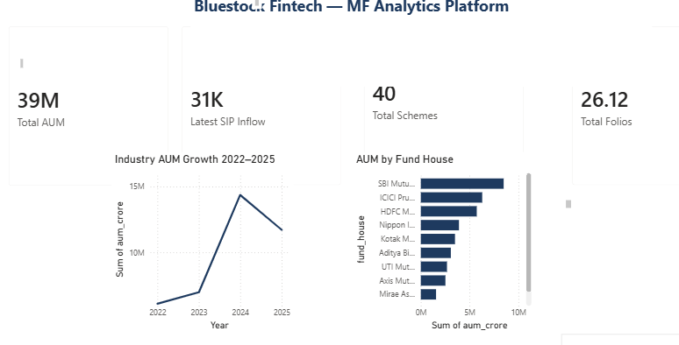
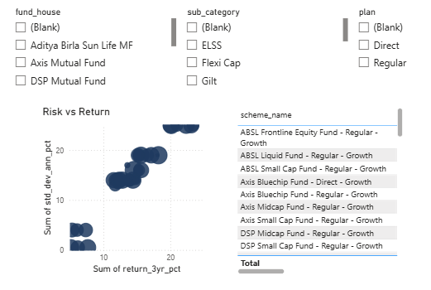
Power BI Dashboard — Pages 1 & 2
PAGE 1 — Industry Overview
PAGE 2 — Fund Performance
₹81L Cr
Total AUM
₹31K Cr
SIP Inflow

Slide 10
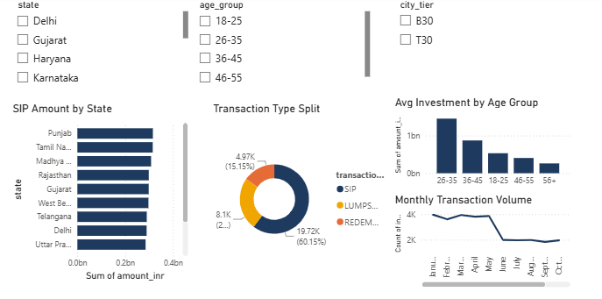
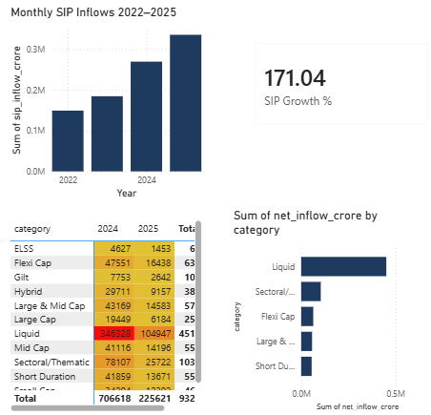
Power BI Dashboard — Pages 3 & 4
PAGE 3 — Investor Analytics
PAGE 4 — SIP & Market Trends

Slide 11
Key Findings & Recommendations
📈
SIP Surge
💡 Recommendations
SIP inflows grew 2.8× to ₹31,002 Cr — India's equity culture is maturing rapidly
High Risk
SBI / ABSL Small Cap
→ 20%+ CAGR potential
🏆
Best Performers
SBI Small Cap leads with 23.39% 3yr CAGR and highest alpha (30.34%)
Low Risk
ICICI Pru Liquid
→ Sharpe 7.68, stable
🏦
SBI Dominance
SBI MF is India's largest AMC with ₹12.5L Cr AUM — 3× more than DSP
Tax Saving
ELSS funds before March
→ ₹1.5L deduction limit
👥
Young Investors
AMCs
Focus B30 cities
→ Growing 2.5× faster
26-35 age group = 43% of investors. Youth-driven SIP culture is the growth engine
Folios Doubled
Data Fix
Rectify AMFI code
mismatch in task sheet
📊
MF folios grew from 13.26 Cr to 26.12 Cr — 2× retail participation in 4 years

Slide 12
Thank You!
Bluestock Fintech — Mutual Fund Analytics Platform

