Slide 1

PREDICTION OF RHEUMATOID ARTHRITIS SEVERITY USING BIOMARKERS AND BLOCKCHAIN
24AIM112 Molecular biology and basic cellular physiology
24AIM115 Ethics, innovative research, businesses & IPR
K. Nitya - CB.AI.U4AIM24123
B. Pavani Shreeya - CB.AI.U4AIM24106
Ardhra Vinod - CB.AI.U4AIM24105
Harikrishna Sivanand Iyer - CB.AI.U4AIM24114

Slide 2
Introduction
Autoimmune diseases, such as rheumatoid arthritis (RA) involve multiple biomarkers like cytokines and immune cell markers. RA diagnosis and treatment strategies often depend on subjective clinical evaluations which leads to delay in treatment. So, there’s a need to develop a model to predict severity of RA and suggests appropriate medication.
To develop a Graphical User Interface (GUI) which allows the users to input the biomarker levels which can predict the severity of RA using XGBoost algorithm and suggest medications. We integrated Blockchain technology in our project for patient’s data privacy.
Dataset was acquired from the NCBI’s Gene Expression Omnibus(GEO).
Preprocessing was done using MinMaxScaler.

Slide 3
XGBoost Algorithm
XGBoost is an optimized implementation of Gradient Boosting and is a type of ensemble learning method. Ensemble learning combines multiple weak models to form a stronger model.
It uses decision trees as its base learners combining them sequentially to improve the model’s performance. Each new tree is trained to correct the errors made by the previous tree and this process is called boosting.
Why XGBoost?
We use XGBoost because it gives high accuracy and handles complex data well by using gradient boosting with regularization, making it ideal for predicting RA severity from biomarker inputs.

Slide 4
Methodology
Convert Biomarker Values
- Applies biological conversion formulas to normalize IL-6, IL-17, TNF-α, and IL-10 levels.
Classify Severity Based on Thresholds
- Classifies each patient as Mild, Moderate, or Severe using a rule-based threshold function.
Train and Save XGBoost Model
- Trains a multi-class XGBoost model on the biomarker data and saves the model and scaler.

Slide 5
Initialize Blockchain for Patient Records
- Creates a secure blockchain structure to store immutable patient prediction records.
Predict Severity Using Trained Model
- Uses the trained XGBoost model to predict severity from user-entered biomarker values.
Recommend Treatment Based on Severity
- Displays specific treatment suggestions tailored to the predicted severity level.
Save Patient Record to Blockchain
- Adds the prediction and treatment history to the blockchain with a secure hash.
User-Friendly GUI with Login
- Provides a Tkinter-based graphical interface with login access and interactive prediction tools.

Slide 6
Building GUI
Using Tkinter in python we built the Graphical User Interface (GUI) for entering biomarker levels(5) and get prediction using the trained model.
Tkinter is a standard GUI library for Python which provides a fast and easy way to create desktop applications.
The pre-trained model was loaded for making predictions.
The application window was given a sky blue background.
5 Input fields were created and a “prediction severity” button was added to get prediction.
This GUI takes input biomarker levels, scales them, makes a prediction and displays the result.
This GUI is useful for lab researchers, clinicians and doctors to analyze patients with RA severity.

Slide 7
Blockchain Integration
Data Bundling
- Each time a user inputs biomarker levels and gets a severity prediction, the data is bundled into a "block" along with a timestamp.
Blockchain Structure
- These blocks are added to a secure, linked digital ledger (the "blockchain").
Immutability
- Once added, the blocks cannot be changed, ensuring tamper-proof data.
Data Integrity
- This prevents alteration of past medical records, ensuring accurate and trustworthy information.
Transparency & Security
- Blockchain guarantees full transparency, security, and integrity, critical for sensitive health data tracking.

Slide 8
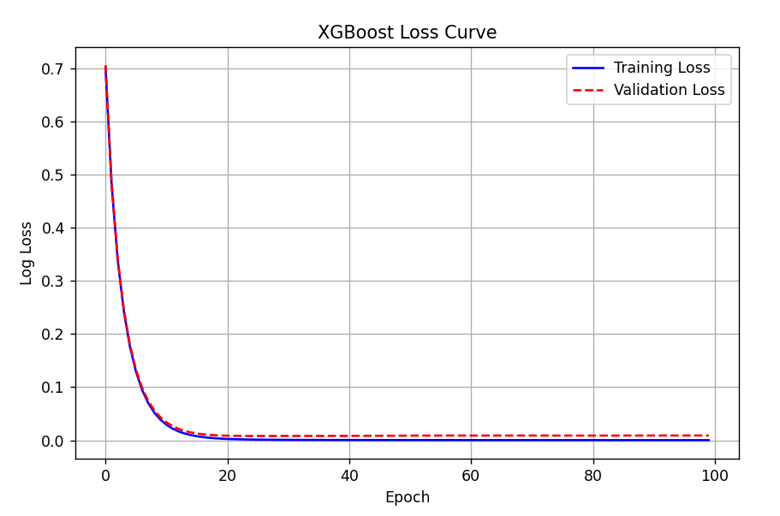
Results
After training the XGBoost model, it
acheived an accuracy of 99.75%

Slide 9
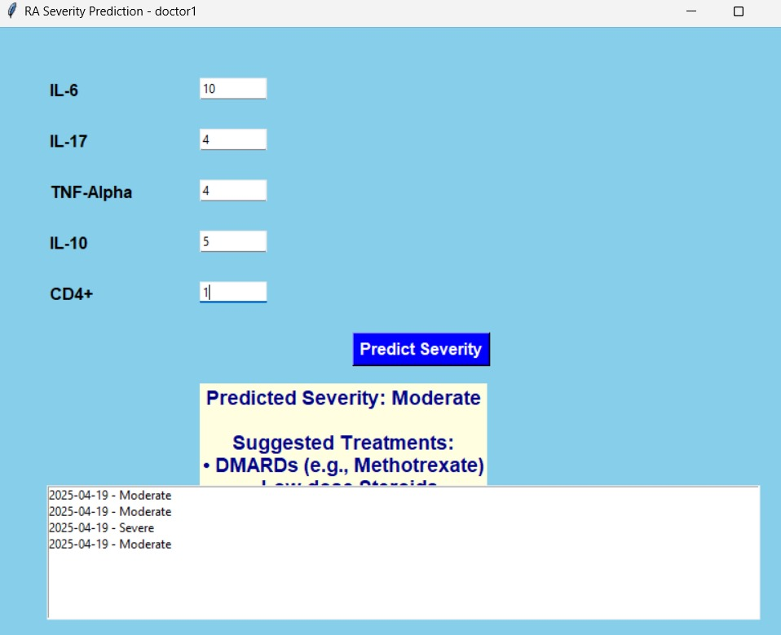
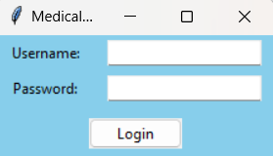
GUI Window

Slide 10
Suggested Medications
Severe RA (TNF-α >15 pg/mL, IL-6 >50 pg/mL, IL-17 >20 pg/mL, CD4+ >6%):
Biologic DMARDs (TNF inhibitors: Infliximab/Adalimumab; IL-6 blockers: Tocilizumab) work on dominant cytokines to inhibit inflammation and joint damage. IL-17/IL-23 inhibitors (Secukinumab) target Th17-driven pathology (under trial). EULAR-endorsed anti-TNF + Methotrexate combinations enhance effectiveness and slow radiographic progression.
Moderate RA (TNF-α 8–15 pg/mL, IL-6 25–50 pg/mL, IL-17 8–20 pg/mL, CD4+ 3–6%):
Synthetic DMARDs (Leflunomide/Methotrexate) suppress T-cell activation and synovial hyperplasia. Flares are managed with low-dose glucocorticoids (Prednisone), and Anakinra (IL-1Ra) is used in IL-1-mediated refractory cases.
Mild RA (TNF-α <8 pg/mL, IL-6 <25 pg/mL, IL-17 <8 pg/mL, CD4+ <3%): NSAIDs (Ibuprofen) and physiotherapy alleviate symptoms and preserve joints. IL-10/TGF-β levels are checked to track compensatory anti-inflammatory reactions; biomarker shifts initiate DMARD intensification if acceleration occurs.

Slide 11
Artificial intelligence in rheumatoid arthritis: potential applications and future implications
The article highlights data privacy, transparency of models, and regulation as primary ethical issues in the use of AI in medicine.
It identifies potential dangers with the "black box" aspect of AI, the likelihood of bias in prediction, and difficulty in applying past, piecemeal, and frequently unstructured patient data.
The authors urge physician guidance and careful regulation to ensure the safe incorporation of AI tools into practice medicine.

Slide 12
Transforming Rheumatoid Arthritis Management: Harnessing Artificial
Intelligence for Early Detection, Personalized Treatment, and Ethical
Challenges
Machine learning algorithms can analyze large datasets of biological samples from RA and can be used to tailor treatment strategies to individual patients, improving the efficacy of therapies.
The development and deployment of AI in the management of RA can support a goal that all patients should be assured of high-quality, fairly administered, and transparently accounted care.
Artificial intelligence systems may easily become more transparent in making decisions, and the reasons behind these decisions are therefore more understandable and human interpretable.

Slide 13
Advancements in machine learning and AI in rheumatoid arthritis
ML approaches offer promising tools to address myriad challenges by analysing large and diverse datasets to aid diagnosis and screening, predict treatment responses, and personalise patient care in RA. The technology also displays potential in the field of drug discovery.
Ethical considerations, privacy concerns, and regulatory requirements surrounding data sharing and algorithm deployment pose additional challenges to the implementation of ML approaches in clinical practice.

Slide 14
On the Integration of Artificial Intelligence and Blockchain Technology: A Perspective About Security
AI is a multidisciplinary field that draws from various areas including machine learning, deep learning, natural language processing, and robotics.
The principal characteristic of Blockchain is its decentralized nature, removing the need for a central authority or intermediary.
The immutability feature in blockchain is one of the key security advantages of Blockchain technology.
AI techniques that utilize Blockchain can offer decentralized learning to facilitate a trust and secure sharing of knowledge and decision outcomes

