Slide 1

TELESCOPE CONTROL SYSTEM
K. Nitya -CB.AI.U4AIM24123
B. Pavani Shreeya -CB.AI.U4AIM24106
Ardhra Vinod -CB.AI.U4AIM24105
Hari krishna Iyer -CB.AI.U4AIM24114

Slide 2
Data Acquisition:
Imported JPL horizons from Astroquery python package.
Imported SkyCoord (co-ordinates)from astropy to retrive positions of celestial objects.
DSA Implementation:
Used arrays to store angles, angular velocities and feedforward terms.
NumPy arrays is used to handle state space representation, matrix multiplications, simulation data and control input efficiently.

Slide 3
LQR ALGORITHM
Linear Quadratic Regulator (LQR) is a feedback control algorithm that utilizes all state variables for optimal control design, where each state variable is multiplied by a gain and summed to generate a single actuation value

Slide 4




ALGORITHM
-> System Dynamics Modeling
State Space Representation:
$$\dot{x} = Ax + Bu, x ={ [θ, \dot{θ},φ,\dot{φ} ] }^{T}$$
A: Defines how state variables change over time.
B: Control input matrix for torque application.
-> Optimal LQR Control
computes u to minimize:
$$J = \int_{0}^{∞}{{(x}^{T} Qx+u^{T}Ru)dt}$$
$$u=−kx$$
Q: State weighting matrix (prioritizes angular precision).
R: Control effort weighting matrix.
Algebraic Riccati Equation (ARE):
Solve
$${A^{T}P+PA−PBR }^{−1}B^{T}P+Q=0$$
$$K=R^{−1}B^{T}P$$
P = Solution matrix used to compute optimal control gain

Slide 5


-> Feedforward Compensation
Velocity Feedforward: Enhance tracking by compensating for target motion:
$${ff}_{θ} = \frac{∆θ target}{∆t}, {ff}_{∅}= \frac{∆∅ target}{∆t}$$
​
​
Integrated into control law:
$$u=−k(x−x_{target})+{ff}_{u}$$
-> Real-Time Target Tracking Simulation:
Celestial Position Updates:
Fetch real-time RA/Dec coordinates of target (e.g., Sirius) using astroquery.
Time-Delay Simulation:
Introduce latency with time.sleep() to mimic real-world operation.

Slide 6
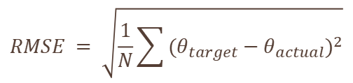

-> Numerical Integration of Dynamics
Runge-Kutta 4th Order (RK4):
Propagate system states over time:
Solves nonlinear dynamics with time-varying feedforward terms.
$$y_{n+1}=y_{n}+\frac{h}{6}(k_{1 }+{2k}_{2}+{2k}_{3}+k_{4})$$
-> Performance Metric
Root Mean Square Error (RMSE):
Quantify tracking accuracy:
$$RMSE = \sqrt{\frac{1}{N}\sum{{(θ_{target}−θ_{actual})}^{2}}}$$

Slide 7
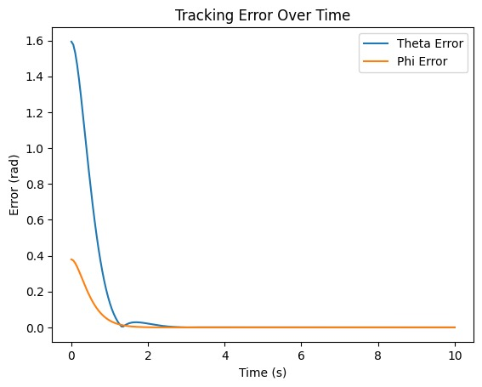
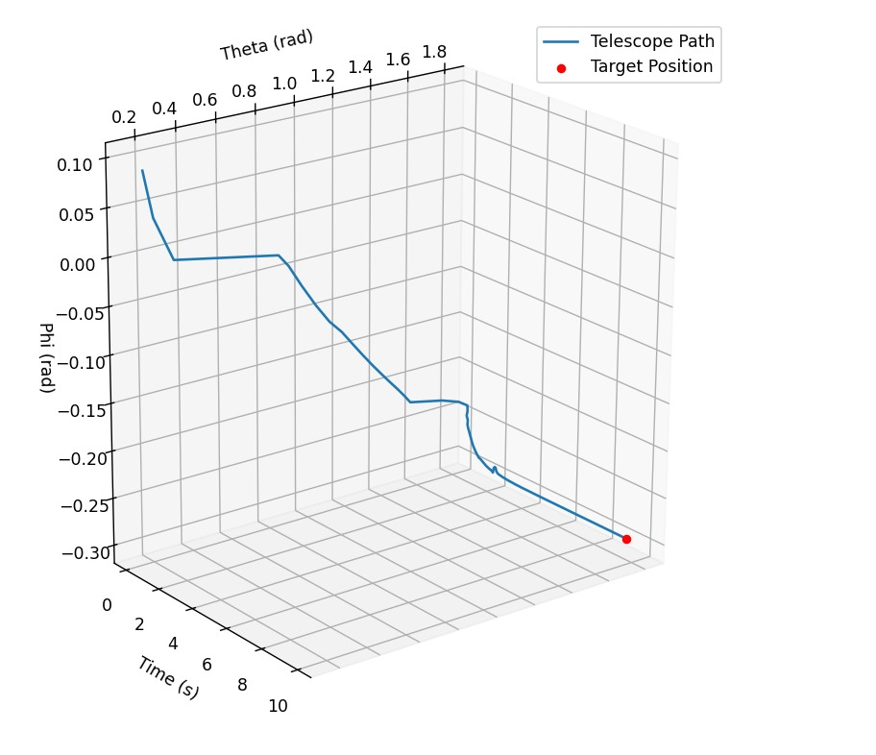
Tracking Error Over Time:
The error in theta (blue) and phi (orange) decreases rapidly and stabilizes close to zero.
Telescope Path Over Time:
The telescope starts from an initial state and gradually corrects its angles toward the target.
Observation: The LQR control effectively stabilizes the telescope and brings it to the desired target with minimal oscillations.

Slide 8
Thank You

