Slide 1

TELESCOPE CONTROL SYSTEM
K. Nitya -CB.AI.U4AIM24123
B. Pavani Shreeya -CB.AI.U4AIM24106
Ardhra Vinod -CB.AI.U4AIM24105
Hari krishna Iyer -CB.AI.U4AIM24114

Slide 2
PROBLEM STATEMENT
Modern telescope systems require precise pointing accuracy to track celestial objects efficiently. This work introduces an interactive simulation setup that controls theory, real-time visualization, and user interaction to address these challenges.
Data Acquisition:
Imported SkyCoord (co-ordinates), EarthLocation and Time from astropy to retrive positions of celestial objects.
DSA Implementation:
Used arrays to store angles, angular velocities and feedforward terms.
Dynamic arrays are used to handle state space representation, matrix multiplications, simulation data and control input efficiently.

Slide 3
LITERATURE REVIEW
Sl. no. | Title | Year | Methodology | Key Contributions
1. | A Systematic Methodology for Modeling and Attitude Control of Multibody Space Telescopes | 2024 | Kane's method for multibody modeling, Linear Quadratic Regulator (LQR) design. | Developed a systematic method for modelling multibody space telescope.
2. | Execution of Queue-Scheduled Observations with the Gemini 8m Telescopes | 1997 | Queue scheduling, dynamic simulation models. | Proposed an efficient queue-based scheduling model for telescope operations.

Slide 4
3 | Pointing Accuracy Improvements for the South Pole Telescope with Machine Learning | 2024 | Two XGBoost models were trained using historical telescope observation data, and weather conditions to predict real-time corrections. | Achieved a 33% reduction in pointing errors, enabling more precise observations.
4 | Model Predictive Star Tracking Control for Ground-Based Telescopes: The Telescopio Nazionale Galileo Case | 2024 | A two-layer MPC-based tracking system is designed, to track astronomical targets while mitigating disturbances. | Achieved superior tracking accuracy, robustness to wind disturbances, and improved performance over traditional PID and LQG-PI controllers, validated on the Telescopio Nazionale Galileo (TNG).
5 | Model Control Law by William Brogan | 1990 | Centers on designing optimal control laws by minimizing a quadratic cost function that balances state regulation (matrix Q) and control effort (matrix R) We solve the Algebraic Riccati Equation to compute a feedback gain matrix K, ensuring asymptotic stability for stabilizable systems. | used for its systematic trade-off tuning and inherent robustness margins
6 | Modern Control Engineering by Katsuhiko Ogata | 1970 | The optimal feedback gain is computed by solving the algebraic Riccati equation, resulting in a control law that ensures system stability and a systematic trade-off between performance and energy use. | highlights LQR’s practicality for modern control system design, especially for multi-variable and state-space models

Slide 5
7 | Modern Control of Dynamic Systems by Gene F. Franklin J David Powell | 1986 | The approach formulates a quadratic cost function that penalizes both deviations in system states and excessive control effort, leading to a control law where the optimal gain matrix is found by solving the algebraic Riccati equation. | This ensures a balance between performance and energy use, providing robust and stable closed-loop behavior.
8 | Modern Control Systems by Richard C Dorf | 1967 | Minimizes a quadratic cost function reflecting both state deviations and control effort, weighted matrices Q and R. The optimal feedback gain is determined by solving the algebraic Riccati equation, resulting in a control law u=−Kx that ensures system stability and a systematic trade-off between performance and actuator usage. Dorf emphasizes LQR’s value for its mathematical rigor, robustness, and practical applicability to modern state-space control system design. | Dorf emphasizes LQR’s value for its mathematical rigor, robustness, and practical applicability to modern state-space control system design.

Slide 6





ALGORITHM
-> System Dynamics Modeling
State Space Representation:
$$\dot{x} = Ax + Bu, x ={ [θ, \dot{θ},φ,\dot{φ} ] }^{T}$$
A: Defines how state variables change over time.
B: Control input matrix for torque application.
-> Optimal LQR Control
computes u to minimize:
$$J = \int_{0}^{∞}{{(x}^{T} Qx+u^{T}Ru)dt}$$
$$u=−kx$$
Q: State weighting matrix (prioritizes angular precision).
R: Control effort weighting matrix.
Algebraic Riccati Equation (ARE):
Solve
$${A^{T}P+PA−PBR }^{−1}B^{T}P+Q=0$$
$$K=R^{−1}B^{T}P$$
P = Solution matrix used to compute optimal control gain

Slide 7


-> Feedforward Compensation
Velocity Feedforward: Enhance tracking by compensating for target motion:
$${ff}_{θ} = \frac{∆θ target}{∆t}, {ff}_{∅}= \frac{∆∅ target}{∆t}$$
​
​
Integrated into control law:
$$u=−k(x−x_{target})+{ff}_{u}$$
-> Real-Time Target Tracking Simulation:
Celestial Position Updates:
Fetch real-time RA/Dec coordinates of target (e.g., Sirius) using astroquery.
Time-Delay Simulation:
Introduce latency with time.sleep() to mimic real-world operation.

Slide 8

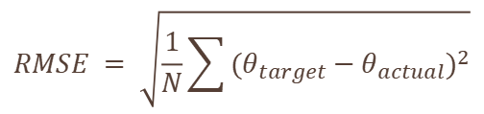
-> Numerical Integration of Dynamics
Runge-Kutta 4th Order (RK4):
Propagate system states over time:
Solves nonlinear dynamics with time-varying feedforward terms.
$$y_{n+1}=y_{n}+\frac{h}{6}(k_{1 }+{2k}_{2}+{2k}_{3}+k_{4})$$
-> Performance Metric
Root Mean Square Error (RMSE):
Quantify tracking accuracy:
$$RMSE = \sqrt{\frac{1}{N}\sum{{(θ_{target}−θ_{actual})}^{2}}}$$

Slide 9
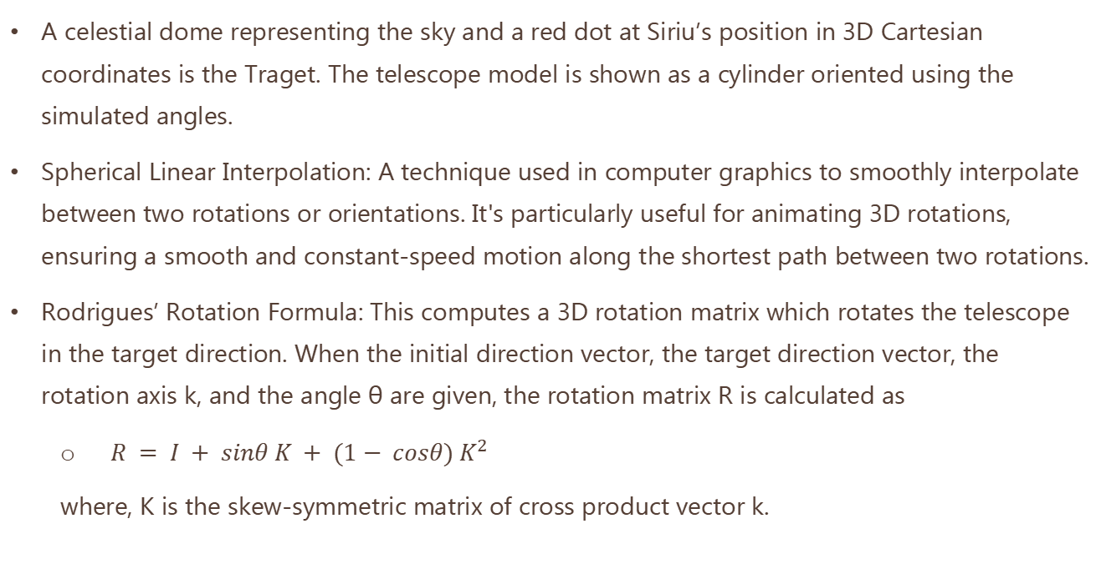
3D - VISUALIZATION
A celestial dome representing the sky and a red dot at Siriu’s position in 3D Cartesian coordinates is the Traget. The telescope model is shown as a cylinder oriented using the simulated angles.
Spherical Linear Interpolation: A technique used in computer graphics to smoothly interpolate between two rotations or orientations. It's particularly useful for animating 3D rotations, ensuring a smooth and constant-speed motion along the shortest path between two rotations.
Rodrigues’ Rotation Formula: This computes a 3D rotation matrix which rotates the telescope in the target direction. When the initial direction vector, the target direction vector, the rotation axis k, and the angle θ are given, the rotation matrix R is calculated as
$R = I + sinθ K + (1− cosθ) K^{2}$
where, K is the skew-symmetric matrix of cross product vector k.

Slide 10
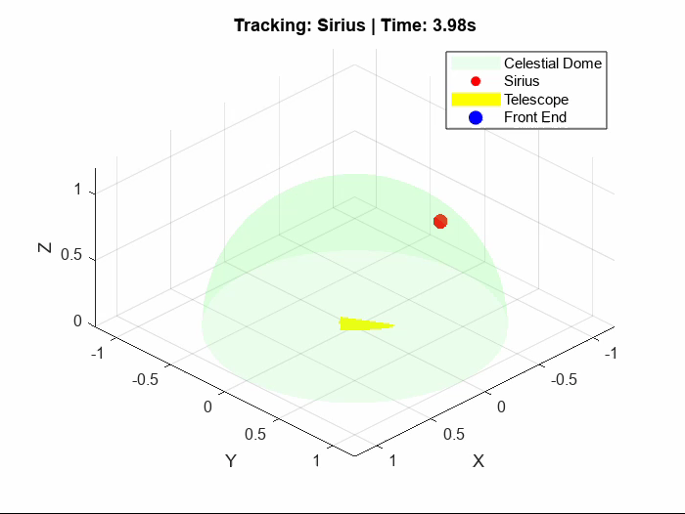
RESULTS
Observation:
The LQR control effectively stabilizes the telescope and brings it to the desired target with minimal oscillations.

Slide 11
Thank You

