Slide 1

Eye Tracker Analysis
Goni Naamani, Yossi Sadot Sorgin,
Nitzan Albeck
Sagol School of Neuroscience,
Data Science Hackathon,
June 2019
https://github.com/goninaa/Eye-Tracker-Analysis.git

Slide 2
Project Goal
Prof. Galit Yovel's Person Recognition lab experiments with human subjects in MRI. During the experiment, three types of images are showed to subjects and asked them to fixate on a specific point on the screen. However, they can't be sure that subjects did look on that point during all times.
The goal of the project is to create a tool that given the Eye-Tracker raw data and the general experimental design, outputs figures showing a "heatmap" of the gaze of each subject during MRI experiments.

Slide 3
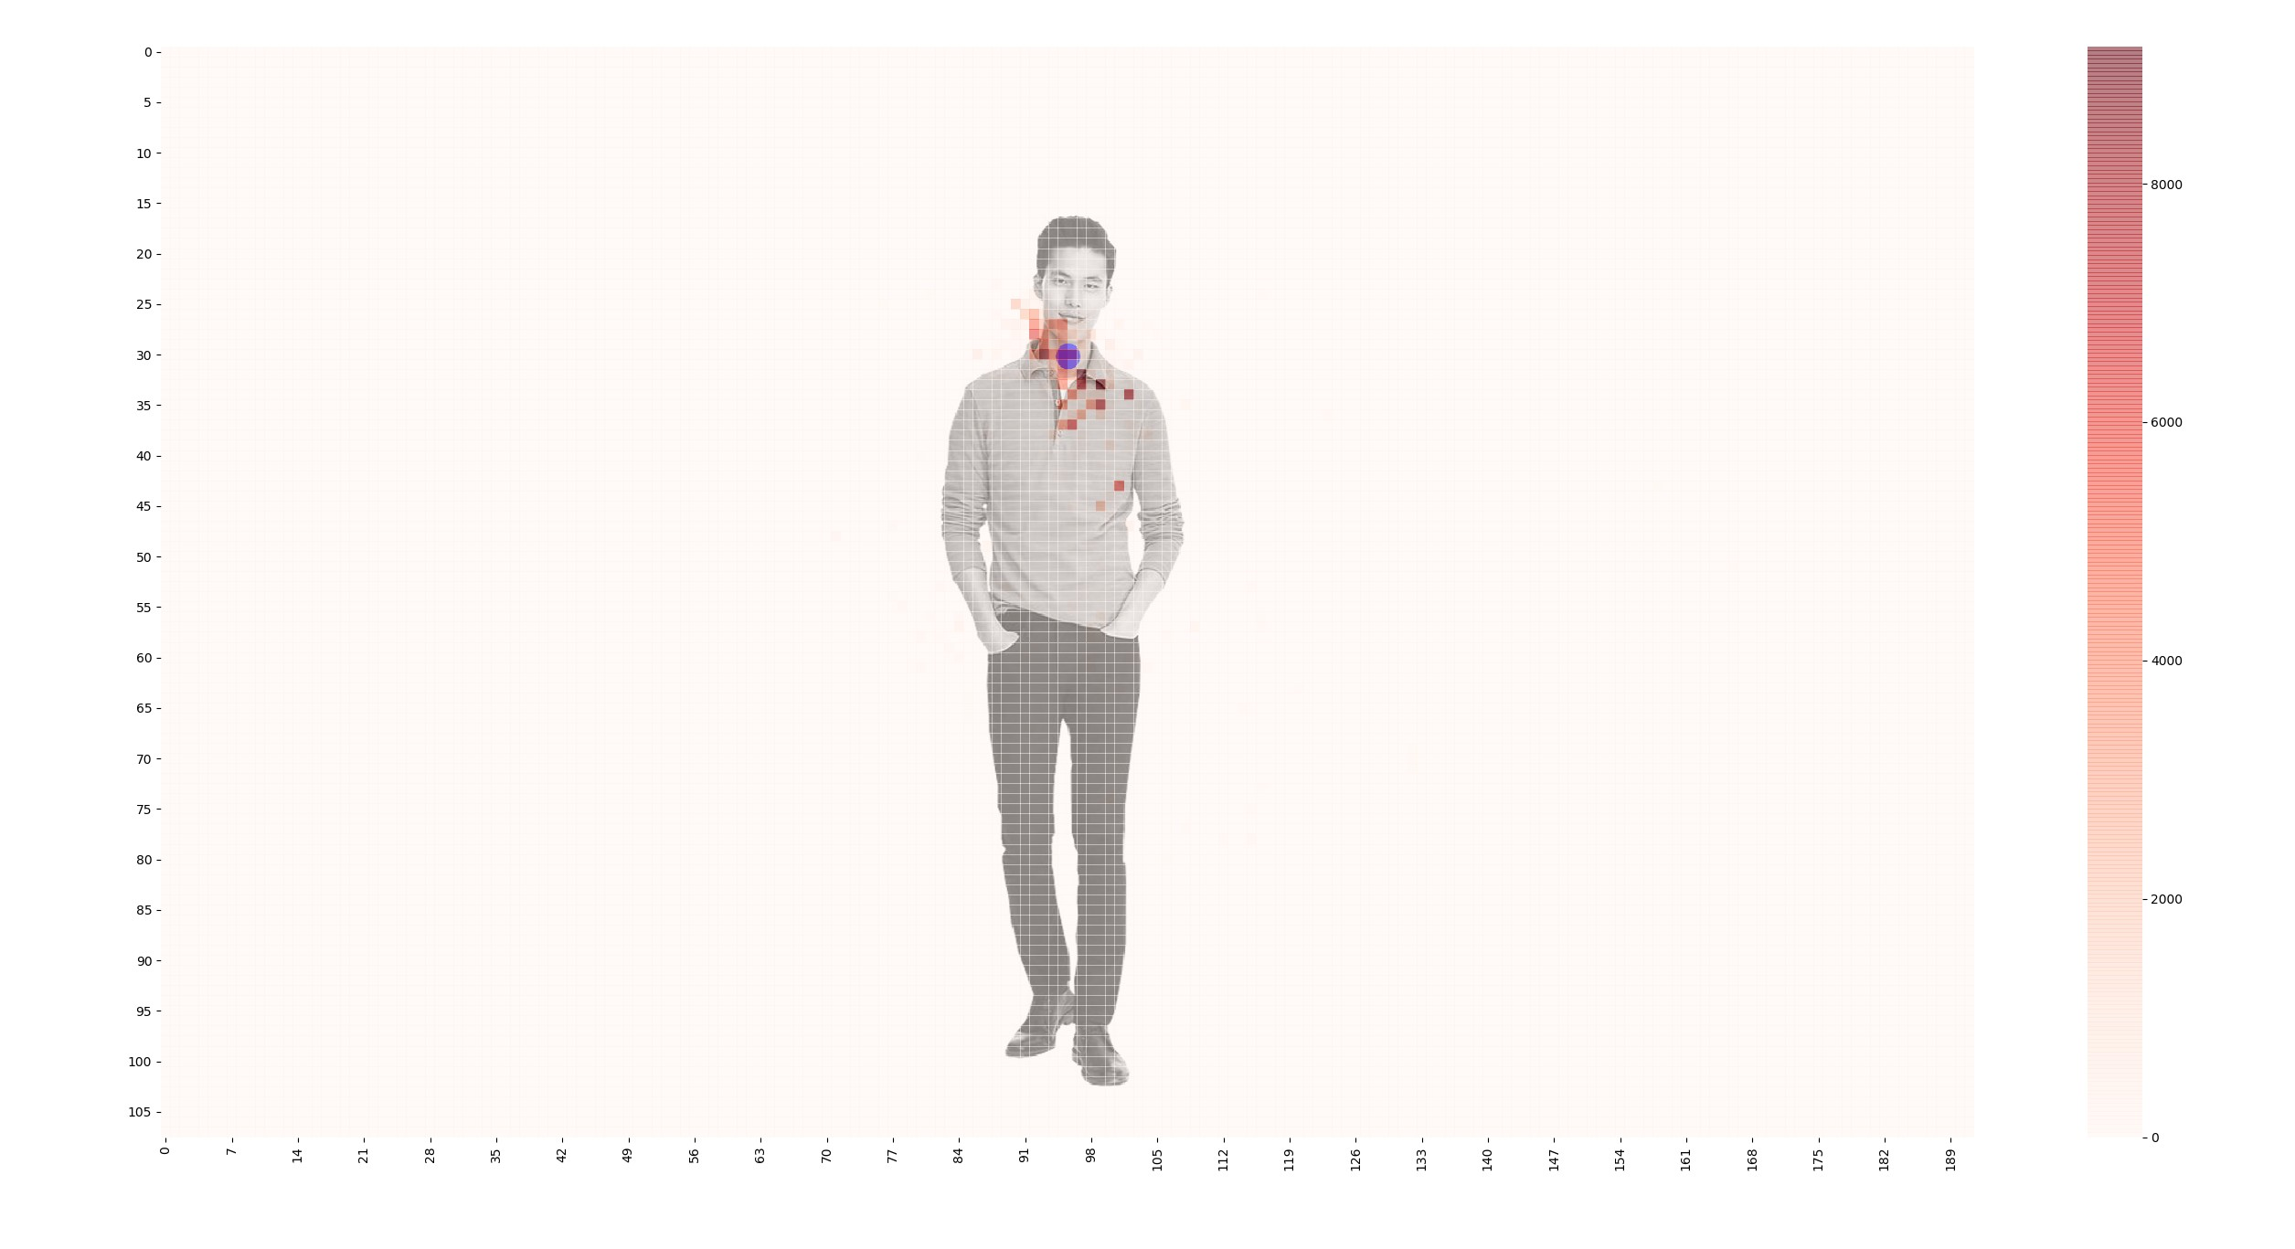
Project Demo

Slide 4
Major Components
Component 1: GUI + processing files – Yossi – The GUI allows the user to enter the file names and then extract the meta-data from them.
Component 2: Database – Goni – The database handles th
Component 3: Visualization – Nitzan – The visualize part is meant to “play” with the data and show it in an informative way.

Slide 5
GUI Key Features
*** IMAGE OF GUI ***
*** CODE SAMPLE ***

Slide 6
Database Features and Examples
The database saves user login data:
@attr.s
class LoginDb:
“”” Saves user logins “””
db_conn = attr.ib()
…

Slide 7
Visualize Features and examples
The Visual Class has a few methods, each takes an (overbooked but beautiful) DataFrame, and the relevant photos and gives back the heatmaps of each condition.
Methods:
1. C

Slide 8
Main Challenges and Difficulties
Parsing the log file turned out to be a hassle. Finally we found a pip-installable library that…

Slide 9
Main Challenges and Difficulties
Parsing the log file turned out to be a hassle. Finally we found a pip-installable library that…

Slide 10
Concluding Remarks
Is the project usable?
What’s left to do?

