Slide 1
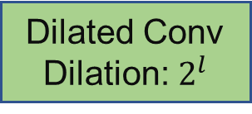
1 x 1
Up-sampling
Refinement stage with attention mechanism
Multi-Head
Attention
Down-sampling
+
1 x 1
ReLU
Dilated Conv
Dilation: $2^{l}$
1 x 1

