Slide 1




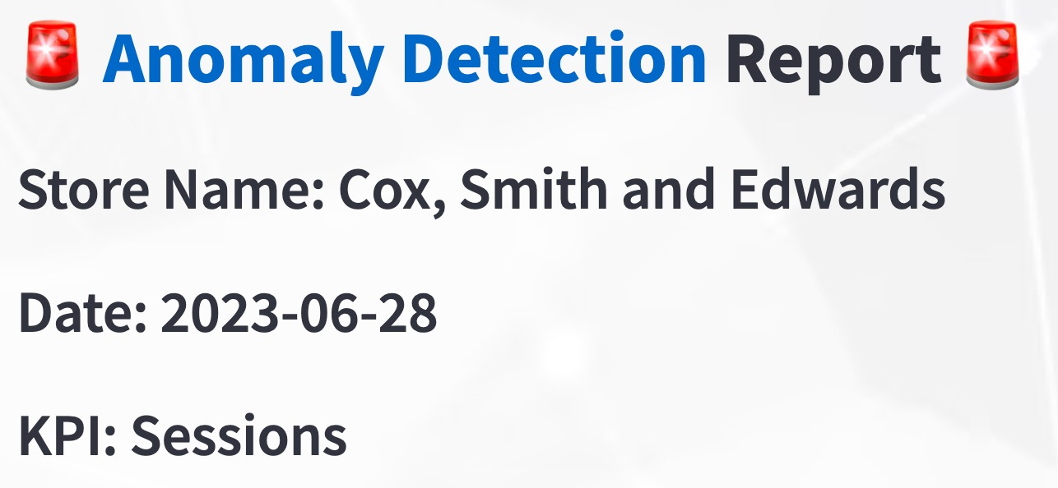
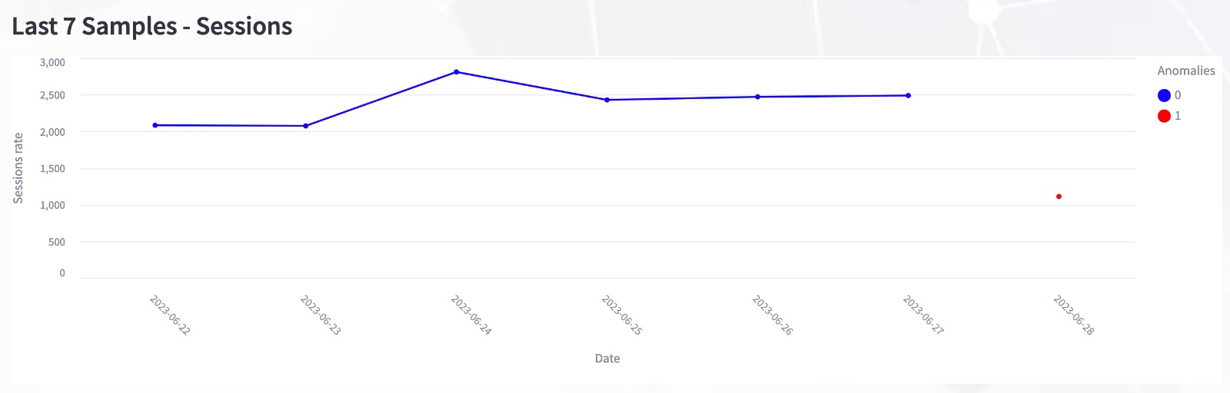
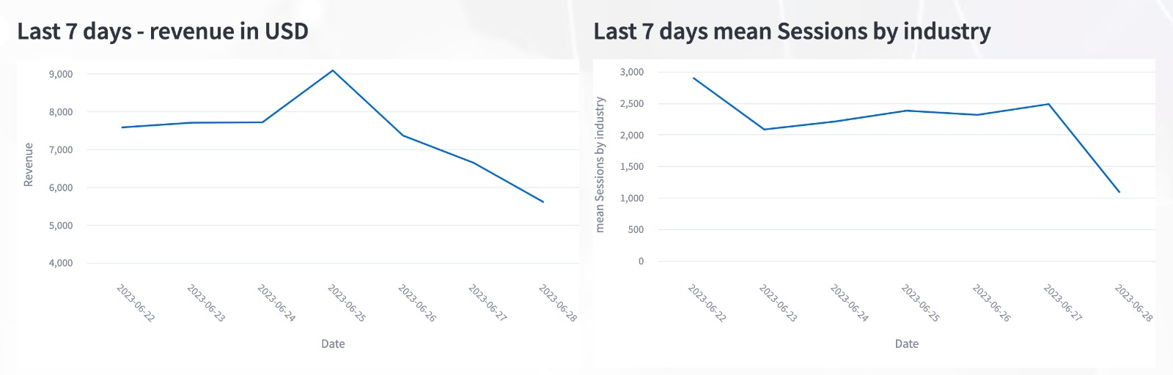
Anomaly Detection Reports
Nitzan Cohen, Yanai Bardos, Idan Bar Oz | Advisor: Alon Bar (CTO, Blyp) | Project Number: 22-0-221
Introduction
The project's objective is to detect unusual activities in e-commerce platforms related to key performance indicators (KPIs). These KPIs include:
Customer conversion rate (percentage of site visitors making a purchase).
Average order value.
Customer traffic (number of site visitors).
Shopping cart abandonment rate.
The project's primary goal is to establish a alerts system for Blyp's customers. This system will analyze data from e-commerce stores and provide actionable insights. Whenever abnormal traffic patterns emerge, we will notify customers, specifying the type of the anomaly and its underlying causes. The system takes various factors into account, including the day of the week, quarter, holidays, and the KPIs themselves to minimize false alarms.
Motivation
Before our project, Blyp did not use machine learning models to identify customers’ anomalies days to alert on unusual traffic patterns. Our method includes defining outlier days for each metric and clarifying them by using additional factors that include holidays, time-related variables, revenue data, as well as industry performance in that KPI. To achieve this, we use a variety of machine learning models adapted to unsupervised problem-solving scenarios.
We decided to incorporate a broader spectrum of data spanning various periods, believing that the greater exposure our model has to this diverse dataset, the better equipped it becomes at recognizing distinct patterns specific to each time period. This, in turn, enhances its ability to identify anomaly days within those respective timeframes throughout the year.
Users' Database
Pre-processing and feature extraction
Anomaly Detection
Using our models
Create Reports
and UI
Users
Methodology
We have chosen a visual inspection method to validate the outcomes of our models, which involves assessing key performance indicators (KPIs), revenue data, and industry trends from the past week.
Additionally, our report includes comparative analyses spanning two weeks, one month, and one year. The model's predictions are based on specific parameters such as the quarter, day type (e.g., within two weeks of a holiday or a regular day), and the day of the week (weekend or regular weekday).
In our assessment, a strong positive correlation between KPIs and both revenue and industry trends (except for the abandonment rate, where a negative correlation is observed) supports the decision that a given day is indeed an anomaly.
Conclusion
In summary, this project aims to create a customer notification system for Blyp. Using machine learning models for the unsupervised problem, we identified anomalies for each store and provided detailed explanations using additional features such as holidays, time, revenue, and industry context. We have developed a user-friendly Streamlit report that warns of unusual activity in the store, taking into account factors such as day of the
week, quarter and holidays so that we do not raise a false alarm.
This dynamic report allows you to customize the analysis period, the KPI and the selection of stores. In addition, it presents important insights and recommendations for further action, enabling informed decision-making for Blyp and its customers.
Future Work
Due to the existing circumstances, which include data that is not currently available to us in an up-to-date format, and due to a time limit for monitoring the KPI at the inventory level, which behaves differently from the other KPIs. In the project, we will recommend a future improvement to the system, this improvement will include the integration of a cyclical task, which allows us to predict in real time if a day is unusual, and in addition, to handle the KPI at the inventory level as required according to the method appropriate to this KPI.

