Slide 1


From Stars to Statistics: Understanding Globular Clusters with Data
Niusha Ahvazi
GECO Fellow, UVA
Email: nahvazi@virginia.edu

Slide 2

Topics we will cover today:
Gaussian Distributions: The bell curve and how to describe it
Likelihood: How to measure whether data supports a hypothesis
Mixture Models: How to unmix overlapping populations
Bayes' Theorem: How to combine data with prior knowledge
MCMC Sampling: How to explore the space of possible solutions
Link to the notebook: https://colab.research.google.com/drive/1UfYfpl7t8fVzLu0c4-6m191DYB2YfTKU?usp=sharing

Slide 3
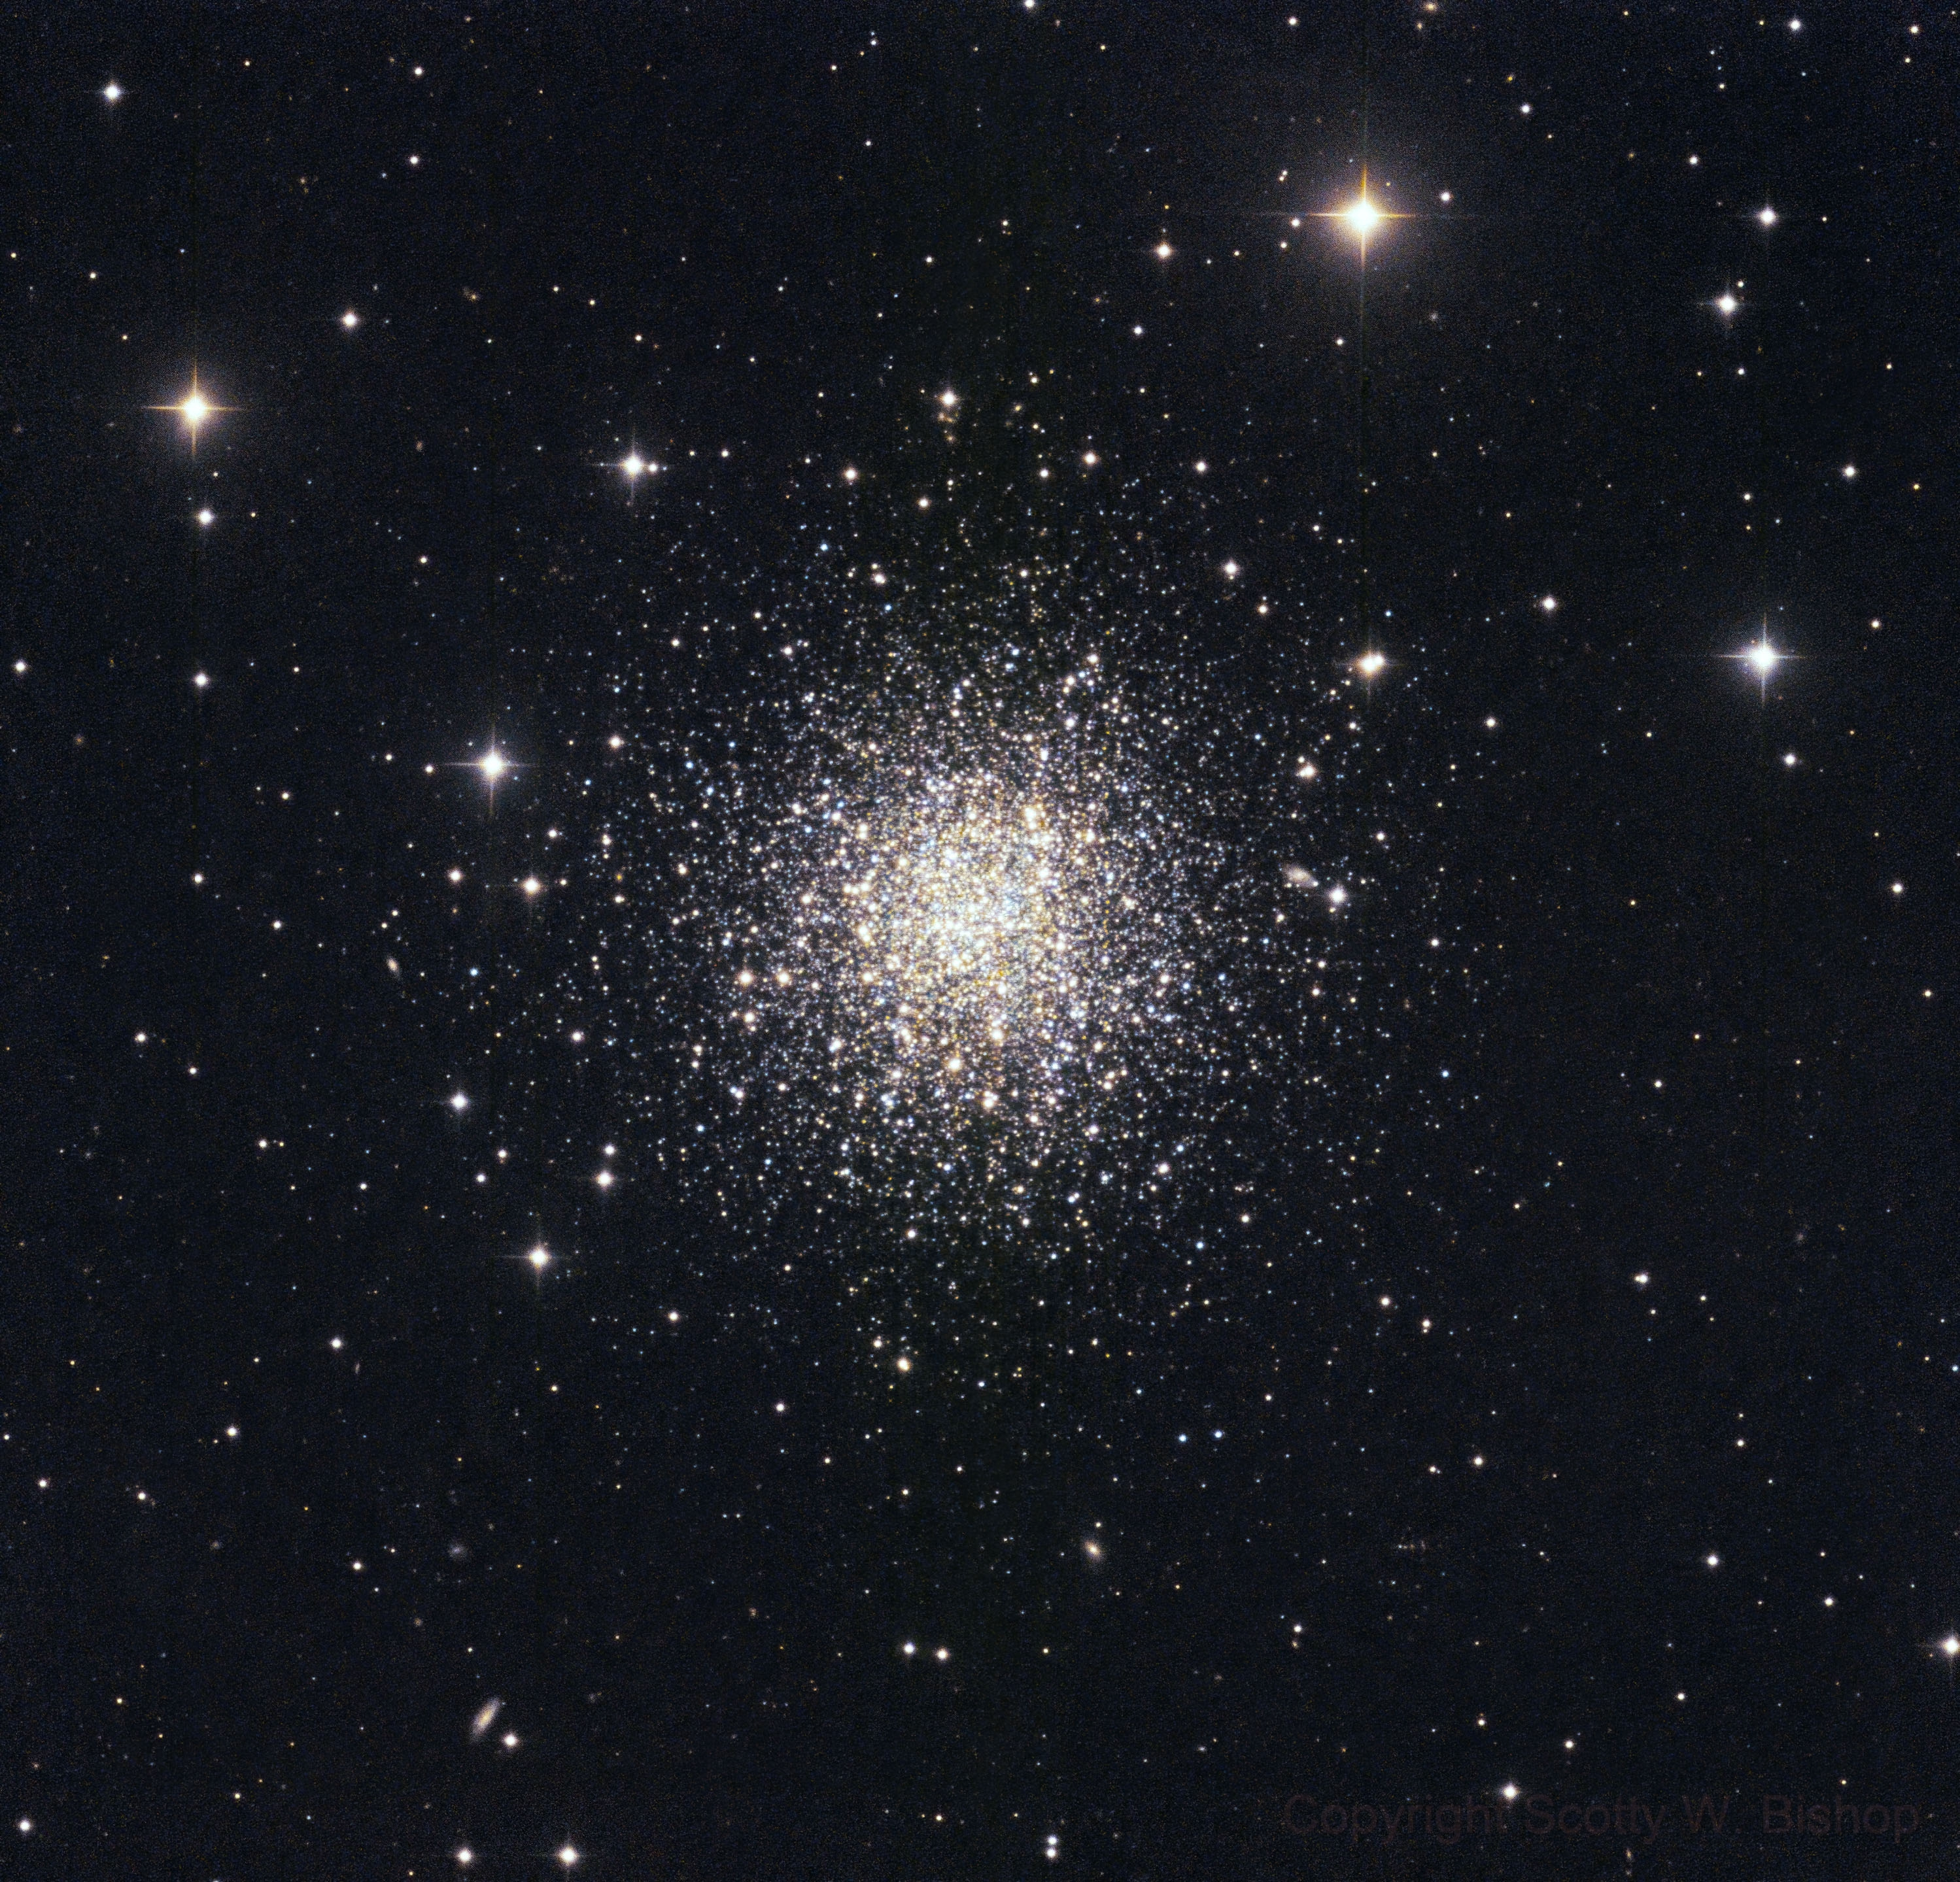
The story of NGC 288, a “Globular Cluster”
Dense, gravitationally bound system of stars
Include thousands to millions of stars
Orbit galaxies (like the Milky Way)
RA
DEC
NGC 288 image credit: https://telescopius.com

Slide 4
The story of NGC 288, a “Globular Cluster”
proper motion: the apparent movement of a star across the sky over time (measured in milliarcseconds per year, or mas/yr).
Dense, gravitationally bound system of stars
Include thousands to millions of stars
Orbit galaxies (like the Milky Way)
RA
These stars formed together/move together this is our key statistical signal
DEC
NGC 288 image credit: https://telescopius.com

Slide 5
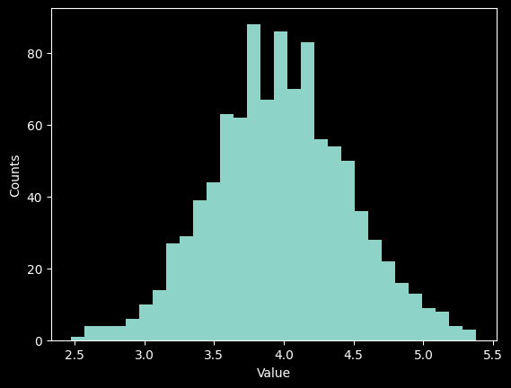
The story of NGC 288, a “Globular Cluster”
proper motion: the apparent movement of a star across the sky over time (measured in milliarcseconds per year, or mas/yr).
Dense, gravitationally bound system of stars
Include thousands to millions of stars
Orbit galaxies (like the Milky Way)
RA
These stars formed together/move together this is our key statistical signal
Proper motion values for each star
DEC
Measurement noise + small intrinsic dispersion spread
NGC 288 image credit: https://telescopius.com

Slide 6
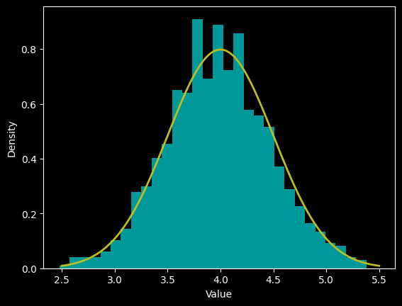
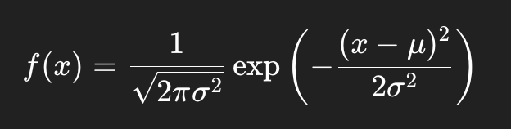
Gaussian Distribution
2σ
Mean (μ): center of the distribution
Standard deviation (σ): width of the distribution
μ

Slide 7
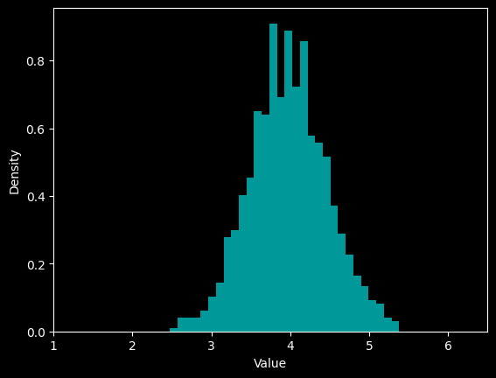

Likelihood
Likelihood(θ) = P(D | θ) = probability of observing data D if θ is true
Explain simply:
“How well does a model explain the data?”
For data points x_{i}:
$$ℒ=\prod_{i=1}^{N}{P\left(x_{i}\right)}$$
We usually work with log(likelihood) for practical reasons:
l$og\left(ℒ\right)=Σ_{i=1}^{N}log(P\left(x_{i}\right))$
👉 we maximize this

Slide 8

Likelihood
Likelihood(θ) = P(D | θ) = probability of observing data D if θ is true
Explain simply:
“How well does a model explain the data?”
For data points x_{i}:
$$ℒ=\prod_{i=1}^{N}{P\left(x_{i}\right)}$$
We usually work with log(likelihood) for practical reasons:
l$og\left(ℒ\right)=Σ_{i=1}^{N}log(P\left(x_{i}\right))$
👉 we maximize this

Slide 9
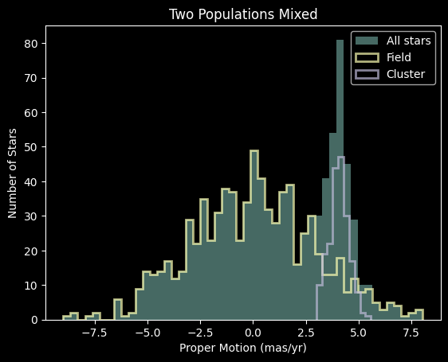
Two Populations/Mixture Models

Slide 10


Likelihood for our Mixture Model:
Simplistically we can write:
Total = cluster + background
Then formalize:
$$P\left(x\right)=f⋅𝒩\left(x ∣ μ_{c},σ_{c}^{2}\right)+\left(1−f\right)⋅𝒩\left(x ∣ μ_{f},σ_{f}^{2}\right)$$
Normal distribution of cluster members
Normal distribution of field members
Fraction of cluster stars
Now same as before we calculate log(likelihood):
l$og\left(ℒ\right)=Σ_{i=1}^{N}log(P\left(x_{i}\right))$
👉 then we maximize it

Slide 11
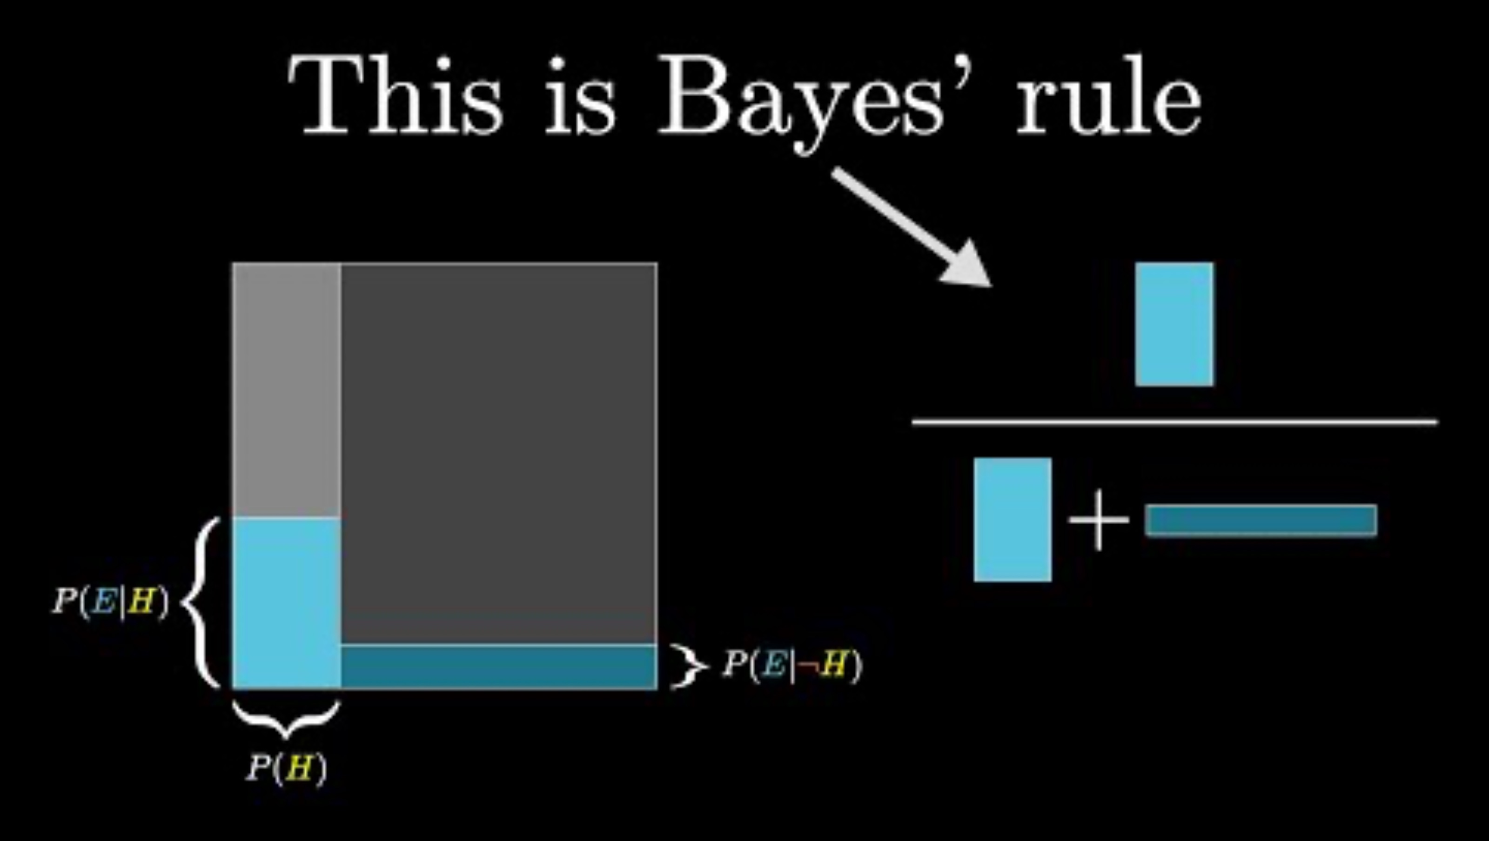

Bayes’ Theorem
Conceptually:
$$\text{Posterior}∝\text{Likelihood}×\text{Prior}$$
Likelihood → data
Prior → what we believe before
Posterior → updated belief
👉 check out this YouTube video:

Slide 12
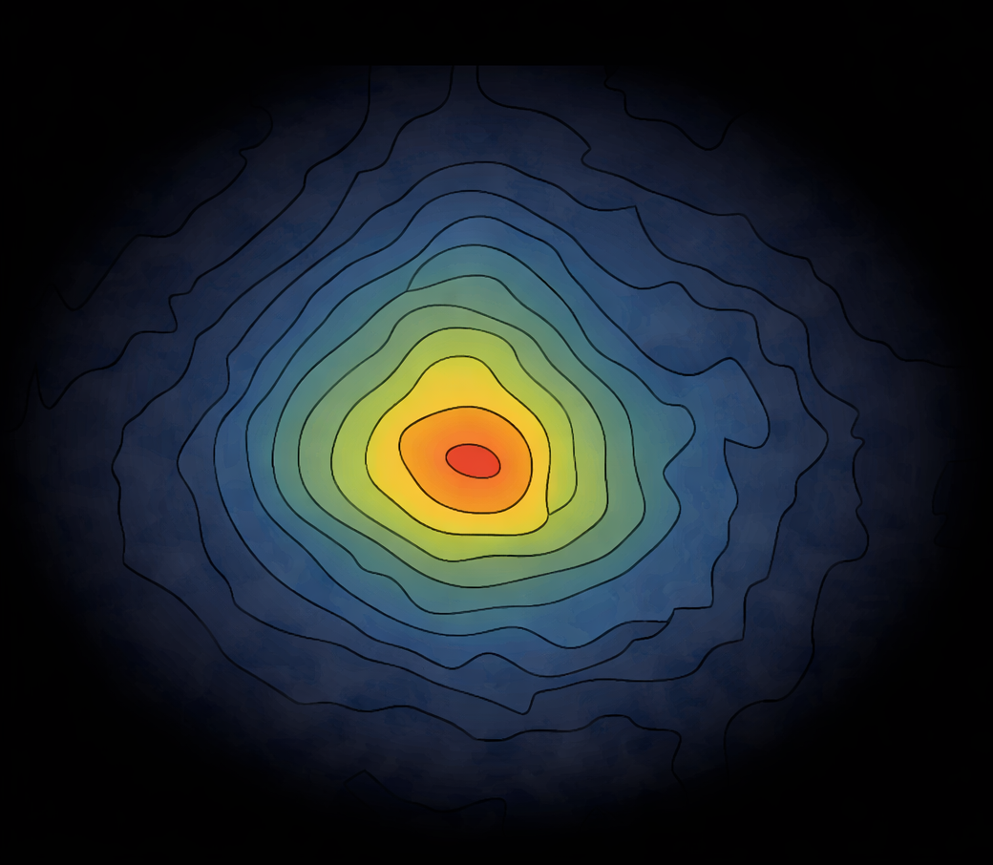
Markov Chain Monte Carlo (MCMC):
σ
Before: Using grid base method
μ

Slide 13
Markov Chain Monte Carlo (MCMC):
Walkers
Now: Walking randomly but preferring better regions
σ
👉 check out the last example from notebook
μ

