Slide 1

Name: Itamar Aharon
ID: 302867742
Advisor: Prof. Uri Mahleb

Slide 2
Neptune as a System
Neptune
DB
Engines
My Project:
GA Improvement
Weighted Entropy
Fiber-Cut
Optimization Algorithms
Power Budget
Cost Functions
Defragmentation
Simulator
Optical Mesh Network
Optical Physical Layer

Slide 3
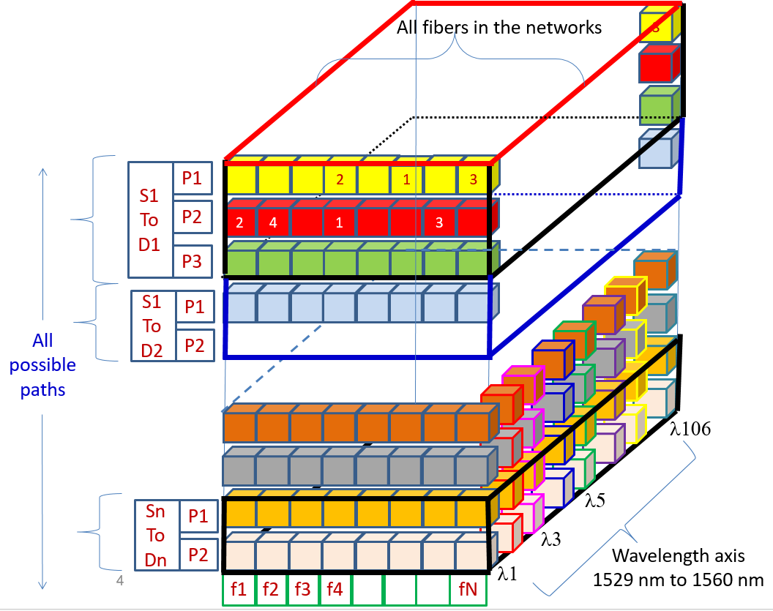
1. Genetic Algorithm
Solution
Before Defrag
6
After Defrag
9
1
Path
SD
3
Path
2
Path
4
8
0
1
4
9
7

Slide 4
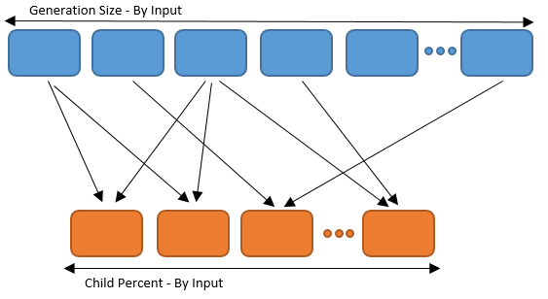
1. Genetic Algorithm
Cross-Over
Father
Mother
Gene = distribution of Services in Paths on each SD
Combine

Slide 5
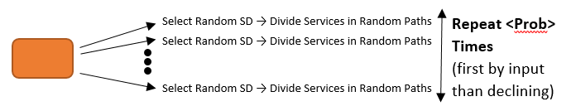
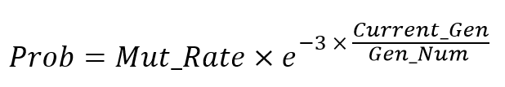
1. Genetic Algorithm
Mutate 50% of offspring

Slide 6


1. Genetic Algorithm
Select Best Solutions
Variance
Entropy
Hits
Variance
+
Entropy
Entropy
+
Hits

Slide 7
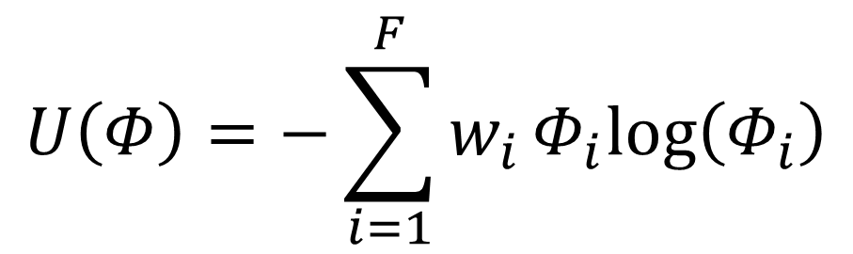
2. Weighted Entropy
Entropy
$$U\left(Φ\right)=−\sum_{i=1}^{F}{w_{i}Φ_{i}log\left(Φ_{i}\right)}$$
0.05 For Bottle-Necks
1 For The rest
Purpose – fibers with less transportation
will get higher weigh

Slide 8
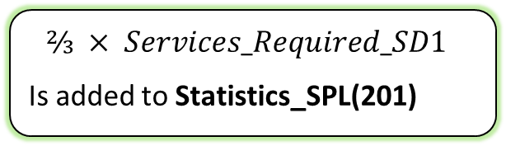
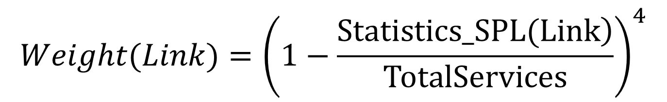
2. Weighted Entropy
NEW Weights
$$Weight(Link)={\left(1−\frac{\left.Statistics_SPL(Link\right)}{TotalServices}\right)}^{4}$$
 | 201 | 202 | 203 | 204
Path 1 | V
Path 2 | V |  |  | V
Path 3
Path 4 |  |  | V
Path 5 |  |  | V
SD1
⅔ of paths in SD1 are going throw Link 201
$$⅔ × Services_Required_SD1$$
Is added to Statistics_SPL(201)
(Paths_mat)

Slide 9
3. Fiber-Cut
1. Update Paths_mat
 | 201 | 202 | 203 | 204
Path 1 | V
Path 2 | V |  |  | V
Path 3
Path 4 |  |  | V
Path 5 |  |  | V
 | 201 | 202 | 203 | 204
Path 1 | V
Path 3
Path 4 |  |  | V
Path 5 |  |  | V
2. Create solution vector
Divide falled sevices between random paths in the SD
3. Create solution
Send to external engine for lambdas division

Slide 10
Results
 | NEW | OLD GA | OLD W
Min hits | 0.443 | 0.455 | 0.455
Min var | 95.3 | 125.9 | 101.4
Max Ent | 1.314 | 1.199 | 2.804
The End

