Slide 1

Neptune
Optimizer Simulator
Yotam Wolbrum Ziv Erlichson
Prof. Uri Mahlab

Slide 2
Background and Rational
In recent years, the amount of data transferred by network systems has increased significantly.
This increase requires building smarter, faster and more reliable network systems and control centers.
In our project, we attempted to build a system which would know how to work and handle different, dynamical situations and behaviors of optical networks.
In order to do this we had to:
Make the system as dynamic as possible
Take into consideration the physical limitations of the optical fibers (elaborated in the next slide)

Slide 3
Overview
Final Product
A generic simulator that provides an optimized, balance-loaded traffic, by using the cross entropy algorithm in a given optical fiber mesh network according to traffic requirements.
Input
Optical fiber mesh infrastructure (including all relevant optical elements).
Day 1 services traffic map - not optimized from balance point of view.
Output
Optimized and balance-loaded services per fiber matrix.
Take into consideration
Spectrum Utilization.
Power Budget (Power sensitivity, OSNR threshold and Nonlinear effect).

Slide 4
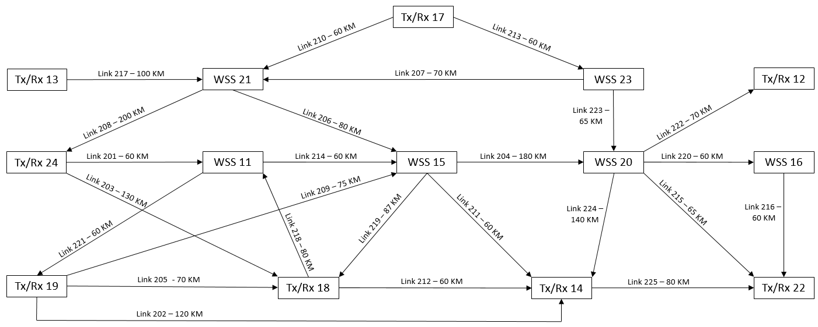
Topological Map Of The system
41,42,43..
61,62,63..
1,2,3..
21,22,23..
41,42,43..
1,2,3..
61,62,63..
1,2,3..
21,22,23..
1,2,3..
41,42,43..
61,62,63..
21,22,23..
41,42,43..
81,82,83..
81,82,83..
For illustration , every color symbolize a path and every number symbolize a service.

Slide 5
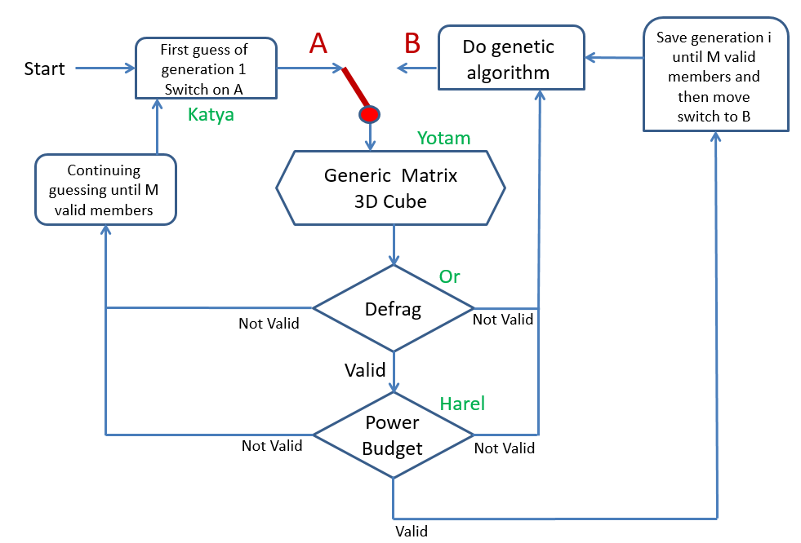
Optical Network Virtualization- CE
Do Cross Entropy Algorithm

Slide 6
Integration of the System
The integration role is to connect between the optimization algorithm and the engines.
The integration methods receive a guess from the optimizer and generate a matrix that both engines know how to check for validity.
An invalid solution mark, we return "not valid" to the optimizer, and it produces another guess.
A valid solution mark , we return "valid" and the cost "hit" of the guess to the optimizer, and it saves the guess into the database.

Slide 7
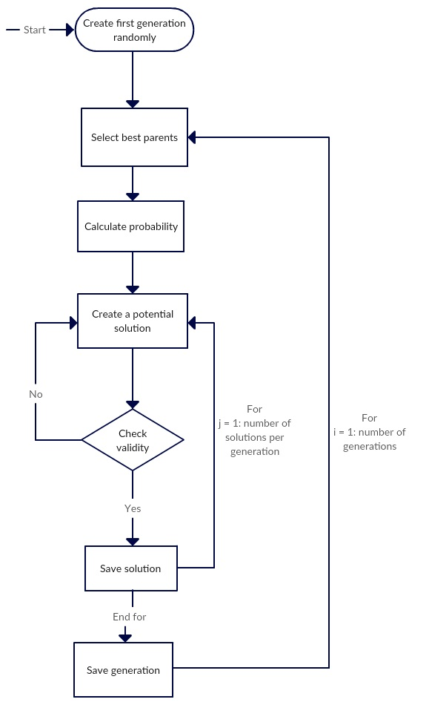
Cross Entropy Block Diagram

Slide 8
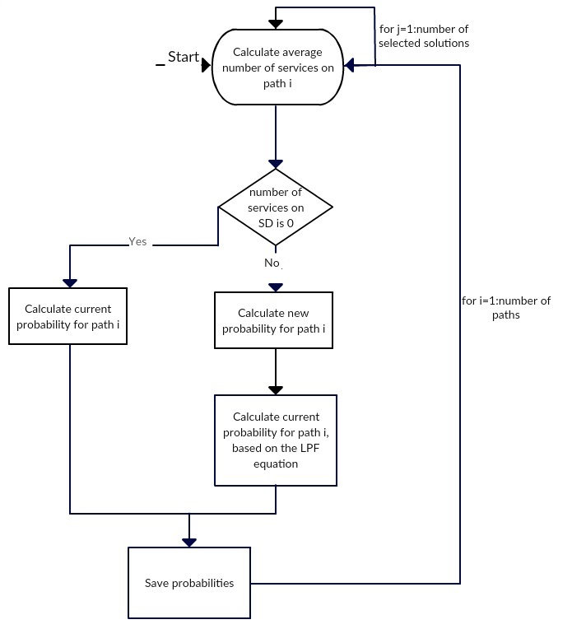
Calculate Probability Block Diagram

Slide 9
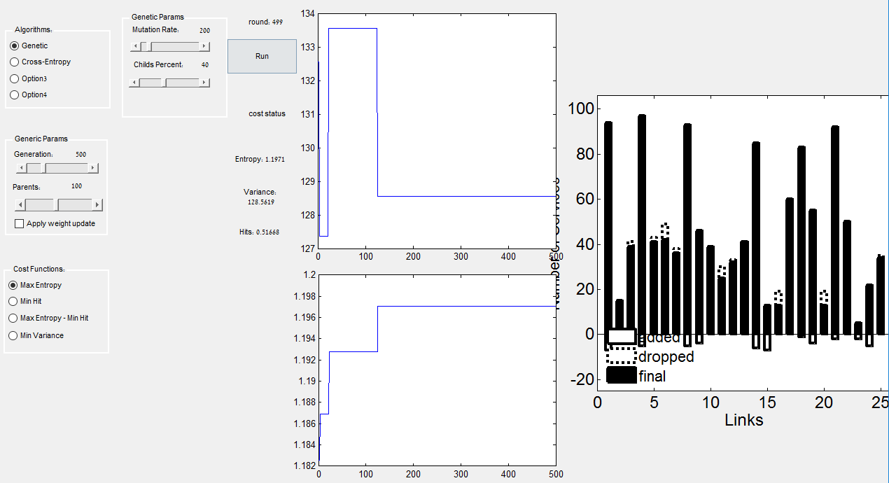
GUI - Concept
Run
Optimization Type
Algorithm
Optimization
Settings
Cost Function
Calculation
Results

Slide 10
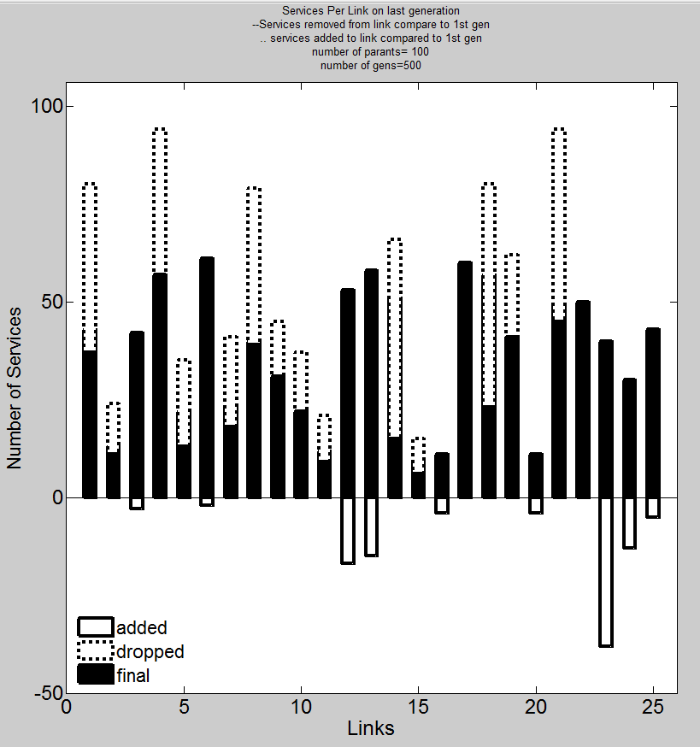
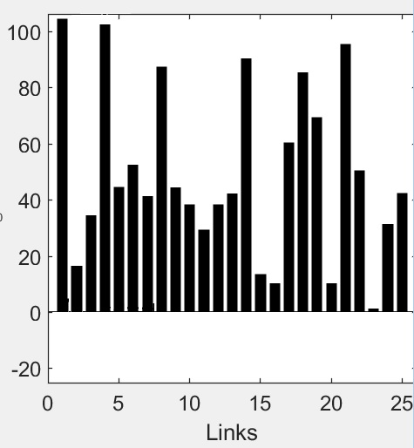
Balance Results
Input:
Infrastructure of optical elements
and day 1 services traffic map.
Optimizer Simulator
Based on Cross Entropy Algorithm
Output:
Optimized balanced load
services matrix.
services

Slide 11
Conclusions
The most efficient value of alpha is 0.2, as with this value we have achieved the lowest variance result.
Neptune shows unequivocal convergence of the results.
The results also confirm the validity of our system.
Elaborated results and explanation can be found under chapter 9 of the Neptune Book.

Slide 12
Thank You!

