Slide 1
SONGS ALL OVER THE WORLD
Finding a connection between the worldwide success of songs to their success in the US
LIOR ABUHAV
NIV HAMISHA
GITHAB

Slide 2
RESEARCH INTRODUCTION
Spotify is one of the most successful song streaming platforms in the world.
Due to Spotify’s success, they started to rank songs, give user personalized songs recommendations, create dedicated charts and so on.
In this project we decided to relay on one of those Spotify releases - named country top charts.

Slide 3
RESEARCH INTRODUCTION
For each country all over the world (that has smartphones of-course), Spotify collects the “top 200” most played songs, based on their success in the platform.
Due to Spotify popularity, Spotify’s countries “top 200” charts became very reliable and they reflect the actual success of the songs.

Slide 4
RESEARCH INTRODUCTION
In our project we decided to use those Spotify’s charts to create a model that predicts a song’s success based on its success in other countries.
Research question:
Can we predict the success of a song in united states based on its ranking stats in other countries?

Slide 5
THE DATA
We are going to use a complete dataset of all the "Top 200" charts published globally for 70 countries by Spotify.
Spotify published new chart every 2-3 days.
This dataset comprises about 10 million records.
To solve the research question, we're going to use the records in the collection since January 1,2021 for all countries (about 1-million records).
The data is published by Kaggle website at:
https://www.kaggle.com/dhruvildave/spotify-charts

Slide 6
THE DATA
The dataset contains the following categories:
Position – song rank
Track name – song name
Artist – artist name
Streams – number of streams
Url – url of the song
Date – date of chart
Code - country code
Name – country name

Slide 7
Data processing
In order to solve our research question, we needed to modify the received songs data:
Delete unnecessary columns.
Filter the songs ranked in 2021
Find the max chart position occurrence for a song in its country.
Create data “buckets” based on songs ratings – will be used in the learning process.
Merge all the song ranking buckets from all countries to one row for each song

Slide 8

Data processing
Delete unnecessary columns.
The url & streams columns are irrelevant for our research.
We erased those columns to make the data processing & learning more efficient

Slide 9
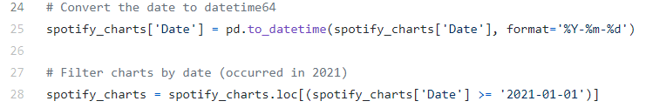
Data processing
Filter the songs ranked in 2021
we decided to filter the records in addition to make the learning process relevant.
As a result were facing a scaled amount of data.

Slide 10
Data processing
Find the max chart position occurrence for song in its country.
For each song we found his best chart position in every country he was ranked in.
We decided that the max chart position of song in the country chart is the most relevant rank to its success in this country.

Slide 11
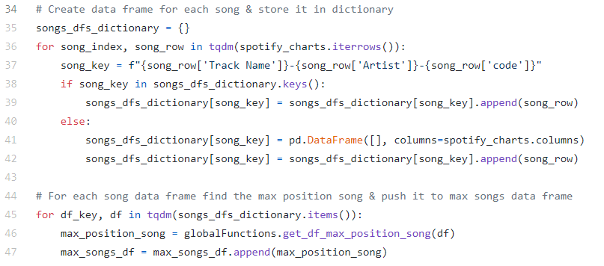
Data processing
Find the max chart position occurrence for song in its country.

Slide 12
Data processing - challenge
Find the max chart position occurrence for song in its country.
as we started to work on this topic, we came up with an algorithm that find the max chart position in o(n^2) efficiency.
As we started to run the data processing on large amount of data, we faced unreasonably long processing times.
We needed to figure how to make this algorithm more efficient.
We decided to allocate more memory to the data processing stage, and a dynamic programming like solution was used to make this algorithm run in o(n) efficiency.
This step improved the processing time significantly.

Slide 13
Data processing
Create data “buckets” based on songs ratings – will be used in the learning process.
As a preparation for the learning process we decided to represent the charts positions data in “buckets” shape, while the possible values for bucket is 0/1.
We defined 6 buckets types, and by using them we will measure a song’s success.

Slide 14
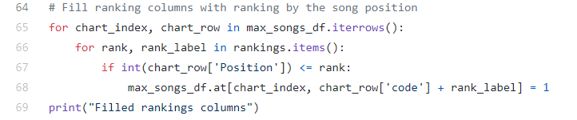
Data processing
Create data “buckets” based on songs ratings – will be used in the learning process.
For each song occurrence we filled the buckets by the relevant rank in the country.
1 will be filled for a smaller rank than bucket rank.
Default is 0.

Slide 15
Data processing
Merge all the song ranking buckets from all countries to one row for each song
For each song, combine the max positions (buckets) of all countries rankings. This data will be send to the learning process as rows of songs and all of their ranking buckets from all countries.

Slide 16
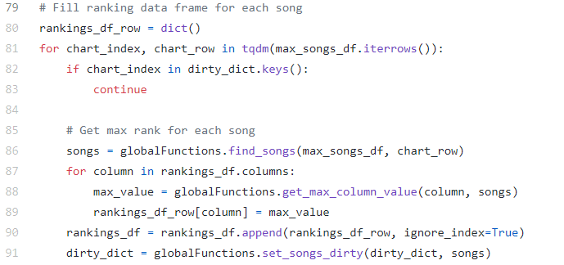
Data processing
Merge all the song ranking buckets from all countries to one row for each song

Slide 17
EDA – Data Correlation
We created a correlation matrix from the buckets data. The correlation matrix can show us graphicly the connections between different buckets across countries.
For the graphical view we used matplotlib.pyplot & seaborn libraries
The libraries cannot produce and show the correlation matrix when dealing with big amounts of data, so we used real data of 800 songs from 4 different countries to show the power of the correlation and the knowledge that the table can give us.

Slide 18
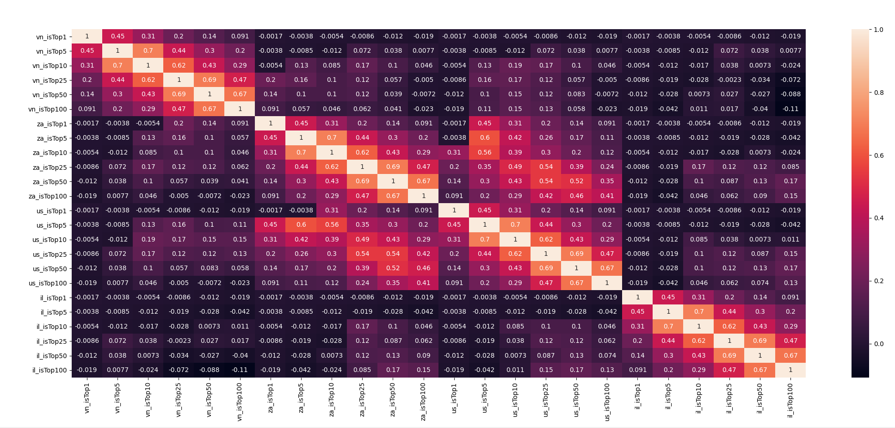
EDA – Data Correlation

Slide 19
EDA – Data Correlation
The correlation is shown in graphics of a heatmap – when a cell is brighter, the correlation between the two buckets is stronger
For example, from this correlation matrix we can see a strong connection between buckets us_isTop5 and za_isTop5 (value is 0.6) , means that 60% of the songs will ranked top 5 at the USA or at South Africa will be ranked top 5 at both.

Slide 20
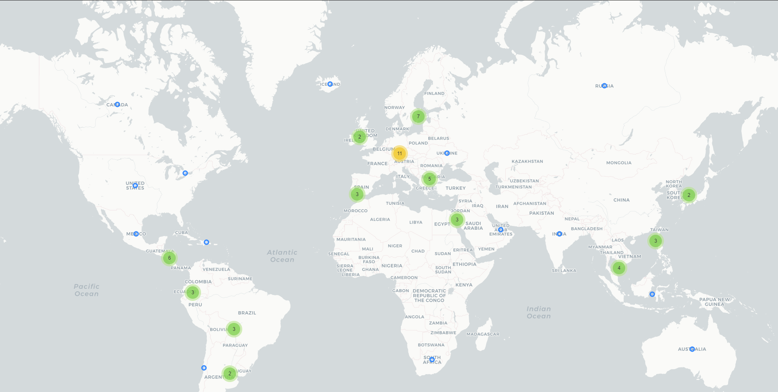
EDA – The ranking countries
We can see that the ranking countries are all over the world and the data reflects the Spotify platform usage.
You can see the dynamic map at map.html in our github

Slide 21
ML – Data splitting
For the learning process we splitted the data to training and test groups.
Test group will be 30% of all data.
We splitted the data using the splitting function of the sklearn library.

Slide 22
ML – IDEA
For our research we used 4 of the most popular learning algorithms and compared the differences of the results from each algorithm
The algorithms:
LogisticRegression
RandomForest
DecisionTree
SVC

Slide 23
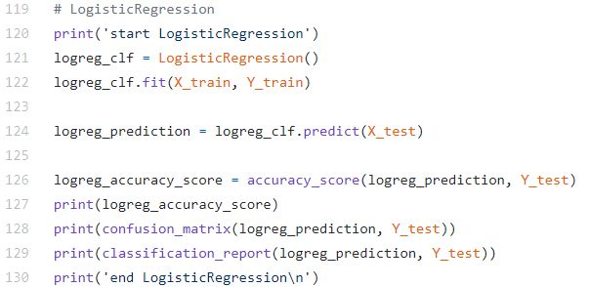
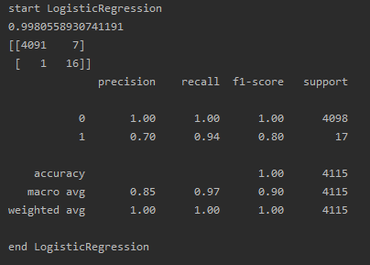
ML – LogisticRegression

Slide 24
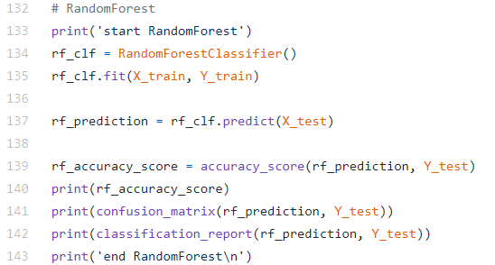
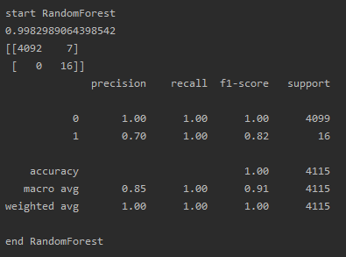
ML – RandomForest

Slide 25
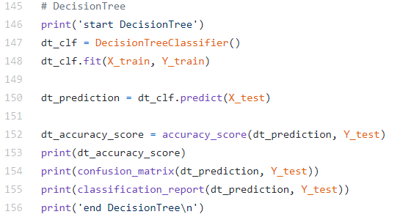
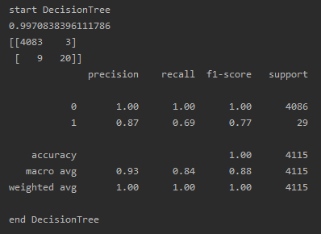
ML – DecisionTree

Slide 26
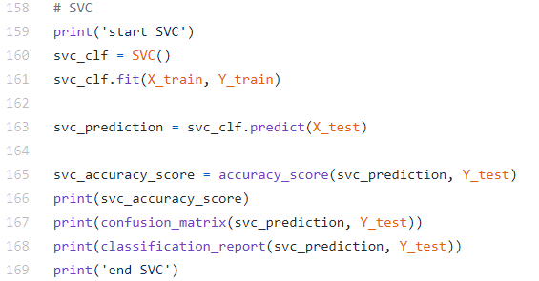
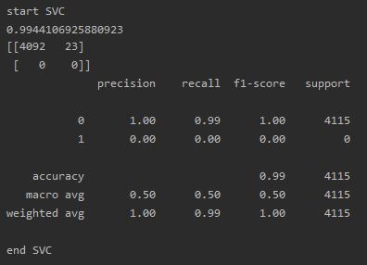
ML – SVC

Slide 27
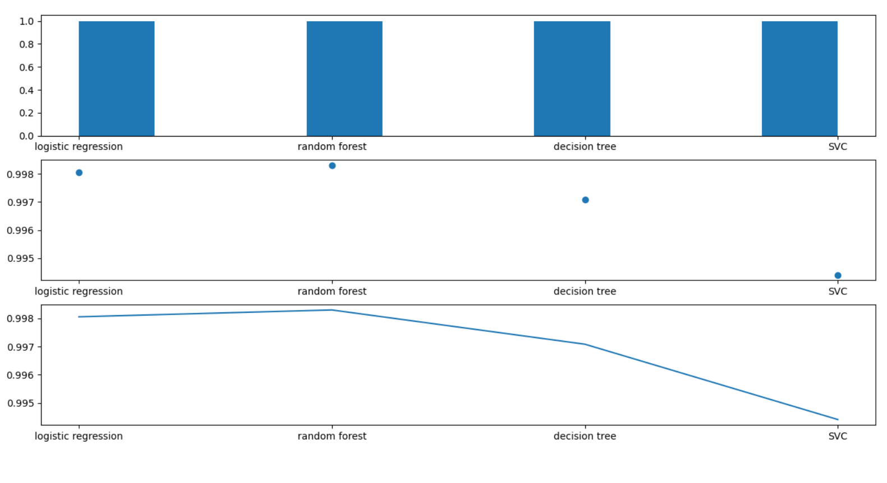
ML – Results
Our models returned almost the same result
SVC returned the lowest result – meaning accuracy is the lowest
Random forest returned highest accuracy

Slide 28
CONCLUSIONS
Did we have an answer to our research question?
Can we predict the success of song in united states based on his ranking stats in other countries?
YES WE CAN!
Our models did it and with a high accuracy!

Slide 29
CONCLUSIONS
Of course we are not perfect ☺
There are some things that we believe can make our models better reliable.
The tested data should be more balanced. (there is a strong bias toward one group)
Add dates to the data and reflect the success process of a song over a period of time.
( We will face it better soon )

Slide 30
“WOW EFFECT”
After we have finished our main goal of checking the songs ratings of 2021, we decided to try to run our model over all the data we have – the ratings from 2017.
Its about 10 million ranks.
We run our 4 learning processes on the data and the results were interesting

Slide 31
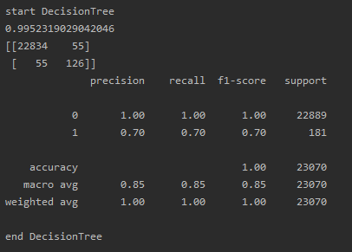
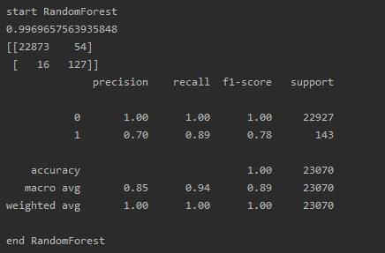
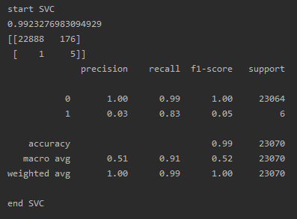
“WOW EFFECT”
Decision Tree:
Random Forest:
SVC:

Slide 32
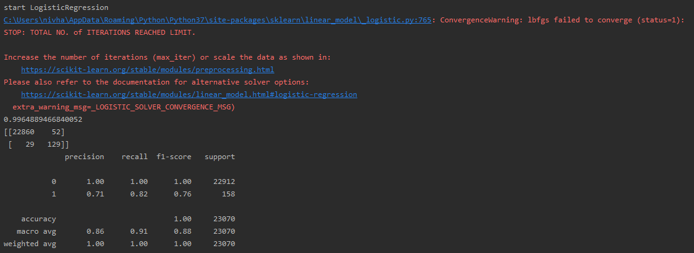
“WOW EFFECT”
Logistic Regression:
Here something interesting happened:
The code threw a warning of: total number of iterations reached limit.
Means this algorithm or at least this implementation is not supposed to work with such amount of data and has to make more iterations then usually needed for the process

Slide 33
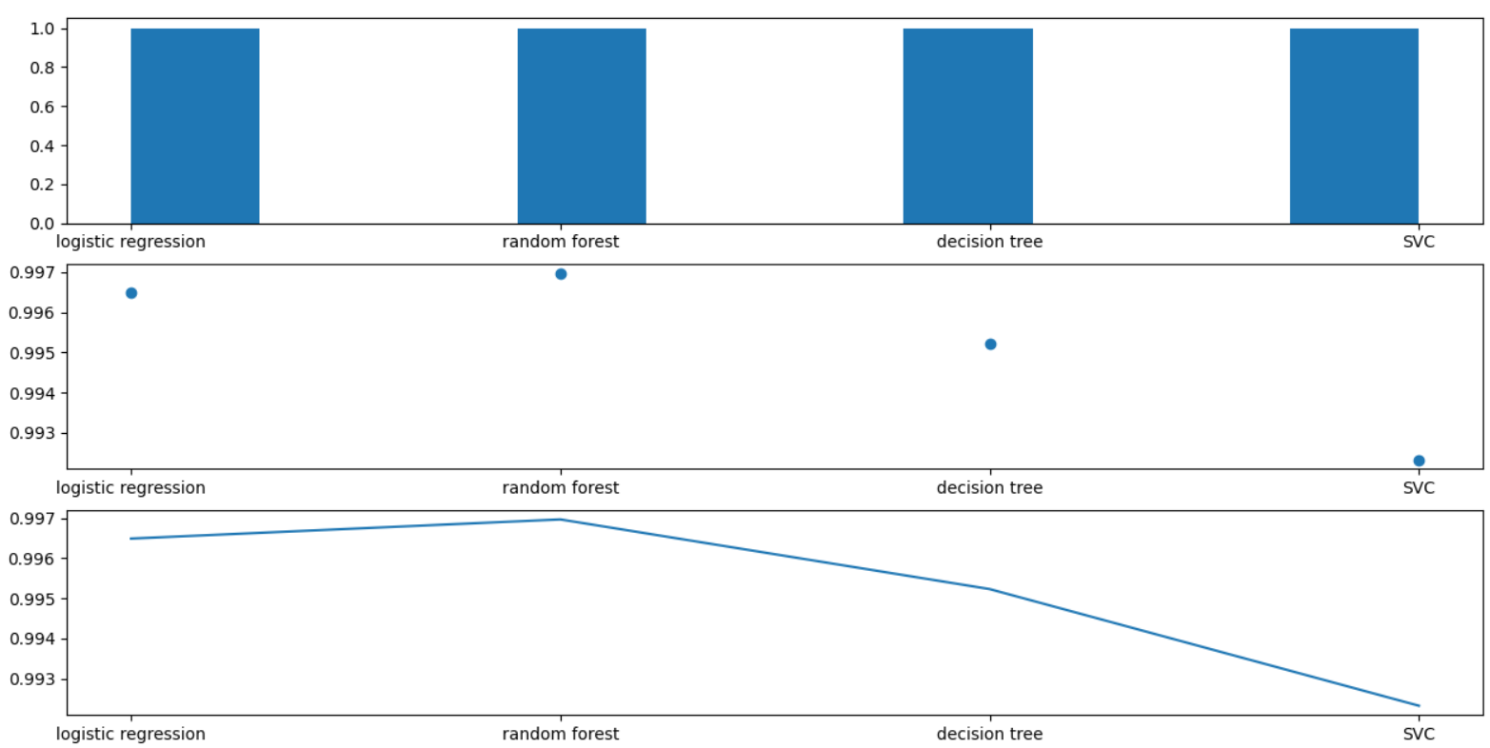
“WOW EFFECT” - Results
Results are almost the same as the smaller data
The amount of data didn’t change the ratio of accuracy between the different algorithms
SVC – still the lowest, Random forest – still the highest

Slide 34
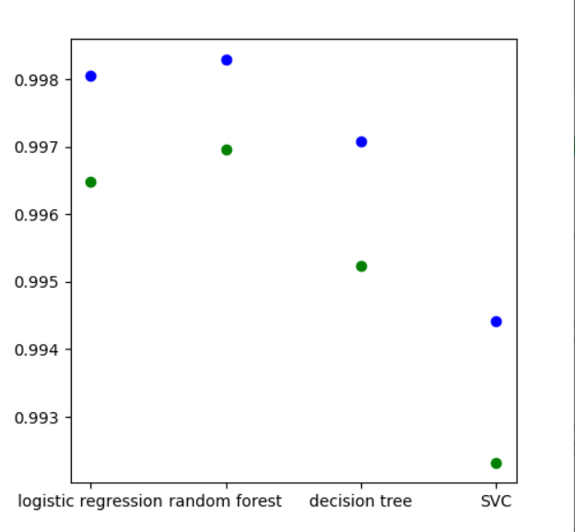
“WOW EFFECT” - Conclusions
The differences between accuracy scores of same algorithm with different amounts of data
Blue – about 1M, Green – about 10M
We can see that the accuracies of the bigger amounts of data are smaller - surprising for bigger amounts of data
We expect: more data = more accuracy

Slide 35
“WOW EFFECT” - Conclusions
We have seen an interesting effect – the more data we gave to the models – the less accuracy they achieved.
We can assume where it comes from.
First, our models ran all over 2021 rankings, with all the data they ran all over 2017 – 2021 rankings. The extra data we had on our second run (like ranks of 1/2017) may be not relevant for some of the ranks of 2021.

Slide 36
“WOW EFFECT” - Conclusions
Why?
Many changes took place in the music world during this period, creating significant changes in the songs rankings.
Also the world changed, for example the Corona virus period could change the way people are exposed to world music.
Running our models on a data from along period of time can be misleading to our models.

Slide 37
END
QUESTIONS?

