Slide 1
ONLINE BANKING SYSTEM
Kowshhal Uppu
Yash Trivedi
Ramya Bandi
Nivali Reddy Sripati

Slide 2
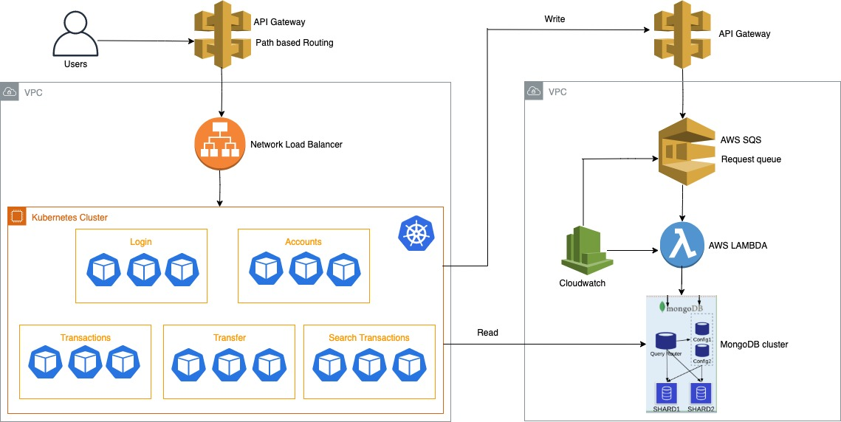
Architecture Diagram

Slide 3
Extra Credit

Slide 4
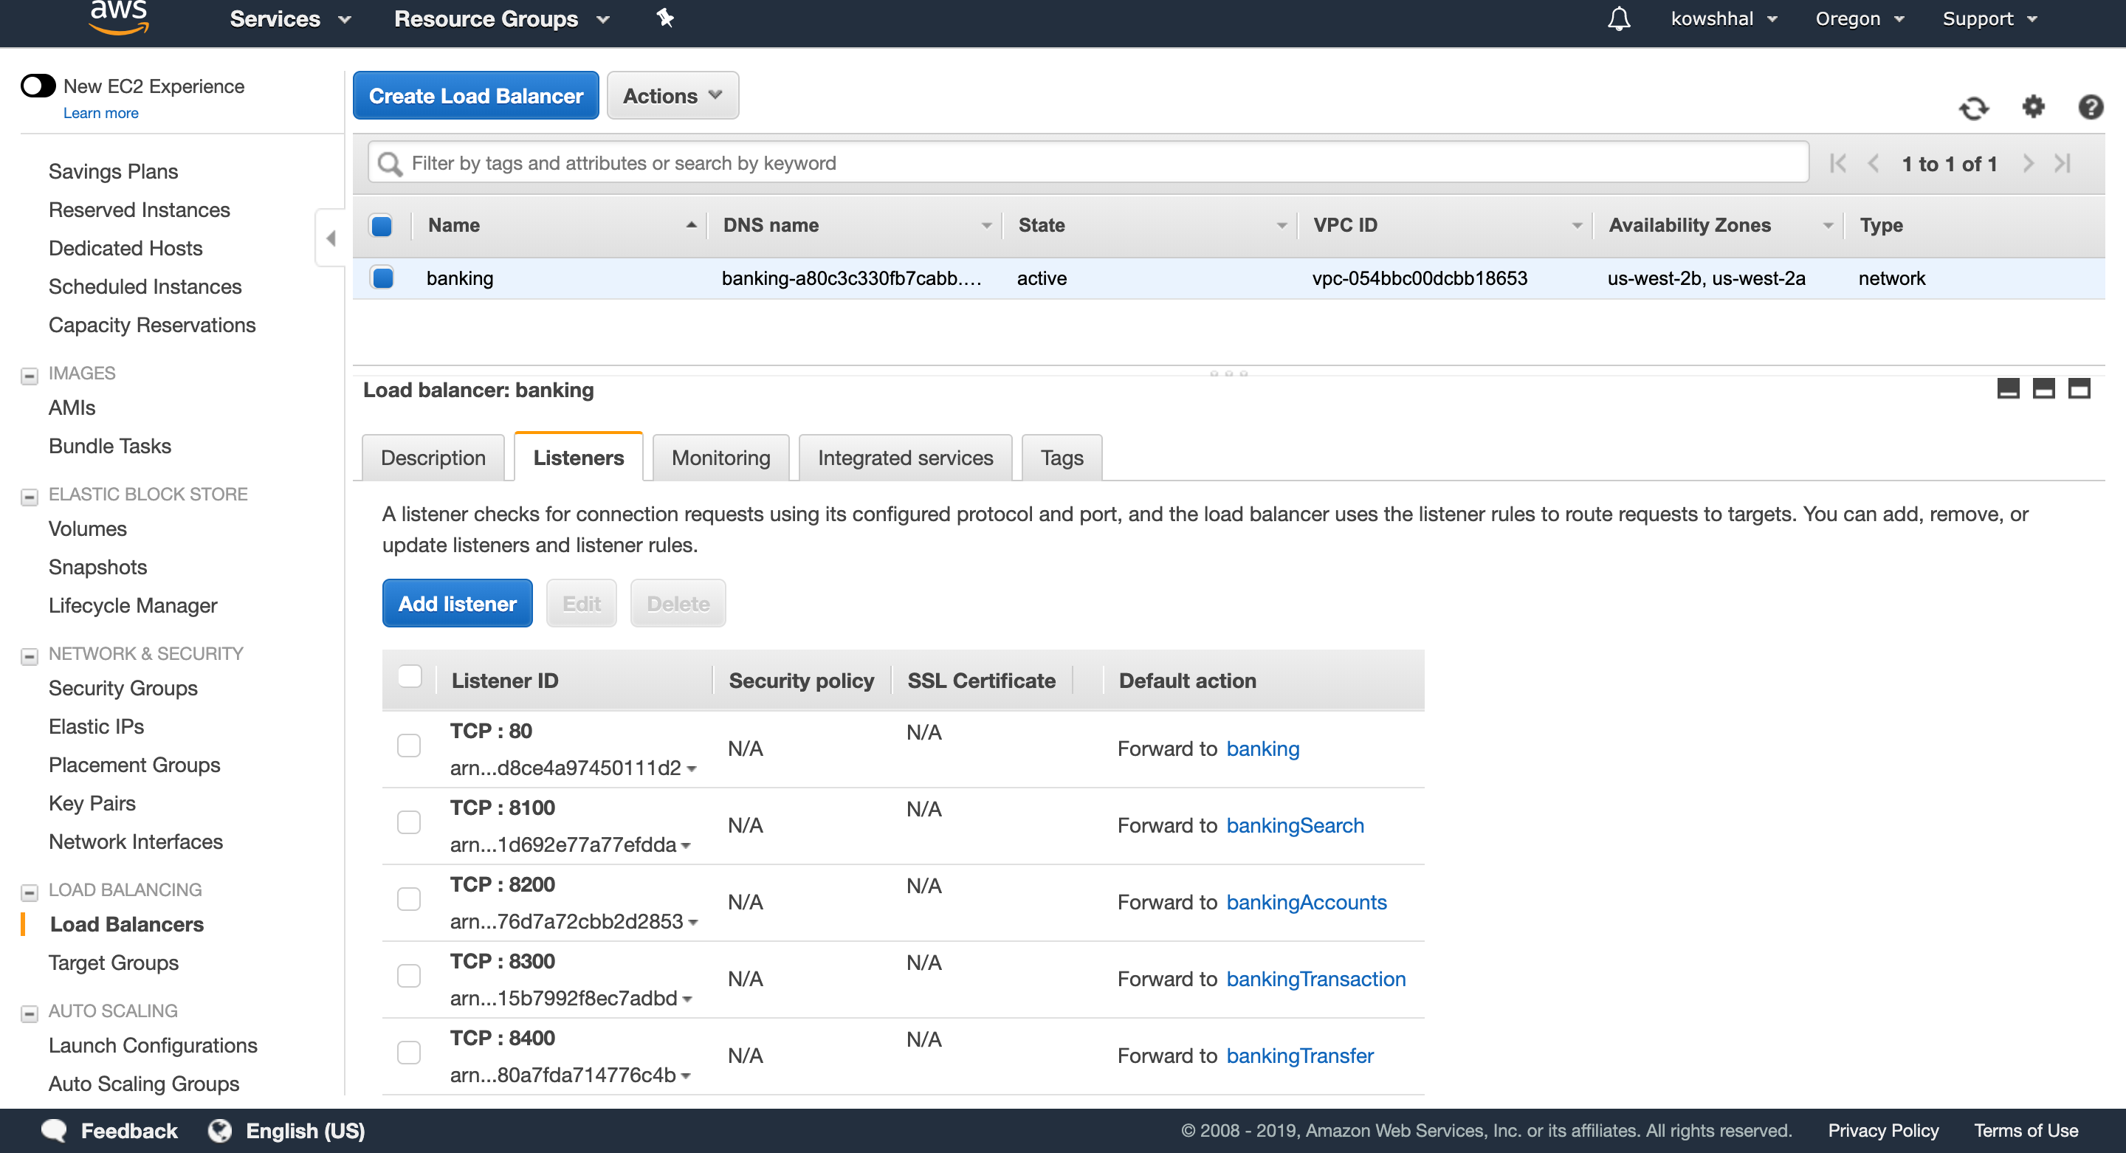
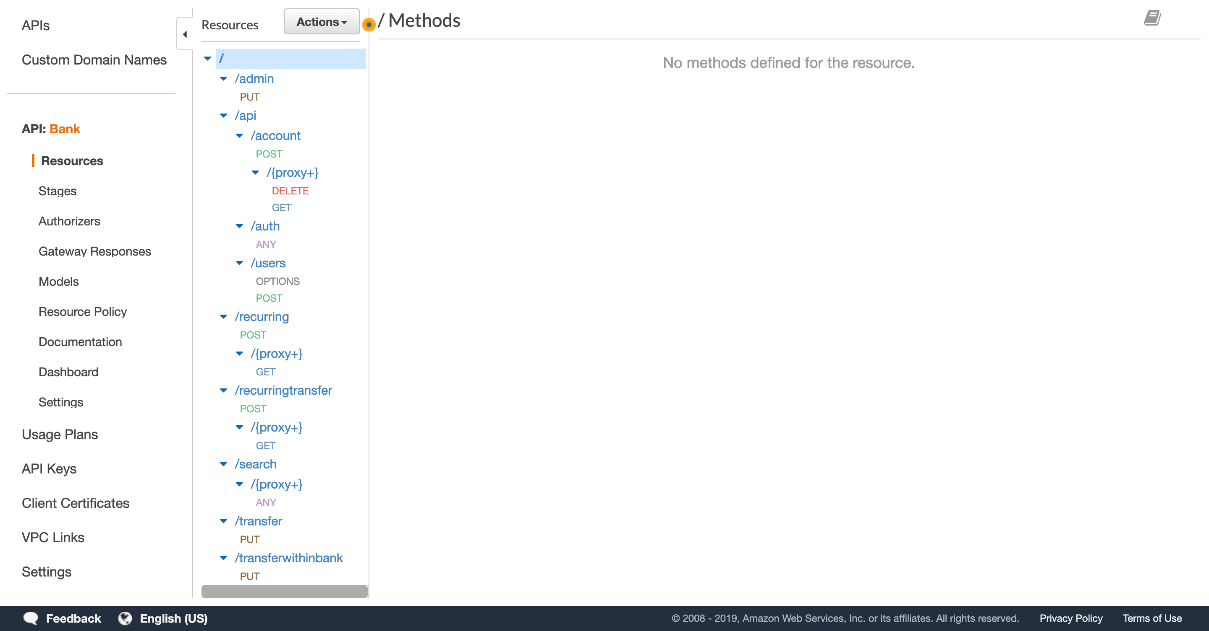
Load Balancer and API Gateway

Slide 5
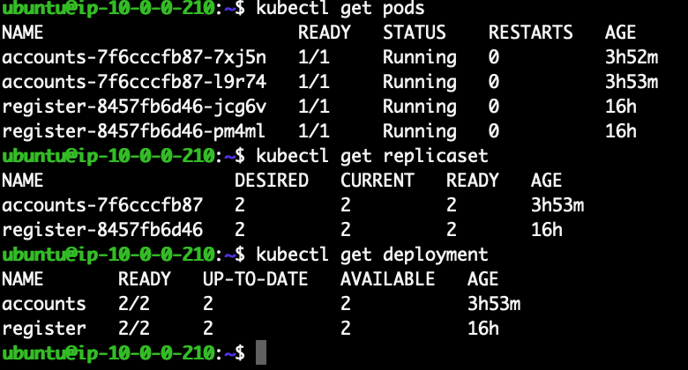
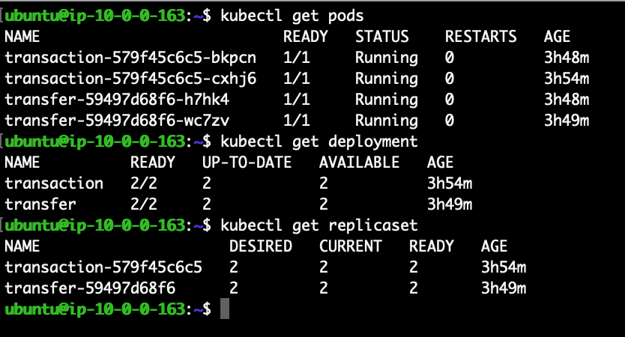
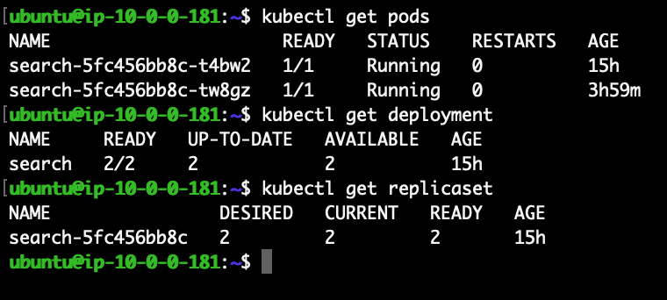
Auto Scaling in Kubernetes

Slide 6
Demo

