Slide 1
Blockchain task 1 Gal Karasnty 208934786 Niv Arad 316080035
1

Slide 2
Tasks statues (TODO)
Done
Implemented bloom-filter
Implemented Merkel tree
Transaction verification
30 transactions
Each block contains 4 transactions
Mining rewards.
Base fee is 1 * (attached block number)
Coins burning
Printing information
Missing functionality

Slide 3
Preparing environment
Install the following packages:
npm install elliptic
npm install secp256k1
npm install fully-connected-topology
npm install fs
npm install crypto
npm install crypto-js
npm install bloom-filters
npm install merkletreejs

Slide 4
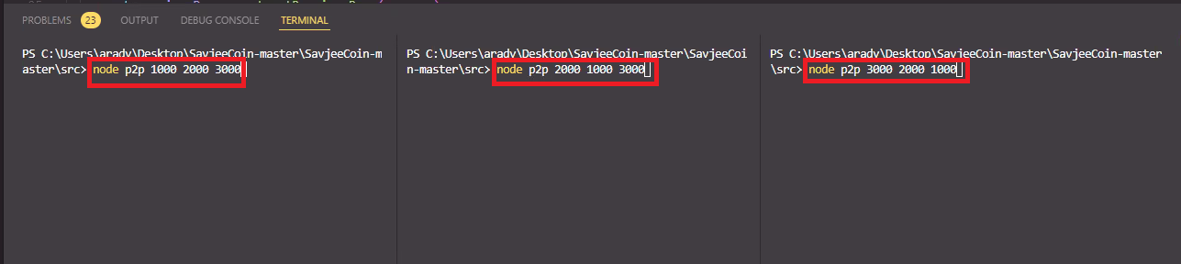
Running the project
Open new terminal from src directory and split it two times.
Run the following commands in each terminal:

Slide 5

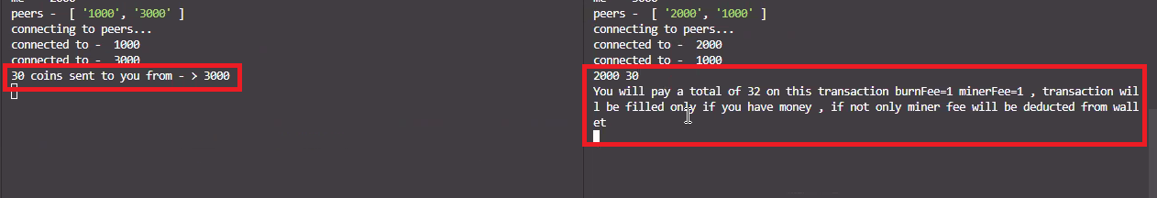
Mining and transactions
To mine a block, enter “mine” into the Full-node’s terminal.
To make a transaction to peer enter peer port and

Slide 6
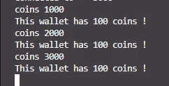
Checking wallet balance
Enter “coins” with the peerPort you want to check into the Full Node’s terminal.
after transactions, first mine as presented in the previous slide.

Slide 7



Getting general information
Enter the command based on the information wanted into Full-node’s terminal.
Total coins on the blockchain
Total burned coins
Total mined coins

Slide 8
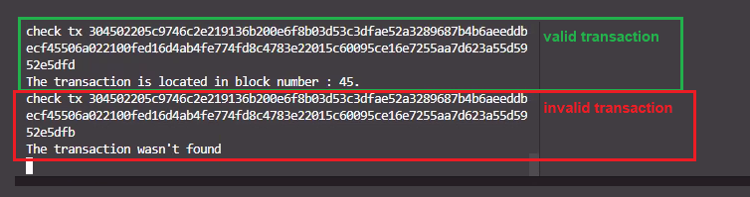
Search for transaction
Enter “check tx ” with the transaction signature you want to check into the Full Node’s terminal.

Slide 9
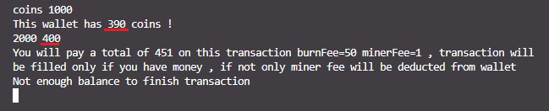
Check if buyer has enough coins
When buyer doesn't have enough coins an error message is sent to the Full Node’s terminal.

Slide 10
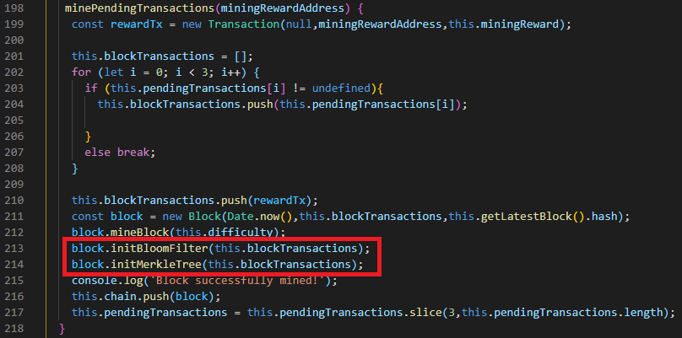
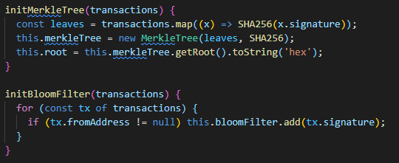
Bloom filter & Merkel tree
Merkle Tree and Bloom filter are been initiate each time the function “minePendingTransactions” is called and the block is mined successfully.

Slide 11
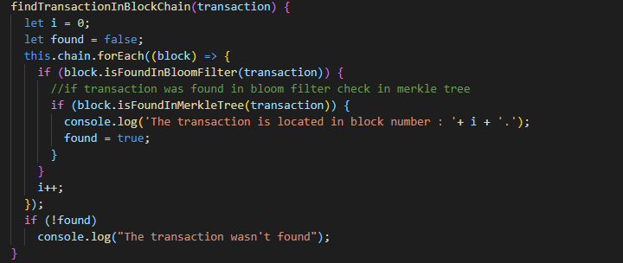
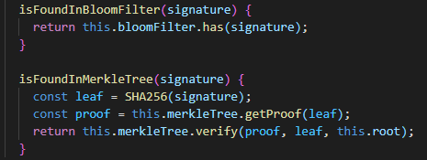
Bloom filter & Merkel tree (continue)
In order to check if the transaction was executed on the blockchain call the function “findTransactionInBlockChain” which uses the functions “isFoundInBloomFilter” and “isFoundInMerkleTree”.

Slide 12
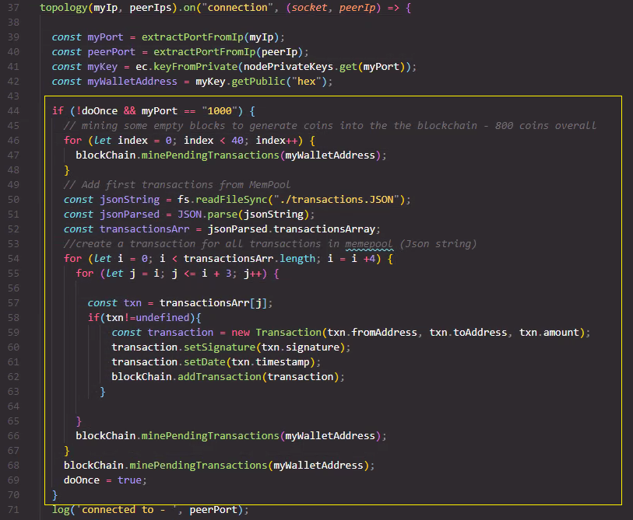
MemPool
Full node wallet mines 100 times.
reads some transactions from the JSON initiation file.

Slide 13
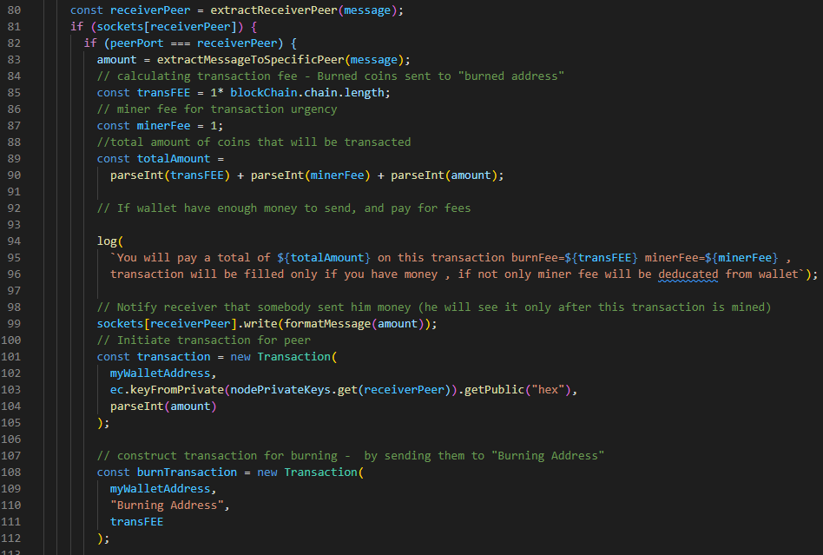
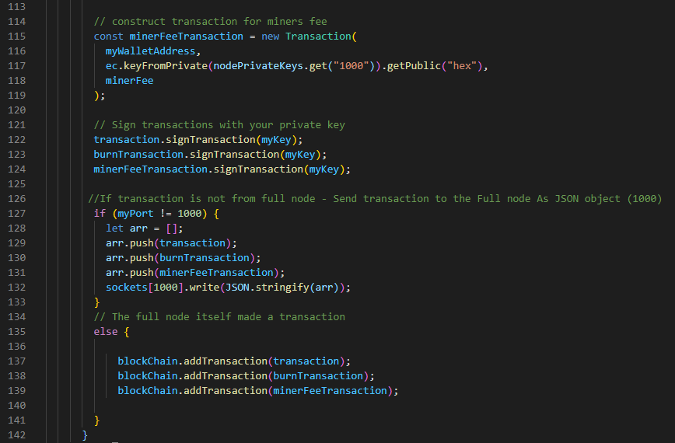
Fee and burning transaction
Transactions that are made from the light wallet will initiate two new transactions – burning and mining fee.

Slide 14

THANKS!

