Slide 1
Kella Jhansi
Final Project
3/21/2024 Annual Review

Slide 2

PROJECT TITLE
Key Logger & Security
3/21/2024 Annual Review

Slide 3


AGENDA
Project overview
Problem Statement
Who are the end users
Your solutions and its value preposition
The wow in your project
modeling
Results
3/21/2024 Annual Review

Slide 4


PROJECT OVERVIEW
Keyloggers pose a threat to the security of an organization’s sensitive
data and systems. When sensitive data — such as passwords — is typed
Into a computer, there are no protections in place preventing it from
being collected by malware. A keylogger can steal sensitive data that can
be used for various purposes.
3/21/2024

Slide 5
PROBLEM STATEMENT
The problem statement is that the keyloggers can be detected using antiviruses. Installation of hardware keyloggers is difficult without the knowledge of the owner of the system. The solution to the above existing problem is that we can build a software keyloggers instead of hardware keyloggers.
3/21/2024

Slide 6

WHO ARE THE END USERS?
1
3
Cybercriminal and malicious actors
2
State-Sponsored Actors and Intelligence Agencies
Employers and Business Owners
4
5
6
Parents and Guardians
Security Professionals and Researchers
Individuals with Personal Security Concerns:
3/21/20

Slide 7

YOUR SOLUTION AND ITS VALUE PROPOSITION
When considering keyloggers and security, the value propositions can be framed around the benefits and advantages they potentially offer, as well as the safeguards needed to mitigate risks. Here are some key value propositions related to keyloggers and security
Enhanced Monitoring and Oversight
Early Detection of Malicious Activity
Improving Security Awareness
Forensic Analysis and Incident Response
Compliance and Policy Enforcement
Protecting Intellectual Property
3/21/2024

Slide 8

THE WOW IN YOUR project
keylogger in the context of security, several factors come into play that define its effectiveness and appropriateness for different purposes. Here are key considerations for evaluating a keylogger in terms of security:
3/21/2024 Annual Review
8

Slide 9

MODELLING
Modeling in the context of keyloggers and security typically refers to creating representations or simulations of keylogger behavior and its impact on system security. Here’s how modeling is relevant in this domain
3/21/
9

Slide 10
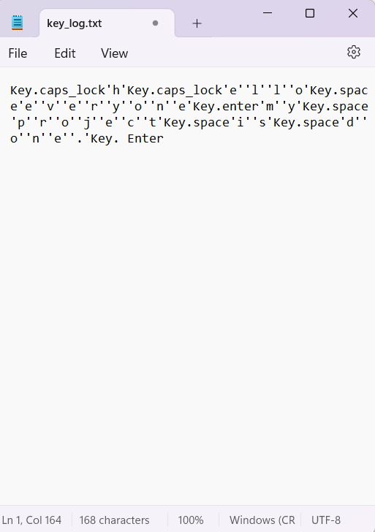
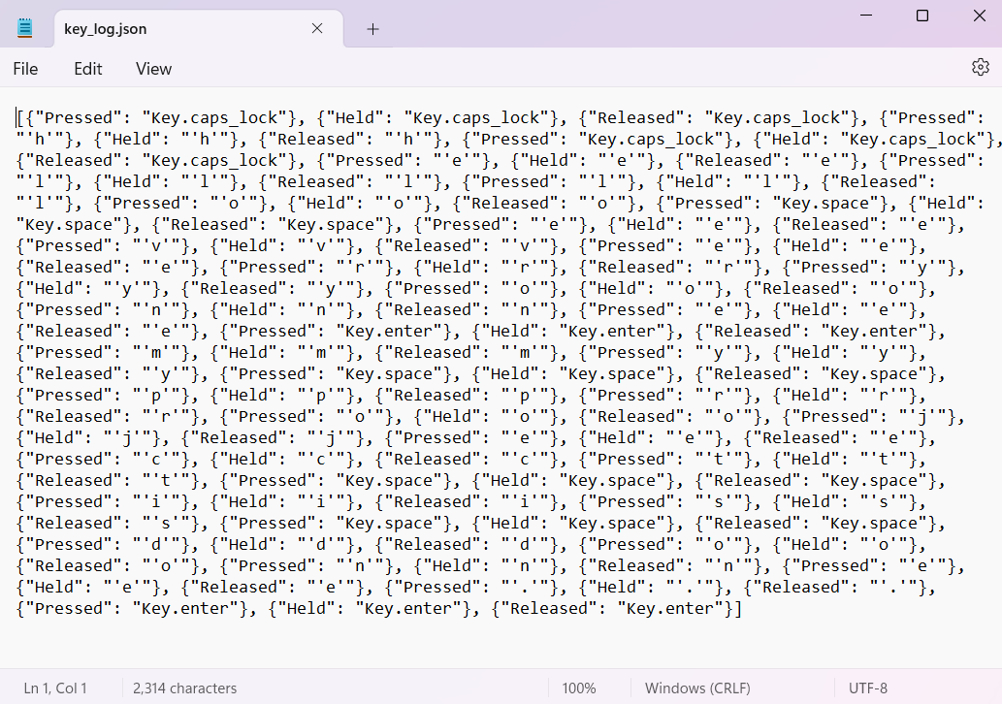
Out put
Keylogger.txt
Keylogger.json

Slide 11
RESULTS
The results of keyloggers in the context of security can vary significantly depending on how they are used and the intentions behind their deployment. Here are some potential outcomes or consequences associated with keyloggers and security
THANK YOU………
3/21/
11

Slide 12


Project link
Get link :
https://github.com/kella-Jhansi/keylogger.git

