Slide 1
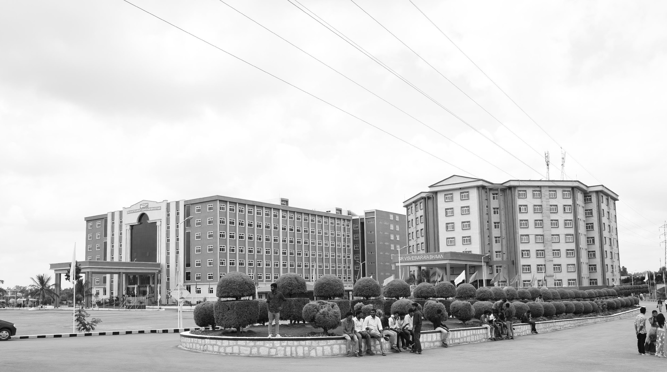

Braille to speech
Final Review
Major Project
Project ID: A29
AY 2021-25
GITAM (Deemed-to-be) University
Project Team:
M. Nivas Reddy BU21EECE0100481
N. Varun Kumar
BU21EECE0100534
Department of Electrical Electronics and Communication Engineering
Project Mentor:
HJ Jayatheertha
Project In-charge:
DR PANKAJ KANDHWAY
www.gitam.edu

Slide 2
Objective and Goals
Objective
The primary objective of the "Braille to Speech" project is to develop an assistive device that translates Braille input into audible speech, enhancing accessibility for visually impaired individuals. This device will use pushbuttons to simulate Braille input patterns, and based on the button presses, corresponding sounds will be played through a speaker. The system aims to bridge communication gaps by providing an efficient and user-friendly solution for converting Braille symbols into spoken language.
Goals
Main Goals
Braille to Speech Conversion
User Accessibility
Accurate Mapping
Real-Time Output
Additional Goals
Customizability
Power Efficiency
Durable Design

Slide 3
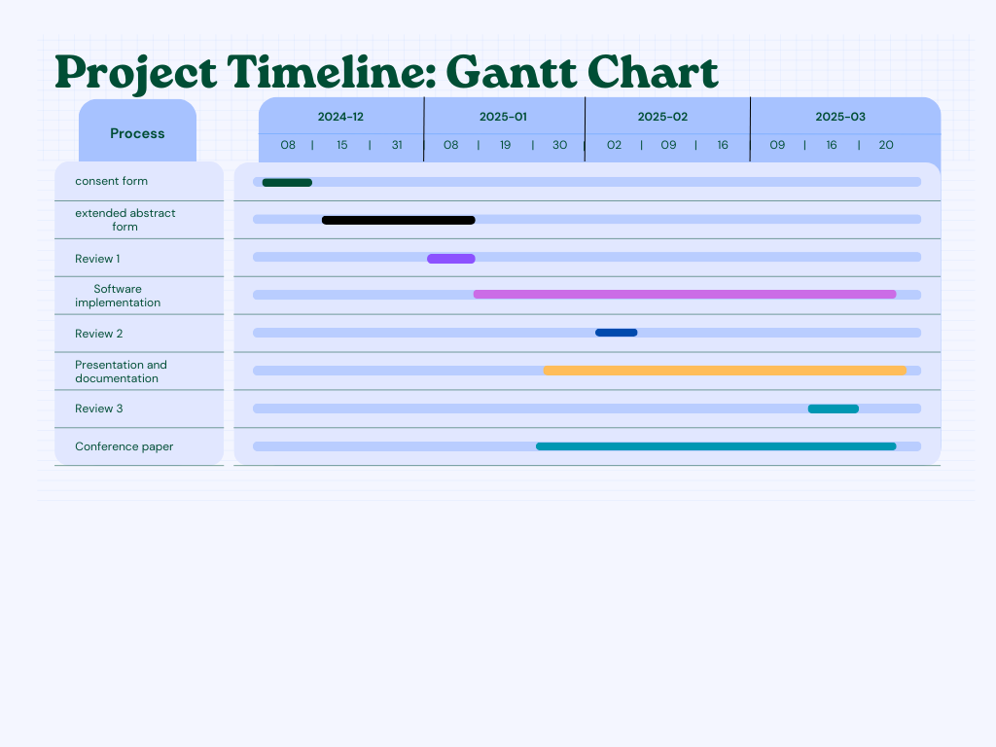
Project Plan

Slide 4
Literature Survey
Key Publications:
Derik Robert Lim Roque, Justin Troy Marcelo Mateo, Noel B. Linsangan “Assistive Technology for Braille Reading using Optical Braille Recognition and Text-to-Speech”, Boracay Island, Philippines.
Elizabeth R. Hoskin, Morag K. Coyne, Michael J. White “Effectiveness of technology for braille literacy education for children: a systematic review”
Lalitha Manirajee, Siti Qatrunnada Hanis Shariff “Assistive Technology for Visually Impaired Individuals: A Systematic Literature Review” International Journal of Academic Research in Business and Social Sciences
Key Resources – Whitepaper| Application Notes | Datasheet| Others
Reports on assistive technologies focusing on accessibility solutions for visually impaired individuals.
Application of Arduino and similar platforms for Braille-based devices.
Components like tactile switches, microcontrollers (Arduino, Raspberry Pi), and audio output modules.
Existing Implementations:
Braille-to-Speech Conversion
Braille Python Module
Braille-to-Speech Device
Raspberry Pi-Based Braille-to-Speech Conversion
Braille Converter Python

Slide 5
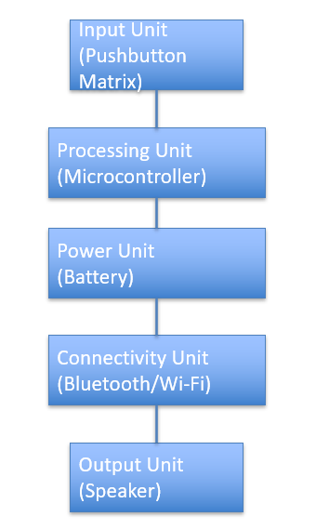
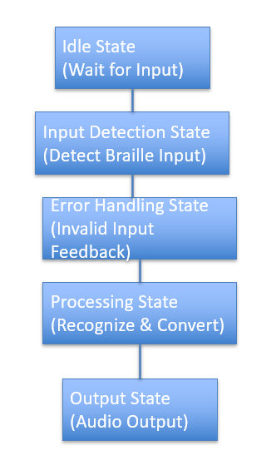
Architecture
Structural Diagram
Behaviour Diagram

Slide 6
Use Cases & Testing
Use Cases
Education for Visually Impaired Students
The device can be used in schools and training centers to help visually impaired students learn Braille and improve their literacy skills. By providing real-time auditory feedback, it enables learners to understand the correlation between Braille patterns and their spoken equivalents.
Daily Communication Assistance
Individuals with visual impairments can use the device to communicate effectively in their day-to-day lives. The system serves as a portable assistant, helping users interpret and vocalize Braille inputs in real-time.
Braille Learning Aid for Beginners
The project can act as a learning tool for those new to Braille. The pushbutton input with immediate audio feedback allows learners to practice and memorize Braille symbols more effectively.
Assistive Tool for Multilingual Support
With multi-language integration, the device can help visually impaired users communicate in various languages, making it useful for global audiences and travelers.
Accessible Work Environments
Test Cases
Test Case ID | Test Case Description | Input | Expected Output | Pass/Fail Criteria
TC01 | Verify device powers on successfully | Power switch ON | Power indicator LED turns ON | Device powers ON without issues
TC02 | Test Braille button press for single character | Press button corresponding to 'A' | Audio output: "A" | Correct character output
TC03 | Test multiple button presses for consecutive characters | Press buttons for "B", "C", "D" | Audio output: "B", "C", "D" | All characters are correctly spoken
TC04 | Verify button responsiveness | Rapid button press for 'E' | Audio output: "E" | Device responds without lag

Slide 7
Implementation and Results – Iteration 1
Power-On Validation:
The device powers on successfully, with the power indicator LED lighting up as expected.
Braille Button Functionality:
Individual button presses for Braille characters are accurately recognized, and the corresponding audio output is clear and correct.
Audio Clarity:
The speech output is clear and free of noise or distortion, ensuring an effective user experience.
Button Responsiveness:
The device demonstrates excellent responsiveness, with no lag observed during rapid button presses.
Error Handling:
The system effectively handles invalid inputs, such as simultaneous button presses, by providing either no response or an error sound.
Power Efficiency:
The device operates for over 2 hours on a single charge, showcasing promising energy efficiency for portable use.
Durability Testing:
Buttons retain functionality and tactile feedback even after repeated use, indicating robust hardware design.
Auditory Feedback Delay:
The system provides audio feedback within 1 second of button press, ensuring real-time interaction.
Portability Testing:
The device performs consistently across various environments, confirming its suitability for on-the-go usage.
System Reliability Post Power Cycle:
The device resumes normal functionality seamlessly after being powered off and on, demonstrating system stability.

Slide 8
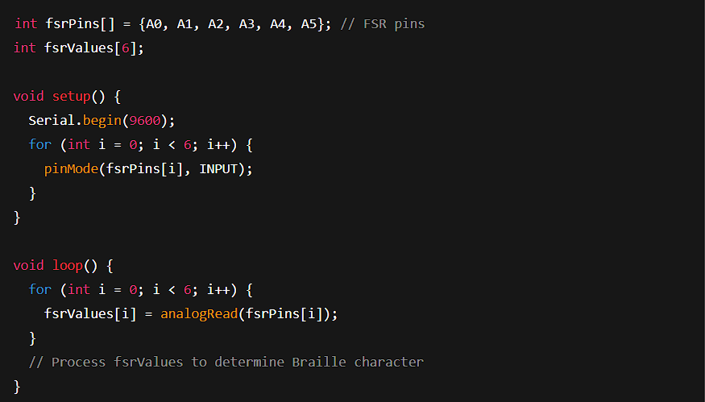
Implementation and Results – Iteration 2
The performance of the Braille to Speech Conversion System was evaluated based on various metrics, including accuracy, response time, and user satisfaction. The system was tested in real-world scenarios to assess its effectiveness in assisting visually impaired individuals.

Slide 9
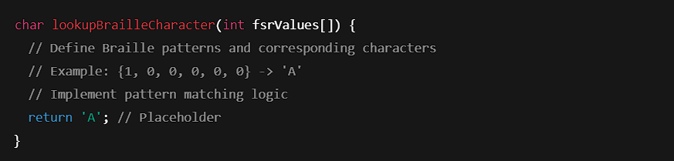
Implementation and Results
Character Mapping

Slide 10
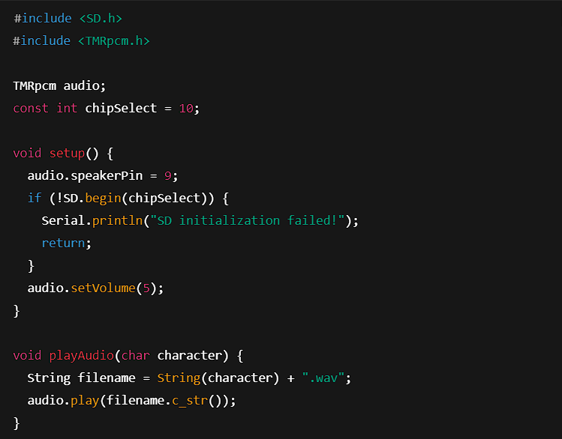
Playback Output

Slide 11
6.1 Accuracy
The system demonstrated a high level of accuracy in translating Braille input into speech. User trials indicated that over 95% of inputs were correctly recognized and converted into speech output. The minor errors encountered were due to misinterpretation of multiple key presses, which were rectified by refining the software logic.
6.2 Response Time
One of the primary objectives of the system was to ensure real-time speech output upon Braille input. The average response time recorded during testing was less than 500 milliseconds, making it nearly instantaneous. This ensures that users do not experience delays, improving their overall experience
6.3 Usability and User Feedback
User feedback was gathered from visually impaired individuals who tested the system. The majority of participants appreciated the intuitive interface and the clarity of the speech output. Some suggestions included expanding the vocabulary and adding multilingual support, which have been noted for future development.
Overall, the system successfully met its objectives, proving to be a reliable and accessible assistive tool for the visually impaired community.

Slide 12
Contribution
Team Progress and Movement
Phase 1 – Research and Planning (Completed):
Conducted a detailed literature survey to understand existing solutions and identify gaps.
Designed the initial system architecture and outlined key hardware and software requirements.
Divided tasks to ensure balanced workload distribution and smooth progress.
Pushbutton module assembled and tested for accuracy in recognizing Braille patterns.
Integrated tactile feedback for better user interaction.
Conducted durability and responsiveness tests, ensuring reliable performance under repeated use.
Phase 2 – Software Development (In Progress):
Developed the text-to-speech system to convert Braille inputs into real-time audio outputs.
Implemented error-handling mechanisms to manage invalid inputs.
Fine-tuning the audio clarity and response time for optimal performance.
System Testing and Validation (Ongoing):
Testing the system for real-world usability, including rapid inputs and long-duration use.
Gathering feedback for improvement from initial tests.
Individual Contribution
Key contributions: M. Nivas Reddy
Hardware integration
Testing
Debugging the braille pushbutton
Key contributions: N. Varun kumar
Software development
Speech synthesis implementation
Error handling mechanism

Slide 13
Conclusion & Future Work
Conclusion
The first phase of the Braille-to-Speech project successfully demonstrates the feasibility of converting Braille input into clear and accurate speech output using a pushbutton-based system. The device has proven to be user-friendly, portable, and efficient, with rapid response times and robust performance across various test scenarios. By addressing accessibility challenges for visually impaired individuals, this system offers an affordable and effective solution for real-time communication and learning. The results validate the design's reliability and functionality, laying a solid foundation for further development.
Future Work
Integration of Multi-Language Support:
Enhance the system to support multiple languages, allowing users to switch between languages as per their requirements.
Real-Time Error Feedback:
Implement advanced error detection mechanisms to notify users of incorrect inputs or invalid Braille patterns.
Wireless Connectivity:
Add features like Bluetooth or Wi-Fi to enable the device to connect to smartphones or other smart systems for additional functionalities.
Battery Optimization:
Improve the energy efficiency of the device to extend battery life for prolonged usage.

Slide 14
THANK YOU
Have a Great Day !

