Slide 1
DATA ANALYTICS PROJECT
Customer Shopping Behavior Analysis
Uncovering spending patterns, customer segments, and product preferences from 3,900 transactions to guide strategic business decisions.

Slide 2
Dataset at a Glance
3,900
18
37
Purchases
Columns
Missing Values
Transactional records
Features per record
Review Rating column
Customer Demographics
Purchase & Behavior
Age, Gender, Location, Subscription Status
Category, Amount, Discount, Frequency, Rating, Shipping

Slide 3
PYTHON
Data Preparation & Cleaning
01
02
Load & Explore
Handle Missing Data
Imported via pandas; df.info() and .describe()
Imputed Review Rating with median per category
03
04
Standardize & Engineer
Load to PostgreSQL
Snake case columns; created age_group and purchase_frequency_days
Cleaned DataFrame loaded for SQL analysis

Slide 4
SQL ANALYSIS
Revenue Insights
Revenue by Gender
Revenue by Age Group
Compared total revenue generated by male vs. female customers.
Calculated total revenue contribution of each age group.

Slide 5



SQL ANALYSIS
Discount & Shipping Behavior
High-Spending Discount Users
Discount-Dependent Products
Shipping Type Comparison
Average spend: Standard vs. Express shipping
Customers using discounts yet spending above average
Top 5 products with highest % of discounted purchases

Slide 6
SQL ANALYSIS
Product & Rating Analysis
Top 5 Products by Rating
Top 3 Products per Category
Highest average review ratings across all categories.
Most purchased products within each category.

Slide 7
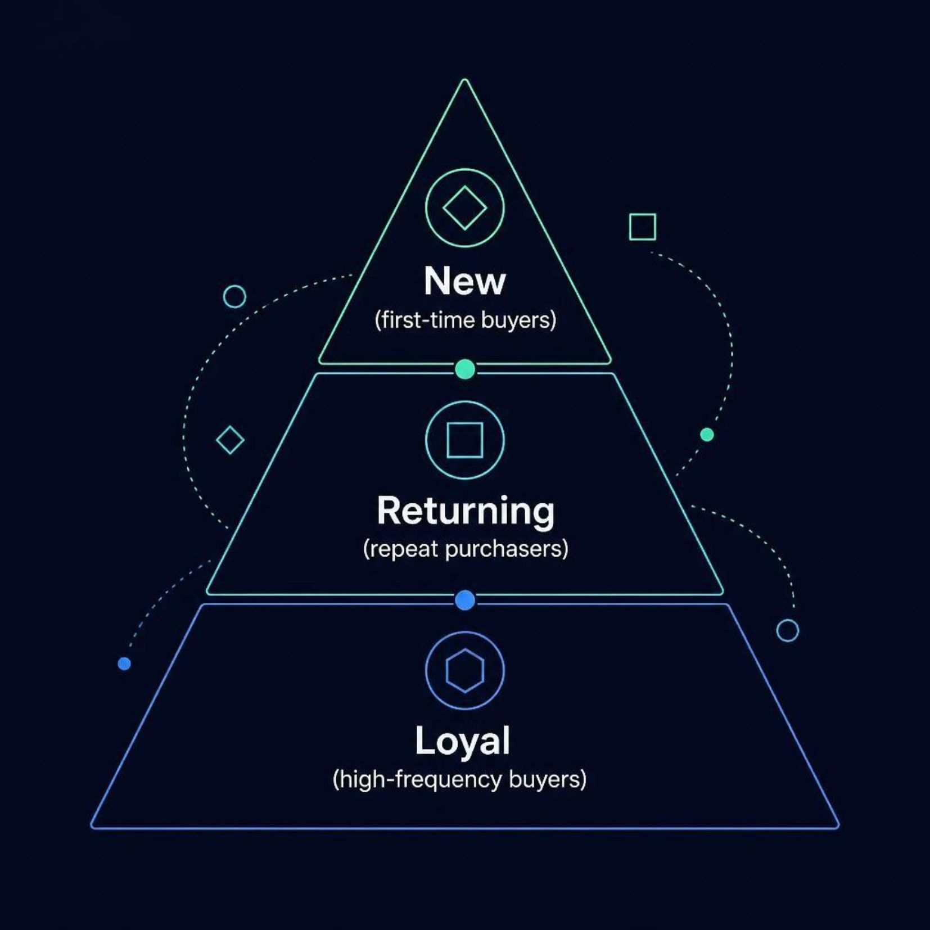
SQL ANALYSIS
Customer Segmentation
Customers classified into three segments based on purchase history.

Slide 8
SQL ANALYSIS
Subscribers vs. Non-Subscribers
Average Spend & Total Revenue
Repeat Buyers & Subscriptions
Compared across subscription status to reveal spending differences.
Customers with >5 purchases — are they more likely to subscribe?

Slide 9
POWER BI
Interactive Dashboard
Visual presentation of all key insights — revenue, segments, products, and behavior — in a single interactive Power BI dashboard.

Slide 10





Business Recommendations
Boost Subscriptions
Loyalty Programs
Review Discount Policy
Promote exclusive subscriber benefits
Reward repeat buyers toward "Loyal" segment
Balance sales boosts with margin control
Targeted Marketing
Product Positioning
Focus on high-revenue age groups & express-shipping users
Highlight top-rated & best-selling products in campaigns

