Slide 1
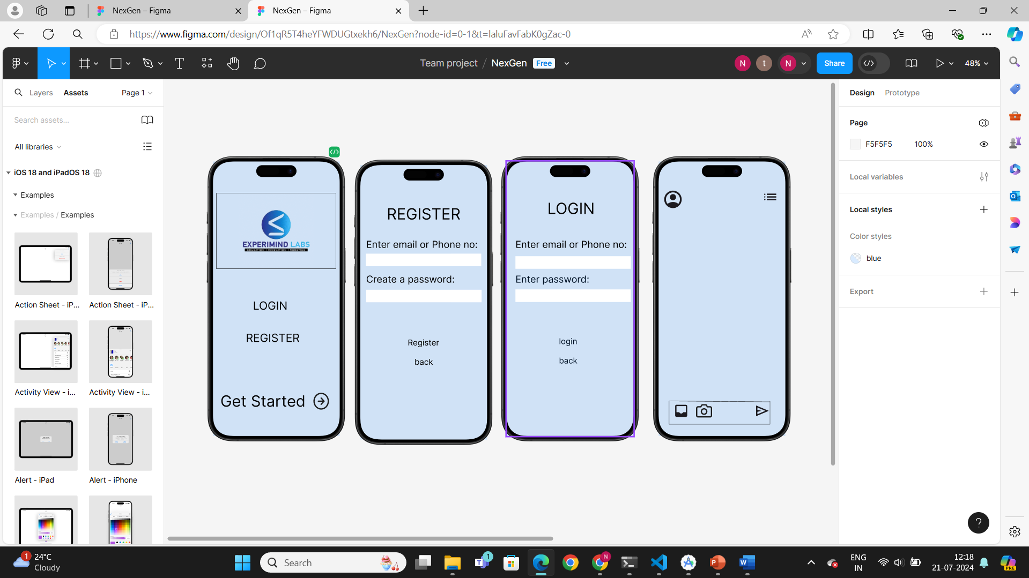
FRONTEND LINK:
https://www.figma.com/design/Of1qR5T4heYFWDUGtxekh6/NexGen?node-id=0-1&t=laluFavFabK0gZac-1

