Slide 1

Master Thesis Calculation of Mechanical Stress of a Motorcycle Rear-frame
Presented By- Under the Guidance of-
Venkatasubramanian Sundaramoorthy(63942) Prof. Dr. –Ing. Matthias Kröger

Slide 2
Introduction
This research aims to optimize the design of a motorcycle's rear frame to reduce weight while maintaining strength.
The experimental vibration analysis is recreated in the same conditions as in the actual world, with a z-direction displacement load on the steering head and swing arm and output data such as strain and acceleration monitored.
The observed strain and acceleration signal are used to assess how well the simulated data matches reality.
Occasionally, the steering head or swing arm receives a low-amplitude input signal, but the output signal, such as acceleration, responds unexpectedly, raising the topic of the acceleration signal's unpredictability.

Slide 3
Introduction
The rear frame is designed using Abaqus, a shell structure, and a vibration boundary condition. Based on the experimental vibration investigation, strain and acceleration signals are obtained.
The critical points are extracted from the time-frequency analysis of the Short-time Fourier Transform using MATLAB, and the critical stresses are estimated using the Dynamic Implicit technique.
Using the Abaqus connector element, a spring-mass system is created to validate the simulation and experimental results.
A parametric analysis is performed with different spring, mass, and damping values to understand the influence of mass, spring, and damping coefficients on acceleration signals.

Slide 4
Signal Analysis
Time domain Analysis (Heng, 1998):
Frequency domain Analysis (Brie, 2000):
Time Frequency Analysis (Mori, 1996):
Short time fourier analysis (STFT)
Wavelet transform (WT)
Wavelet packet transform (WPT)
Hilbert-Huang Transform (HHT)
Time domain Analysis (Heng, 1998):
Quantitative analysis to evaluate the presence of flaws in bearing
Statistical properties such as RMS, Crest factor, Kurtosis are examined

Slide 5
Signal Analysis
Frequency domain Analysis (Brie, 2000):
Investigates on spalled bearing vibration model and conventional techniques and the constraints of time-frequency analysis
If the defect is minor, the gear signal can compensate for the bearing’s contribution.
Utilizing time-frequency vibration analysis helps overcome the limitations of both the temporal domain and frequency analysis.
Figure 1: Single point defect bearing vibration signal analysis (Brie, 2000) (a) time domain vibration signal (b) amplitude spectrum

Slide 6
Signal Analysis
Time Frequency Analysis (Mori, 1996):
The main focus of time-frequency analysis is to identify and describe instances in which the frequency information of a signal varies over time.
Discrete Wavelet transform is applied to vibration analysis of accelerometer signal to detect spalling and rolling elements.
The difficulty in identifying impulsive actions is because the amplitude of the sud

Slide 7
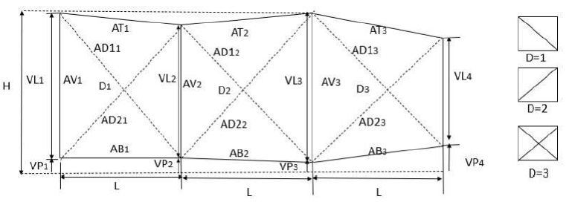
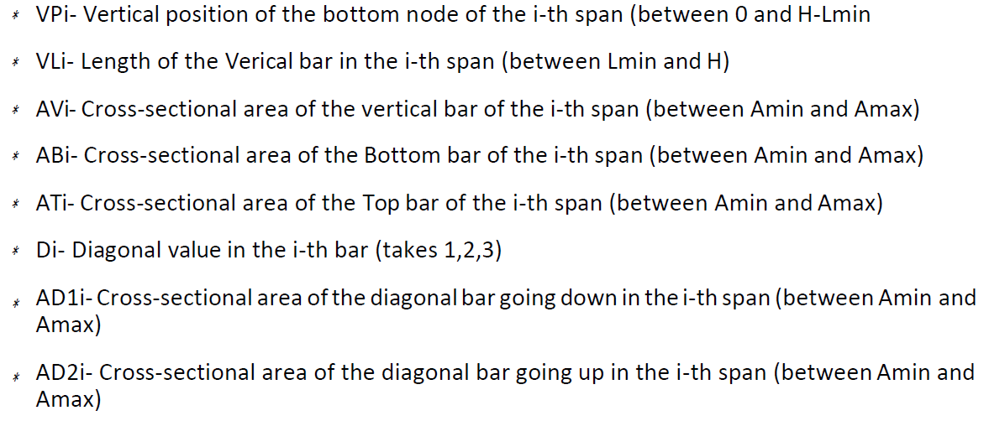
AIM
Figure 1: Truss Structure to Optimize

Slide 8
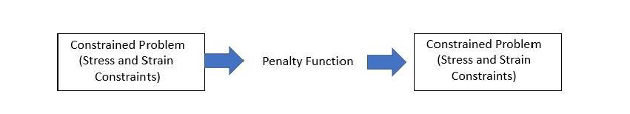
THEORY
The penalty function is applied to nonconforming individuals to deal with nonlinear constraints.
The mass of the truss (which must be minimized), but depending on the severity of the constraint violating, this value is then penalized by a certain amount.
Penalty Function: The goal of penalty functions is to turn constrained problems into unconstrained ones by imposing an artificial penalty for breaking the constraint.
Figure 2: Penalty Function

Slide 9
THEORY
The algorithm begins by creating a population of candidate solutions at random within the design space (allowable parameters range).
From here, the population is iterated in a loop (each loop giving birth to a new generation of individuals), ideally evolving to an optimal solution.
Each individual in the population is assigned a fitness value based on the total mass of the proposed solution and how well it conforms to the overall stress and maximum permissible displacement using FEM.
While the Genetic Algorithm and FEM seem to have a straightforward work flow, their implementation is quite difficult.

Slide 10
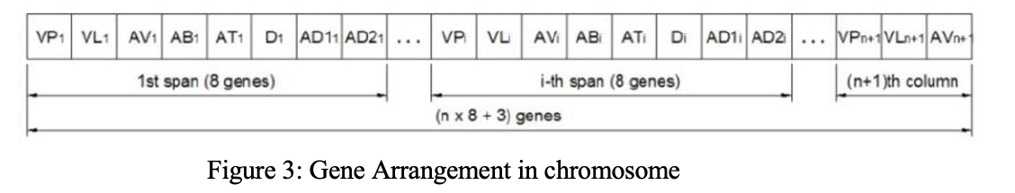
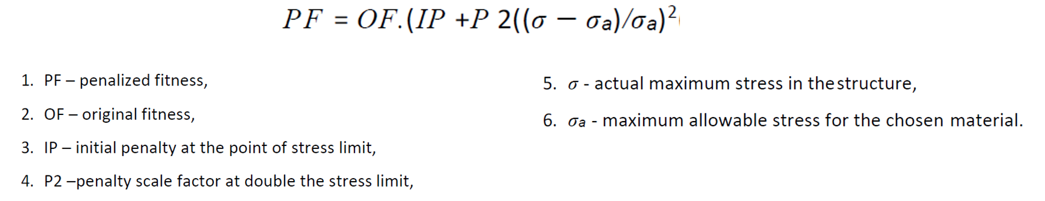
GENETIC ALGORITHM
GA Operators | Description
Encoding Technique | It is represented by its chromosome → vector of genes (each of which contains the value of one parameter). All of this data is put into an array and transferred to the optimizing function.
Fitness Evaluation | Penalty Function used for this Project

Slide 11
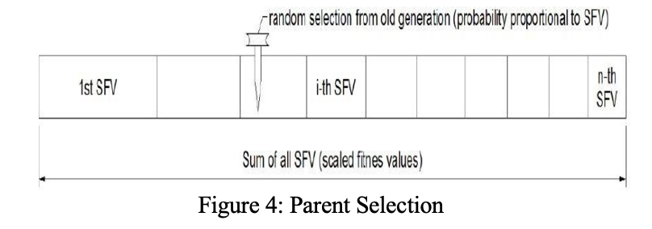
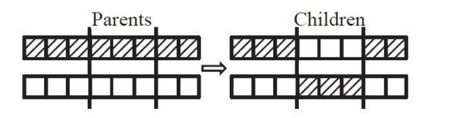
GENETIC ALGORITHM
GA Operators | Description
Parent Selection | Based on scaled fitness ,individuals are selected at random. Selection Method: Roulette Wheel Selection (simulates a roulette spin by creating a random number within a space where each individual occupies a portion proportional to its fitness)
Crossover | Crossover Method: Two-point crossover to create a new generation for two chosen parents (two integer values between 1 and the chromosome size are chosen at random)

Slide 12
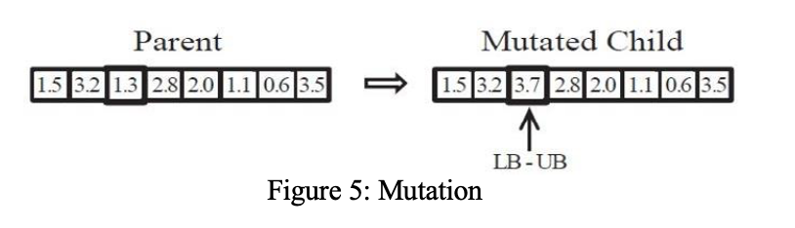
GENETIC ALGORITHM
GA Operators | Description
Mutation | Mutation Method : Classic Uniform Mutation (each gene has a probability ρm of being mutated). A new value for the gene is then selected at random from a uniform distribution over the gene’s possible range.
Elitism | Elite Count : 2 (Two Fittest Individuals would almost certainly be found in the next generation, where they may be replaced by even fitter children).

Slide 13
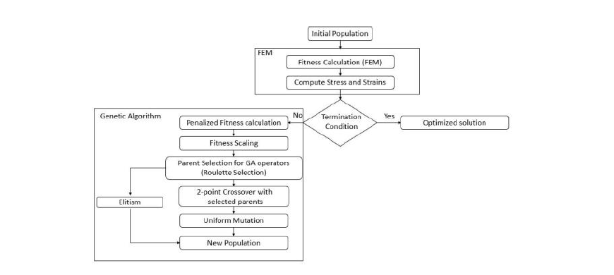
FLOW CHART
Figure 3: Main Program Flow chart

Slide 14
THEORY
Two dimensional trusses are considered.
To translate the local element matrices (stiffness matrix, force vector) into the structural (global) coordinate system, a transformation of coordinate basis is needed.
Trusses, like bars, only support compressive and tensile forces. At the nodes, all forces are applied.

Slide 15
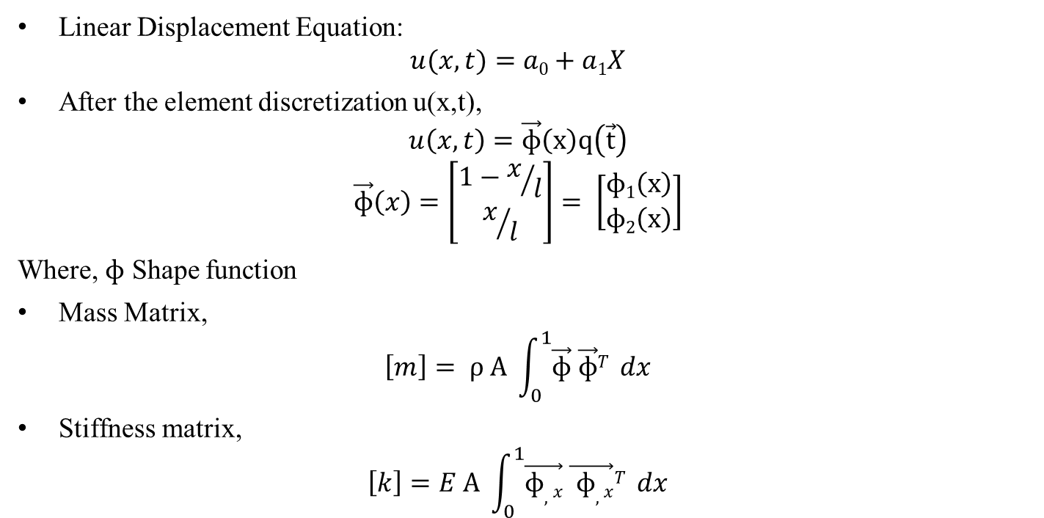
THEORY
Linear Displacement Equation:
$$u(x,t)=a0+a1X$$
After the element discretization u(x,t),
$$u\left(x,t\right)=\vec{ɸ}\left(x\right)q\left(\vec{t}\right)$$
$$\vec{ɸ}\left(x\right)=\left[\begin{matrix}1−x/l \\ x/l\end{matrix}\right]= \left[\begin{matrix}ɸ1\left(x\right) \\ ɸ2\left(x\right)\end{matrix}\right]$$
Where, $ɸ$ Shape function
Mass Matrix,
$$\left[m\right]= ρ A \int_{0}^{1}{\vec{ɸ} \vec{ɸ}T} dx$$
Stiffness matrix,
$$\left[k\right]=E A \int_{0}^{1}{\vec{ɸ,x} \vec{ ɸ,x}T} dx$$

Slide 16
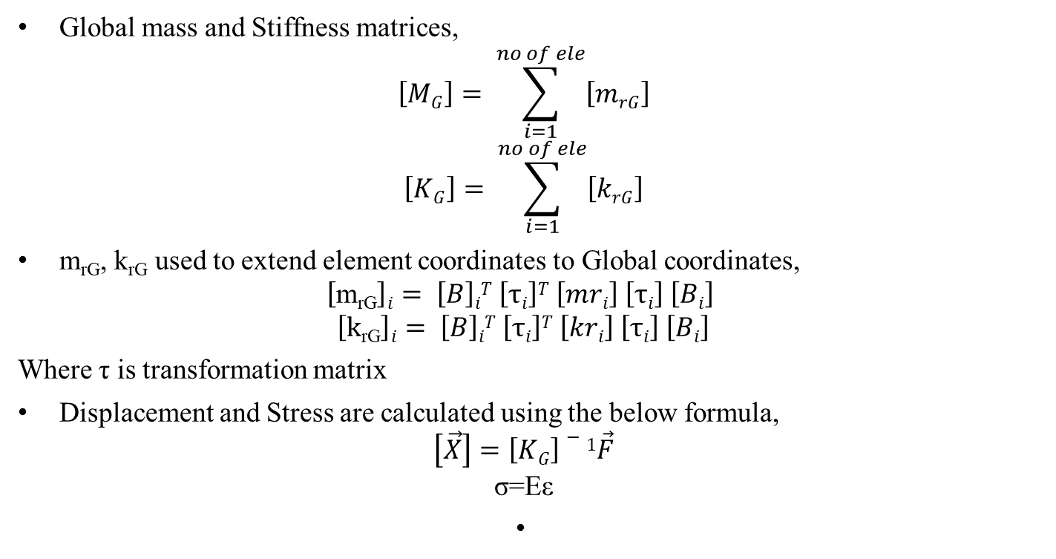
THEORY
Global mass and Stiffness matrices,
$$\left[MG\right]= \sum_{i=1}^{no of ele}{\left[mrG\right]}$$
$$\left[KG\right]= \sum_{i=1}^{no of ele}{\left[krG\right]}$$
m_{rG}, k_{rG} used to extend element coordinates to Global coordinates,
$$\left[\text{m}\text{rG}\right]i= \left[B\right]iT \left[τi\right]T \left[mri\right] \left[τi\right] \left[Bi\right]$$
$$\left[\text{k}\text{rG}\right]i= \left[B\right]iT \left[τi\right]T \left[kri\right] \left[τi\right] \left[Bi\right]$$
Where τ is transformation matrix
Displacement and Stress are calculated using the below formula,
$$\left[\vec{X}\right]=\left[KG\right]−1\vec{F}$$
$$\text{σ}\text{=}\text{E}\text{ε}$$

Slide 17
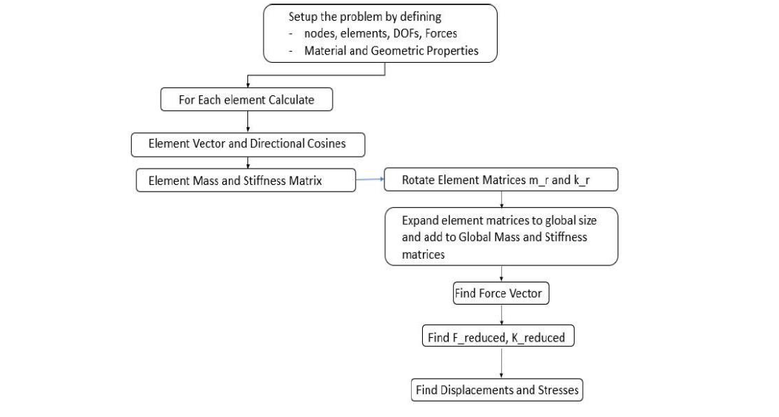
FLOW CHART
Figure 4: FEM Program Flow chart

Slide 18
RESULTS

Slide 19
RESULTS - PARAMETER
Must reduce the truss weight by optimizing the truss parameters while keeping tension and strains within acceptable limits.
Have selected the following material and GA parameters and stopping criteria with 40 iterations and a single constraint problem.
Output what we are getting is optimized result.
Parameters | Input
number of parameters | 8
number of span | 2
Maximum length of the bar | 18 m
Maximum height of the bar | 9 m
Min value of area | 5 m²
Max value of area | 10 m²
Population size | 40
Number of constraints (stress (1) / strain(2) or both (3) | 1
Density of the element | 0.1 kg/m³
Stiffness of the element | 10 Pa
Stress limit | 25 Pa
Probability of mutation | 0.6
size of restrained dofs | 4
number of restrained dofs in the truss | 1
number of restrained dofs in the truss | 2
number of restrained dofs in the truss | 3
number of restrained dofs in the truss | 4
Forces[1] x | 100 N
Forces[1] y | 200 N
Forces[3] x | 100 N
Forces[3] y | 200 N
Forces[5] x | 100 N
Forces[5] y | 200 N

Slide 20
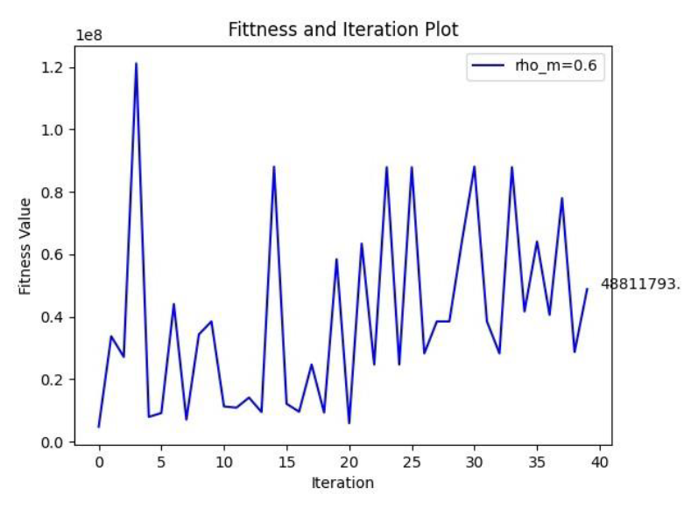
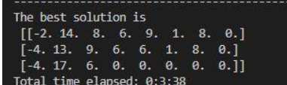
OUTPUT
Penalized fitness of the truss is minimized with number of iterations.
Population size → 40
Mutation Probability → 0.6
Figure 5: Fitness & Iteration Plot with Optimized Solution

Slide 21
TEST CASES

Slide 22
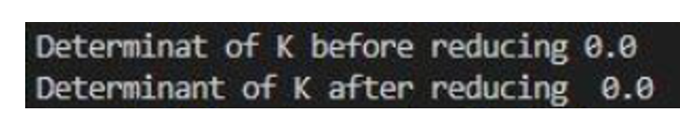
TEST CASE: 1
Stability condition - Stiffness Matrix should be non-singular.
Rigid body Translation - FEM truss structure all the constraints were removed and Forces are applied in all the node in the structure.
Global Stiffness matrix - Singular matrix (no stresses are developed in the nodes).
Singularity of the k matrix will be immediately observed and, as the vector f includes all necessary source and boundary traction terms, the formulation will be completely tested. The test described is now not only necessary but sufficient for convergence.
[Source: The finite element methods its basis and fundamentals]
Figure 6:Singularity of K matrix

Slide 23
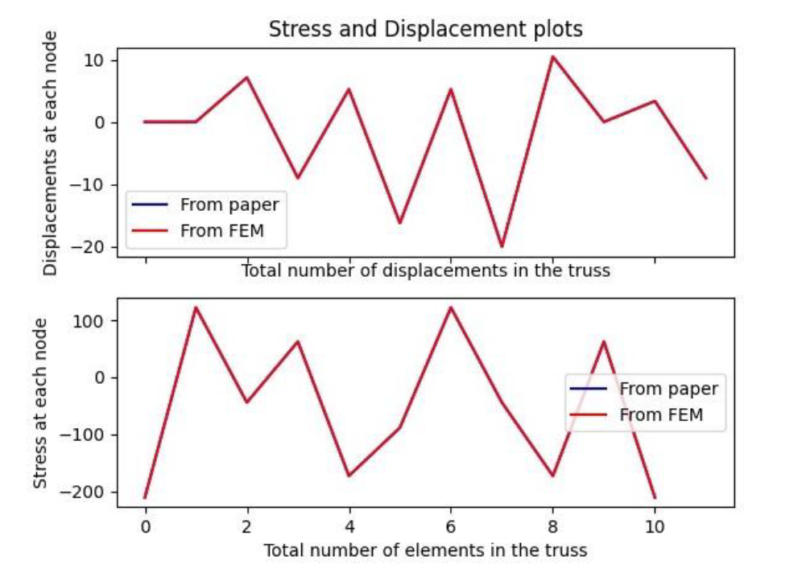
TEST CASE: 2
Stresses & Displacements from a scientific paper (Matlab Codes for Finite Element Analysis FEM Analysis of 2D trusses Chapter 4, Page No: 62)
Verified with my FEM program whether same results are generated for a specific material parameter.
The below graph shows the curve fit of displacements at each node and the stresses in each element in FEM program and the Paper.
Parameters | Input
number of parameters | 8
number of span | 2
Maximum length of the bar | 3000 mm
Maximum height of the bar | 3000 mm
Density | 1 kg/m³
Youngs modulus | 70000 Pa
Restrained DOF | 3 [1,2,10]
Forces[4] | -50000 N
Forces[8] | -50000 N
Forces[12] | -50000 N
Figure 7:Stress & Displacement plot in each element

Slide 24
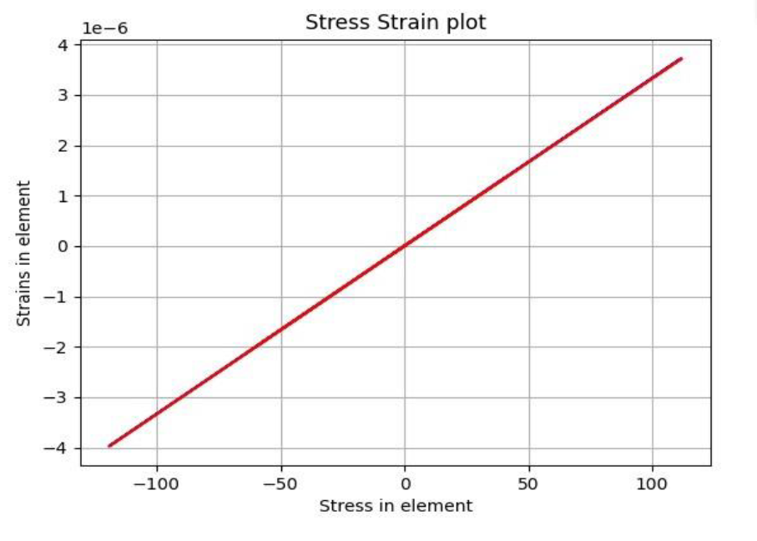
TEST CASE: 3
FEM program is compared with the Manually solved results with specific material parameters (With span size 2 )
Verification of Results - Manual Calculation and the FEM program and the Stress & Strain plot is shown below:
Parameters | Input
number of parameters | 8
number of span | 2
Maximum length of the bar | 18 m
Maximum height of the bar | 9 m
Density | 0.284 kg/m³
Youngs modulus | 3e7 Pa
Restrained DOF | 4 [5,6,9,10]
Forces[3] | 100 N
Forces[4] | -200 N
Forces[7] | 200 N
Forces[8] | -400 N
Forces[11] | 300 N
Forces[12] | -600 N
Figure 8:Stress & Strain plot

Slide 25
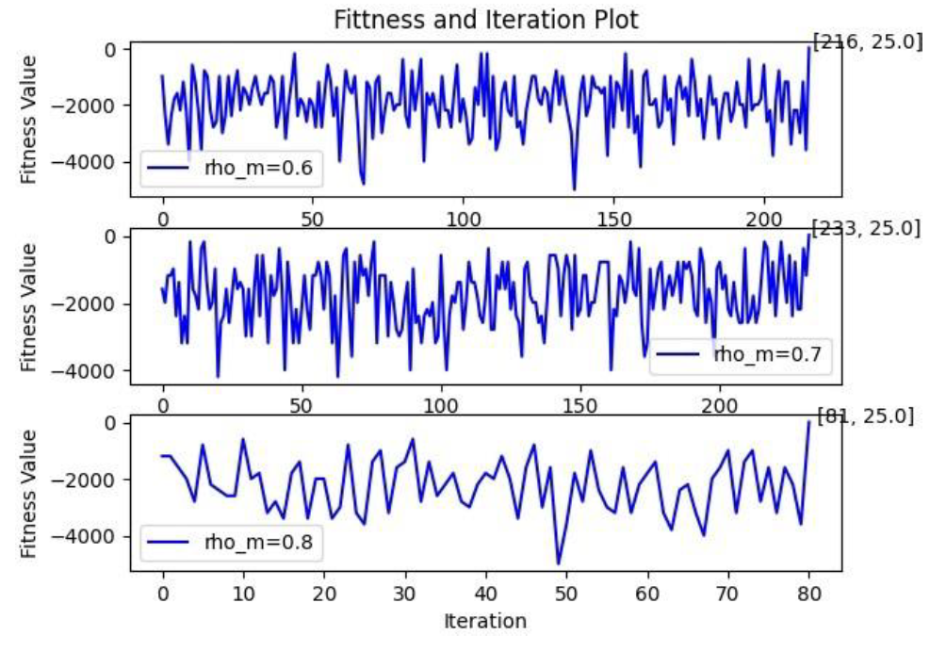
TEST CASE: 4
For validating the Genetic algorithm, simple problem is taken for testing.
Problem : Finding two parameters to maximize the function with constraints and verify the results with SciPy & my GA program.
function to maximize: x1 ∗ x2
constraints: 20 − 2x1 − 2x2
Population size: 40
Mutation Probability | Output & Number of Iterations | Expected Output
0.6 | 5,5 216 | 5,5
0.7 | 5,5 233 | 5,5
0.8 | 5,5 81 | 5,5
Figure 9:Fitness and Iteration plot with varying mutation probability

Slide 26
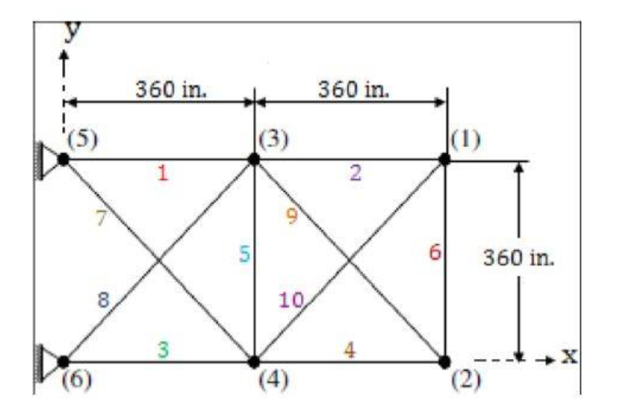
TEST CASE: 5
Validation of Encoding Technique : Algorithm is applied to one of the most common bench- mark problems for plane truss optimization.
Only the sectional areas are subject to optimization, as node locations and bar connections are fixed.
The results are compared with the (Baykasoğlu Adil1 etal (Optimal design of truss structures using weighted superposition attraction algorithm) in page no: 969) & changing the number of generation and the population sizes with varying mutation probability.
It’s assumed that the bars are made of aluminium. The problem’s static scheme is given below:
Figure 10:Benchmark Truss Structure

Slide 27
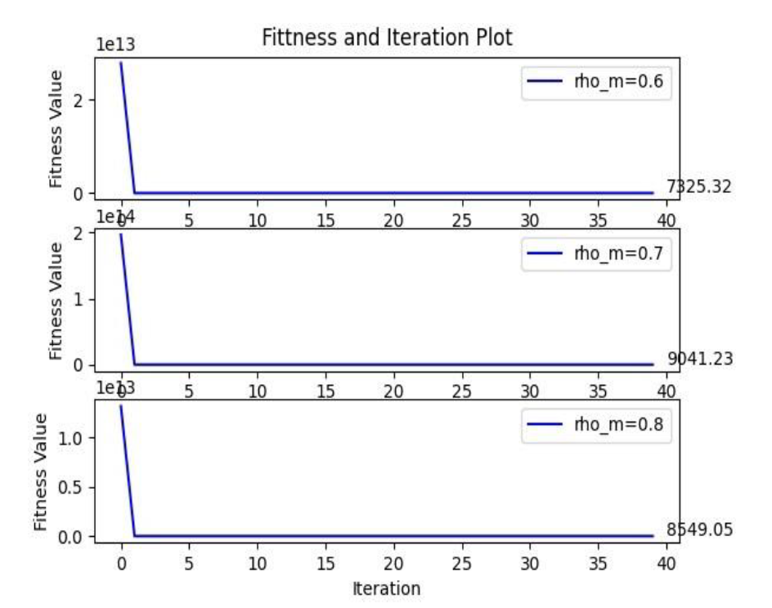
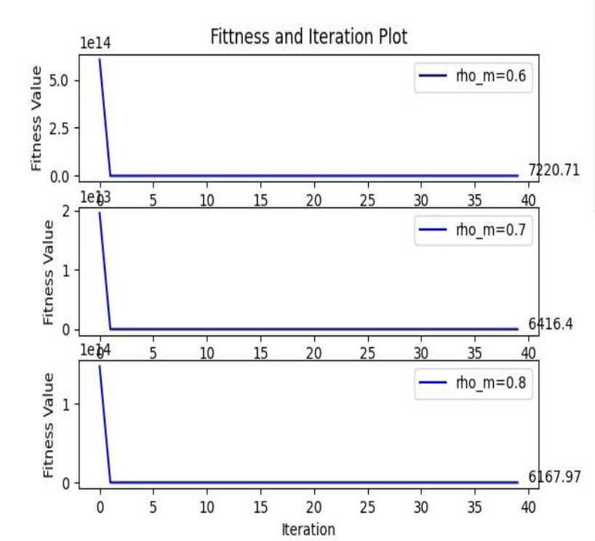
TEST CASE: 5
Iteration value →40
Population size → 40
Mutation probability → 0.6,0.7,0.8
Iteration value →40
Population size → 80
Mutation probability → 0.6,0.7,0.8
Figure 11:Fitness and Iteration Plots with varying Population size & mutation probability

Slide 28
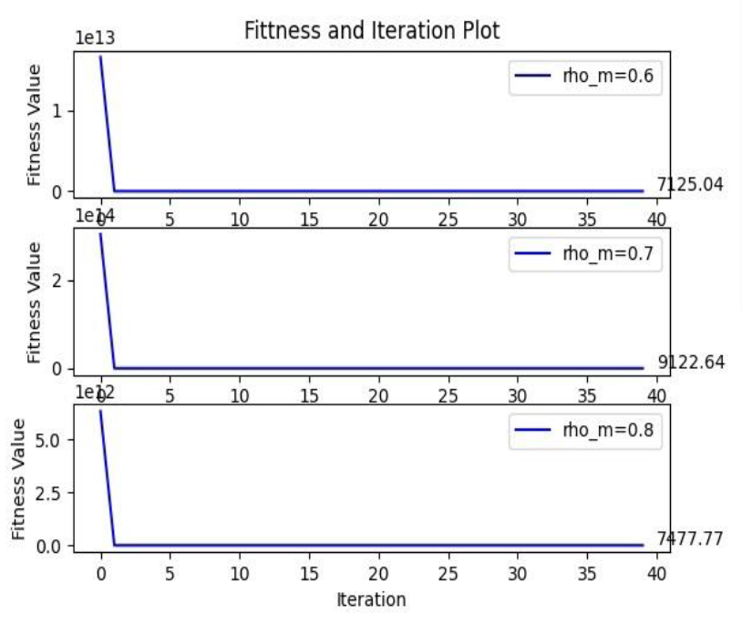
TEST CASE: 5
Iteration value →40
Population size → 100
Mutation probability → 0.6,0.7,0.8
Figure 12:Fitness and Iteration Plots with varying Population size & mutation probability

Slide 29
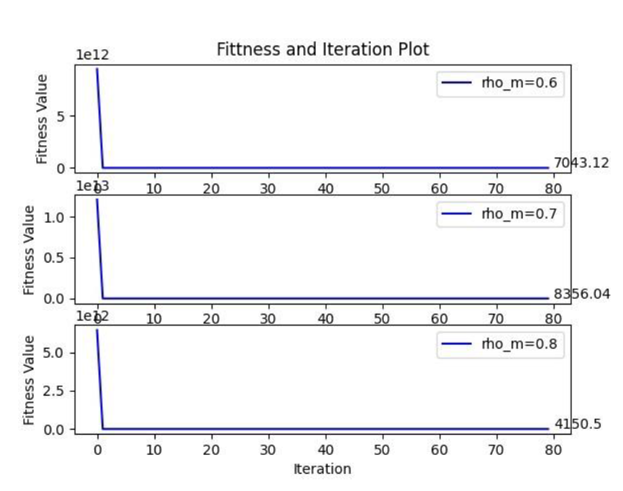
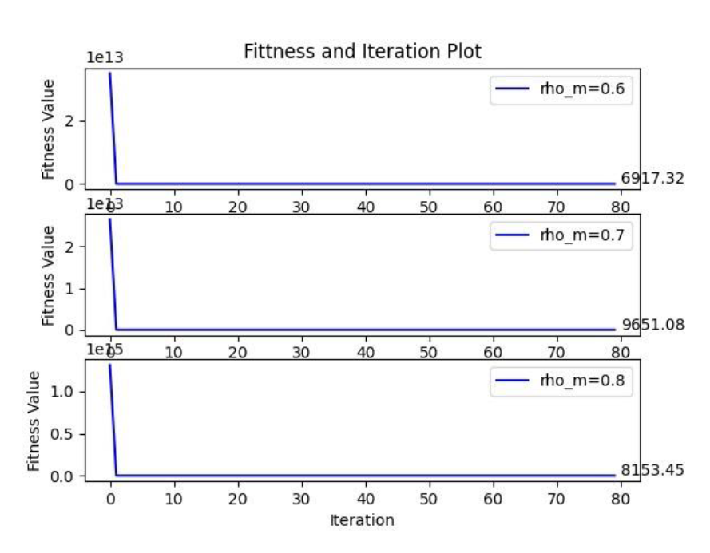
TEST CASE: 5
Iteration value →80
Population size → 50
Mutation probability → 0.6,0.7,0.8
Iteration value →80
Population size → 80
Mutation probability → 0.6,0.7,0.8
Figure 13:Fitness and Iteration Plots with varying Population size & mutation probability

Slide 30
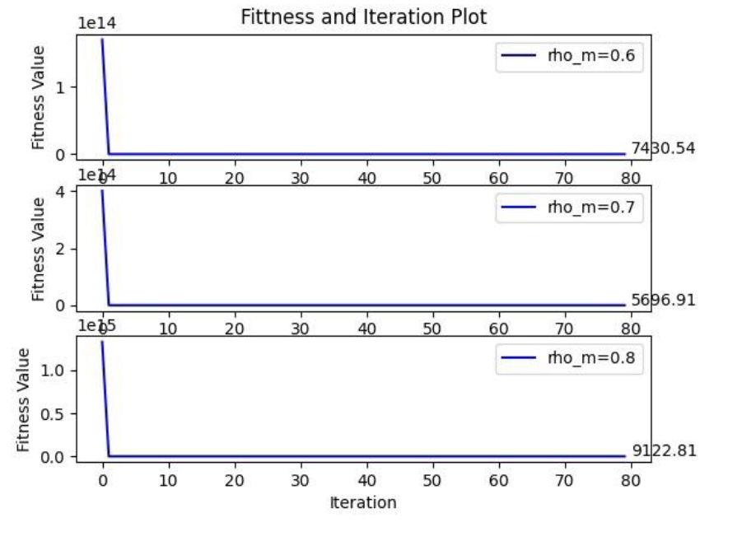
TEST CASE: 5
Iteration value →80
Population size → 100
Mutation probability → 0.6,0.7,0.8
Figure 14:Fitness and Iteration Plots with varying Population size & mutation probability

Slide 31
TEST CASE: 5
The solutions are compared to the paper’s findings, which provide the Penalty function values (IP and P2 values are selected based on trail and error method). There is a percentage of error with the results in the paper due to the Penalty parameter values chosen.
According to the graph above, as population size and mutation probability increase.
A lower value of mutation probability means more mutation, requiring the algorithm to discover new areas of the design space, while a higher value means more crossover, enabling the algorithm to further optimize locally the solutions so far.
Trusses, like bars, only support compressive and tensile forces. At the nodes, all forces are applied.

Slide 32
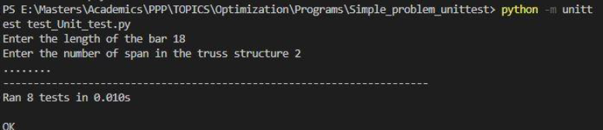
FUNCTIONALITY TEST
Unit testing is a software testing process that involves putting individual units of source code through a series of tests to see whether they are ready for use (Source).
For this program, I have conducted unit test for the below mentioned functions
Function
get all elements in input array
dir cosine
transformation matrix
single pt crossover
multi pt crossover
scaled fitness
forced vector calc
get restrained dofs
Figure 15:Functionality Test

Slide 33
THANK YOU

