Slide 1


Java Programming Project Presentation
  Project Title: Visitor Entry Logging and Security Monitoring System
  Course: Java Programming Mini Project
  Student Name & Roll No: Nivetha k [25BCS039]
  Department: Computer Science
  Mentor / Guide: Dr.Boopalan Sundaramoorthy

Slide 2
Java Programming Project Presentation
Introduction
Overview of the Project and its Purpose:
• Java-based system designed to record and manage visitor details and monitor entry and exit in an organization.
Problem Background and Motivation:
• Manual visitor logbooks are slow, difficult to manage, and may lead to missing or incorrect records.
Significance of the Project in Solving Real-World Issues:
• Provides a secure digital system that improves visitor tracking, reduces manual work

Slide 3
Java Programming Project Presentation
Objective
• To develop a Java-based Visitor Entry Logging and Security Monitoring System.
• To apply core programming concepts such as classes, objects, GUI, and event handling.
• To maintain organized visitor records and generate reports to reduce manual work.

Slide 4
Java Programming Project Presentation
Problem Statement
Current Issue / Gap:
Manual visitor entry makes tracking difficult.
Limitations / Inefficiencies:
• Time-consuming process
• Errors in visitor records
• Difficult to track entry and exit time
• Hard to manage many visitors
How the Project Solves It:
• QR code generated for each visitor
• QR scan records entry time
• Second scan records exit time
• Fast and accurate visitor tracking
• Easy data management and monitoring

Slide 5
Java Programming Project Presentation
System Requirements
Hardware Requirements:
• Computer / Laptop with 4GB RAM or higher
• Processor: Intel i3 / i5 or equivalent
• Storage: Minimum 250GB Hard Disk
• Webcam or Camera for QR Code scanning
Software Requirements:
• Operating System: Windows 10 / Windows 11
• Programming Language: Java
• Development Tool: Eclipse IDE
• JDK (Java Development Kit)
• External Libraries: ZXing (QR Code), iText (PDF), JFreeChart (Graphs)

Slide 6
Java Programming Project Presentation
System Design
System Structure & Workflow:
The system records visitor details and captures a photo using the camera. A QR code is generated for the visitor. The QR code is scanned at entry and exit to record the time and maintain visitor records.
Algorithm Outline:
• Start the system
• Enter visitor details
• Capture visitor photo
• Generate QR code
• Scan QR at entry → record entry time
• Scan QR at exit → record exit time
• Store visitor records
• End the system

Slide 7
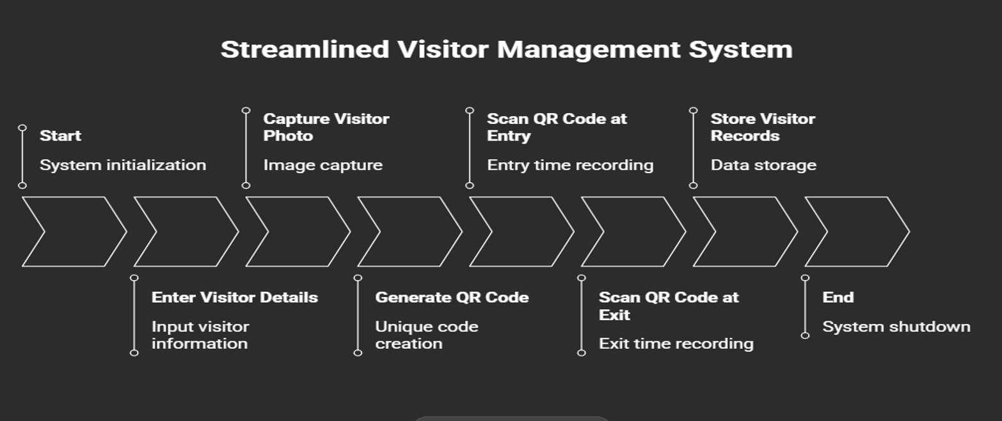
Java Programming Project Presentation
System Design
Block Diagram

Slide 8
Java Programming Project Presentation
Module Description
Input Module:
This module collects visitor information such as name, purpose of visit, and other required details.
Processing Module:
This module processes the visitor data, captures the visitor photo using the camera, and generates a QR code for identification.
Output Module:
.This module displays visitor details, entry and exit time, and generates visitor records or reports.
File Handling Module:
This module stores visitor details, captured photos, QR codes, and reports in files so that the data can be accessed later.

Slide 9
Java Programming Project Presentation
Algorithm
Start the system
• Enter visitor details
• Capture visitor photo
• Generate QR code
• Scan QR at entry → record entry time
• Scan QR at exit → record exit time
• Store visitor records
• End the system

Slide 10
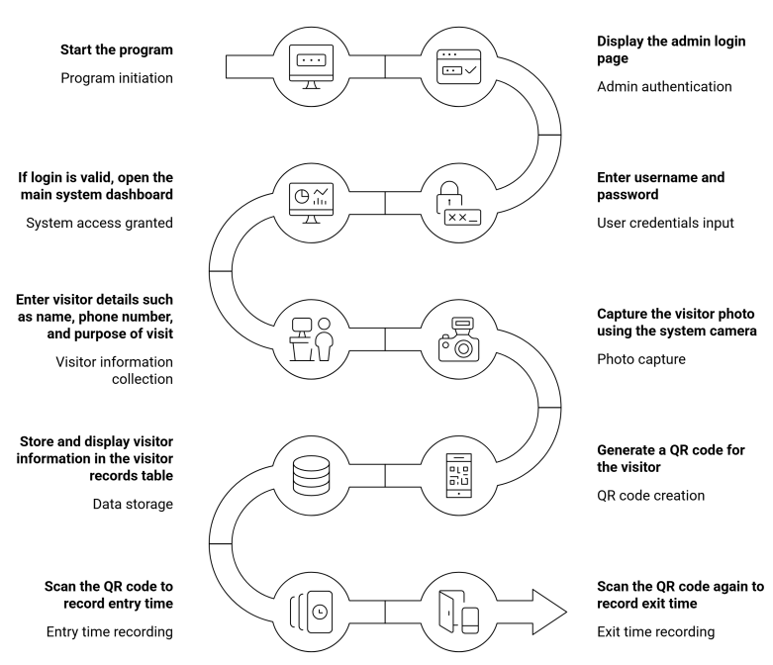
Flowchart
Java Programming Project Presentation

Slide 11
Java Programming Project Presentation
Implementation
The Visitor Entry Logging and Security Monitoring System is implemented using programming techniques that help manage visitor data and monitor entry and exit efficiently.
Techniques Used:
• Loops and conditional statements are used to control the system operations such as adding visitor details and scanning QR codes.
• Classes and methods are used to organize the program and manage visitor information effectively.
• Camera integration and QR code generation are used to capture visitor photos and create QR codes for entry and exit tracking.
• File handling is used to store visitor records, photos, and reports for future reference.

Slide 12
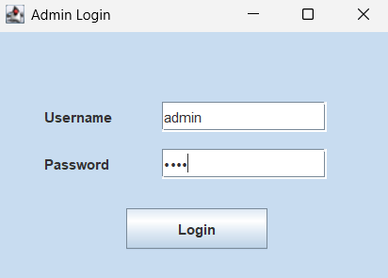
Java Programming Project Presentation
Output Screens
Login page

Slide 13
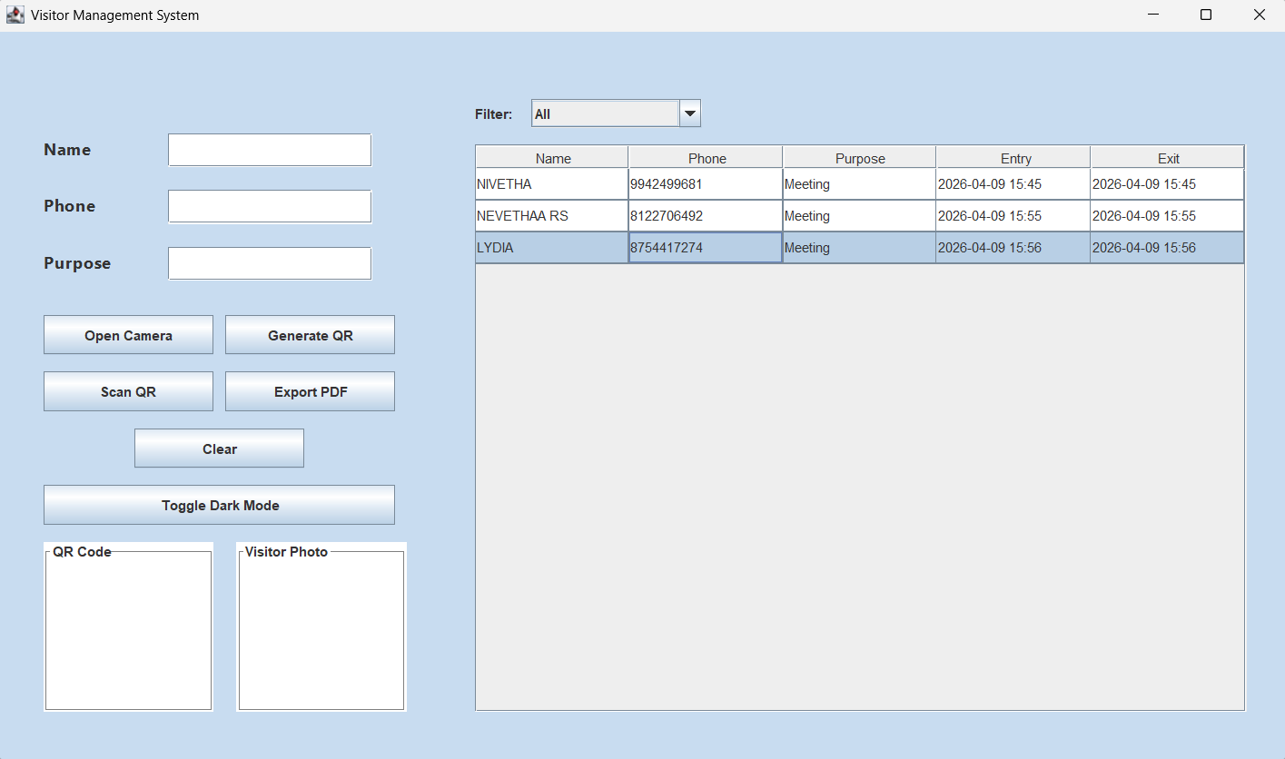
Java Programming Project Presentation
Output Screens
This is the main window hear user details were entered

Slide 14
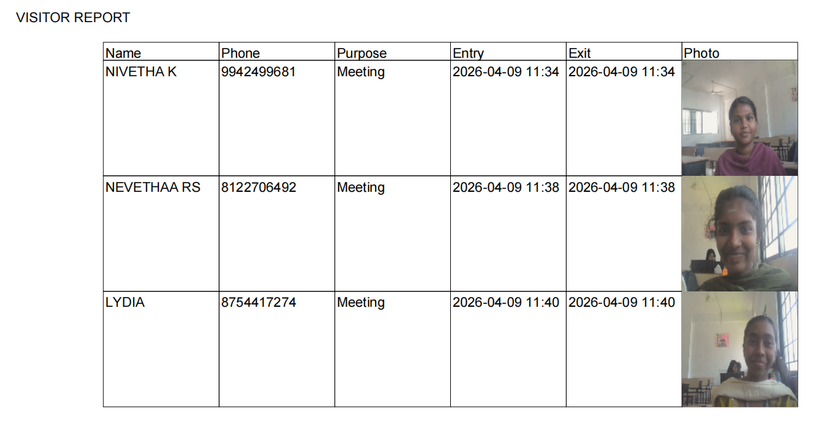
Java Programming Project Presentation
Output Screens
The visitors data where stored in PDF with their photo

Slide 15
C Programming Project Presentation
Results & Discussion
• The system successfully registers visitor details, captures photos, and generates QR codes for identification.
• The results match the expected output by accurately recording visitor entry and exit time through QR scanning.
• The system shows good performance with quick data processing and organized visitor records.
• Some challenges such as camera access, QR scanning, and data storage were handled using proper programming techniques.

Slide 16
Java Programming Project Presentation
Conclusion & Future Enhancement
Conclusion:
• The system helps to record and monitor visitor entry and exit automatically.
• It demonstrates the use of Java programming to build a practical security management system.
Future Enhancements:
• Add face recognition for better visitor identification.
• Connect the system with a database for long-term record storage.
• Improve the system with mobile notification or alert features.

Slide 17
Java Programming Project Presentation
References / Acknowledgement
References:
• Y. Daniel Liang – Introduction to Java Programming
• Cay S. Horstmann – Core Java Fundamentals
• Oracle Java Tutorials
• Javatpoint (Java programming concepts and examples)
• GeeksforGeeks (Programming tutorials and code references)
Acknowledgement:
We would like to thank our project guide for providing continuous support and valuable suggestions during the development of the Visitor Entry Logging and Security Monitoring System. We also extend our gratitude to the faculty members and our institution for their encouragement and guidance. Finally, we thank all those who directly or indirectly contributed to the successful completion of this project.

Slide 18
Thank You
In conclusion, the project successfully shows how automation can transform traditional visitor management into a secure, efficient, and organized digital system.

