Slide 1
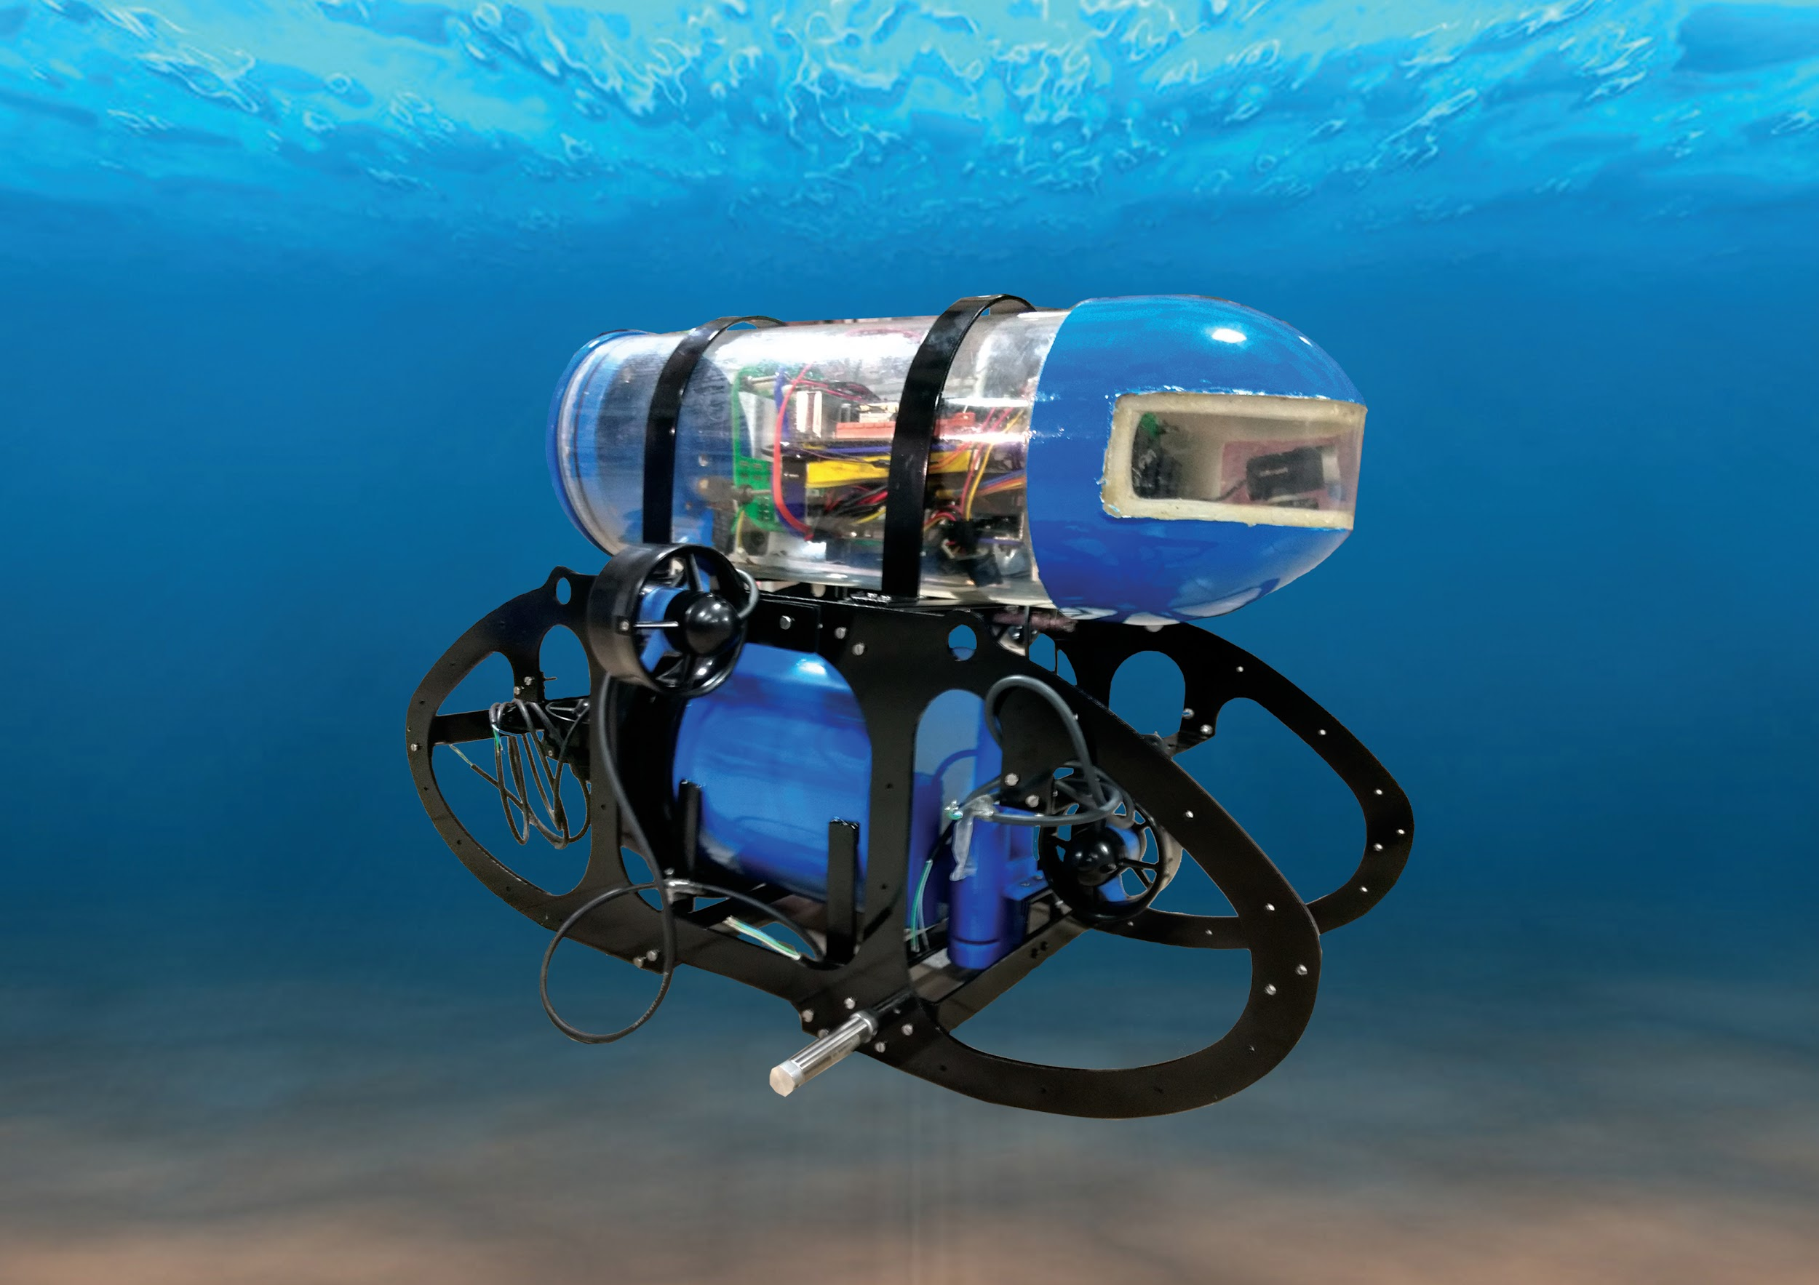

AUV Amogh
TH09-450

Slide 2
What is AUV Amogh?
Amogh is an AUV (Autonomous Underwater Vehicle) designed with the objective of performing data collection and underwater surveillance via the various on-board sensors and deliver/collect small volume underwater samples. It is equipped with cameras for underwater feature identification, a grabber mechanism that can be used to collect payloads and a dropper mechanism that to deliver small payloads to the target location.
Notes:
Exploring the seafloor is quite a challenging task. Sparsity of light, depth and cold temperatures are just a few of the factors that make it such a daunting environment. ROVs (Remotely Operated Vehicles) are well suited to operate between moderate and deep depths underwater, but are fundamentally constrained by the requirement for continuous communication/feedback with the on-ground controller. Thus has emerged a new paradigm for performing tasks at extreme depths - that of Autonomous Underwater Vehicles (AUVs).

Slide 3
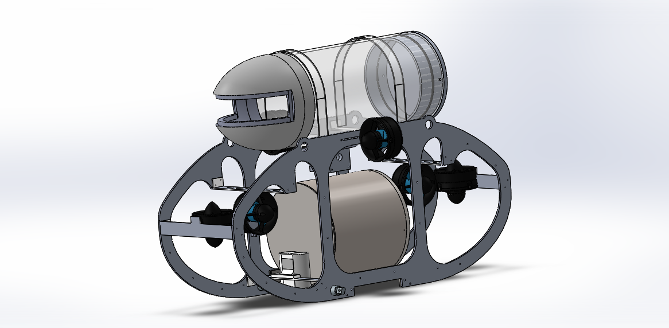
Mechanical Subsystem
Main focus: hydrodynamic design, should be watertight and space efficient for batteries and other critical electronics placed inside.
Sub-modules:
Structural design
Propulsion
Payloads
Fabrication & assembly

Slide 4
Structural Design & Propulsion
Hull Design : Dual hull structure of the vehicle for improved buoyancy and stability underwater. Heavy bottom hull provides stability by lowering center of gravity.
Heavy bottom hull - batteries and other heavy components. Top hull - electronics.
Skeletal frame : A custom designed aluminum frame which is made in solidworks and analyzed for drag considerations in all degrees of motion.
Thruster configuration: 6 Bluerobotics T100 thrusters for control in 5 degrees of freedom. Roll motion is undesirable and suppressed via the structure of hulls.
Notes:
Analyzed in STARCCM+

Slide 5
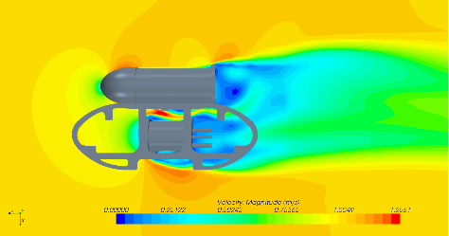
CFD analysis for the AUV

Slide 6
Payloads
Marker - cylindrical payloads restricted to at most 40mm diameter.
Marker dropper : Pneumatic mechanism used for dropping the markers in desired location. Pistons triggered individually by electronic solenoid valves as directed by the motherboard.
Grabber : A custom designed aluminum grabber is made for grabbing and displacing objects within 15cm of diameter.
Electronics and sensors: placed on dedicated racks in both hulls.

Slide 7
Fabrication and assembly specifics
Sealing : Amogh uses O-ring mechanism for water-tight sealing. Top hull uses lateral sealing mechanism and lower hull uses face sealing mechanism.
Connectors: Mechanical subassemblies like pneumatic cylinders, and electronic systems like cameras and thrusters connected through connectors mounted on Aluminium discs of the end caps of top and bottom hull.
Materials : Acrylic for the top hull ( lightweight and transparent )
Aluminium for skeletal frame and end-caps ( lightweight and strong )
Steel for the bottom hull ( heavy and for maximum water-tightness )

Slide 8
Electrical Subsystem
Main function: Interfaces modules, sensing, and controlling the AUV.
Sub-Modules:
Power Management
Sensing
Control
Components:
Main board
Motherboard
ESC boards
Sensors

Slide 9
Batteries Power Source
Main Fuse/
Kill-switch
Power Board
Steps down voltages
Fuses
PSU
Data
Motherboard
Main Board
Power
6x ESC Boards
Thruster speed control
Peripherals
Pressure Sensor, IMU
Leakage Sensor
Notes:
While explaining the chart, go sequentially from batteries -> kill-switch … (move to the 3d design to explain the locations of components)

Slide 10
Power Management
To optimize power consumption, without compromising on electrical safety of devices.
Voltage and current sensor data is logged and used for prediction of electrical faults and to monitor power consumption at various operating conditions while testing.
Main Fuse / Kill-switch
Disabling the AUV under emergency
Custom Power Board
Steps 24V down to 12V, 5V, 3.3V
4x Li-Po Batteries Power Source
Fuses
Over-current protection

Slide 11
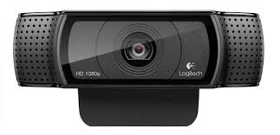
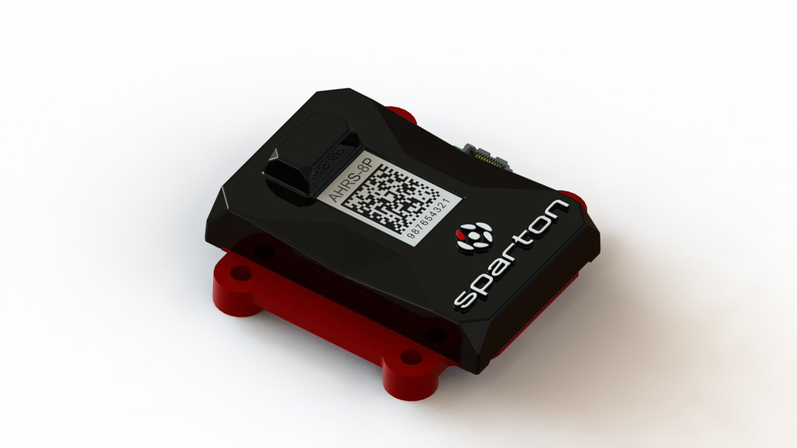
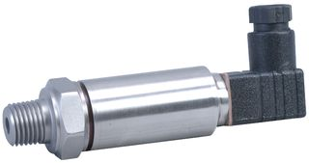
Sensing
3x Cameras
2x front facing, 1x bottom facing
For sensing at shallow depths
IMU (Inertial Measurement Unit)
Precise Heading / pitch / roll measurements
Pressure sensor
Piezo-resistive, non-submersible
Upto 1 Bar gauge pressure
Leak detector
Amplified voltage feedback due to the conductivity of water if there is a leak

Slide 12
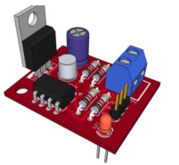
Sensing
Leak detector
Amplified voltage feedback due to the conductivity of water if there is a leak
Current Sensors
Hall effect sensors monitor currents drawn by thrusters, motherboard, batteries.
Voltage Sensors
Simple voltage divider based circuit used to monitor battery voltages
Leak detection circuit

Slide 13
Flow of Control
Motherboard
Image processing, mission controller
Intel i5 - 45W TDP
Main board
Interface with ESCs
6x ESC boards
Drive the thrusters based on PWM input from motherboard
3x Cameras
720p video stream
6x Thrusters

Slide 14
Mission Controller
Controlling brain of the AUV - contains software implementations of control algorithms and predefined responses to the objects recognized by the image processing code. Reliability is improved using error correcting codes on IP input.
Camera Feed
Image processing
Shared Memory
Holds the state information of the AUV
Mission Controller
Control Algorithms
Path planner
Logger

Slide 15
AUV Amogh - Computer Vision Module
Main function - locate objects of interest and communicate it to Mission Controller.
Inputs:
Parameters from Mission Controller - objects and colors to be detected
Raw camera feed from two cameras - front facing and bottom facing
Outputs:
Radial coordinates of targets from center of view
Status/health of Computer Vision processes to Mission Controller
Camera feed (raw and processed) for debugging - via ethernet cable

Slide 16
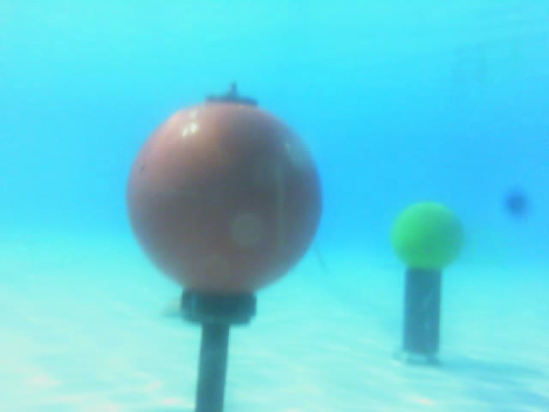
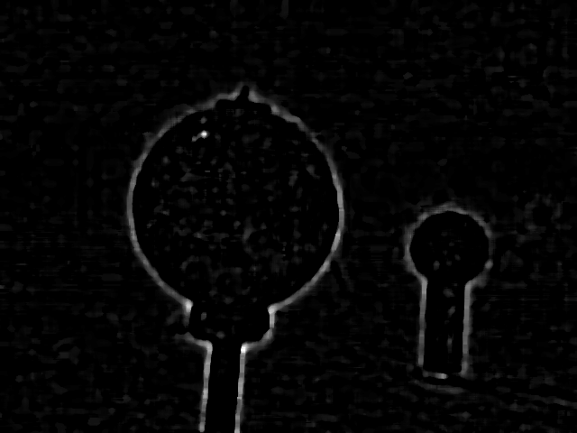
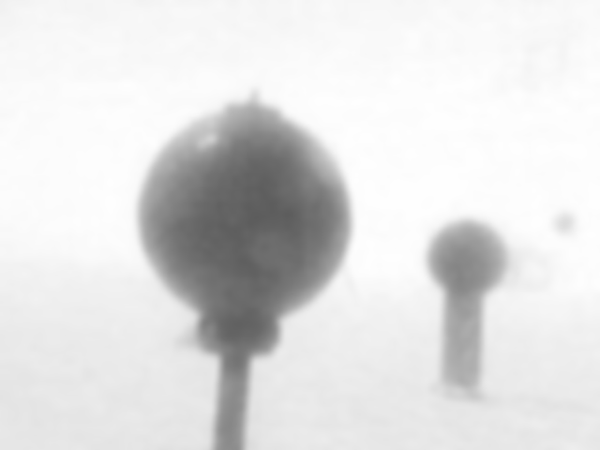
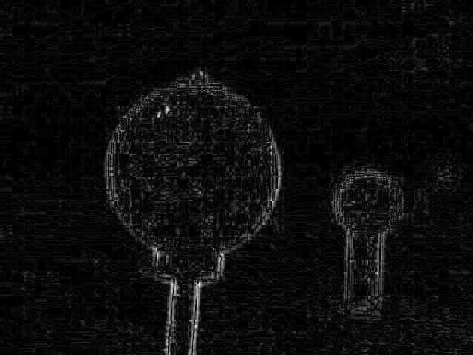
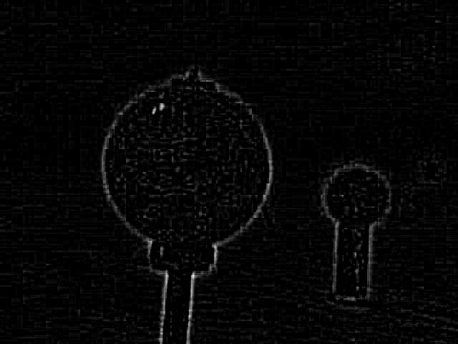

High Pass Filter based Image pre-processing
High pass filter
Intensity scaling
Noise removal
Low pass
High pass
Double edge removal
Median Blur

Slide 17
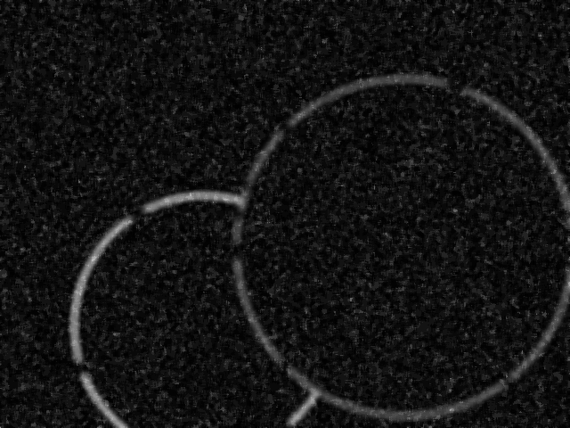
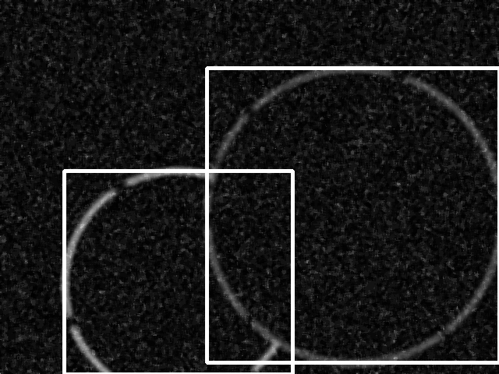
Locate objects using deep neural networks
Architecture: pruned version of YOLO (You Only Look Once), optimized for CPU.
Training data: synthesized grayscale pictures of required objects with defects:
Blurring with Erosion and dilation at random locations
Occlusion due to other objects
Addition of noise - salt and pepper, Poisson, Gaussian
Preprocessed Image
Synthesised Image (dataset)
Labelling result

Slide 18
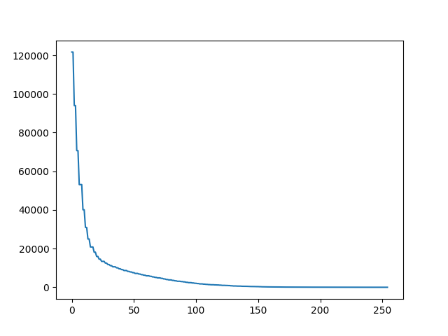

Thresholding pre-processed image
Repeatedly threshold using different values and plot number of white pixels
Justification:
Our preprocessing gives bright object edges and noise with low intensity.
Large slope indicates thresholding of noise. Small slope is due to thresholding of object pixels.
Locate the value where slope of the graph changes abruptly (here, approx 30) and threshold at that value

Slide 19
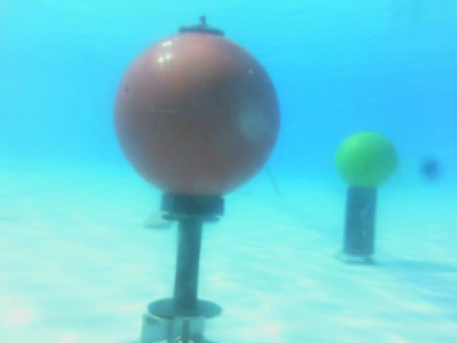
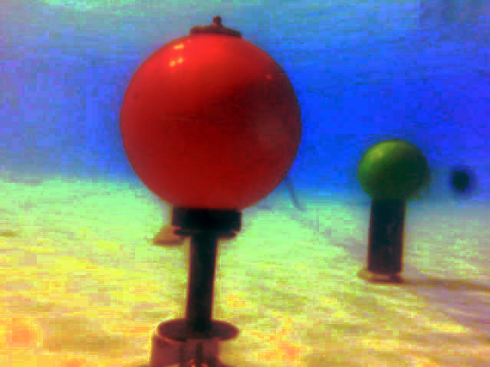
Colour Enhancement
Done using histogram equalization / CLAHE
Using color to separate objects from the background is unreliable (preferential absorption, water caustics etc.) and limited techniques to eliminate these effects.
Colour data is used to differentiate between already located objects of interest.
Notes:
Describe CLAHE as: an adaptive equalization technique used to improve contrast in images.
POINT 3: Color data is used to distingiush between interesting points (different colors of buoys). It is not used to segregate interesting points from non-interesting points.

