Slide 2
What is Phase retrieval
In many optical experiments we cannot directly measure phase only we can measure amplitude or intensity
Phase retrieval consists of finding the phase that satisfies a set of constraints for a measured amplitude

Slide 3
In Holographic optical tweezers we use Spatial light modulator to control the phase of a light beam to create traps
The problem we have is What phase pattern on the SLM produces the desired trap intensities in the focal plane?
We solve this algorithmically using phase retrieval algorithms
Many different phases can give the same intensity pattern
Phase retrieval algorithms only

Slide 4
Different phase retrieval algorithms
Gerchberg–Saxton Algorithm
Weighted Gerchberg–Saxton
MRAF — Mixed-Region Amplitude Freedom
DBS — Direct Binary Search

Slide 5
Gerchberg–Saxton Algorithm
The G-S algorithm is an iterative phase retrieval algorithm that works by repeatedly transforming back and forth between two planes (typically the SLM plane and the focal plane) and applying known constraints in each domain. The key steps involve:

Slide 6
Initial Guess: Start with an initial phase guess (often a random or constant phase) in the input plane (SLM plane) and the known input amplitude.
Propagate the complex field (amplitude and phase) from the input plane to the target (focal) plane using a Fourier transform
In the target plane, the calculated amplitude is replaced by the desired target amplitude profile (e.g., an array of bright spots for the traps), while the phase is kept unchanged
In the input plane, the calculated amplitude is replaced by the known input amplitude (often assumed to be constant across the SLM), while the phase is kept unchanged. This extracted phase is the hologram.

Slide 7
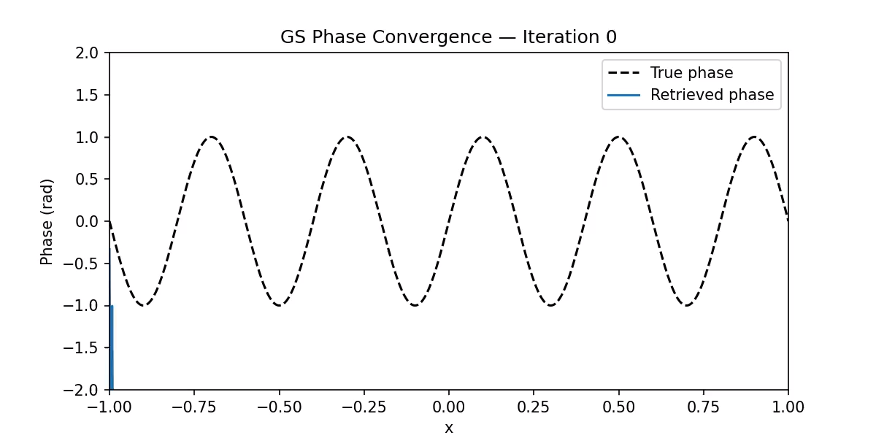
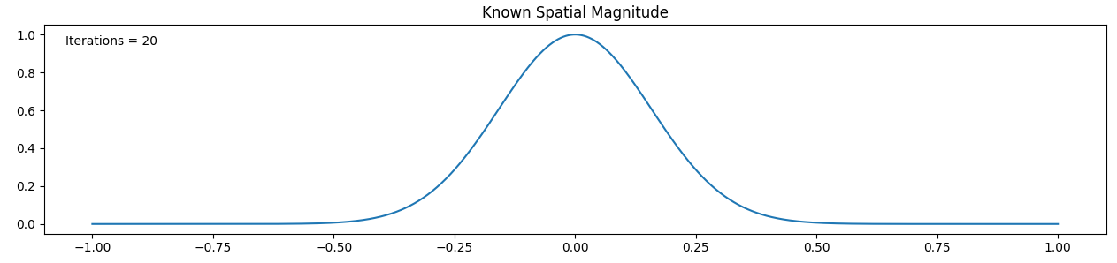
1D GS algorithm convergance

