Slide 1
DATA / MSML 641 • SESSION 06 • OCTOBER 6, 2026
ClauseGuard
Find the clause.
Verify the words.
A PASSAGE TO REVIEW
“We may remove any photos or comments you upload … without notice.”
We help English-reading students and app users locate important ToS clauses and check the original passage.
Content removal
LOCAL NLP
8 CATEGORIES
SOURCE-LINKED
TEAM • EVERYONE WRITES CODE
Ankan Roy
Ameer Shaik
Hemanth Reddy
Jayakrishna Puttur
Niveda Jawahar
Operations
Product
Engineering
Data & evaluation
Users & research
CLAUSEGUARD / MID-SEMESTER
01
Notes:
Ankan
SPEAK:
We are ClauseGuard. We help students and app users find important clauses in English Terms of Service and verify the original words. Our product is a working local NLP tool. Today we will show what we built, what the model and four outside users actually tell us, what failed, and our plan to demo day.

Slide 2
01 / PROBLEM & USERS
The hard part is finding the passage that matters.
Target user: an English-reading student or app user reviewing an unfamiliar Terms of Service.
01
02
03
A concrete question
Today’s workflow
Our value hypothesis
Can the service delete my photos without warning?
Read the document or use keyword search, then interpret the clause.
Find a relevant passage and category, then check the exact words.
Focused scope
Eight clause categories, including content removal, arbitration and liability. Privacy and data-sharing detection are outside the current model.
CLAUSEGUARD / MID-SEMESTER
02
Notes:
Ankan
SPEAK:
Our user has a specific question, such as: can this service delete my photos without warning? Today they may read the entire document or search for a keyword, and still need to understand the passage. Our hypothesis is that source-linked flags can make that task easier. We are testing that hypothesis against manual reading. Our scope is eight contractual categories. The current model does not detect privacy or data-sharing practices, and we are not claiming an advantage over every existing ToS tool.

Slide 3
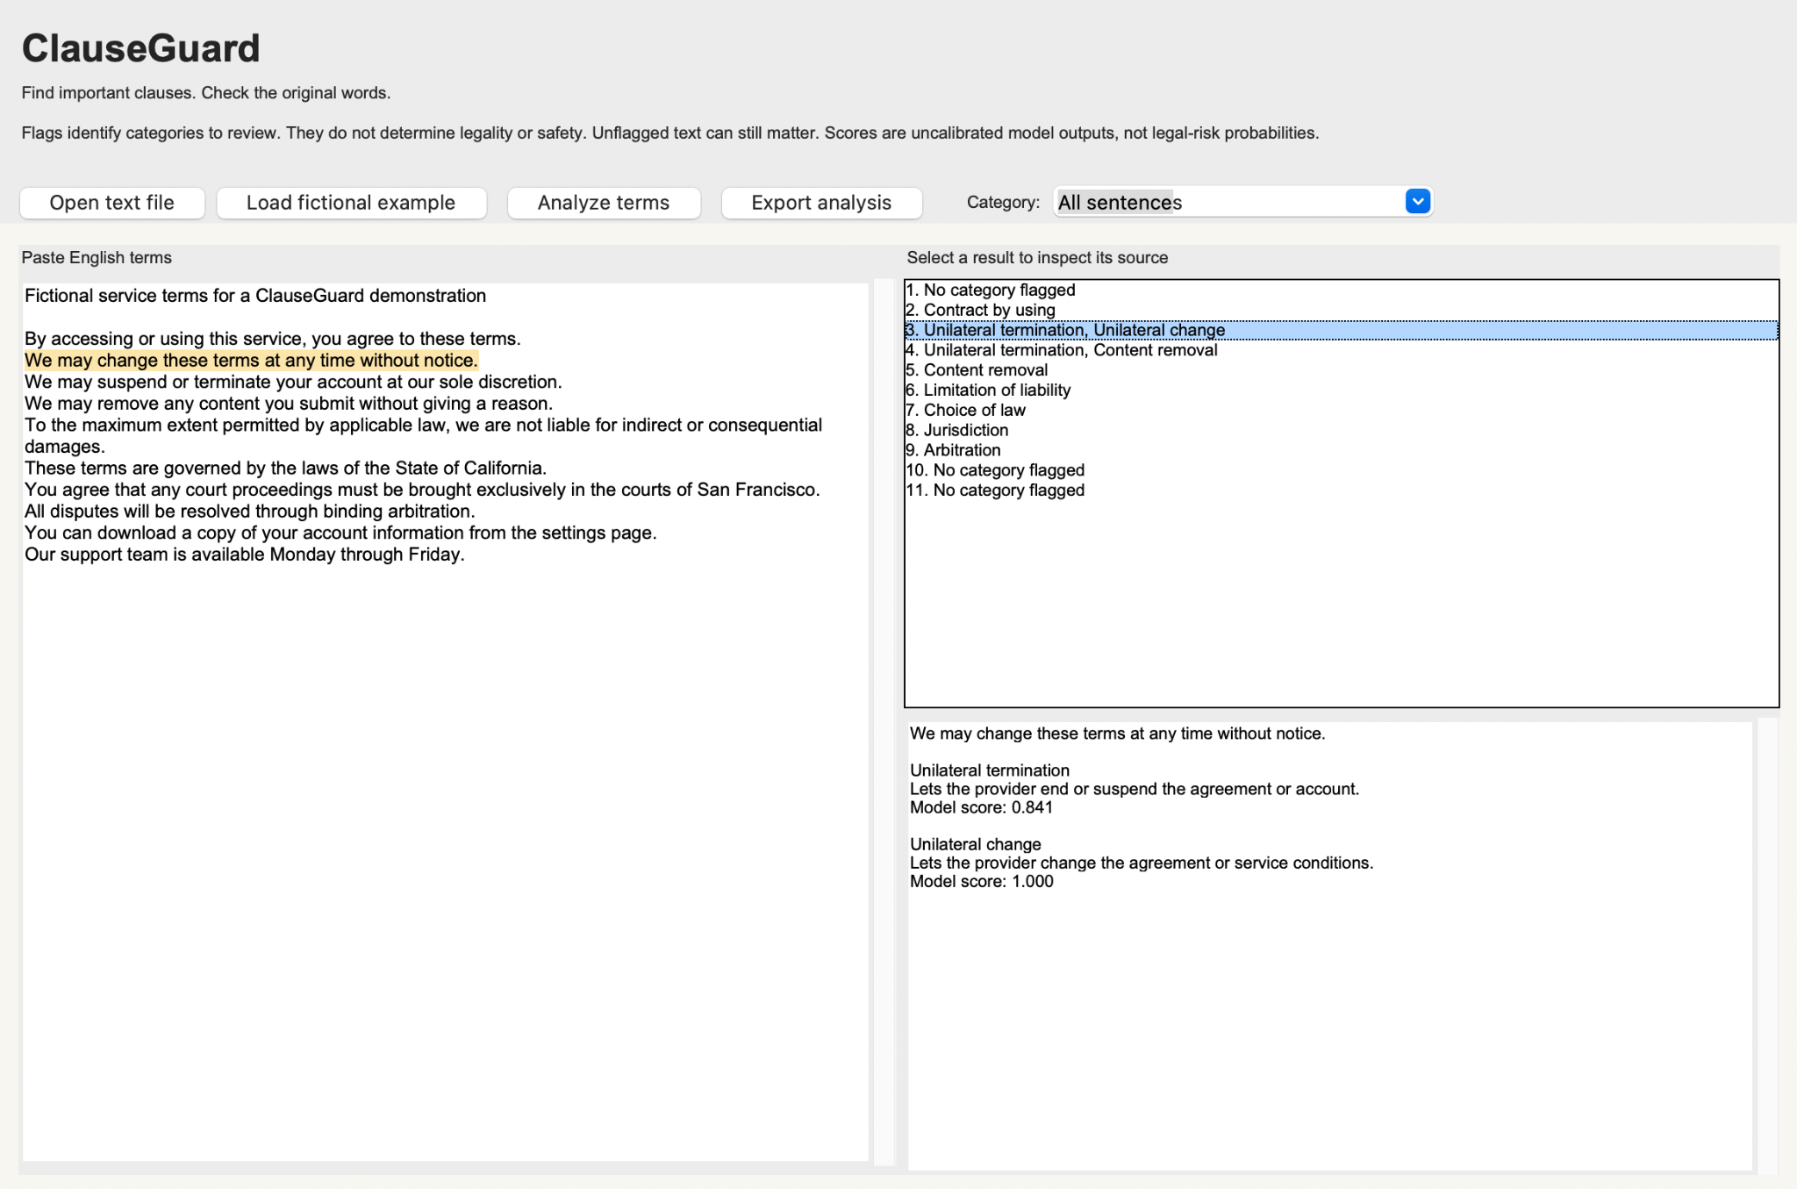
02 / PRODUCT SHIPPED
A working app, with the evidence beside each flag.
Desktop app + command-line analysis + self-contained HTML export.
1
Load + analyze
Paste English text or open a text file.
2
Select a result
See the original sentence highlighted.
3
Inspect the source
Read the passage before relying on a tag.
CLAUSEGUARD / MID-SEMESTER
03
Notes:
Hemanth
SPEAK:
This is an actual screenshot from an outside participant’s desktop session, not a mockup. The user loads or pastes text, clicks Analyze terms, and selects a result. Here, the liability clause is highlighted in the original document and repeated in the detail panel. The category explanation is fixed text, and the score is an uncalibrated model output, not a probability that the clause is legally risky. We also ship a command-line route and HTML export. The screenshot is enough for this midpoint talk; the final presentation will include a live or recorded demo.

Slide 4
03 / NLP METHOD
A small, reproducible NLP pipeline that runs locally.
Multi-label classification: one sentence can receive more than one category.
Input
Segment
Represent
Classify
Review
›
›
›
›
English text
Sentences + offsets
Word + character
TF-IDF
8 balanced logistic
regressions
Labels + exact
source passage
UNFAIR-ToS / LexGLUE • OFFICIAL COMPANY-SEPARATED SPLITS
5,532
TRAIN
2,275
VALIDATION
1,607
RESERVED TEST
30 companies
10 different companies
Not evaluated
Shipped: word n-grams 1–2 + character n-grams 3–5; fixed threshold > 0.5.
No runtime API calls. The app and evaluation use the same model artifact.
CLAUSEGUARD / MID-SEMESTER
04
Notes:
Hemanth
SPEAK:
The system splits text into sentences while preserving character offsets, so we can link predictions back to the original passage. Our selected model combines word unigrams and bigrams with character n-grams, then uses one balanced logistic classifier per category. This is supervised NLP we train and evaluate ourselves. The official splits contain 5,532 training sentences, 2,275 validation sentences from different companies, and 1,607 reserved test sentences. Validation was used for model selection, so it is a development result. The test split remains untouched. The shipped model uses fixed thresholds above 0.5, and its fingerprint matches the evaluated artifact.

Slide 5
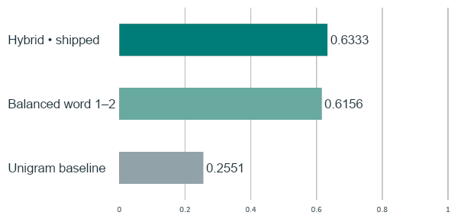
04 / VALIDATION RESULTS
The shipped hybrid model beats our unigram baseline.
Eight-category macro-F1 on the same 2,275 validation sentences; higher is better.
+0.3782
absolute macro-F1 gain
MICRO-F1 • 8 CATEGORIES
Baseline
0.3300
Balanced
0.6084
Hybrid
0.6275
Macro-F1 weights all eight categories equally. These are model comparisons, not weekly gains.
CLAUSEGUARD / MID-SEMESTER
05
Notes:
Jayakrishna
SPEAK:
The main model metric is macro-F1 across our eight target categories. It gives each category equal weight, which matters when most sentences have no target label. The unigram baseline scores 0.2551. Adding bigrams and class balancing reaches 0.6156; the shipped hybrid reaches 0.6333, an absolute gain of 0.3782 over baseline. The eight-category micro-F1 also improves. All variants were evaluated on the same validation sentences. These are three model comparisons, not three weeks of progress. The model does not win on every metric: exact match and nine-label micro-F1, which include the dominant no-category label, are slightly worse than baseline.

Slide 6
05 / ERROR ANALYSIS
The main failure is too many tags on a sentence.
A category prediction is a review cue; it can be wrong.
FICTIONAL STUDY DOCUMENT C • TASK C1
49%
“We may remove any photos or comments you upload at our discretion and without notice.”
of predicted tags lack
the corresponding annotation
Content removal ✓
Unilateral termination ×
195 of 398 category tags
on validation sentences
Unilateral change ×
Weakest category: arbitration F1 = 0.323 • only 9 positive validation examples.
CLAUSEGUARD / MID-SEMESTER
06
Notes:
Jayakrishna
SPEAK:
Here is a concrete failure from our fictional study document. The passage allows content removal without notice, but the product adds unilateral termination and unilateral change tags as well. That is over-tagging. Across validation, 195 of 398 predicted category tags are absent from the corresponding source annotations: about 49 percent. These are category tags, not the percentage of documents that are wrong. Arbitration is particularly weak, with F1 of about 0.323 on only nine positive validation examples. This makes reducing false positives our immediate priority. It also explains why users must inspect the original sentence rather than treat every tag as a finding.

Slide 7
06 / OUTSIDE-USER EVIDENCE
Four users succeeded—but usefulness is still unproven.
North-star metric: the right sentence AND meaning, within 180 seconds.
4
RECORDED OUTCOME
CLAUSEGUARD
MANUAL
outside
participants
Correct within
180 seconds
4 / 4
4 / 4
1 in Session 05
3 in Session 06
8 trials total
Observed median time
51.7 s
70.9 s
Over-tagged C1 task with the app: 2 of 2 correct.
Short fictional documents; tasks differ in difficulty; convenience sample. No causal speed claim.
CLAUSEGUARD / MID-SEMESTER
07
Notes:
Niveda
SPEAK:
Our north-star metric is correct completion: the right passage and its meaning within 180 seconds. Under the corrected protocol, four people outside our team completed one ClauseGuard task and one manual task each. Both conditions had four out of four successes. The observed median times were 51.7 seconds with ClauseGuard and 70.9 manually. We report those times descriptively: the two tasks differ in difficulty, and this convenience sample is too small to establish a speed benefit. Two people used the app on the over-tagged content-removal task; both answered correctly from the source. That is encouraging, but it does not show that wrong tags are harmless.

Slide 8
07 / WHAT WE LEARNED
We fixed measurement and display errors first.
Progress is the running product, the evidence, and the changes made from failures.
Pilot measurement failed
Typing inflated the clock; the user answered a different task.
Changed: stop at the spoken answer; have the user restate the prompt.
Old details stayed visible
Loading a new document left the previous category detail on screen.
Fixed: edits or a new document clear old results until analysis runs.
Source text did the work
All 3 new users read a source result; none used the category filter.
Next: emphasize the source and test how readers interpret extra tags.
TRUST BOUNDARIES
Local processing • no default input logging • no flags ≠ safe
English only • European annotation context • licensed data with attribution
CLAUSEGUARD / MID-SEMESTER
08
Notes:
Niveda
SPEAK:
Our first pilot did not produce a usable product measurement. The clock included answer typing, and the participant answered a different task. We replaced that protocol: users restate the prompt, and timing stops when they say the answer. Engineering also fixed stale details left on screen after loading or editing a document. In the three new sessions, every app user opened a result and answered from the source; none used the category filter. That tells us where to focus the interface. Our boundaries remain explicit: local processing, no default input logging, licensed data with attribution, English and European annotation limits, and no implication that an unflagged document is safe.

Slide 9
08 / THE NEXT MODEL CHANGE
Per-category thresholds look promising in development.
Leave-one-company-out: tune on 9 validation companies, score the 10th, repeat.
EXPERIMENT — NOT SHIPPED
Macro-F1 ↑
Tags per 100 sentences ↓
0.6333
→
0.6768
17.5
→
11.0
Fixed 0.5 • shipped
Held-out-company folds
Fixed 0.5 • shipped
Held-out-company folds
Next release: ship threshold parameters, rerun app tests, then repeat outside-user tasks.
Arbitration remains unstable; final test performance is still unknown.
CLAUSEGUARD / MID-SEMESTER
09
Notes:
Ameer
SPEAK:
Our next model change is supported by a development experiment, but it is not in the app yet. We tested category-specific thresholds by leaving one validation company out: tune on the other nine, score the held-out company, and repeat. Macro-F1 rises from 0.6333 to 0.6768 while category tags per hundred sentences fall from 17.5 to 11.0. We use that estimate rather than the more optimistic score from tuning and scoring on the same data. Our next release will integrate the parameters, verify the product, and repeat user tasks. Arbitration thresholds vary substantially across folds, so this is not a complete fix or a final-test claim.

Slide 10
09 / PLAN TO DEMO DAY
Persevere. Earn stronger evidence before claiming value.
The pre-registered midpoint rule passes; it is a decision heuristic, not proof of usefulness.
OCT 20 • S07
OCT 27–NOV 3
NOV 10–24
DEC 1 • 5 PM ET
Ship the fix
Test understanding
Challenge + freeze
Submit + demo
Per-category thresholds;
heading-filter trial.
More outside users;
“no flags” checks.
Fresh-document checks;
freeze + final test.
Product, demo, report;
slides in repository.
What could change the plan: worse task success or misleading tags → change the interface or job;
a failed model gate or >25-point success deficit → consider a pivot.
Find the clause. Verify the words.
Questions
CLAUSEGUARD / MID-SEMESTER
10
Notes:
Ameer
SPEAK:
Our pre-registered midpoint rule says persevere: the model beats its baseline, we have four outside participants, task success matches manual reading, and nobody failed the over-tagged app task. That is a heuristic decision to keep building, not proof of value. We will ship thresholds in Session 07, expand user testing and check misunderstanding of no flags, then evaluate fresh documents and ablations. We will freeze the model before one final test evaluation and prepare the December 1 submission and demo. If flags mislead readers or task success falls, we will change the interface or reconsider the job. Our goal remains: find the clause, verify the words.
Q&A — NOT PART OF THE TIMED SCRIPT:
Why persevere with 4 users? The pre-registered minimum was 3; it is a pragmatic gate, not statistical evidence. The decision document still has an unfinished decision paragraph, but scripts/midpoint_facts.py computes PERSEVERE from the current committed records.
What triggers a pivot? Failure of the model gate (+0.10 macro-F1 vs baseline and same artifact), or with enough users, app success more than 25 percentage points below manual. Smaller success deficits or a C1 failure imply persevere with change.
Does ClauseGuard provide legal advice? No. It returns review categories and exact text; it does not determine enforceability or safety.
Is it free to serve? No API charge at runtime. The team-laptop check measured 0.054 ms/sentence on a 1,100-sentence synthetic batch; that excludes model load (0.101 s), GUI work, user setup, hardware and electricity.
How do you distribute it? Local app and HTML workflow shared with classmates/student groups. Stranger installation and onboarding need testing; no production web deployment is claimed.
How do you handle privacy and rights? No runtime API calls or default document logging; exports contain user-supplied text. Dataset distribution lists CC BY 4.0; preserve attribution and check additional source rights. English data reflects a European consumer-law annotation context.

